Slide 1
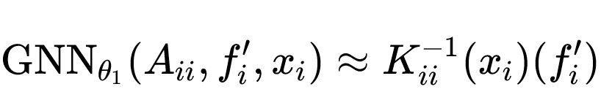
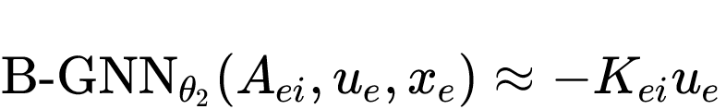
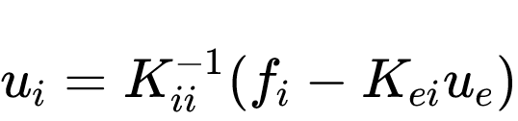
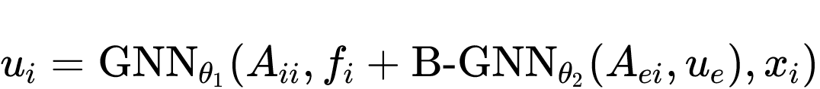
Condense
Equivalence
Architecture

Slide 2






Condense
Equivalence
Architecture
$$f_{i}$$
Backbone GNN
$$u_{i}$$
$$A_{ii}$$
$$A_{ie}$$
+
f
Bipartite GNN
$$A_{ei}$$
$$A_{ee}$$
Node positions are also input for both Bipartite GNN and Backbone GNN but they are ignored here

Slide 3
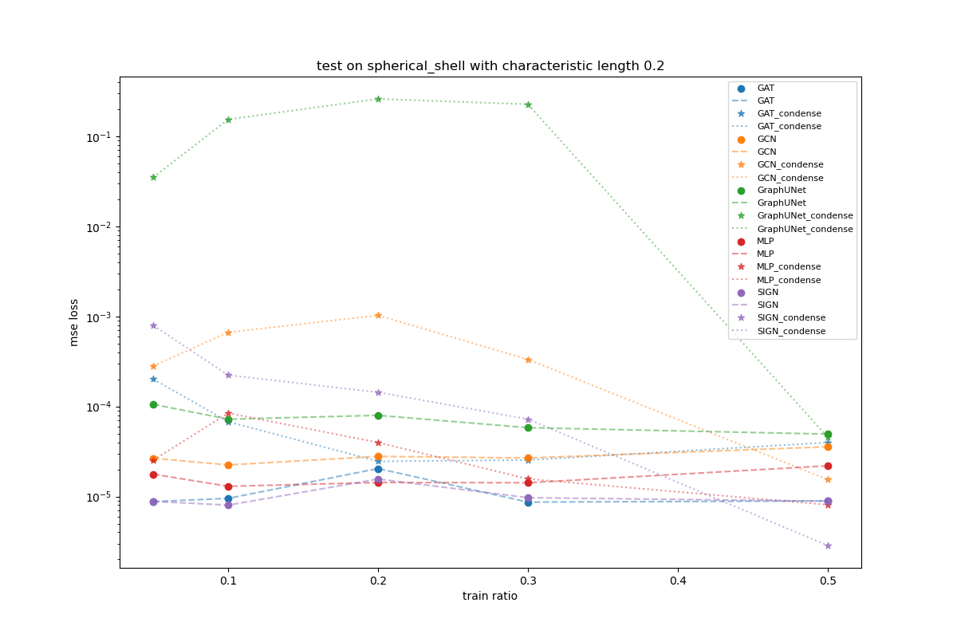
Scale Invariant Test
Train on characteristic length 0.2
Test on characteristic length 0.2

Slide 4
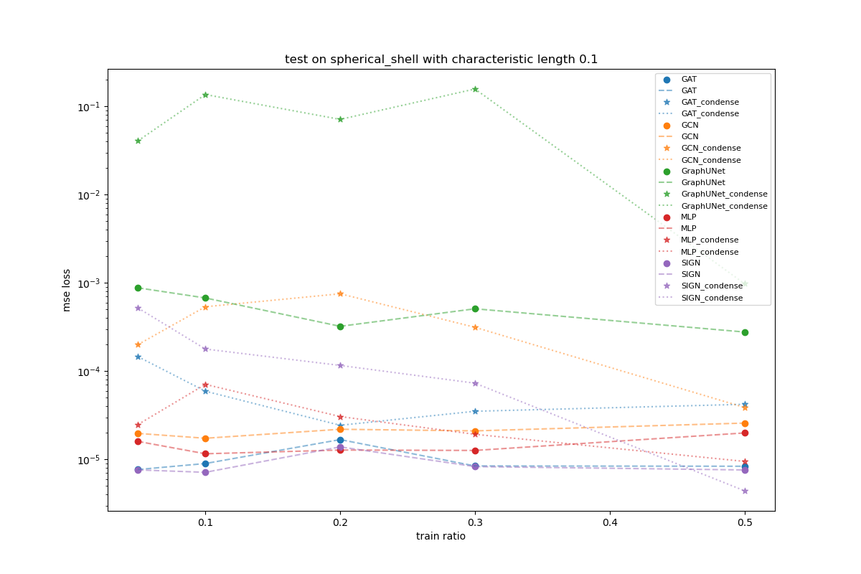
Scale Variant Test
Train on characteristic length 0.2
Test on characteristic length 0.1

Slide 5





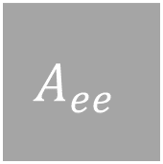

$$f_{i}$$
Backbone GNN
$$u_{i}$$
$$A_{ii}$$
$$A_{ie}$$
+
$$f$$
$$A_{ei}$$
$$A_{ee}$$
Bipartite GNN

