Slide 1
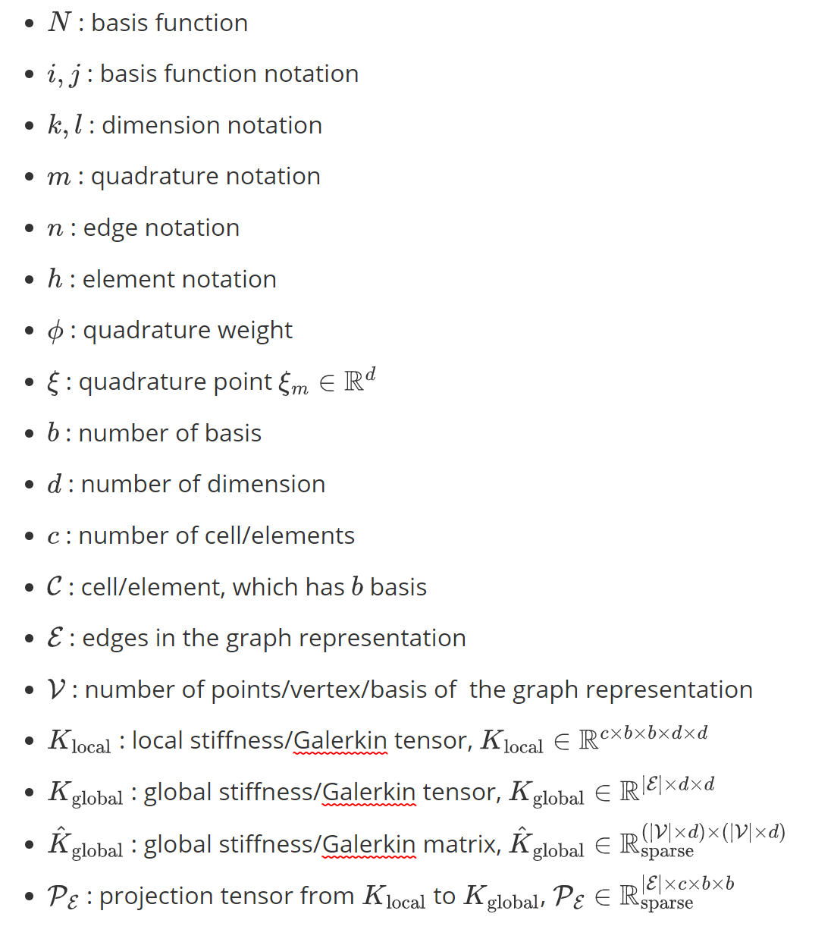
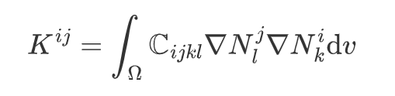

Forward Problem (Stiffness Matrix Equivelance)

Slide 2
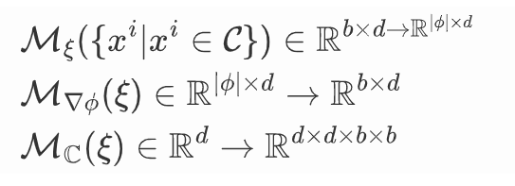
Forward Problem (Stiffness Matrix Equivelance)

Slide 3
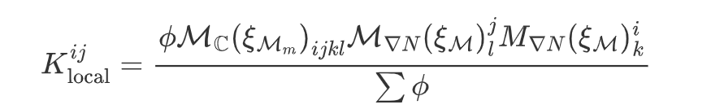
Forward Problem (Stiffness Matrix Equivelance)

Slide 4


Forward Problem (Stiffness Matrix Equivelance)

Slide 5
Forward Problem (Stiffness Matrix Equivelance)
Learn the quadrature rule and shape function

Slide 6
Forward Problem (Stiffness Matrix Equivelance)
Mesh
Undirected Selfloop Graph

Slide 7
Forward Problem (Stiffness Matrix Equivelance)
Assemble of SubGraphs

Slide 8
Forward Problem (Stiffness Matrix Equivelance)
Basis/Vertex/Point as node of graph
Element as node of graph
Galerkin matrix is for each each basis not for each element

Slide 9
Relative Position

Slide 10
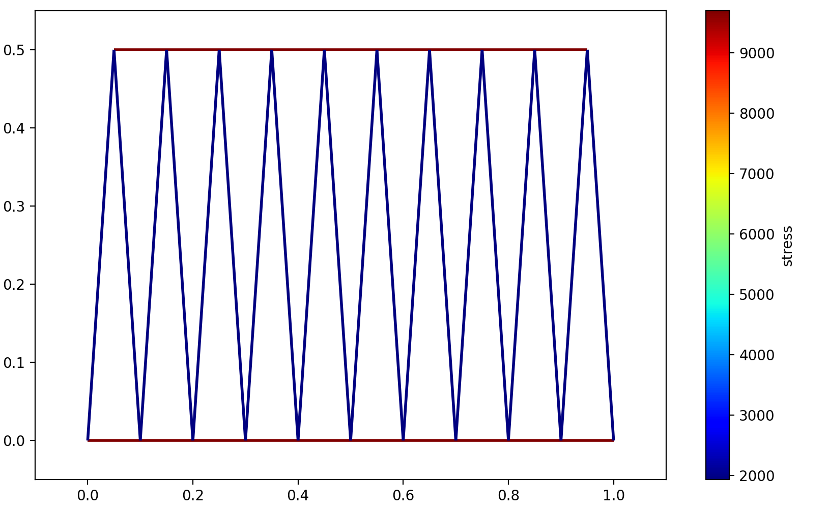
Truss Dataset

