Slide 1
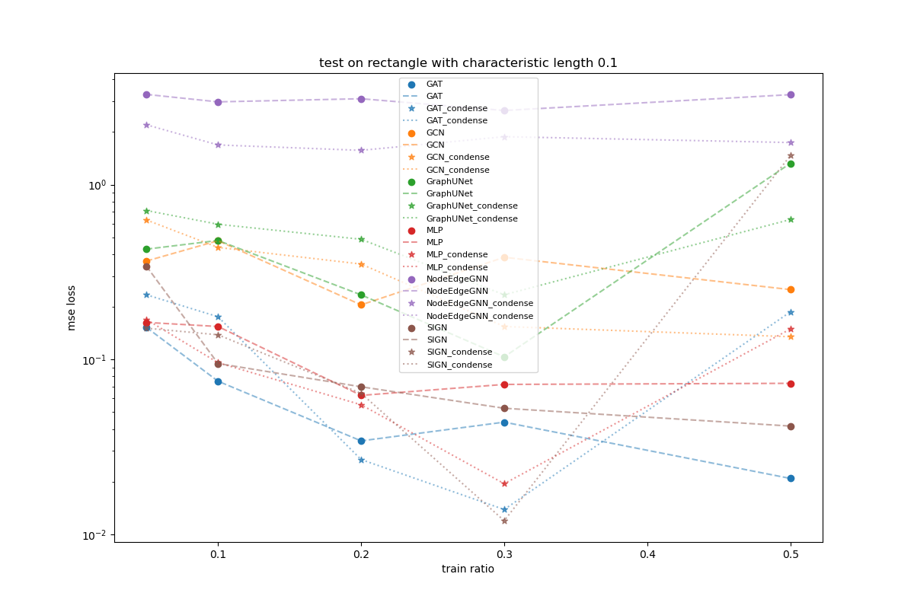
Backward
Condense architecture works much better in PINN trainer

Slide 2
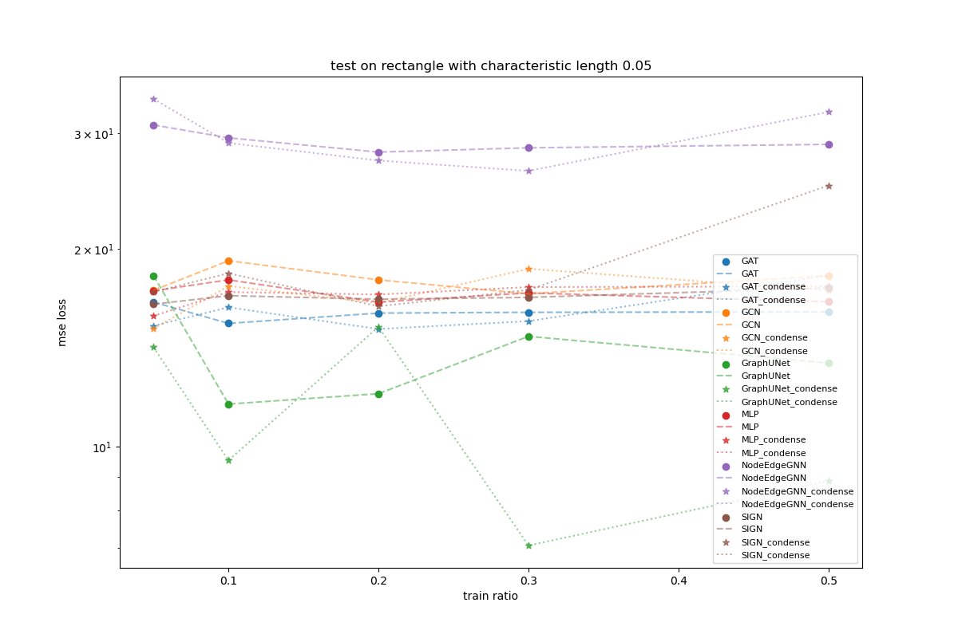
Backward
PINN Trainer does not work well for scale variant

Slide 3
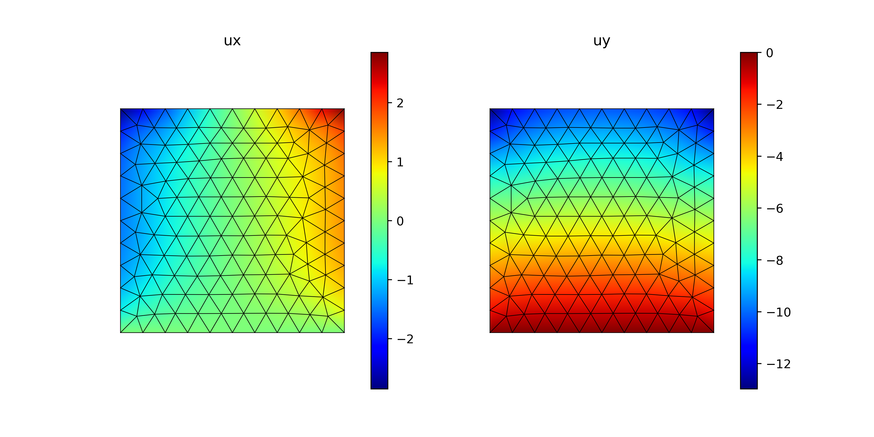
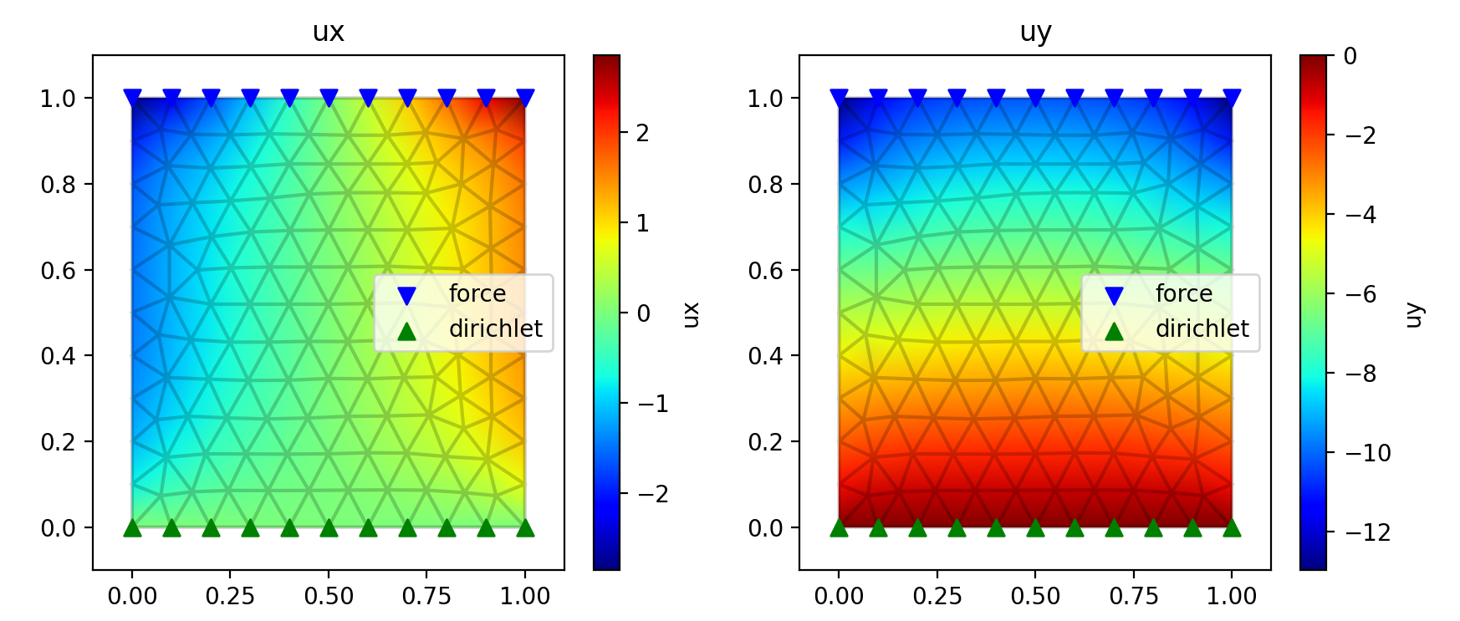
Backward
This Work
Torch-FEM

Slide 4
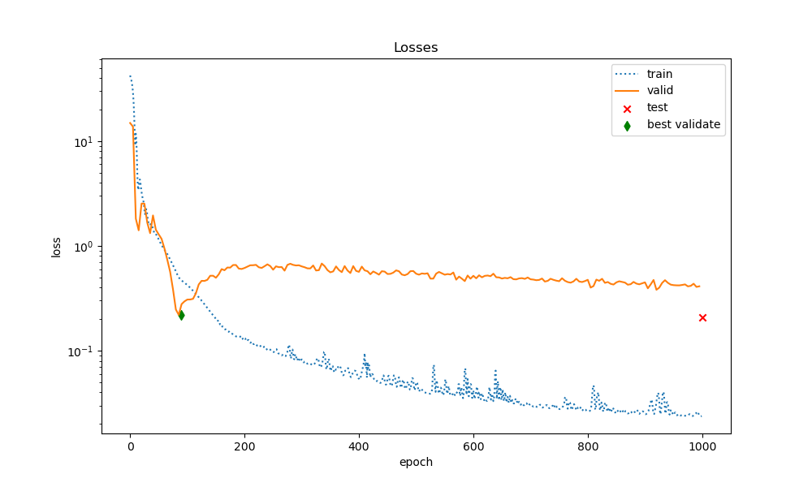
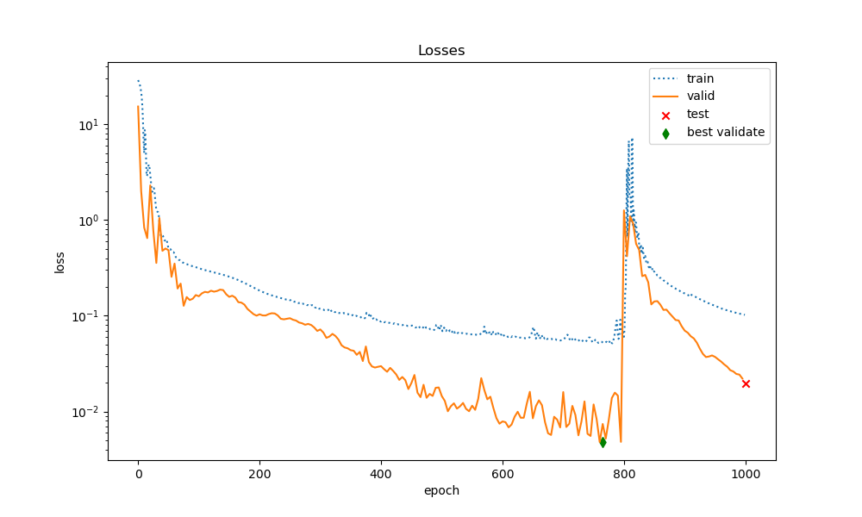
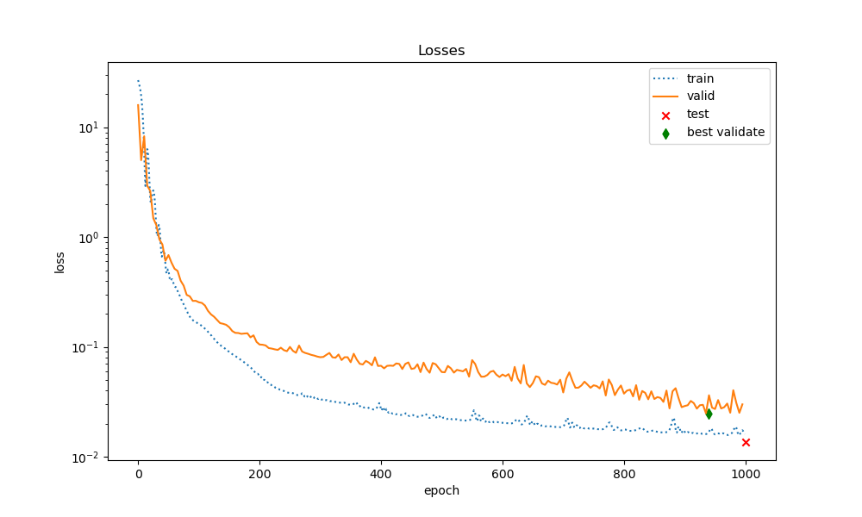
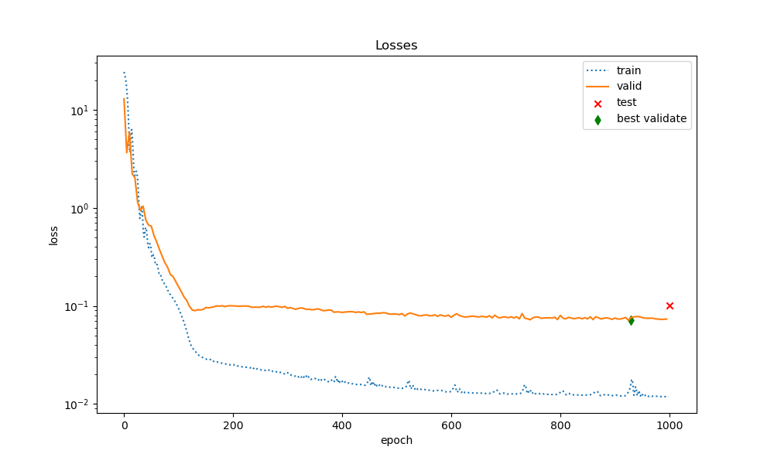
Backward
GAT
Train ratio=0.05
Train ratio=0.3
Condense
equivelant
architecture
Naïve
architecture
physical_loss_weight = 1.0

Slide 5
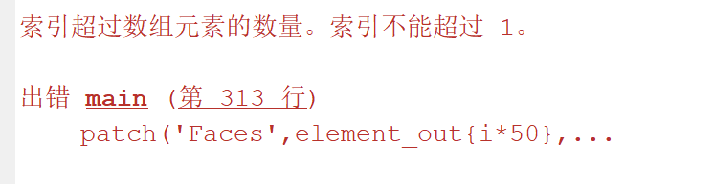
Backward
Matlab truss generation error

Slide 6
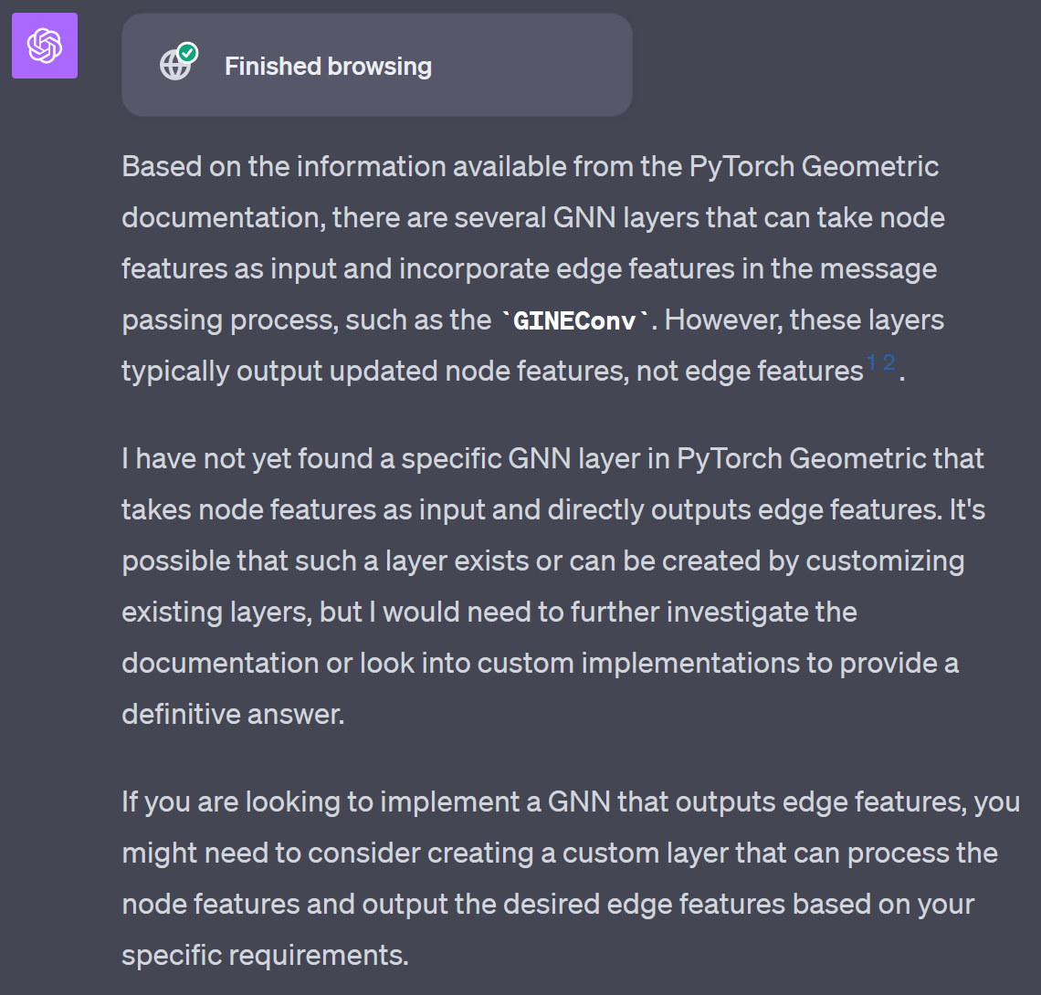
Forward
No NodeFeature->Edge Feature GNN provided by PyG

Slide 7
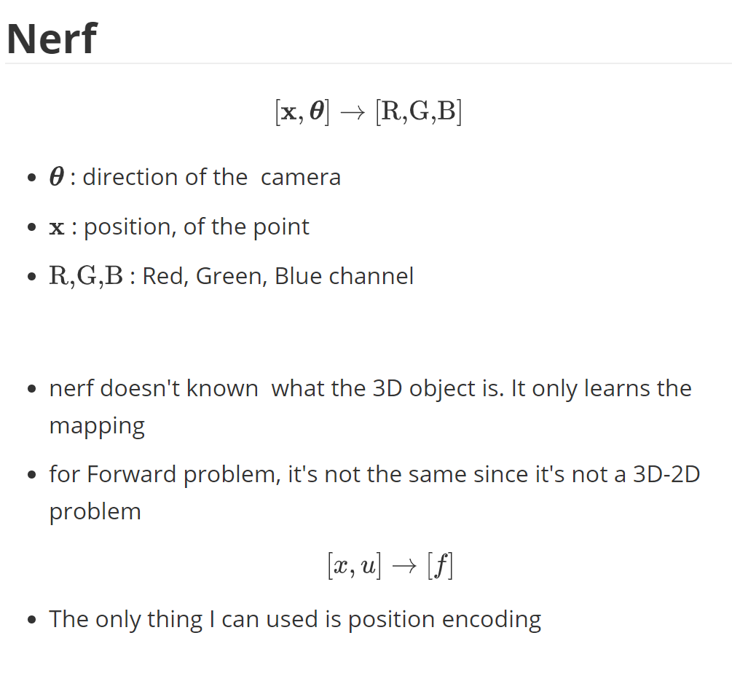
Forward

Slide 8
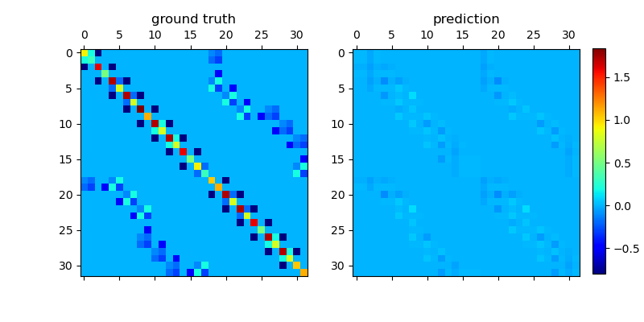
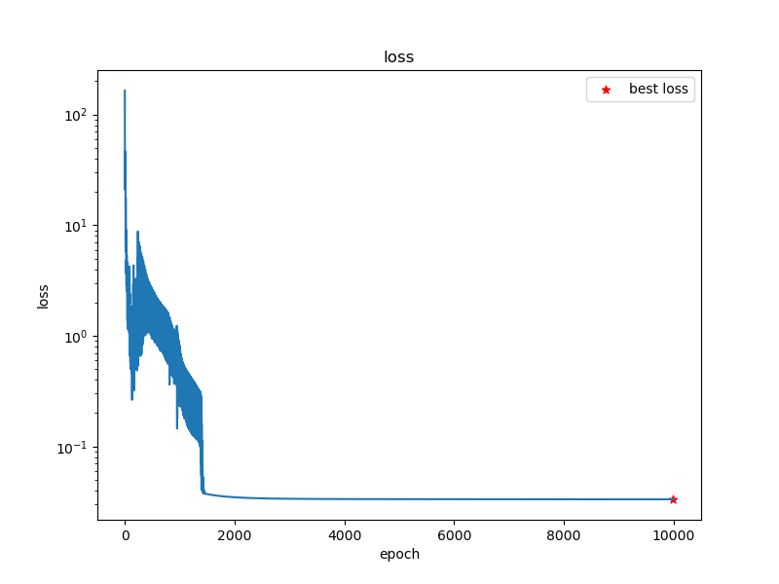
Forward
Global Galerkin Prediction using Positional Encoding
L2 loss-> L1 loss

Slide 9
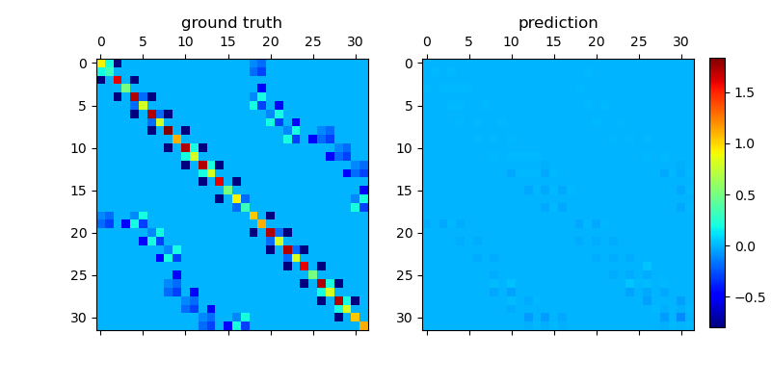
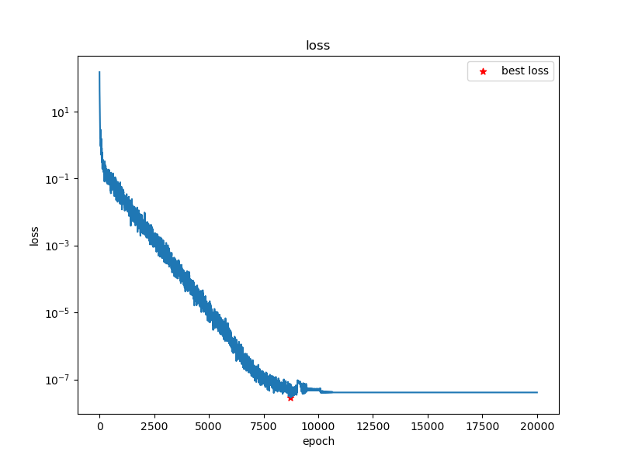
Forward
Local Galerkin Prediction
L2 loss-> L1 loss

Slide 10
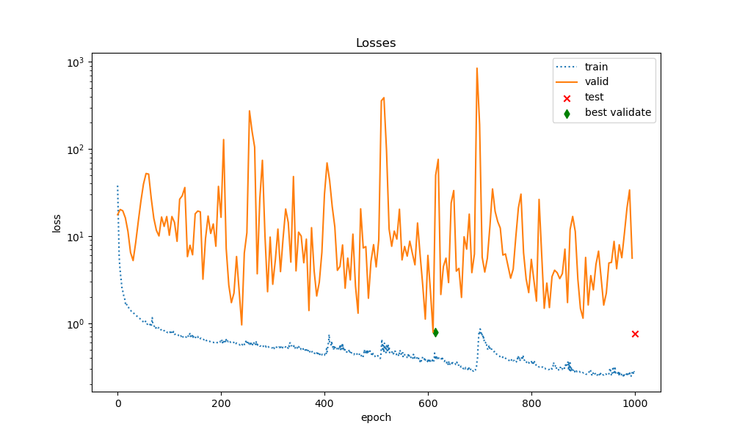
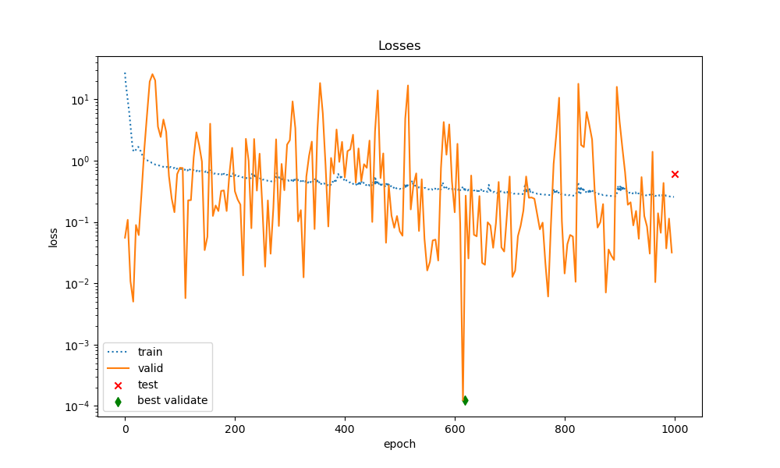
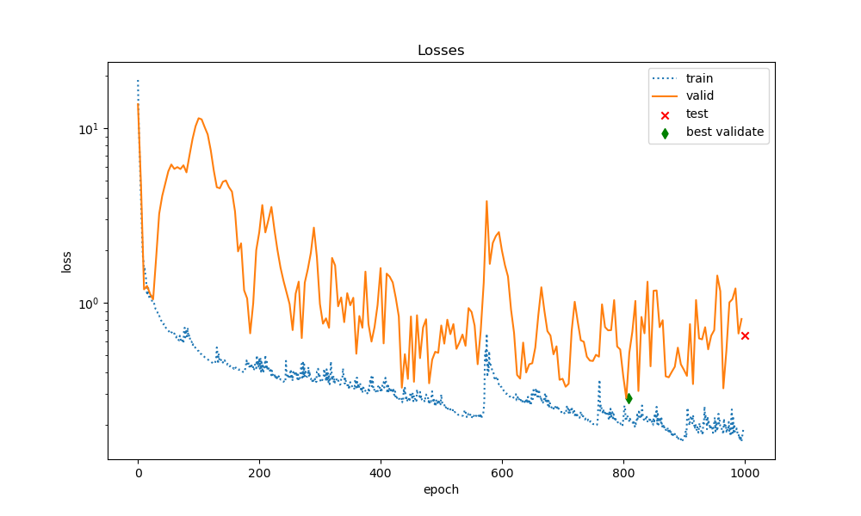
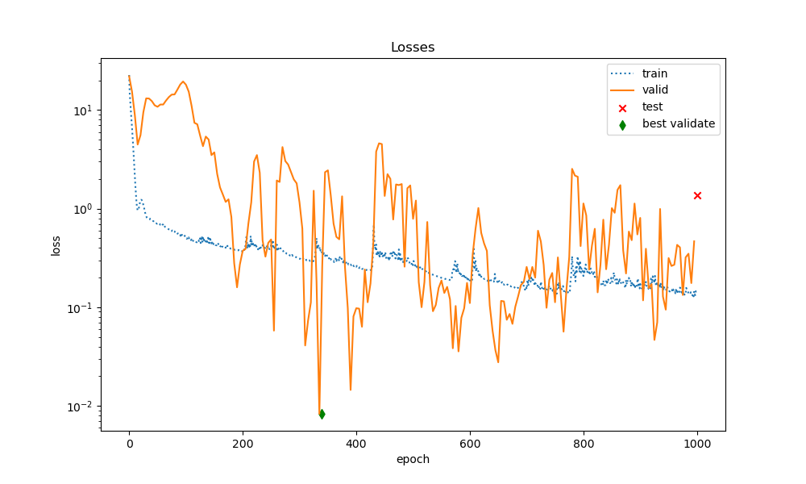
Appendix
Train ratio=0.05
Train ratio=0.5
GraphUNet
Condense
equivelant
architecture
Naïve
architecture
physical_loss_weight = 1.0

