Slide 1
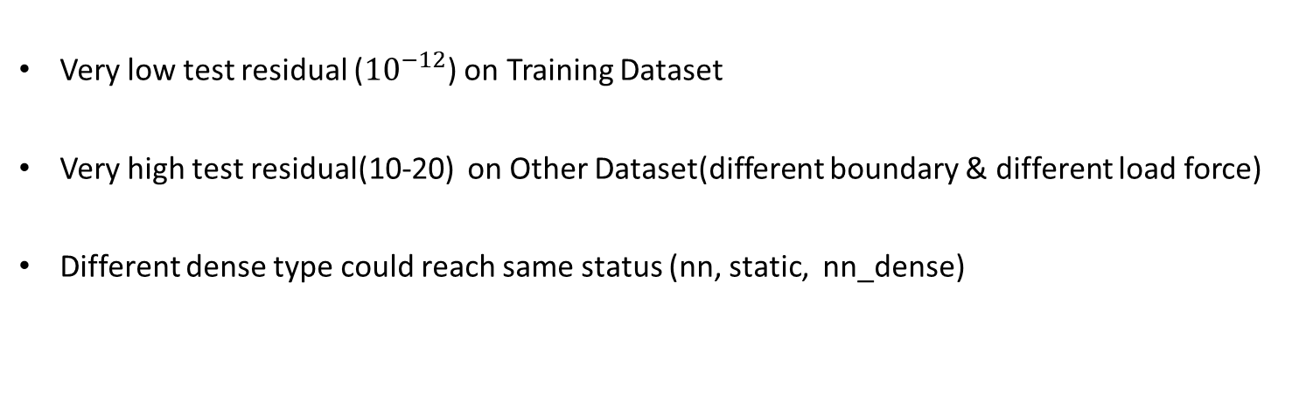
Problem 1
When use node position as input
Very low test residual (${10}^{−12}$) on Training Dataset
Very high test residual(10-20) on Other Dataset(different boundary & different load force)
Different dense type could reach same status (nn, static, nn_dense)
When not use node position as input
Cannot converge & the valid residual(13-16) didn’t go down

Slide 2
Possible Cause
GNN overfit, remember the mapping from node pos to displacement

Slide 3
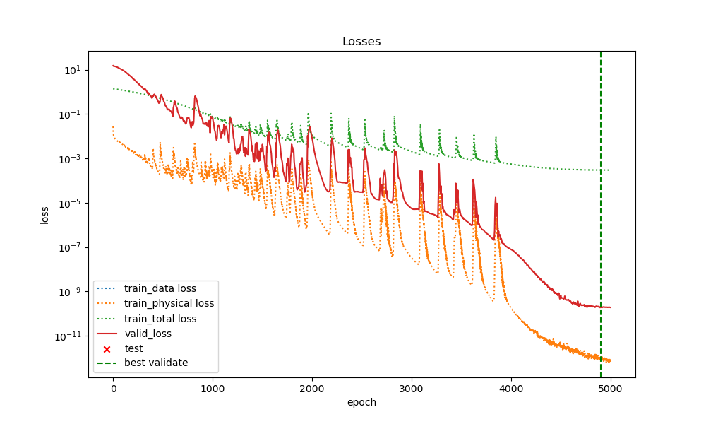
0.0train ratio + SIGN(8 hops) + auto weight + strong form + use_pos

Slide 4
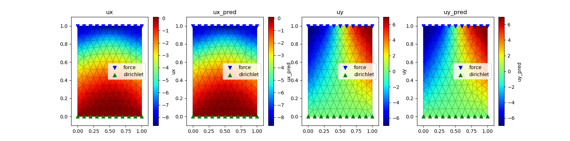
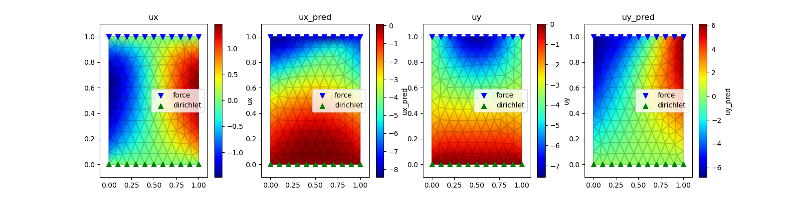
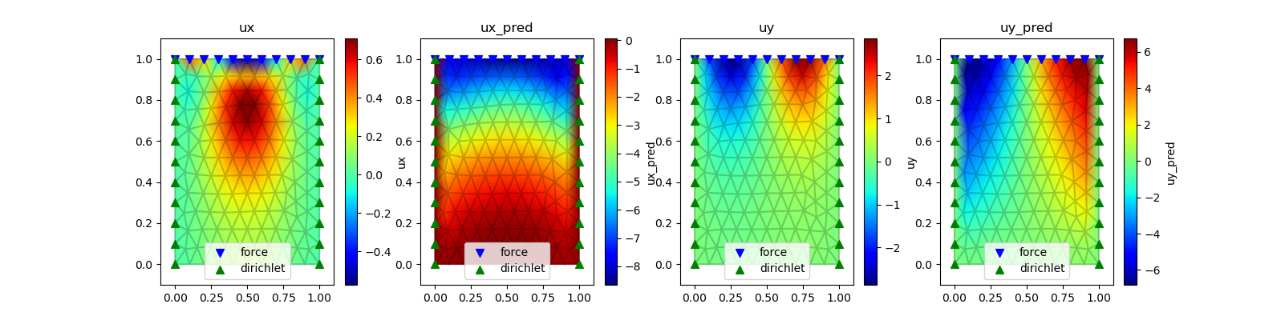
0.0train ratio + SIGN(8 hops) + auto weight + strong form

Slide 5
Problem 2
Weak form loss Debug
Weak form loss doesn’t work, therefore, the form is not correct
Not Important

Slide 6
TODO
Dataset
Encoding-Decoding
Report

