Slide 1

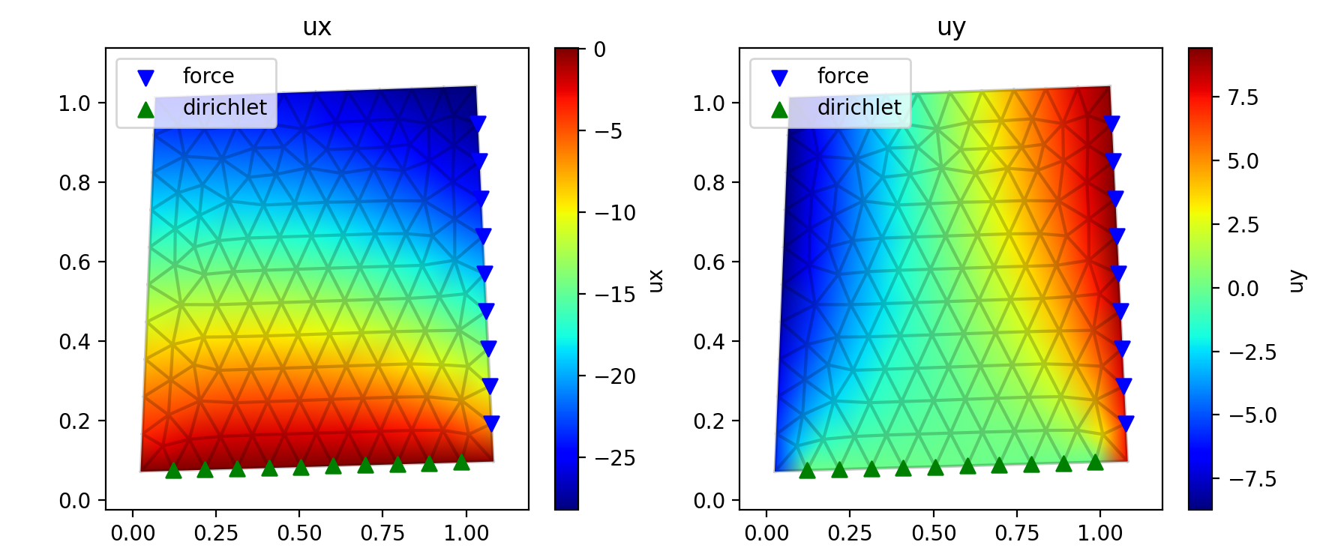

Slide 2
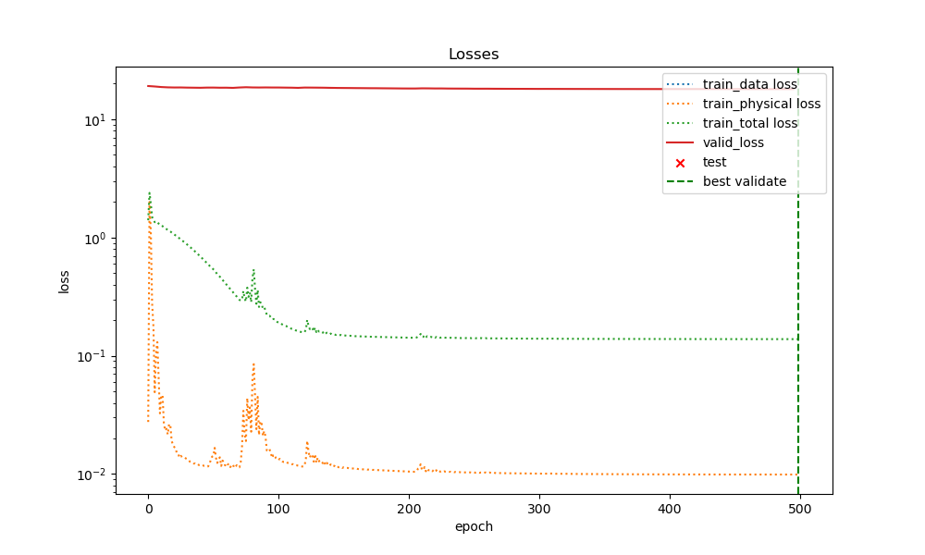

Slide 3
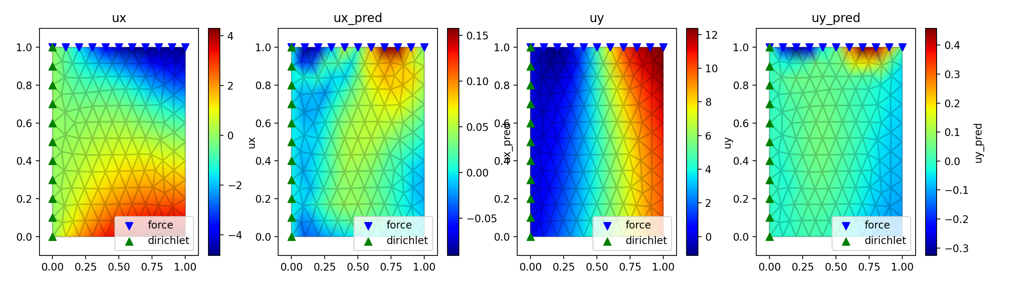

Slide 4
Mesh graph net
Larger deformation
- traingles
- disks (circle, ring)
Node position free (force)
- edge feature (relative position)
Clean the repo/report

