Slide 1
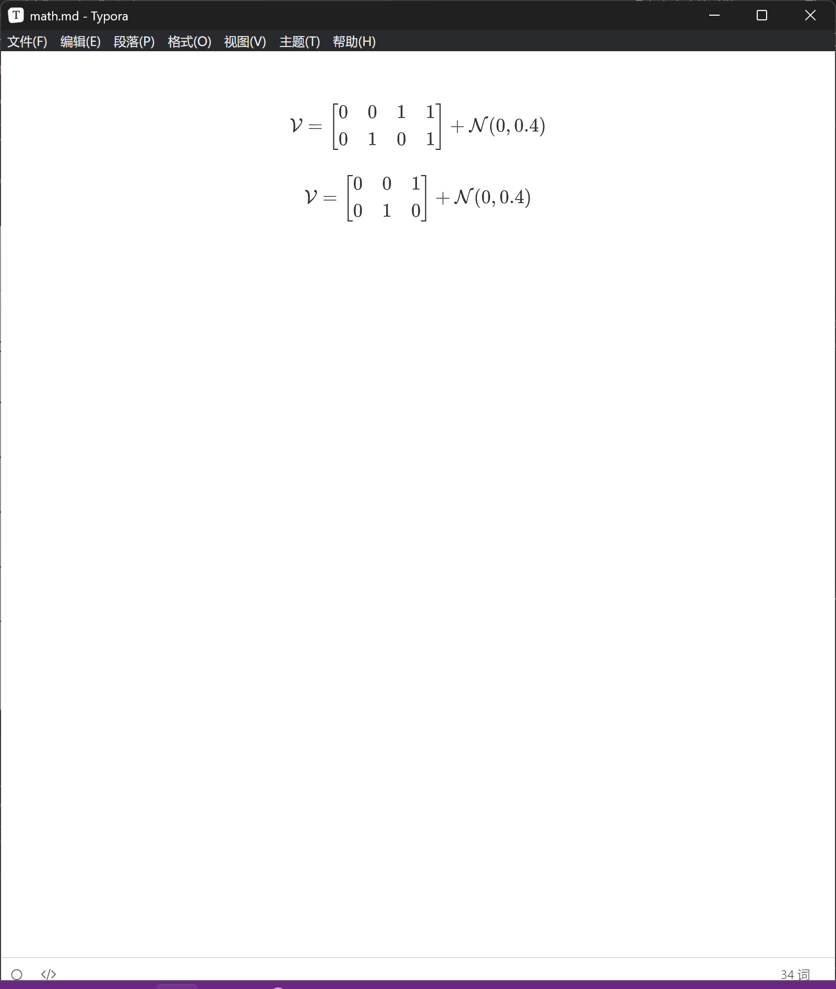
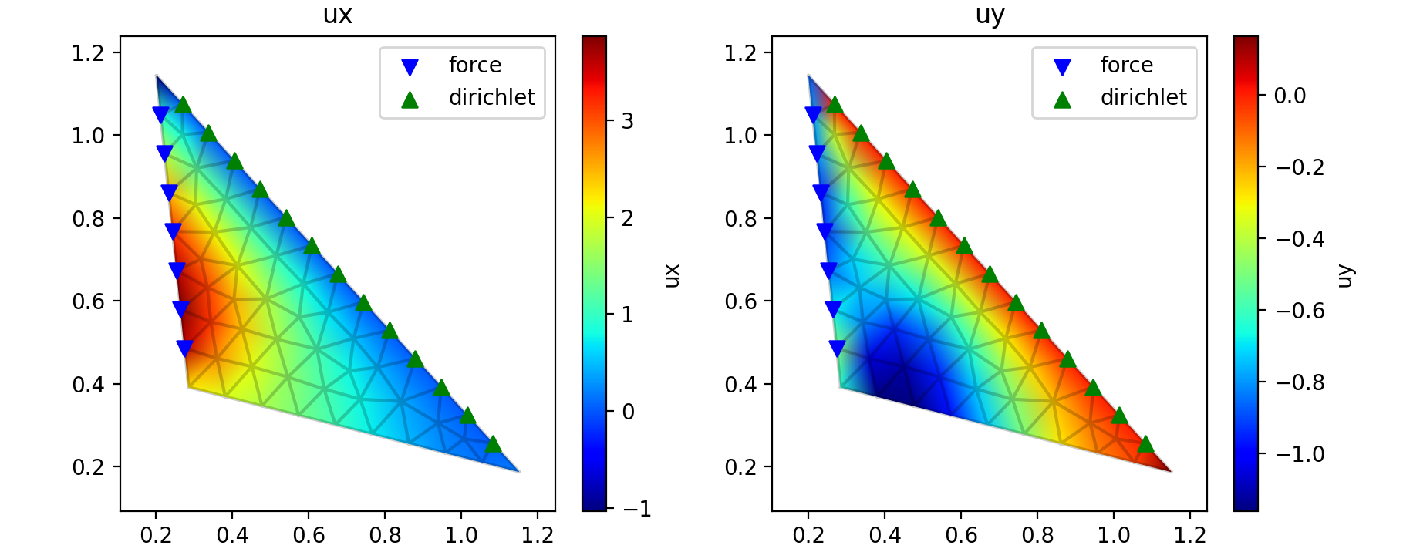
A
B
C

Slide 2
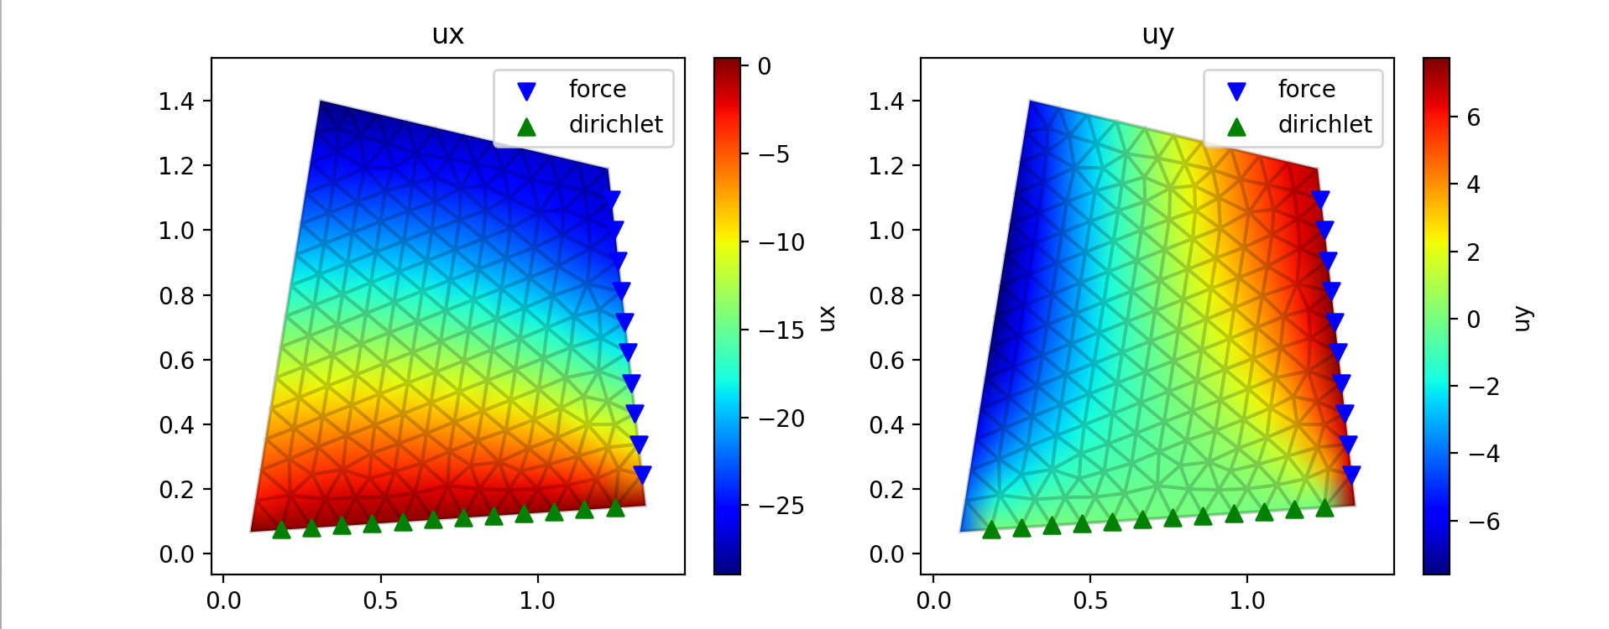
C
D
B
A

Slide 3
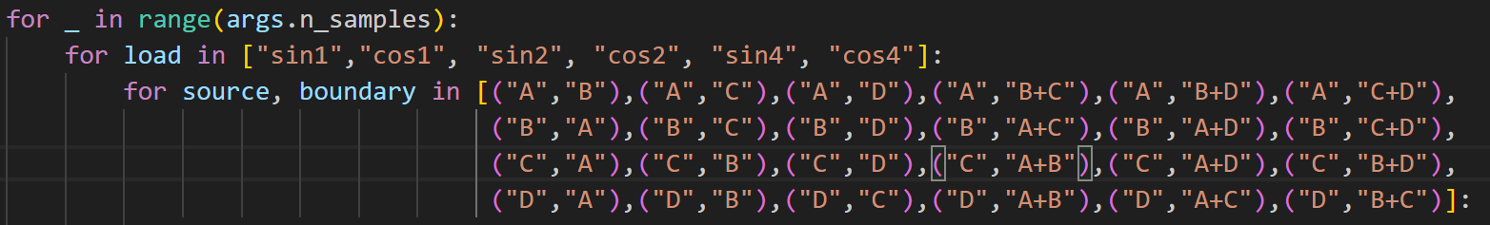
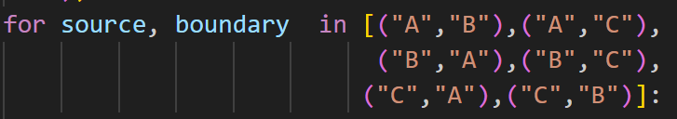
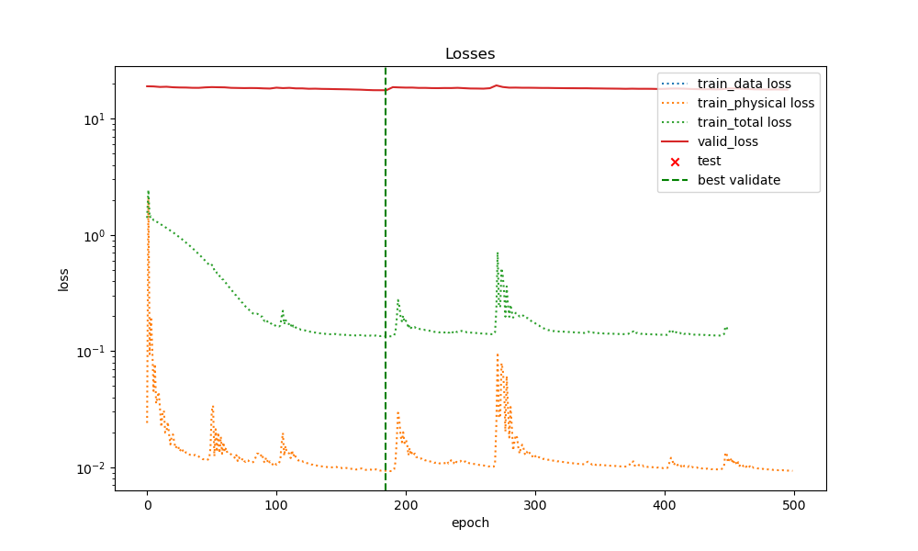

Slide 4
graph1 | graph2 | graph3 | graph4 | graph5 | graph6
100% nodes Train (phy)
100% nodes Valid (phy)
expected
50% nodes Test (data)
current
50% nodes Valid (phy)
100% nodes Train (phy)
graph1 | graph2 | graph3 | graph4 | graph5 | graph6

