Slide 1
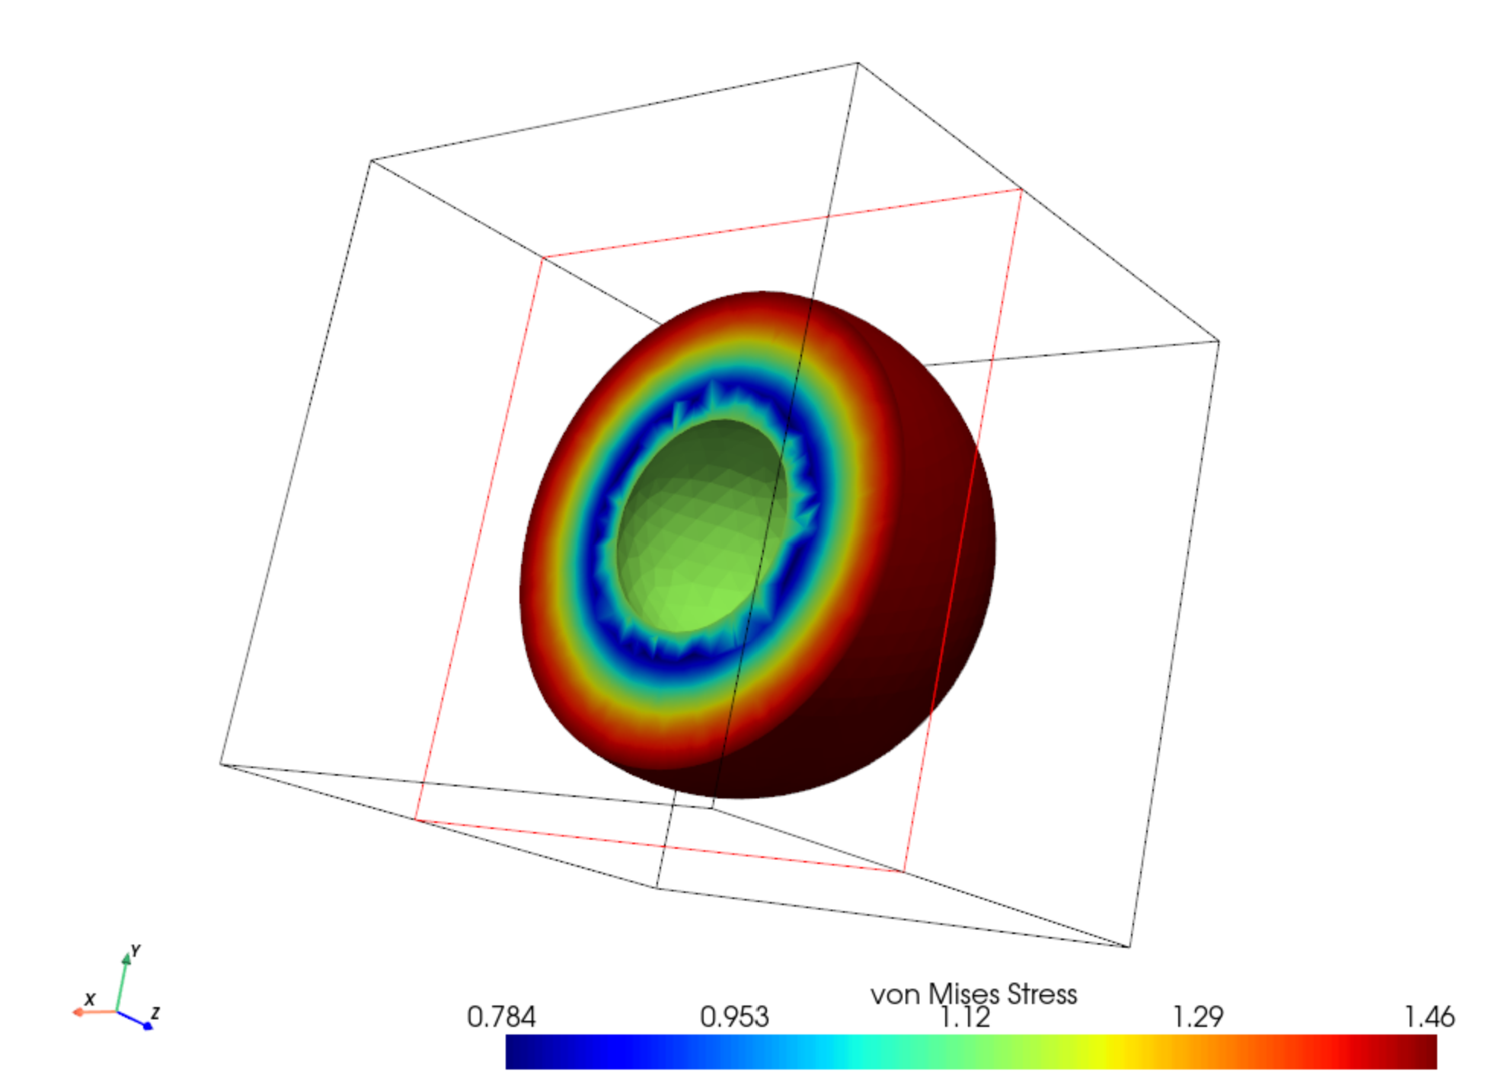
Analytical Solution
Mesh generate (Gmsh)
Train
GNN
Mesh parameters:
Inner radius
Outer radius
Characteristic scale
PDE parameters:
Young’s modulus
Poisson ratio
Outside pressure
FEM Solution (baseline)
compare

Slide 2
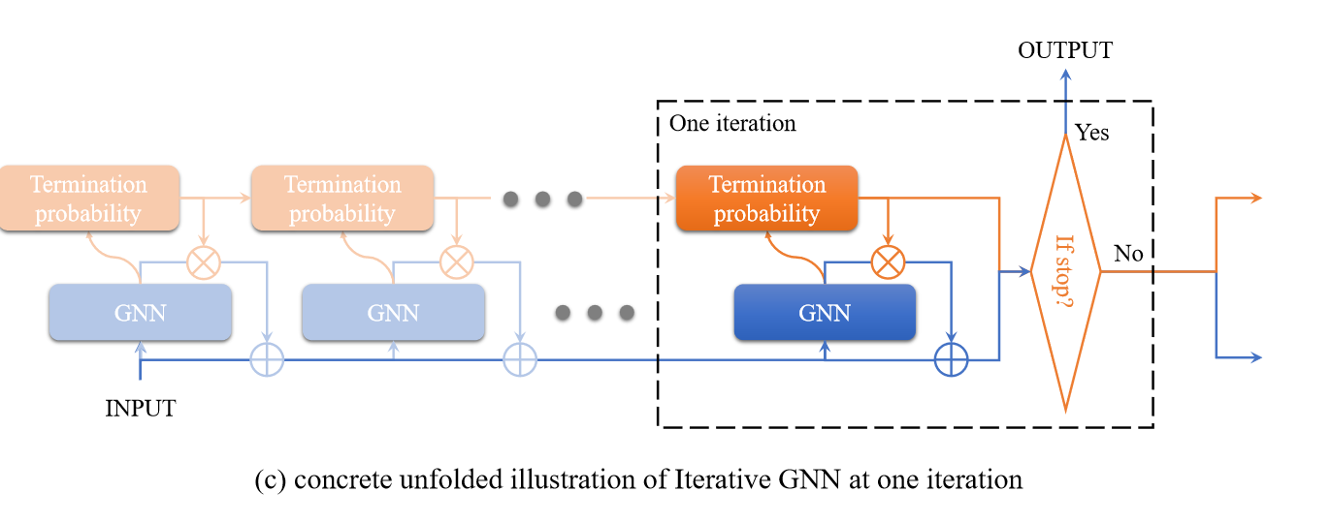
Scale-invariant GNN
Iterative pooling
- dynamic to scale of the mesh diameter
- pooling weight sharing
Tang H, Huang Z, Gu J, et al. Towards scale-invariant graph-related problem solving by iterative homogeneous gnns[J]. Advances in Neural Information Processing Systems, 2020, 33: 15811-15822.

Slide 3
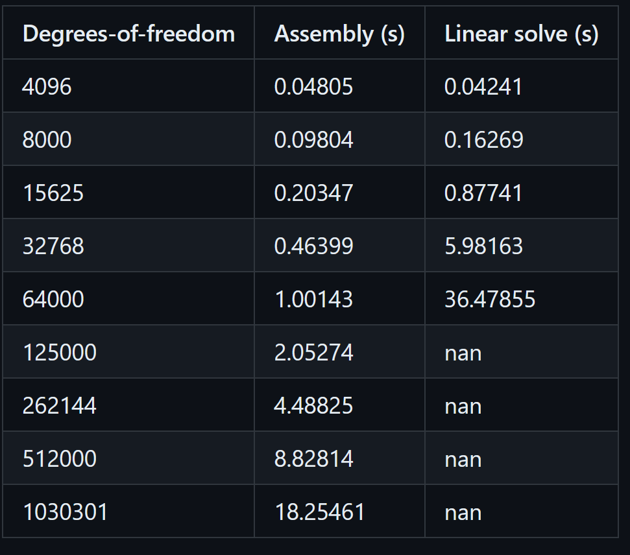
Large Scale GNN
Scikit-FEM(scipy.sparse.linalg.spsolve) upper bound
Naïve graph pooling consumes a lot of memory
Sampling/Partition of graphs

Slide 4
DONE
TODO
Spherical shell dataset generation (analytical and FEM solution)
Naïve Graph U Net and Naïve GNN
Other analytical linear elastic dataset
Further reading
Thinking about unorthogonal pooling
Sampling/Partition Training

Slide 5
Notice
Currently focus on point graph not element graph

