Slide 1
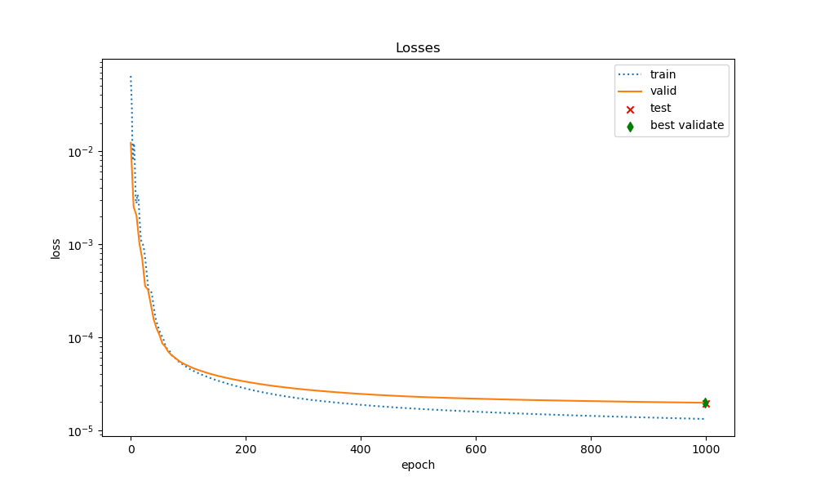
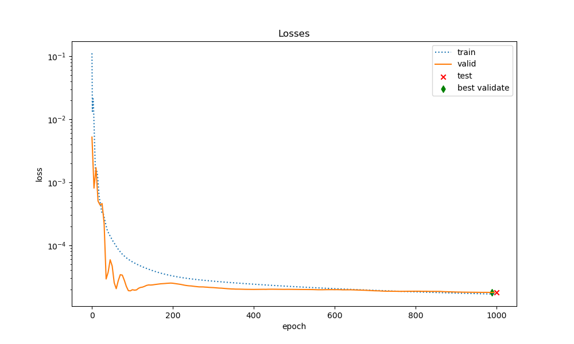
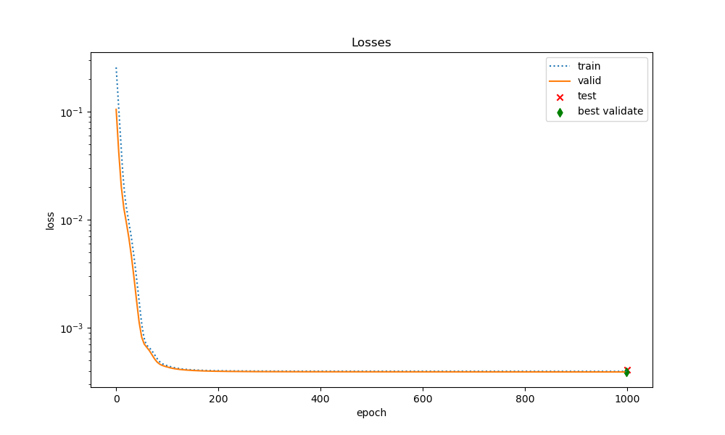
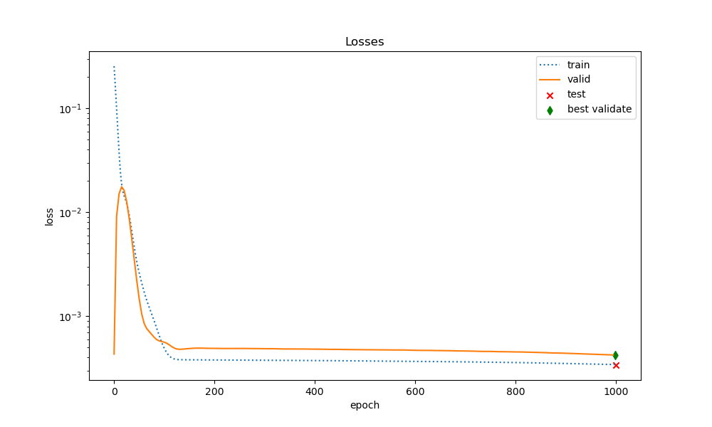
train_ratio =0.05
train_ratio =0.5
GCN
GAT

Slide 2
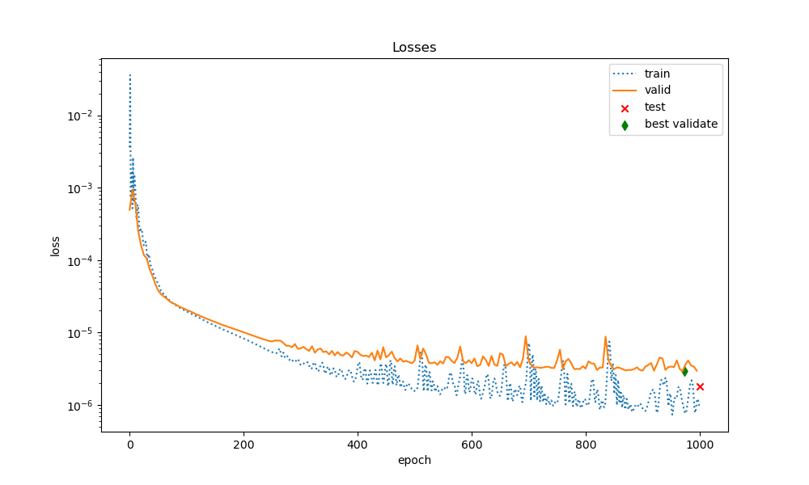
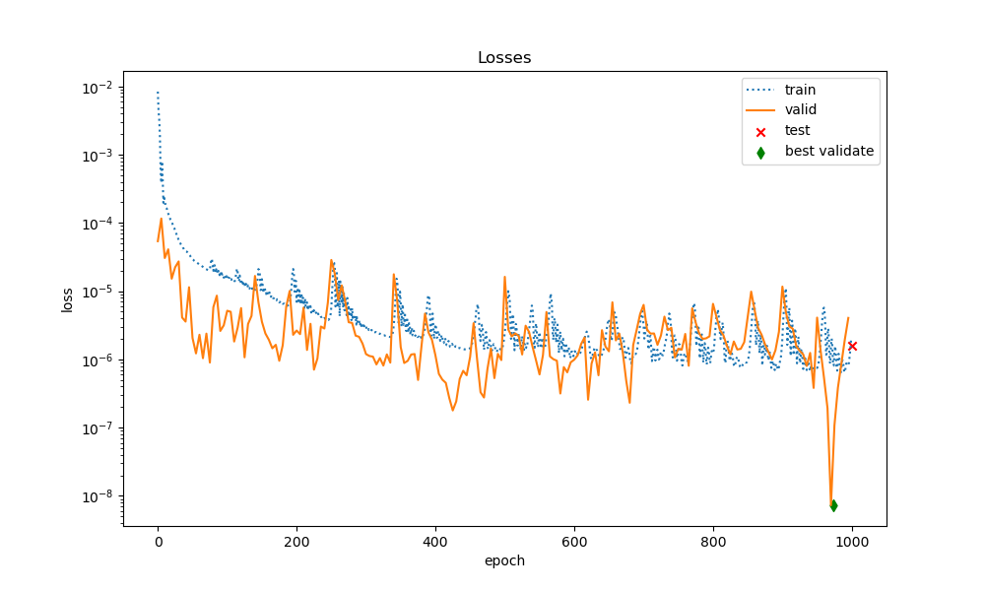
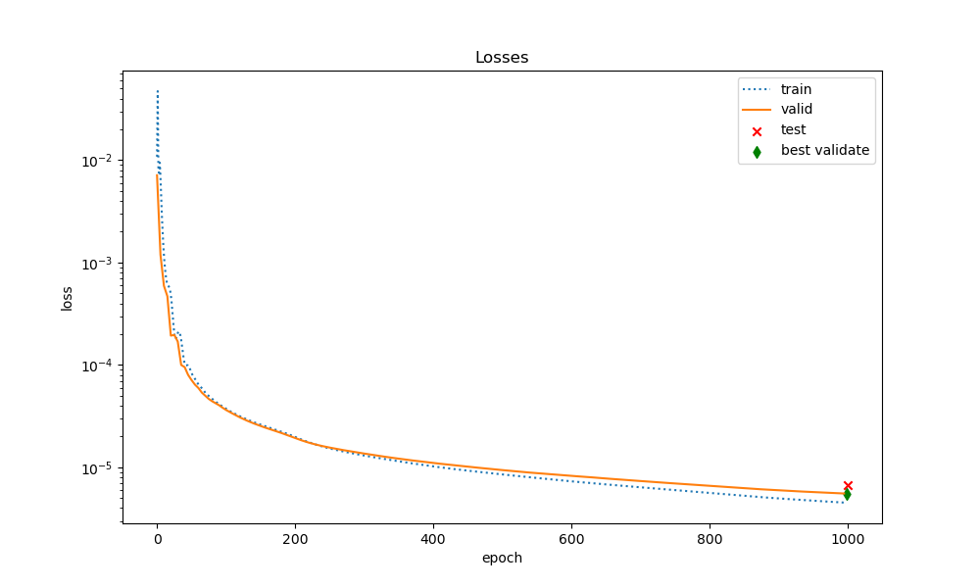
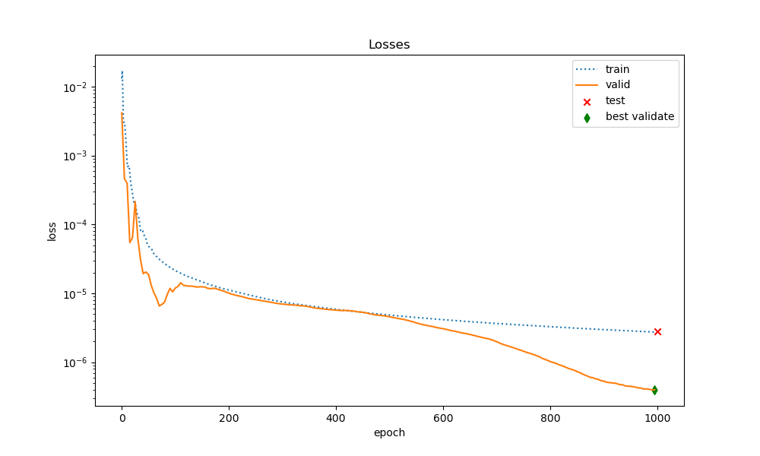
train_ratio =0.05
train_ratio =0.5
SIGN
MLP

Slide 3
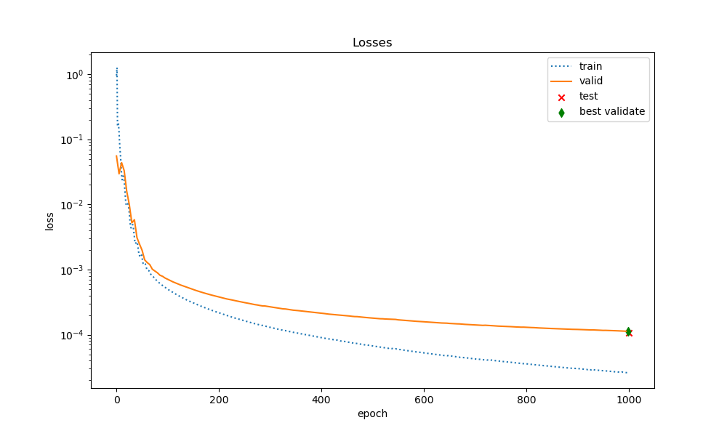
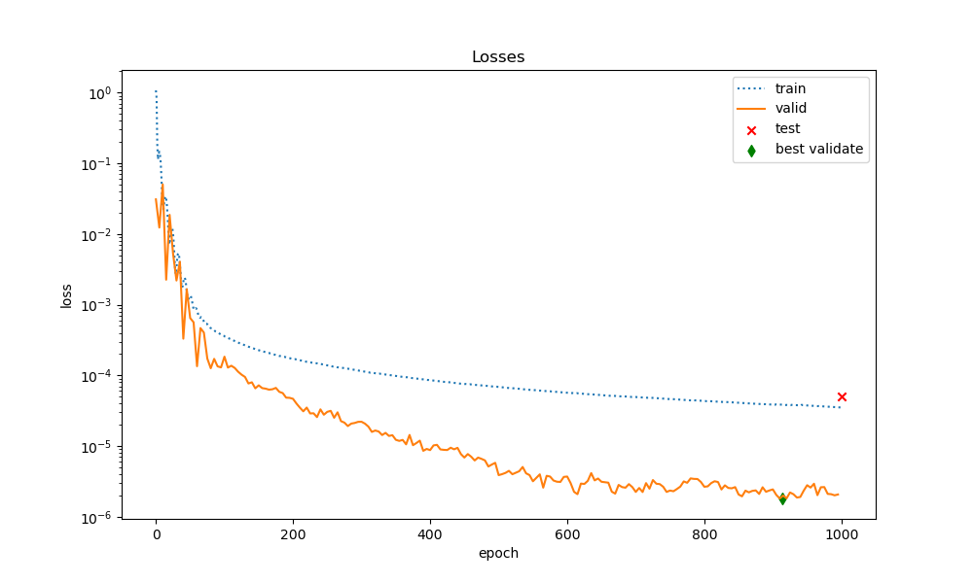
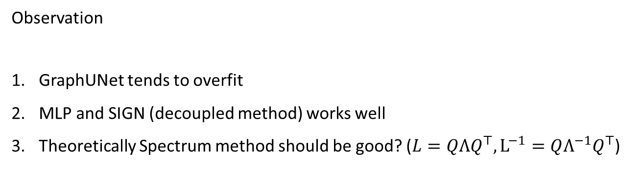
train_ratio =0.05
train_ratio =0.5
GraphUNet
(GCN+Topk)
Observation
GraphUNet tends to overfit
MLP and SIGN (decoupled method) works well
Theoretically Spectrum method should be good? ($L=QΛQ^{⊤}, L^{−1}=QΛ^{−1}Q^{⊤}$)

Slide 4
Done
Naïve experiment
Analytical Dataset
TODO
Multiscale experiment ?(different grid size)
Compare with FEM baseline
Decoupled method? (because it performs better)
Relative position

