Slide 1
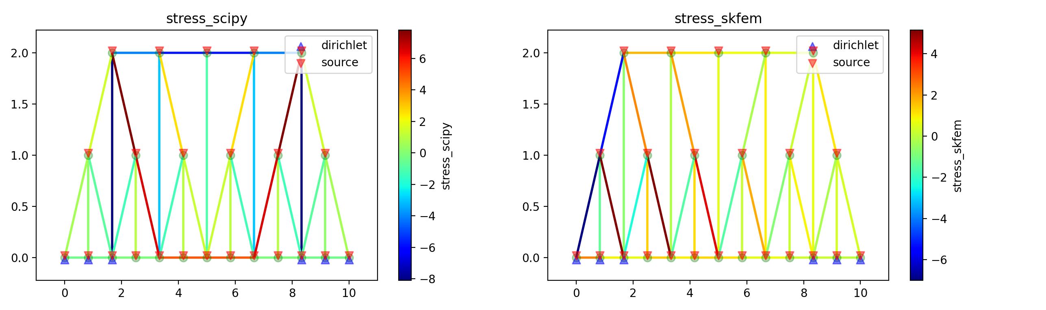
Baltimore bridge
Young’s Modulus : 1
Cross Section : 1
Nodal Pressure : 1

Slide 2
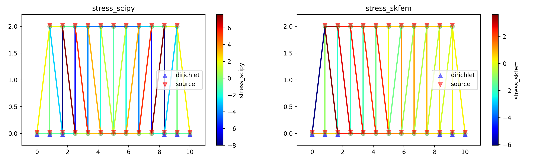
Pratt bridge
Young’s Modulus : 1
Cross Section : 1
Nodal Pressure : 1

Slide 3
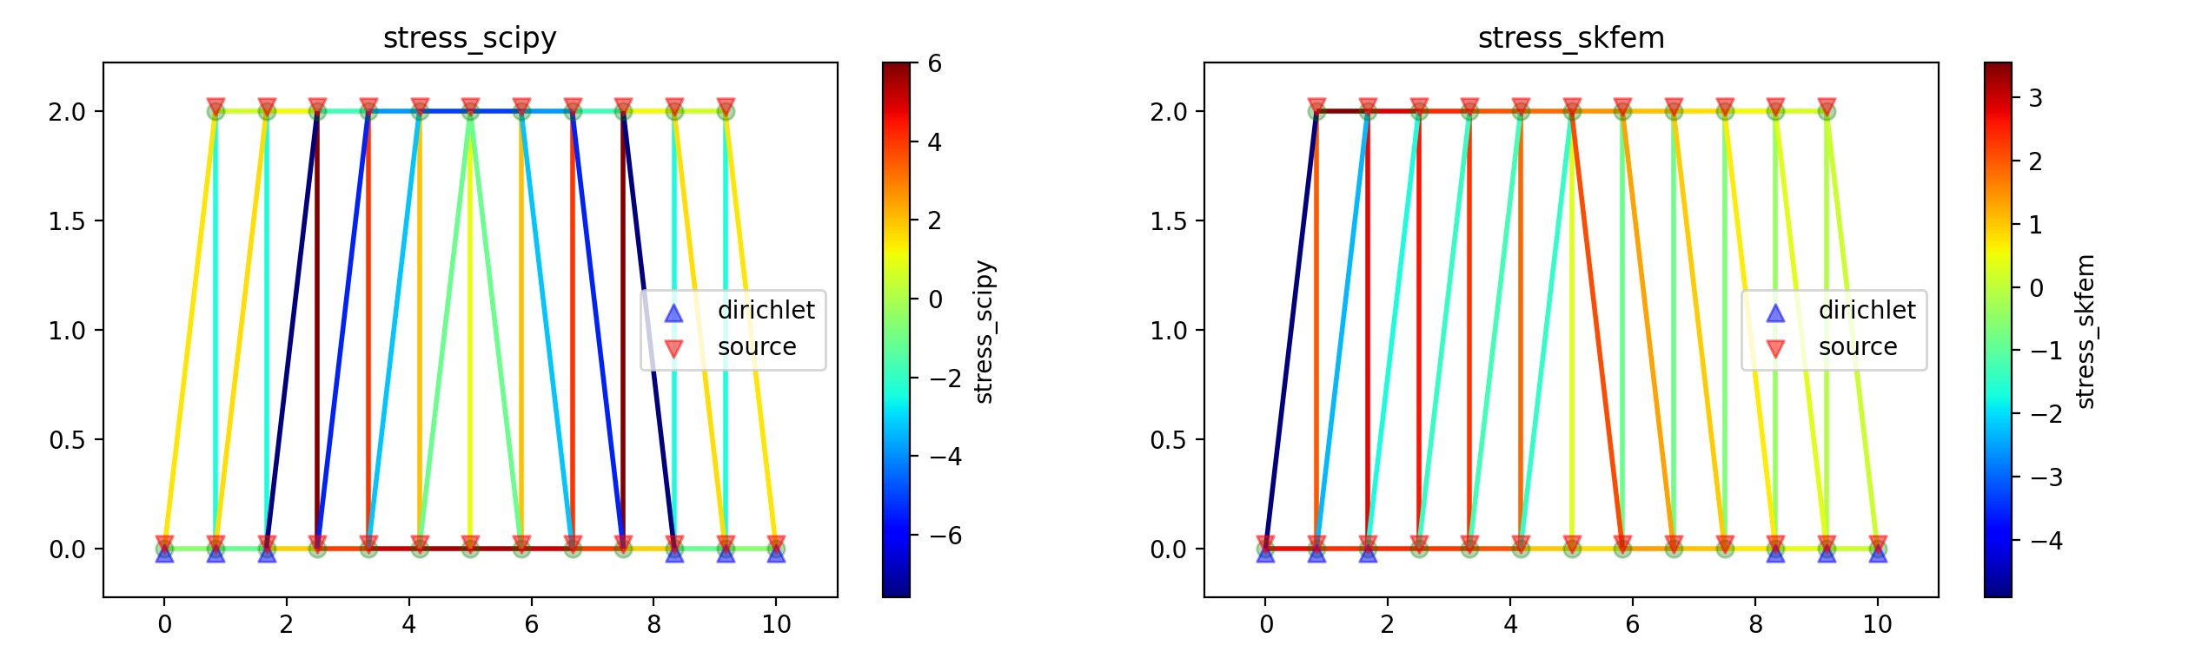
Howe bridge
Young’s Modulus : 1
Cross Section : 1
Nodal Pressure : 1

Slide 4
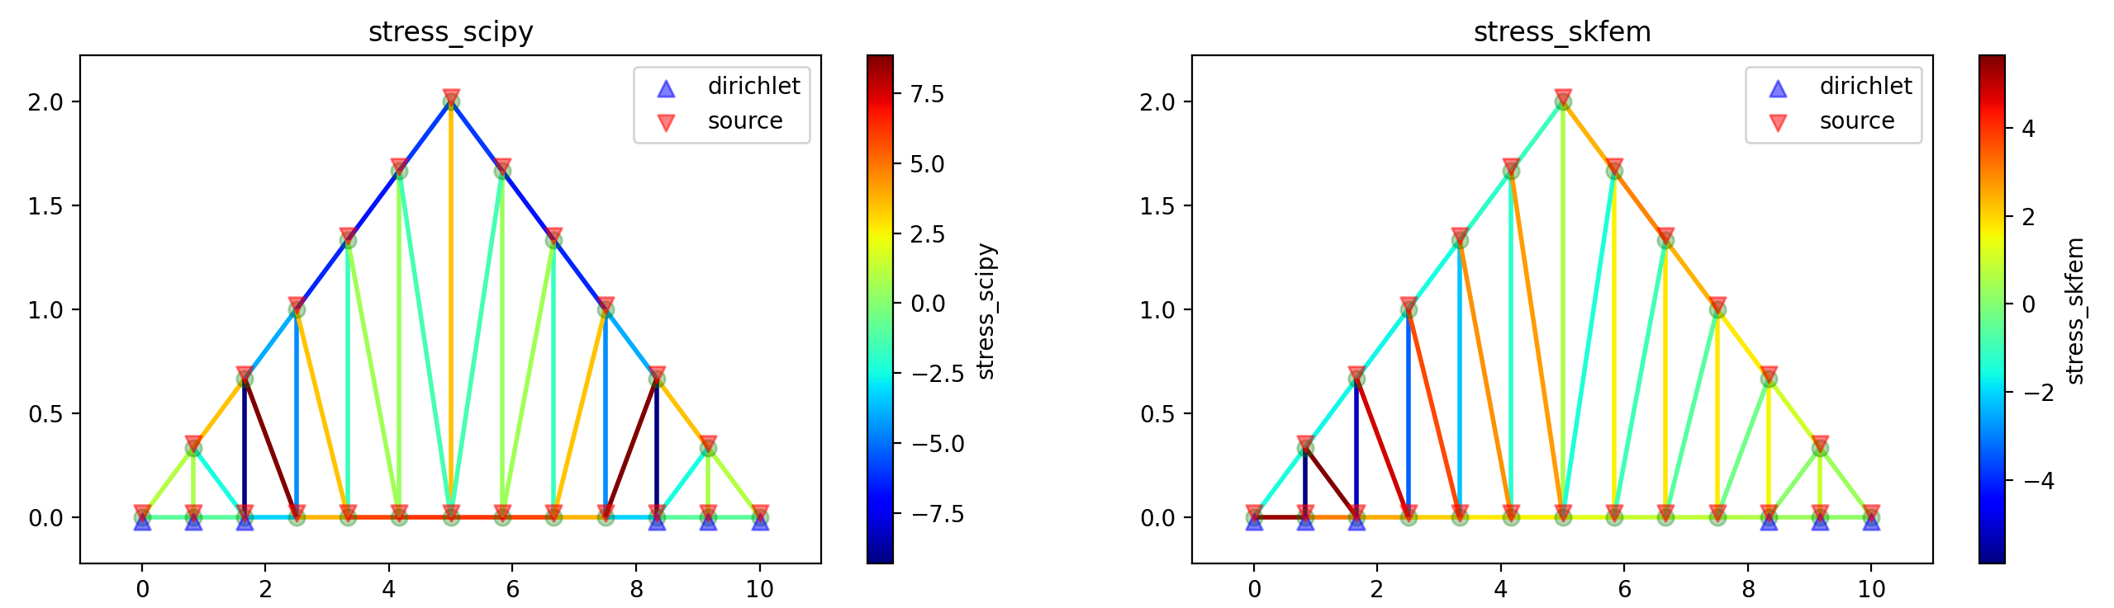
Howe roof
Young’s Modulus : 1
Cross Section : 1
Nodal Pressure : 1

Slide 5
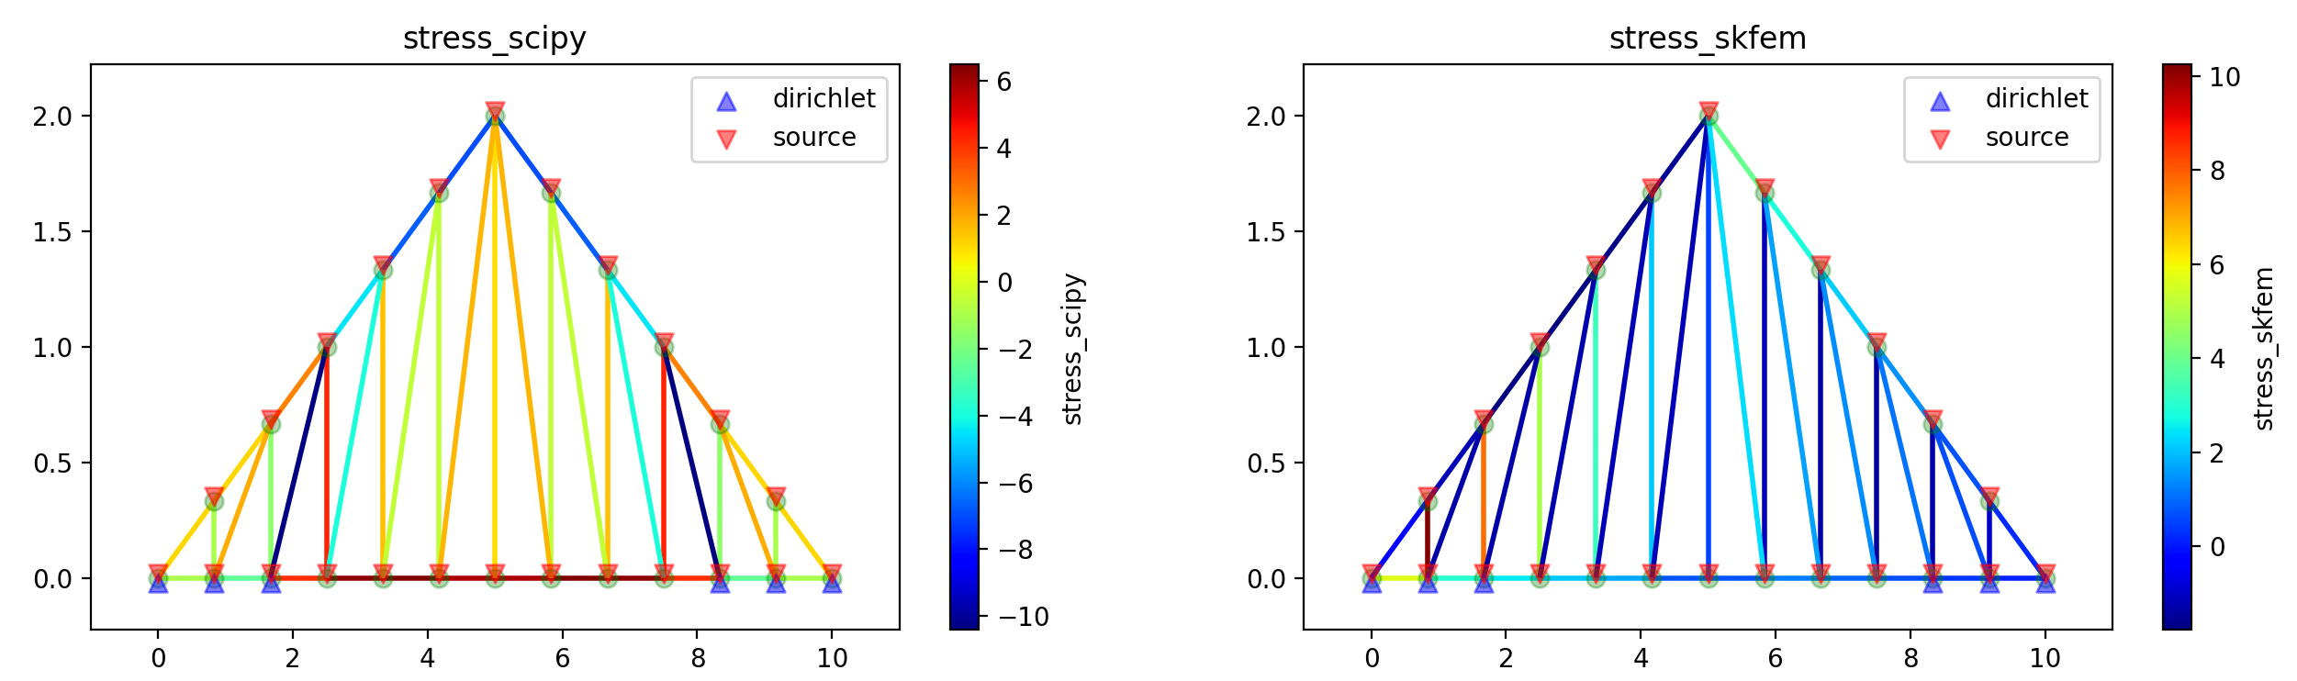
Pratt roof
Young’s Modulus : 1
Cross Section : 1
Nodal Pressure : 1

Slide 6
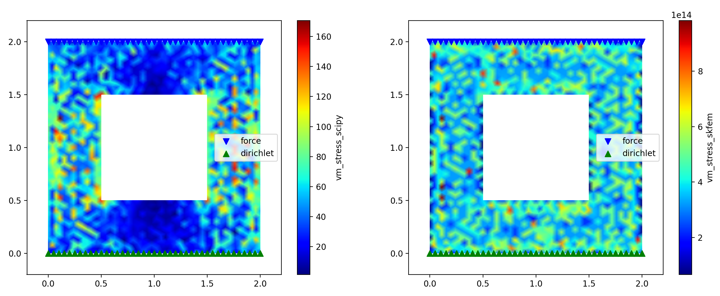
Hollow rectangle
Young’s Modulus : 1
Poisson ratio : 0.3
Nodal Pressure : 1
Character length : 0.05

Slide 7
Trusspy can only solve dynamics system
Skfem doesn’t support truss element well
There is still some error with the skfem implementation

Slide 8
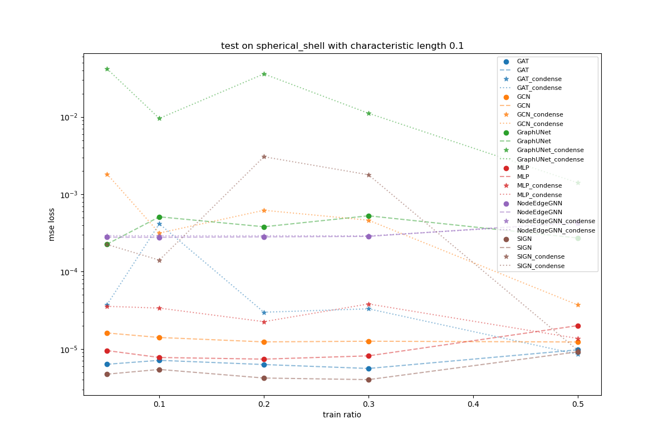
Scale Variant Test on Hollow Sphere

Slide 9
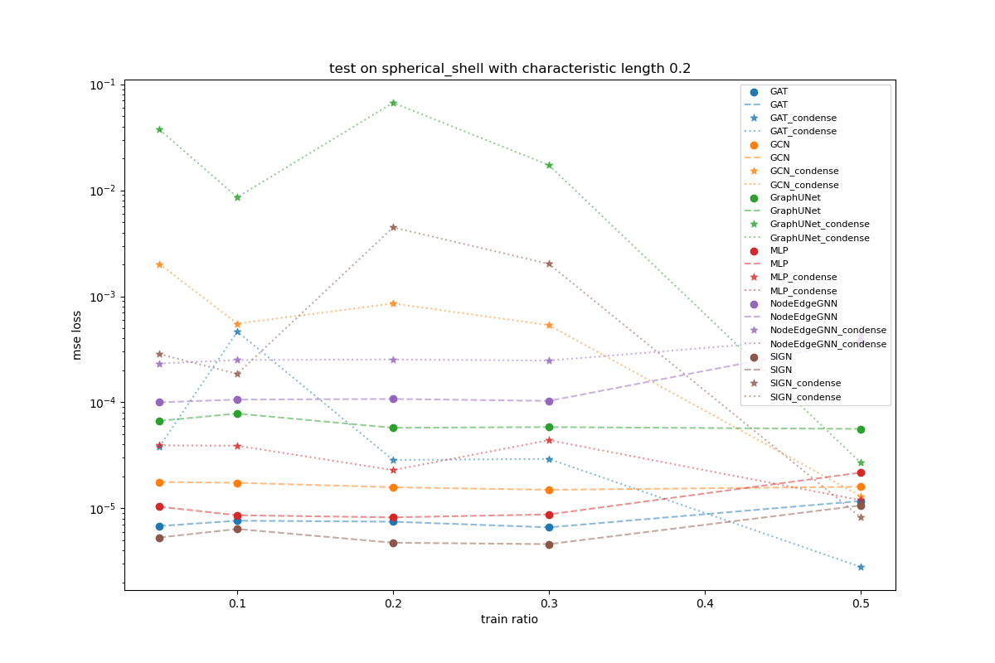
Scale Invariant Test on Hollow Sphere

Slide 10
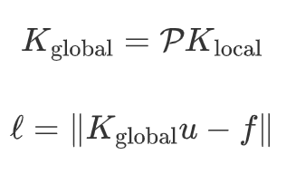

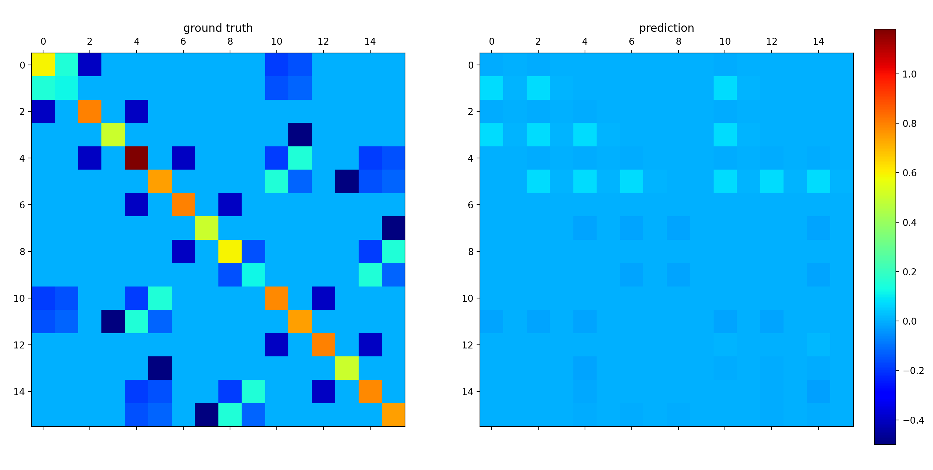
Forward Problem
Pseudo Linear Model
Comparison of Galkerin Matrix

Slide 11

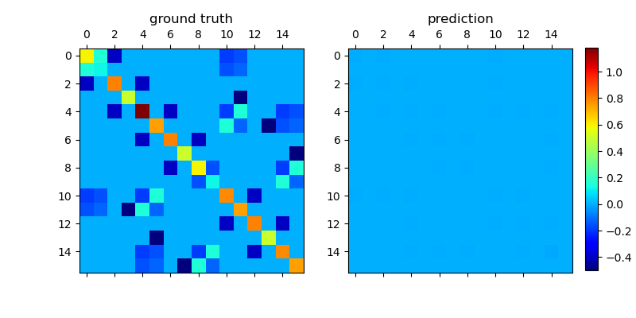
Forward Problem
Pseudo Bilinear Model

Slide 12
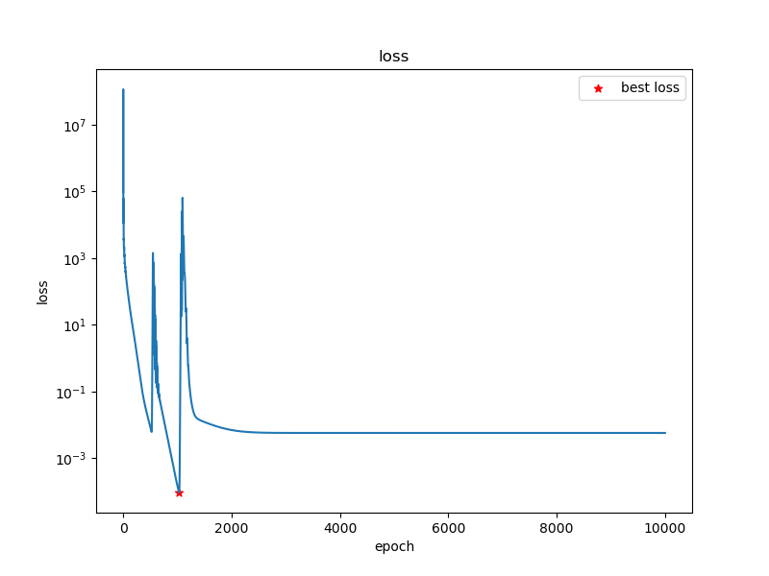
Forward Problem
Pseudo Linear Model

Slide 13
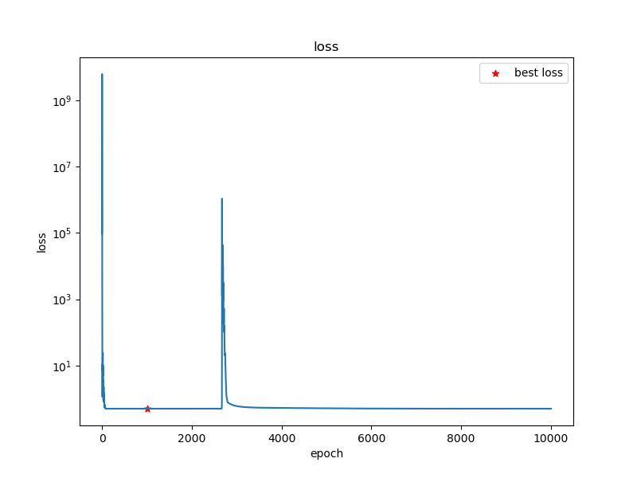
Forward Problem
Pseudo Bilinear Model

Slide 14
TODO
Verify the correctness of the truss/triangle solver
Train GNN/DBC-GNN on different datasets
Try to come up with more architecture that can simulate Galerkin matrix(GAT)

