Slide 1
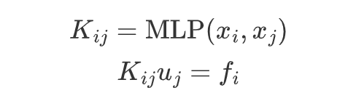
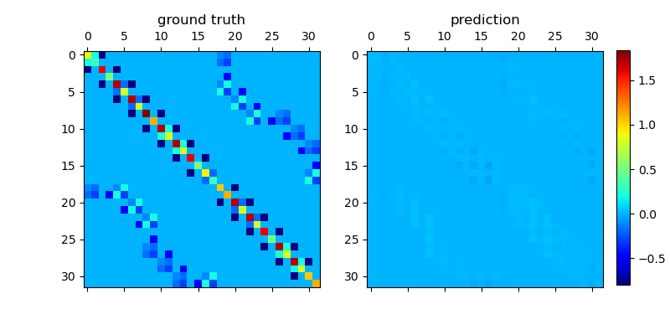
Forward Problem
Direct Learn Global Galkerkin

Slide 2
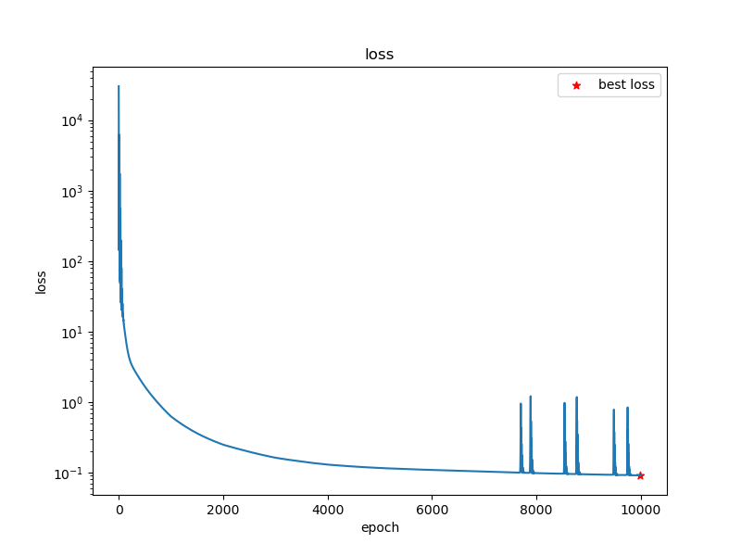
Forward Problem
Direct Learn Global Galkerkin

Slide 3
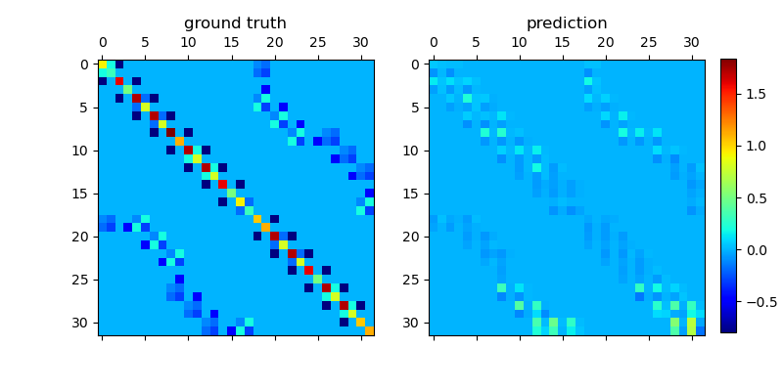
Forward Problem
Learn Global Galerkin
Learn Local Galerkin(Linear)

Slide 4
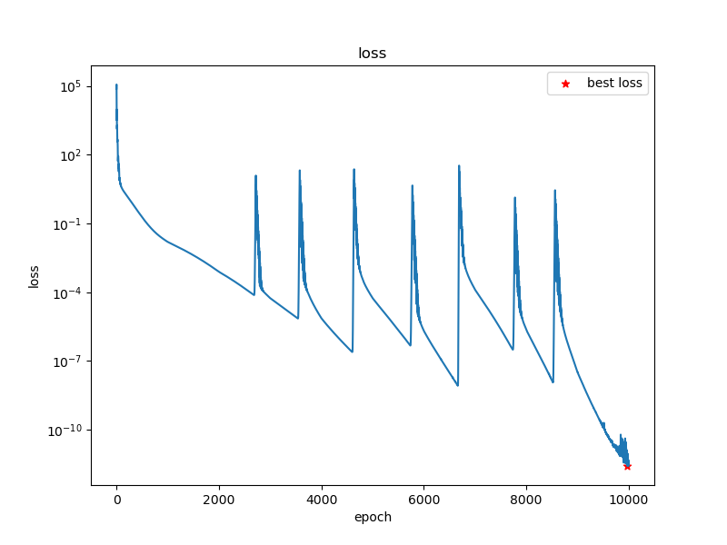
Forward Problem
Learn Global Galerkin
Learn Local Galerkin(Linear)

Slide 5
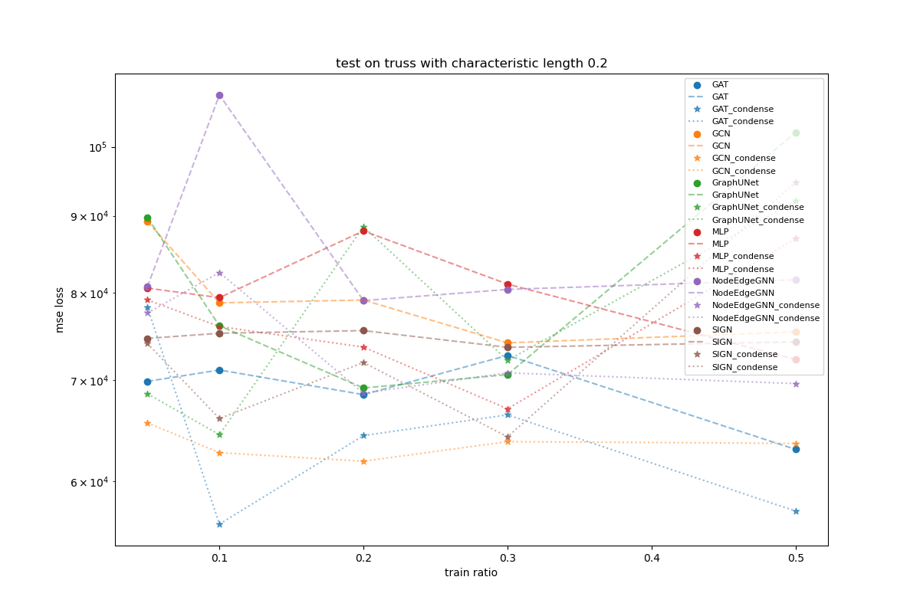
Multi graphs Dataset
Scale Invariant Test

Slide 6
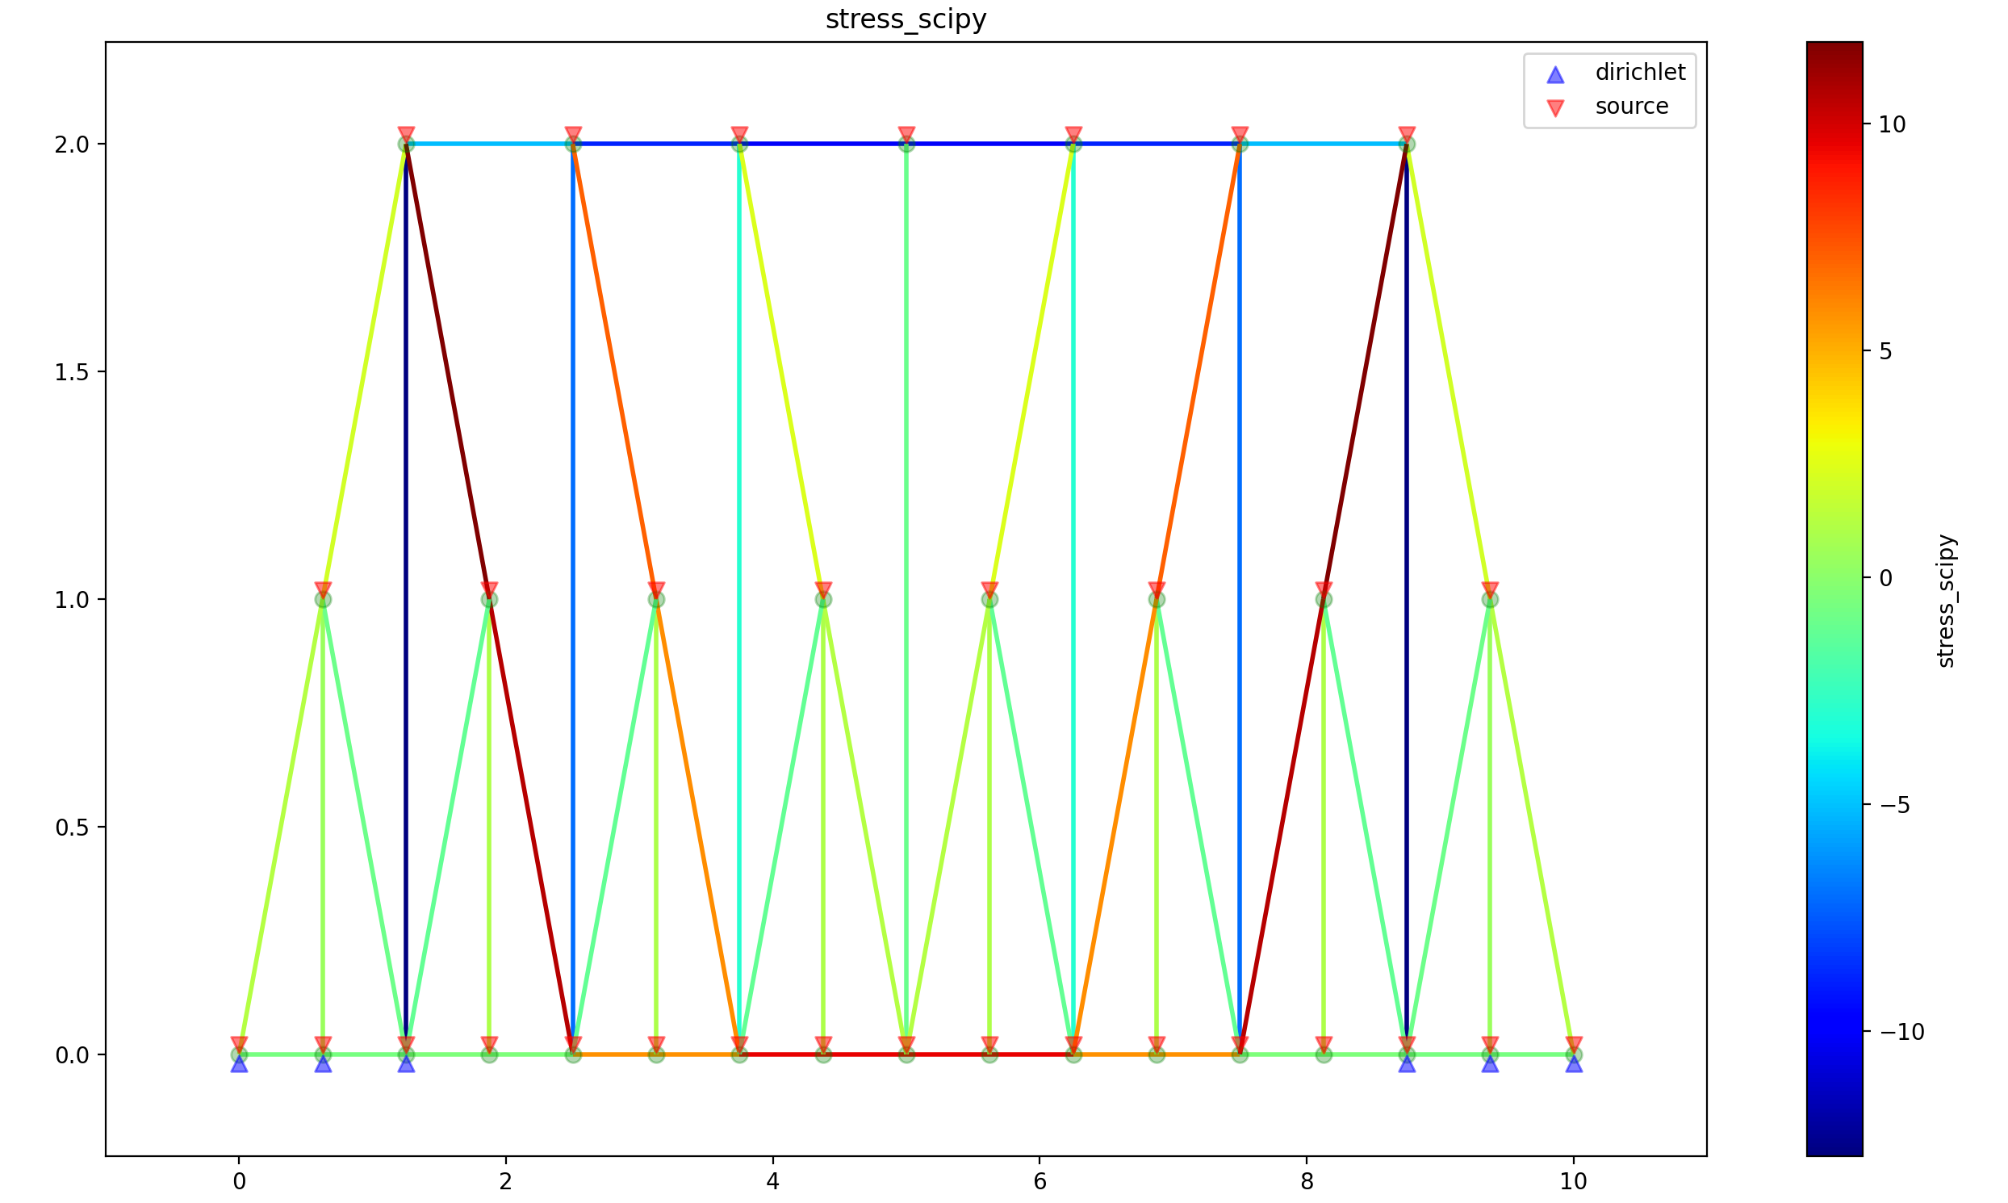
Multi graphs Dataset
Dataset generation
Geometry
n_grid
n_support
"bridge.pratt", "bridge.howe", "bridge.baltimore", "roof.pratt", "roof.howe"
8
12
16
20
24
1
2
3
75 graphs
Dataset too small
n_grid
n_support

Slide 7
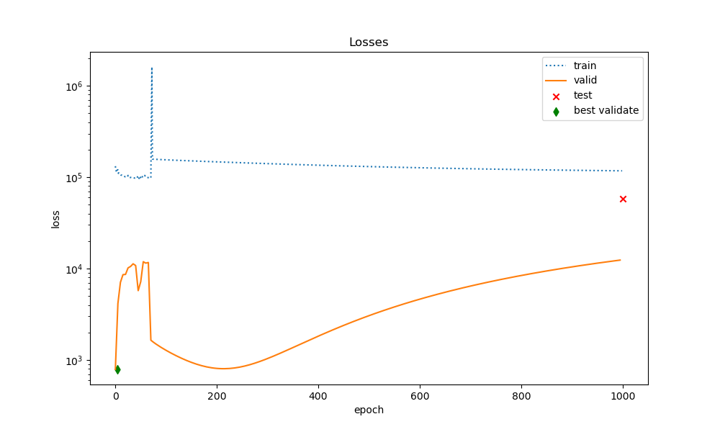
Multi graphs Dataset
SIGN Trainig Loss
Does not converge and hardly learning anything

Slide 8
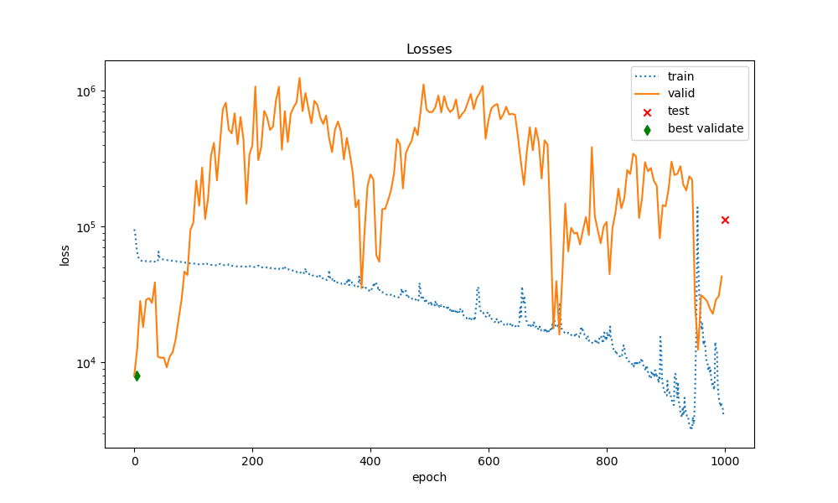
Multi graphs Dataset
GraphUNet Trainig Loss at trainig ratio 0.5
Does not converge and hardly learning anything

Slide 9
Multi graphs Dataset
GraphUNet Trainig Loss at trainig ratio 0.5
Does not converge and hardly learning anything

Slide 10
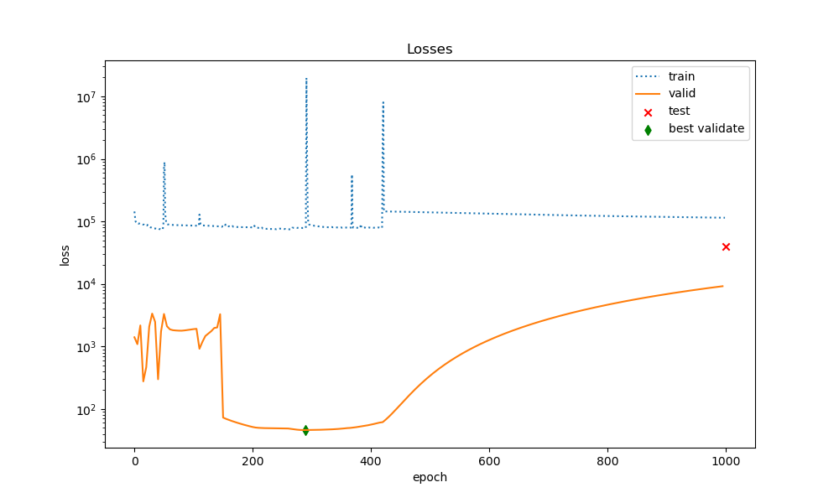
Multi graphs Dataset
GAT Trainig Loss at trainig ratio 0.5
Does not converge and hardly learning anything

Slide 11
Multi graphs Dataset
Conclusion
Problem:
Dataset too small
Solution:
Try physics loss
- strong form PINN
- weak form PINN

Slide 12
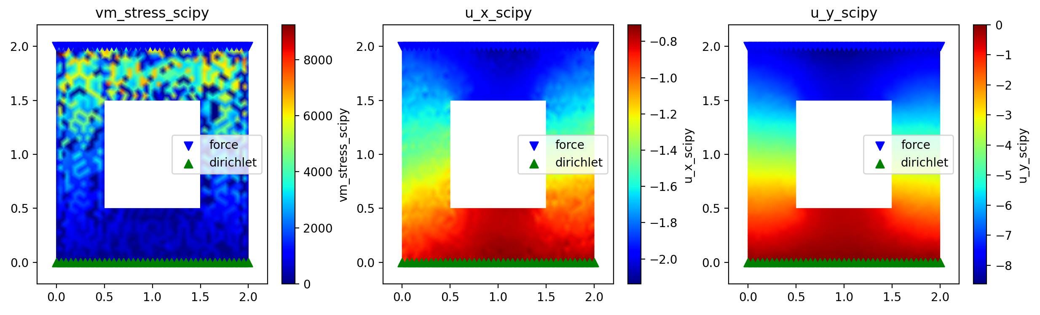
Validate Dataset

Slide 13
SP Summary
Dataset
1d: bridges and roofs
2d: hollow rectangle
3d: hollow sphere
Forward Problem
1. Local Galerkin Linear/Bilinear prediction
2. Global Galkerkin prediction
Backward Problem
1. Dirichlet Equivelance Archtecture
2. Training layout (one graph/multi graphs)
3. Benchmark

Slide 14
1. Forward 1. GNN(ndata, edge_index) - > edata Siren 2. x:nx2 u:n 2. Backward 1. matlab generate data 2. revisit implementation 3. edge_feature relative GNN(from pyg if the y have)

