Slide 1
Process
Risk Taxonomy
Root Cause
Amount in CHF
Team
Business Line
Country
Legal Entity
Date of incident
Description of Incident

Slide 2


Encoder
$$X$$
$$Y$$

Slide 3
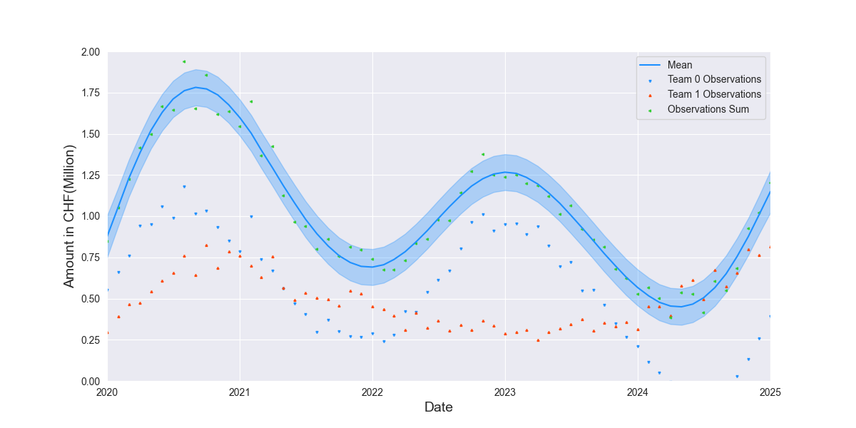

$$Y$$
$$X$$
Encoder

Slide 4

Encoder
$$\tilde{X}$$

Slide 5


$$\tilde{Y}$$
$$\tilde{X}$$
Encoder

Slide 6

$$\tilde{X}$$
Encoder
$$\tilde{Y}$$

Slide 7
Process
Risk Taxonomy
Root Cause
Amount in CHF

