Slide 1
Transformer
Transformer
Transformer
…
Description
Choices
When reporting to the client his quarterly fees …
Operations
Technology

Slide 2
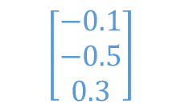
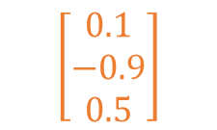
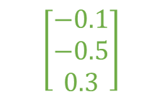
$$\left[\begin{matrix}0.1 \\ −0.9 \\ 0.5\end{matrix}\right]$$
$$\left[\begin{matrix}−0.1 \\ −0.5 \\ 0.3\end{matrix}\right]$$
$$\left[\begin{matrix}−0.1 \\ −0.5 \\ 0.3\end{matrix}\right]$$
Transformer
Transformer
Transformer
…
Description
Choices

Slide 3
0.4
0.7
Transformer
Transformer
Transformer
…
Description
Choices

Slide 4
0.4
0.7
Transformer
Transformer
Transformer
…
Description
Choices

Slide 5
0.4
0.7
$$\left[\begin{matrix}0.1 \\ −0.9 \\ 0.5\end{matrix}\right]$$
$$\left[\begin{matrix}−0.1 \\ −0.5 \\ 0.3\end{matrix}\right]$$
$$\left[\begin{matrix}−0.1 \\ −0.5 \\ 0.3\end{matrix}\right]$$
Transformer
Transformer
Transformer
…
Description
Choices
When reporting to the client his quarterly fees …
Operations
Technology

