Slide 1

Layer0
Conv7x7 S2 P3
MaxPool3x3 S2 P1
In=3x384x512
Out=64x96x128
Layer1
BasicBlock S1
In=64x96x128
Out=64x96x128
Layer2
BasicBlock S2
In=64x96x128
Out=128x48x64
Layer3
BasicBlock S2
In=128x48x64
Out=256x24x32
Layer4
BasicBlock S2
In=256x24x32
Out=512x12x16
height384, width512
Point Head
HeadModule
Conv1x1
In=24x96x128
Out=1x96x128
P1 Projection
ProjectionModule
In=64x96x128
Out=24x96x128
P2 Projection
ProjectionModule
In=128x48x64
Out=24x48x64
P3 Projection
ProjectionModule
In=256x24x32
Out=24x24x32
U4 Upsample
Up Module
ScaleFactor=2
In=512x12x16
Out=24x24x32
Offset Head
HeadModule
Conv1x1
In=24x96x128
Out=2x96x128
Add O3
24x48x64
Add O4
24x24x32
Add O2
24x96x128
U2 Upsample
Up Module
ScaleFactor=2
In=24x48x64
Out=24x96x128
U3 Upsample
Up Module
ScaleFactor=2
In=24x24x32
Out=24x48x64
WH Head
HeadModule
Conv1x1
In=24x96x128
Out=2x96x128

Slide 2
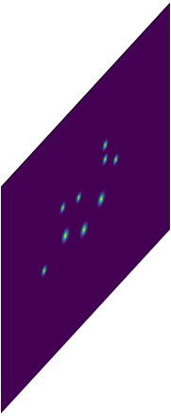
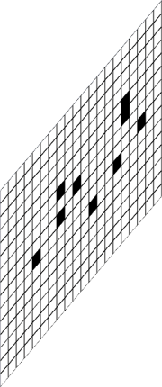
3个head，Point、Offset、WH时
point回归的是有目标，则在其中心放置高斯点（中心位置为1）
的目标heatmap图
obj.cx和obj.cy转换到heatmap大小时，坐标必须整数，也因此
cx，cy存在损失
Point Head
HeadModule
Conv1x1
In=24x96x128
Out=1x96x128
oxoy回归的是obj的中心偏移量误差值
即obj.x在原图384x512上的坐标，缩放到
96x128并转化为整数时的精度损失
stride = 4，// 为整除
ox = obj.cx / stride – obj.cx // stride
oy = obj.cy / stride – obj.cy // stride
Offset Head
HeadModule
Conv1x1
In=24x96x128
Out=2x96x128
ox
oy
WH Head
HeadModule
Conv1x1
In=24x96x128
Out=2x96x128
wh回归的是obj.width和obj.height
除以stride进行norm
w = obj.width / stride
h = obj.height / stride
w
h

Slide 3
2个head，Point、Coordinate时
point回归的是有目标，则在其中心放置高斯点（中心位置为1）
的目标heatmap图
obj.cx和obj.cy转换到heatmap大小时，坐标必须整数，也因此
cx，cy存在损失
Point Head
HeadModule
Conv1x1
In=24x96x128
Out=1x96x128
Coordinate Head
HeadModule
Conv1x1
In=24x96x128
Out=4x96x128
coordinate直接回归以当前点为中心时的dx, dy, dr, db
dx = obj.x / stride – cell_x
dy = obj.y / stride – cell_y
dr = obj.r / stride – cell_x
db = obj.b / stride – cell_y
dx dy dr db

