Slide 1
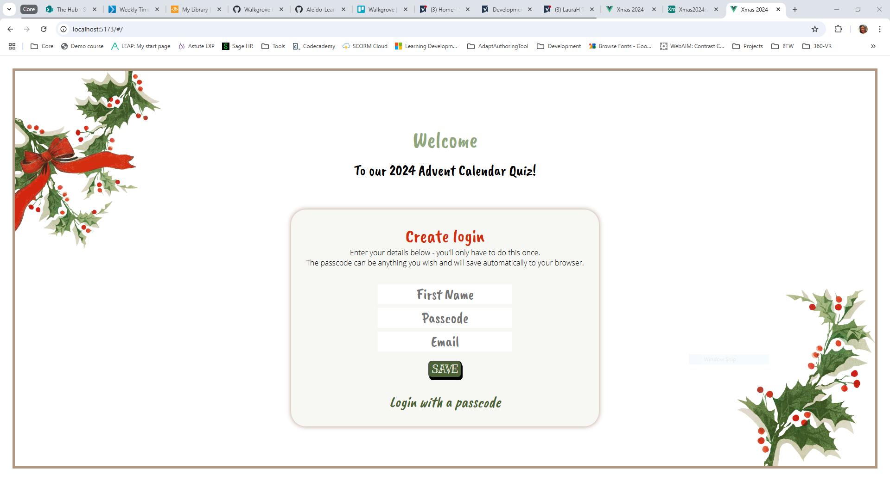
Create a login …

Slide 2
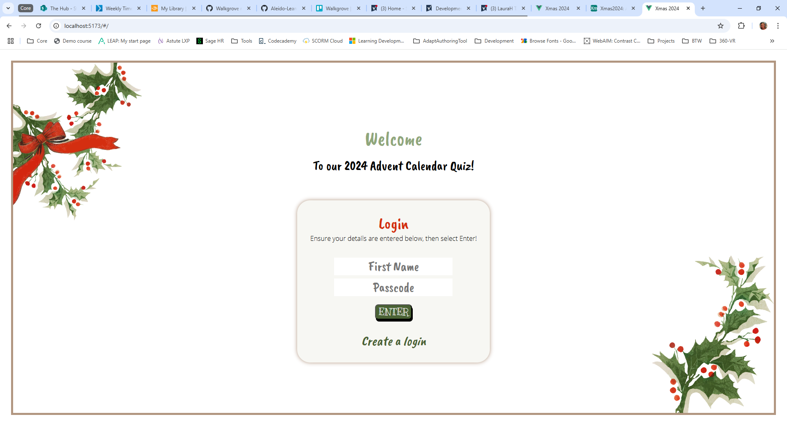
Or login (if you’ve previously created one)…

Slide 3
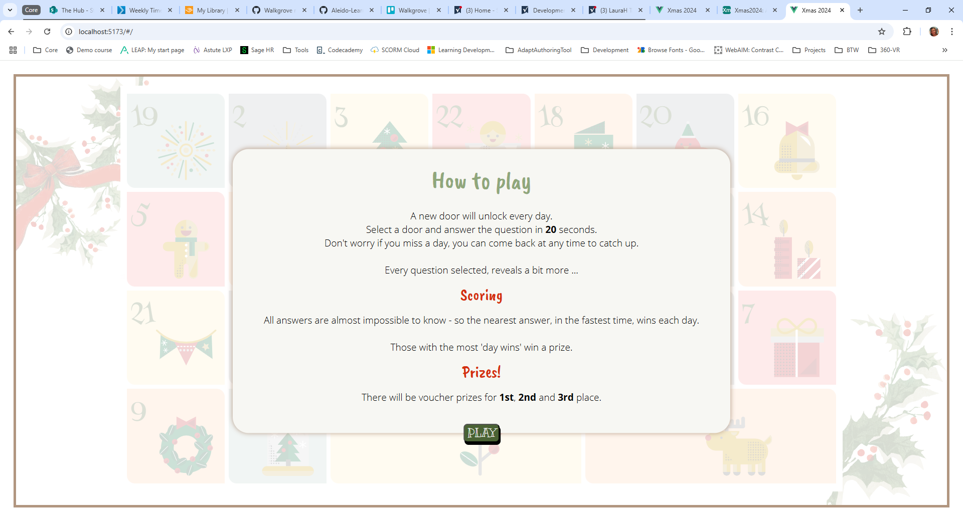
The info

Slide 4
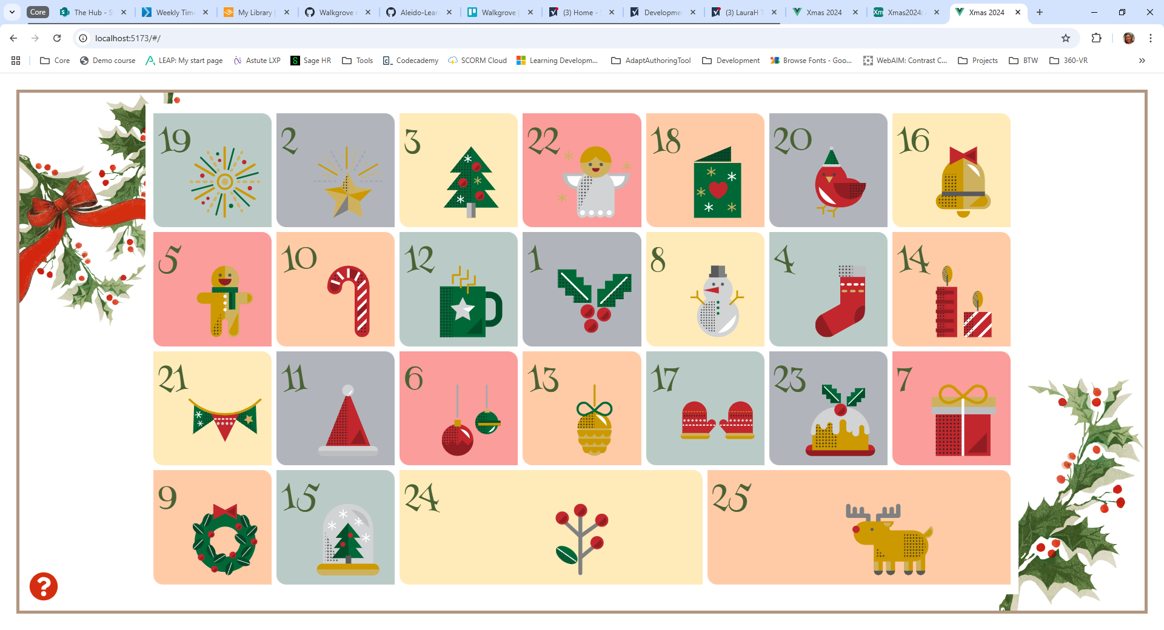
The advent calendar

Slide 5
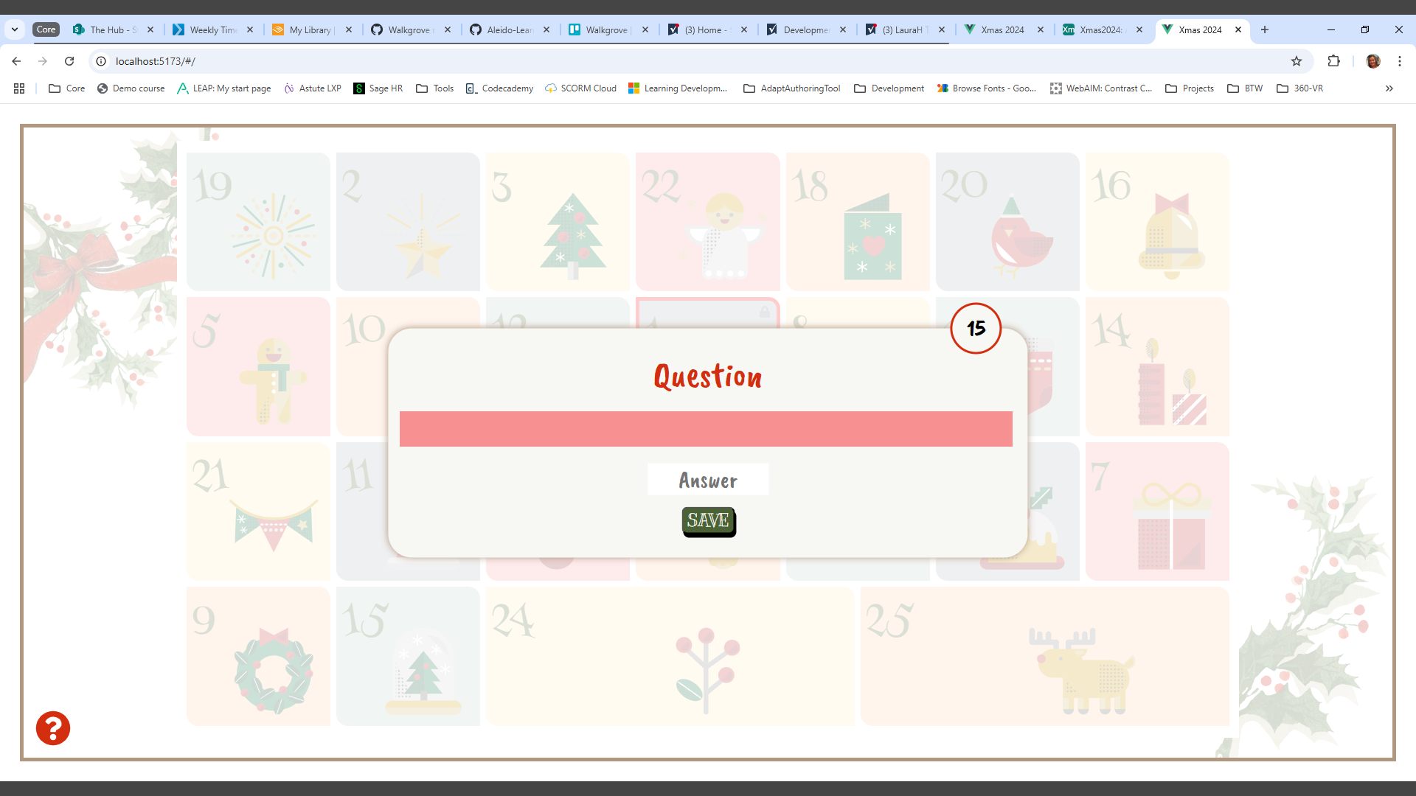
Answer a question
- red so no previews! ;0)

Slide 6
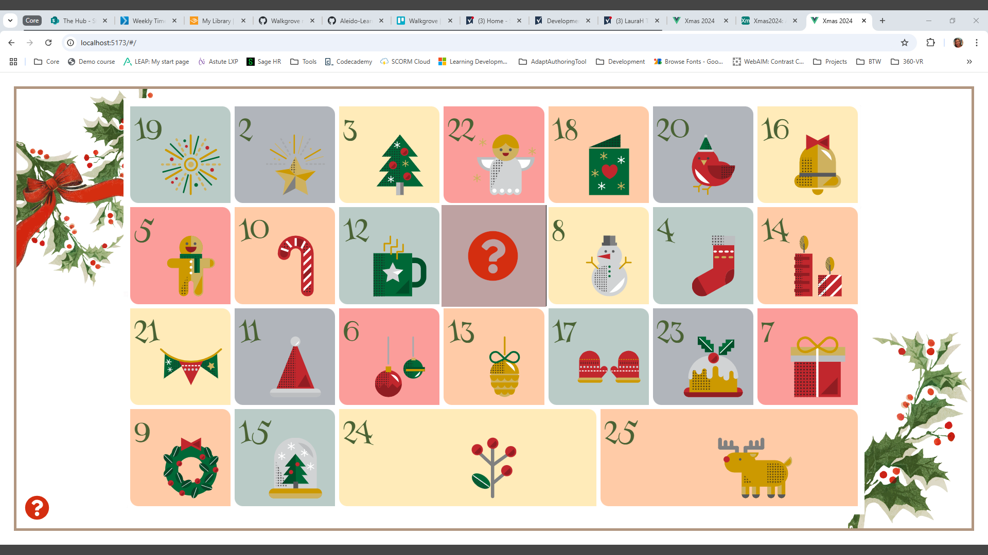
When a door is selected, it is removed to reveal part of the image below

Slide 7
