Slide 1
Travel Agency Management System
Make Your Tour
Submitted by
Shawon Lodh 160104064
Somaia Afrin 160104066
Md. Ruhul Amin 160104070

Slide 2
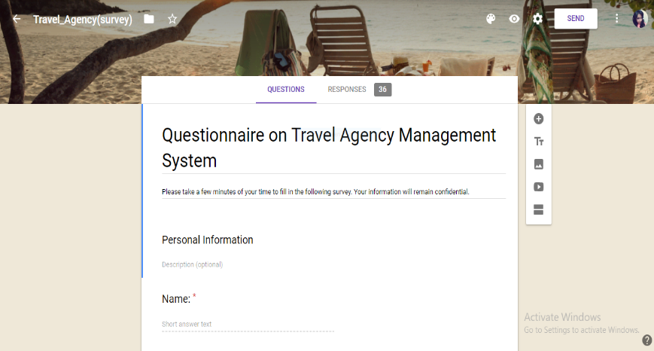
Sampling Decisions
We have undertaken target-oriented method for sampling.
Google form
We have used Facebook, Twitter, Direct E-mail, messages, colleges, universities for getting our data from users.

Slide 3
Sample Design
Sample Size: The sample size selected for the research is 36.
Parameters of Interests: The major parameter of interest is the subgroup of people having an interest in travelling & experience in any travel management system.
Sampling Technique: The sampling size selected for the research is Random sampling technique.

Slide 4
Data Collection Tool Used
The data collection tool used for the research is “Questionnaires” to get the primary data for the empirical research on user preference on manual and online process for our project Travel Agency Management System.

Slide 5
Questionnaire On Travel Agency Management System
Personal
Demo-graphic
Project related

Slide 6
Data Analysis – Gender
The above diagram depicts that out of the total 36 respondent 61.10% of the respondent were male as the objective was to study the consumer behavior with respect to travelling, as male respondents travel more.

Slide 7
Age Brackets
The 58.30 % of the respondent were among 18-24 age bracket as these respondents travel most and well known about it.
Also 27.70% of the respondent were among 25-30 age bracket as these respondents travel second highest most.
Other 8.30% and 5.50% of the respondent were ranging from 25-30 and 31-40 age bracket.

Slide 8
Occupation
For the research to be successful most of the respondent are working as students who are educated.
The Second highest number of the respondent are the businessman.
Rest of the people are such as govt employee, service holder, doctor etc.

Slide 9
Most Visited Travelling Spots
The above diagram depicts that the highest number of tourist places are beaches in accordance with maximum number of people.
Historically significant places are the second number of place for travelling.
The third most place for travelling is chosen for Hill stations along with other places like deserts and commercially busy places.

Slide 10
Approximate Budget
The above diagram clearly depicts that maximum people choose the amount of money ranging from 5000-10000 for their tour which is almost reasonable for any tour.
Some people want to complete tour ranging below 5000.
Besides a few people have a budget ranging 10000-20000 for their tour where very few people choose a big budget for their tour above 20000.

Slide 11
Preferable Transport
The above diagram clearly depicts that most of the people prefer Bus or Coach Services because it is the easiest way for travelling.
Some people prefer Railway but a few people prefer Air Travel & personal Transportation for flexible moving.

Slide 12
Preferable Accommodation
The above diagram clearly depicts that highest number of people prefer the comfort zone in case of accommodation.
They also prefer secured and hygienic accommodation because every person should be ensured security as a must for their better lives.

Slide 13
Preferable Restaurant
The above diagram clearly depicts that most of the people prefer popular restaurant in time of travelling.
Besides they also want medium and high priced and hygienic restaurant as a must. It proves that they prefer such a restaurant with over all a better quality.

Slide 14
Tour with travel agency and how many times?
The above diagram depicts that the highest number of people travel through a travel agency once a year.
Few people travel twice a week and rest of the people travel whenever they got time.

Slide 15
Factors for travel agency
The above diagram depicts that the highest number of people prefer security for choosing a travel agency as security is a must for any kind of system.
The rest of the people give equal importance in price and services from travel agency.

Slide 16
Data Analysis- Preferable Services
The above diagram depicts that most of the people selected the service quality as a must of a travel agency.
Besides they also gave priority to honest review, security, customer services as a must for best performance.
Along with those, they prefer multiple packages, price, transaction must need for best performance.

Slide 17
Issues regarding Online travel agency management system
The above diagram clearly depicts that most of the people always in fear for fake intention, forgery & security issues.
Besides some people are irritated for the commission quantity & a few people thinks the online process as a painful thing.

Slide 18
Benefit of travel agency Management System
The above diagram clearly depicts that most of the people wants the online system for saving their valuable time & maximum people also prefer to avoid long queues.
Besides some people wants to get a list of packages of tour in their hand at a time & also for the discounts & special offers.

Slide 19
Over All Findings
Most visited Travel Place
Beaches
historically significant places
Transportation
Bus route
Accommodation
Comfortable
hygienic living space
Hill stations
Railway route
air travel or personal transport
Secured

Slide 20
Over All Findings(Cont.)
Restaurant
Popular
Medium-priced
Hygienic
Budget
5000-10000
Or
Below 5000
Familarity with Travel agency
Maximum are not familiar.

Slide 21
Over All Findings(Cont.)
Factors For Travel Agency
Price
Security
Service
Regarding Issue
Fake intention
Forgery & Security
Higher commission quantity
Why Beneficial?
Save valuable time & easy access
Avoid long queues

Slide 22
Conclusion
The interview and survey process gave us the opportunity to visit and interview different people and helped us a lot to know what users actually want from a travel agency which contains information of such things related travel. These information and data will help us to design a management system according to user choice and make our work easier.

Slide 23

Thank You
Any Queries?

