Slide 1
Travel Agency Management System
Make Your Tour
Submitted By
Shawon Lodh 160104064
Somaia Afrin 160104066
Md. Ruhul Amin 160104070

Slide 2

Project Motivation
In normal online travel agency system, users need to buy default packages for a tour. For this sometimes the packages can’t fulfill all the requirements of users.
Suppose you have a group of members and want to go to a tour. But you have to choose default packages provided by the travel agency. But you can’t customize it. Our motivation comes from that.
We have given users this opportunity that users can create his/her own packages according to their choice. It can be any kind of criteria like no of passengers, transport medium, desired hotel etc.

Slide 3

List of Primary Actors
Guest user
Member user
Admin

Slide 4
List of Secondary Actors
Telecommunication service
Mailing service
Social networking service
Payment service
Printer service
Transport company
Hotelier
Govt Agency

Slide 5
Use cases according to the Primary Actors

Slide 6
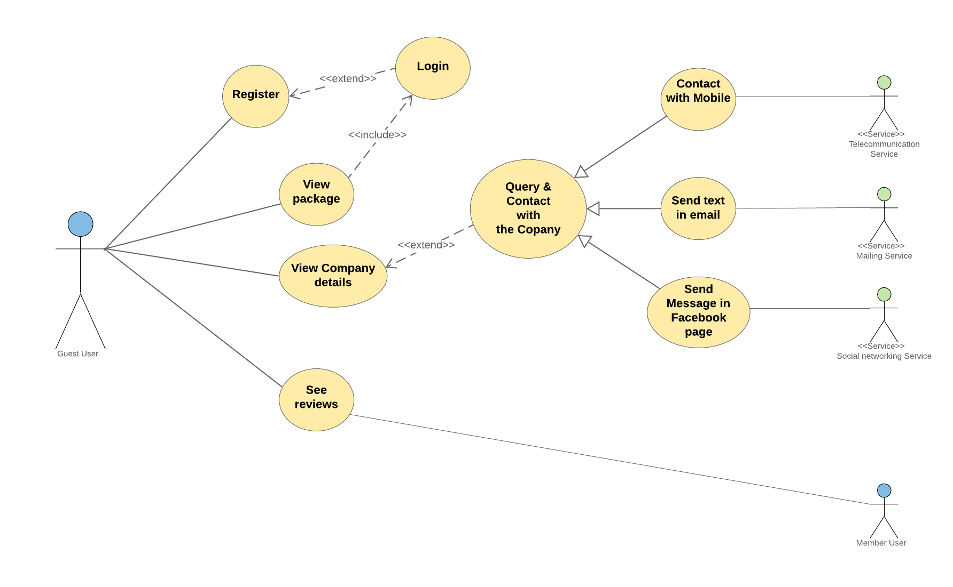
Use case diagram according to guest users
Guest user can register and view packages as well as query and contact with the agency
Can see the review of the member user

Slide 7
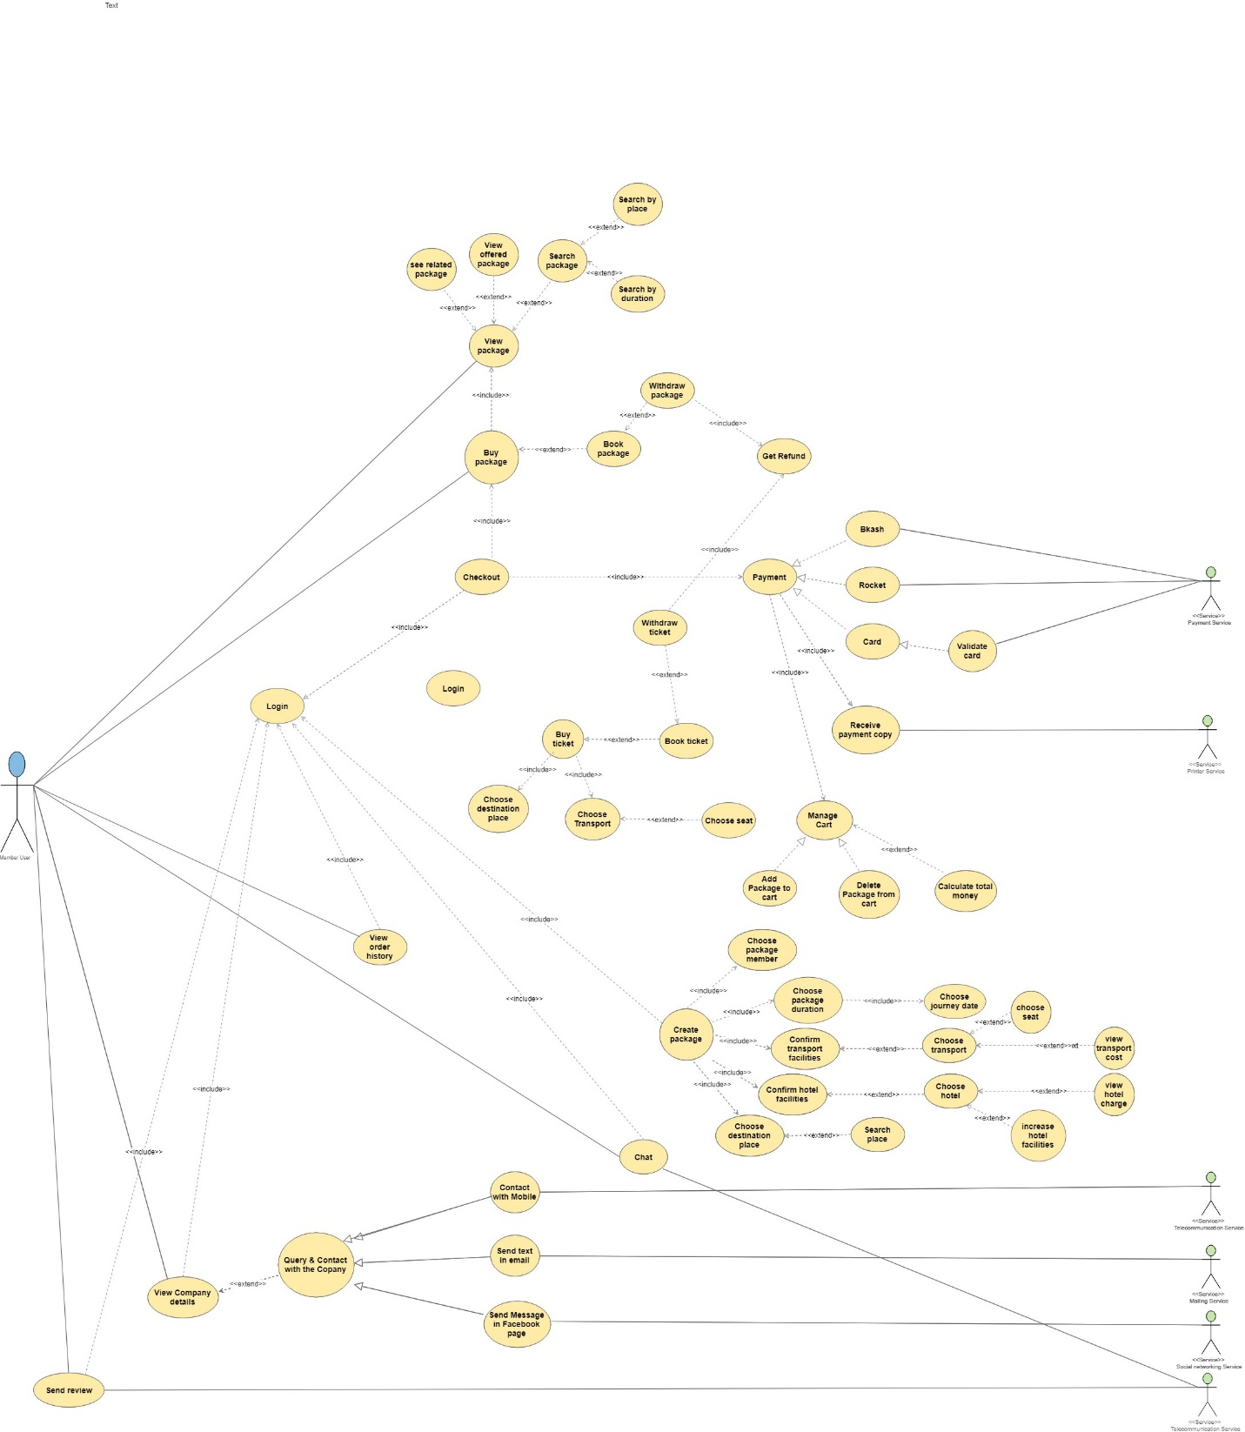
Use case diagram according to member users

Slide 8
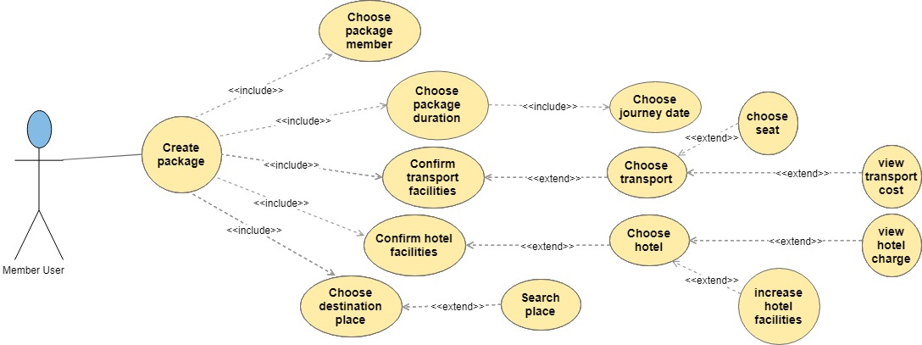
Use case diagram according to member users
Member users can create package according to their choice.
They can customize transport medium, seat number, desired hotel
They can see also hotel charge and transport cost which they will choose

Slide 9
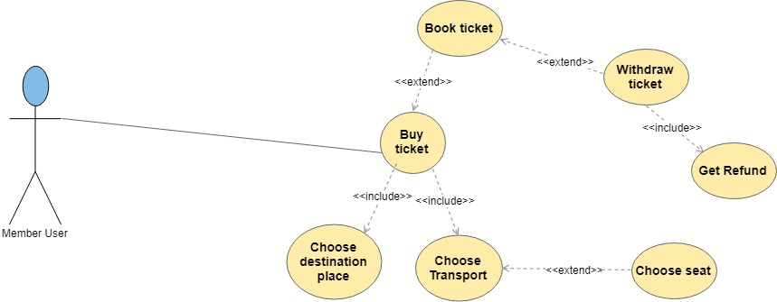
Use case diagram according to member users
Member users can withdraw ticket after booking
They can also get refund

Slide 10
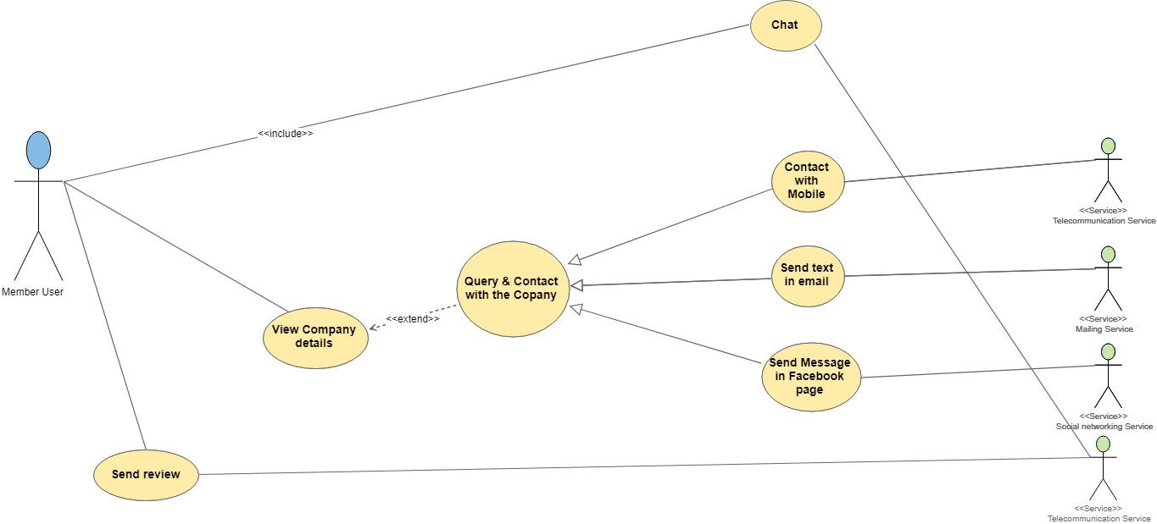
Use case diagram according to member users
Member users can view the agency details and communicate with them via phone call, text message and e-mail etc.
Can send review to the admin.

Slide 11
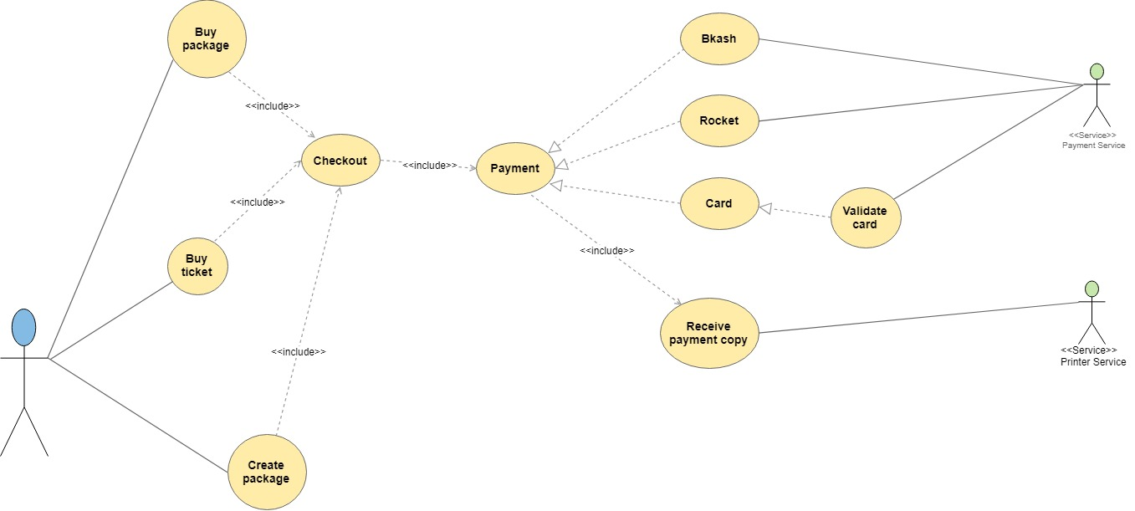
Use case diagram according to member users
After booking any package or ticket, members can pay over online
They can pay through Bkash, Rocket and Card
They will get a receipt after their payment for confirmation.

Slide 12
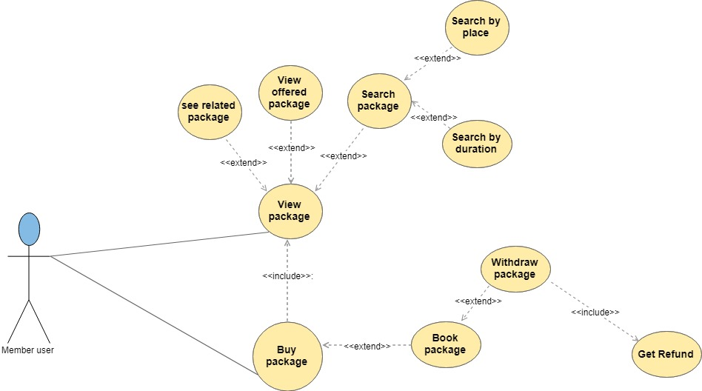
Use case diagram according to member users
Members can see offered packages
Can search packages based on the place and the duration
Can also withdraw package and get refund

Slide 13
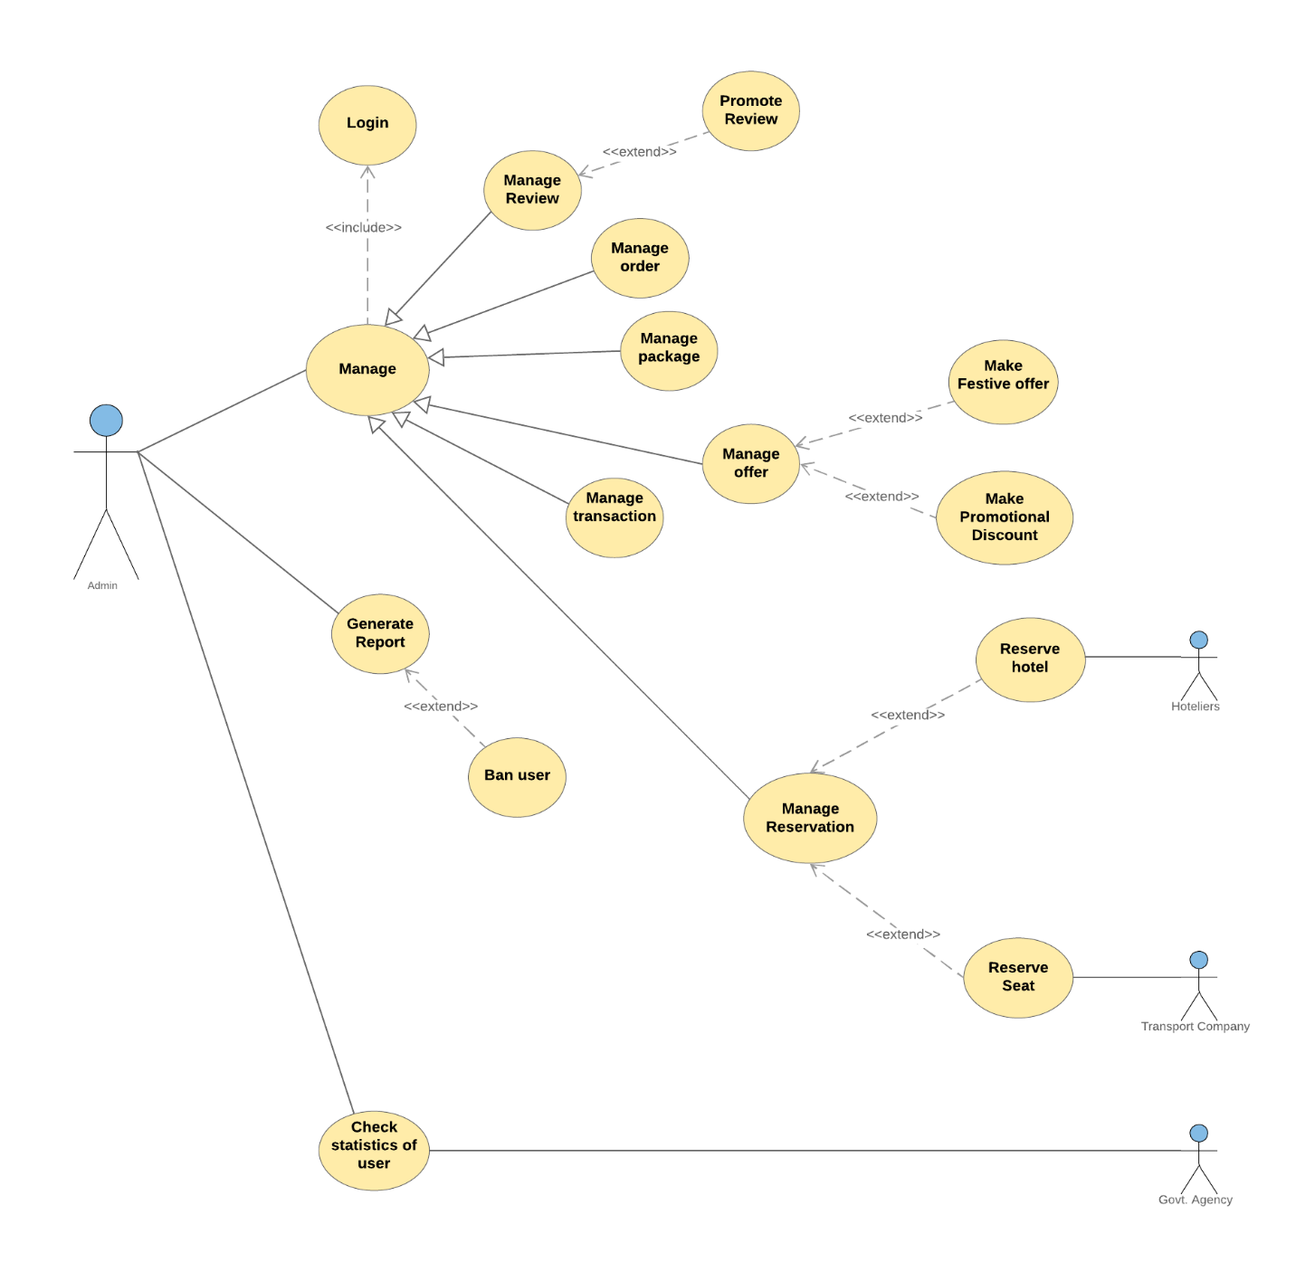
Use case diagram according to admin
Admin can manage order, packages, transactions etc.
Can reserve seat for transport and hotel accommodation.
Can generate report and check statistics of the users.

Slide 14
Class Diagram

Slide 15
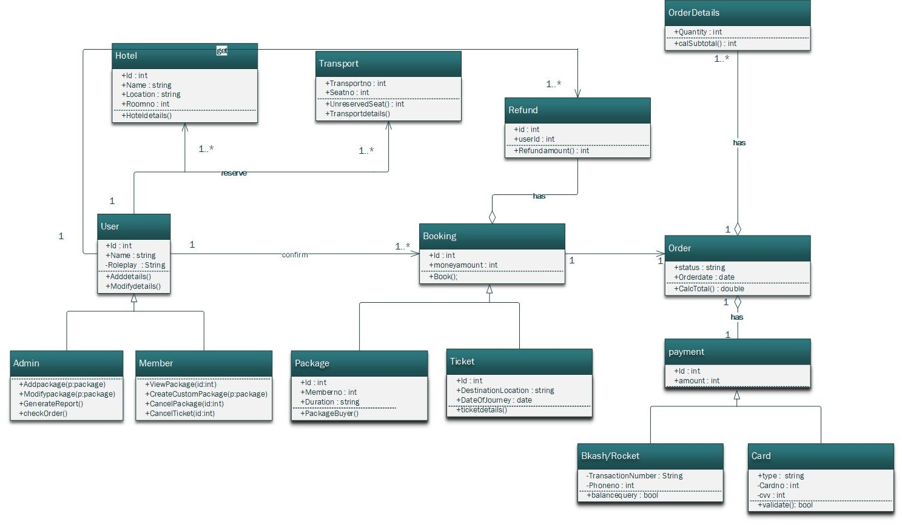

Slide 16
Thank You

