Slide 1
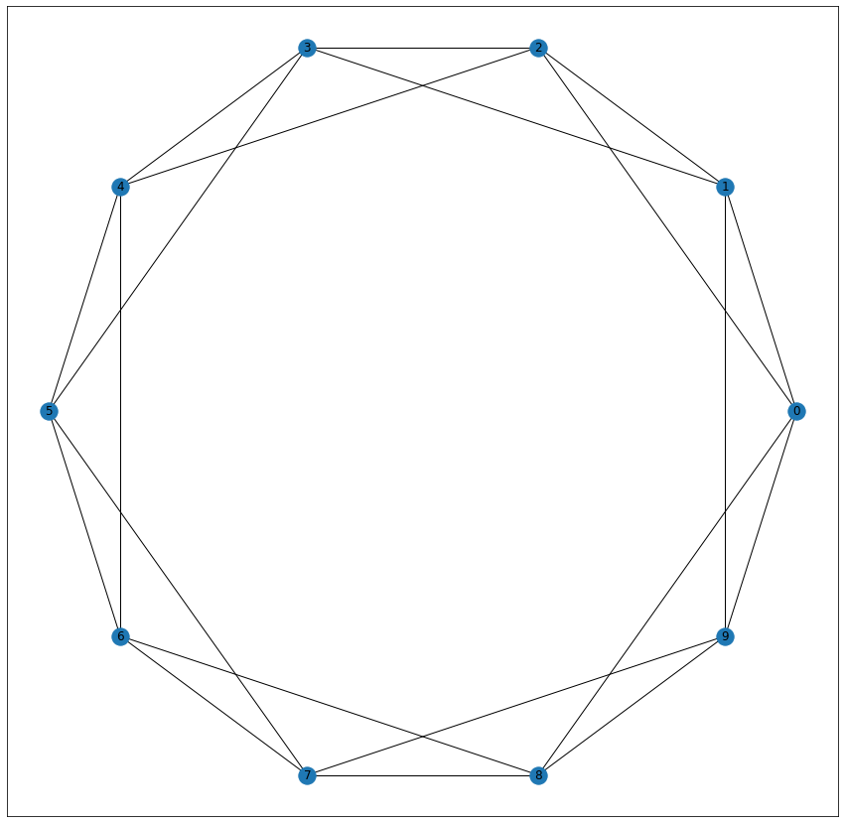
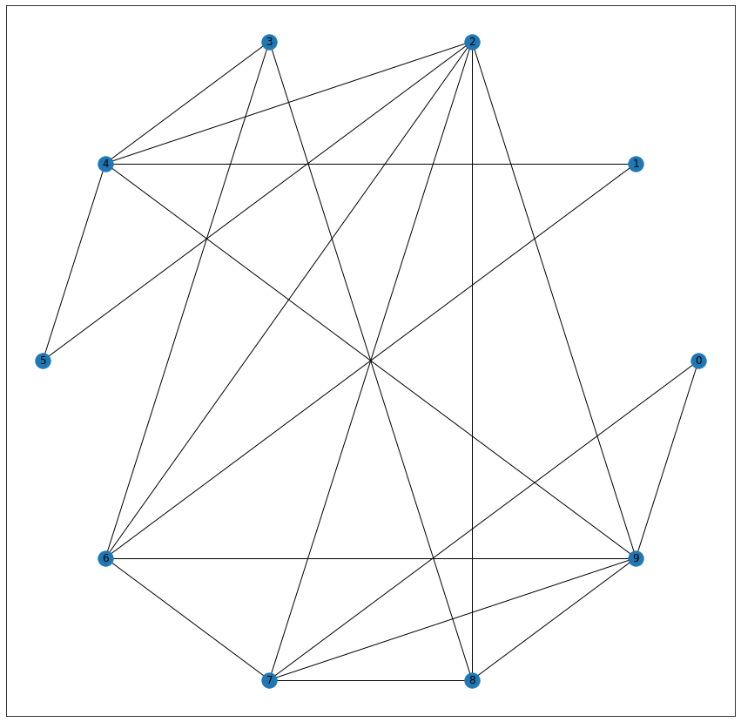
Watts Strogatz Graph
watts_strogatz_graph(n, k, p, seed=None)
共 n 個點
每新增一個節點就會生出 k 條邊連接最近的鄰居
有 p 機率重新連接既有的邊，(u, v)->(u, w)
當p = 0 當p = 1
high distance low distance
high cluster low cluster
Duncan J. Watts and Steven H. Strogatz, Collective dynamics of small-world networks, Nature, 393, pp. 440–442, 1998.

Slide 2
Barabasi-Albert Model
Growth -> the number of nodes in the network increases over time.
Preferential attachment -> the more connected a node is, the more likely it is to receive new links.
barabasi_albert_graph(n, m, seed=None, initial_graph=None)
共 n 個點
每新增一個節點就會生出 m 條邊，新節點為 start，用 preferentially attached 找 end
A. L. Barabási and R. Albert “Emergence of scaling in random networks”, Science 286, pp 509-512, 1999.

Slide 3
Powerlaw Cluster Graph
powerlaw_cluster_graph(n, m, p, seed=None)
共 n 個點
每次為新節點隨機新增m條邊
------------------以上類似 BA---------------------
有 p 的機率在新增邊後，創造三角形
可能是非連通圖
P. Holme and B. J. Kim, “Growing scale-free networks with tunable clustering”, Phys. Rev. E, 65, 026107, 2002.

Slide 4
Watts Strogatz Graph
n: 1M m: 12M | p = 0.01 | p = 0.5 | p = 1
平均的局部聚集係數 | 0.662 | 0.0862 | 0.0000114
三角形比例法的聚集係數 | 0.661 | 0.0825 | 0.0000112
吉尼係數 | 0.00893 | 0.0986 | 0.114
度數相關性 | -0.00052857 | -0.0307 | -0.040375

Slide 5
Powerlaw Cluster Graph
n: 1M m: ~<12M | p = 0 | p = 0.5 | p = 1
平均的局部聚集係數 | 0.00017 | 0.14187 | 0.371
三角形比例法的聚集係數 | 0.00012 | 0.008 | 0.0194
吉尼係數 | 0.3578 | 0.372 | 0.3548
度數相關性 | -0.00584 | -0.0172 | -0.0119

