Slide 1
Blood Bank Management
Requirement for HaMSa
By
Walking Tree

Slide 2
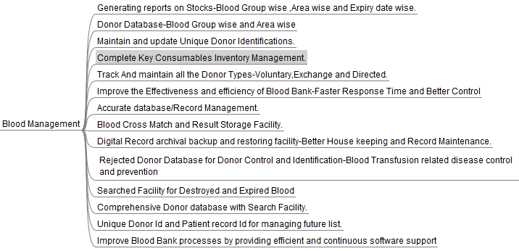
Initial MindMap

