Slide 1








BI Developer and Analyst
Activity Modeller
Business Rule Editors
BRE
SAP Consultant
BAM Server
BI System
Internet
Firewall
Third party interfaces
WTC-HCIS
Nurses, Doctors, Administrators, Chefs, Pharmacy
Administrator, Patients, Doctors, Nurses, etc

Slide 2
Security Management
UI Layer
Web service Layer
Audit/Logging
Transaction Management
API Layer
Core
(Business Layer)
Report Layer
Data Access Layer
HCIS Database

Slide 3
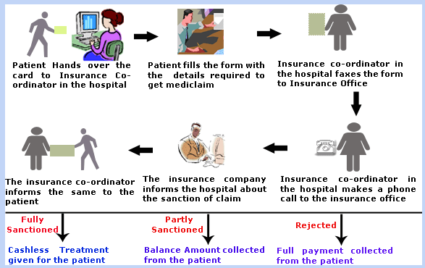
Insurance

Slide 4
Managing Referral
Do not need to configure referring doctor’s detail
NO
Patient takes appointment and specifies the referring doctor’s name
Appointment Confirmed?
YES
Configure referring doctor’s detail including his account number for any financial transactions with him.

Slide 5
Managing Referral
Health care provider is able to manage the referring doctor’s details
Create, Read, Update and Delete referring doctor
Configure charges
Absolute amount or
Percentage amount
Provider is able to
view account details of the referring doctor
appointments referred by the doctor
Treatment performed by the referring doctor
Provider is able pay the referral charges
create charges for a period
store the period information to ensure that referal charges are not paid again for the same period
create payable in the systems
Provider makes payment to the referring doctor to partially or completely close the payables

