Slide 1

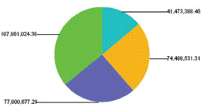
Services
HCIS UI Layer
HCIS Web services
Role-based Security Aspect
Transaction Aspect
Logging & Audit Aspect
Log files
Admin Mgmt
Outpatient
Inpatient
Financials
Material Mgmt
Pharmacy
Other Modules
Data Access Objects
Reports
Business Activity Monitoring
HCIS Database
Analysis Cubes
ETL Jobs
Dashboard

Slide 2
Background Processing
Services
VMS UI Layer
VMS Web services
VMS API & Business Layer
VMS Database
BVG Job
Batch files
GenDistFile Job
Job
E-mail
E-mail
CD
Distributor files
DistributeFiles Job
FraudMonitor Job
RSS Feed
FTP, sFTP, HTTPS

