Slide 1
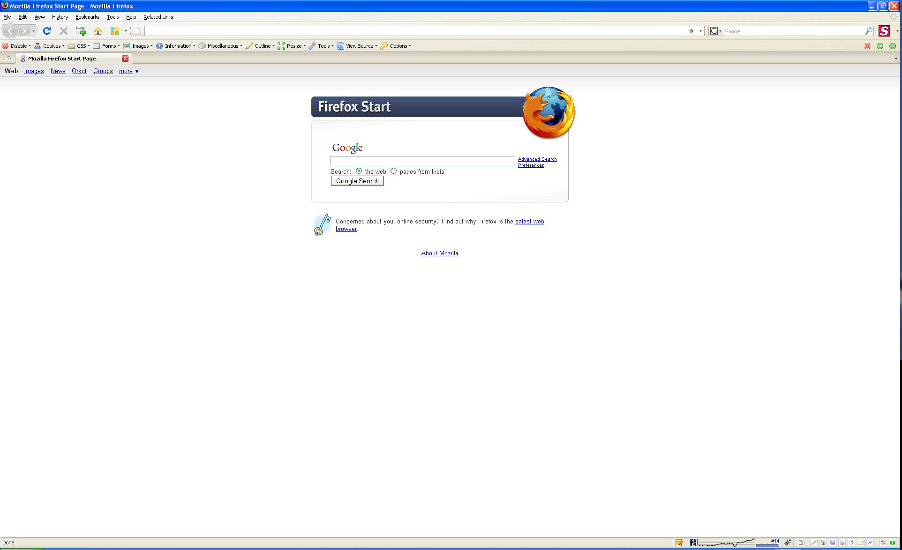
User login
Username:*
Password:*
Remember me
Lost password?

Slide 2
User logs in as Administrator

Slide 3











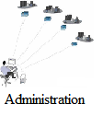
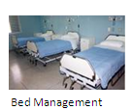




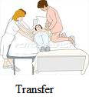
Welcome: <first name> <last name>
Home
Miscellaneous
Reports
Settings
Help
Change Password
Logout
Manage Doctor

Slide 4






Welcome: <first name> <last name>
Home
Miscellaneous
Reports
Settings
Help
Change Password
Logout
Configuration
Manage Password Profiles
Manage Users
Manage Roles
E-mail Templates

Slide 5
Patient Management
This module captures complete and relevant patient information, which helps in automating the patient administration functions to have better and efficient patient care process. The patient management provides features for enquiries about the patient, the patient's location, admission, appointment scheduling and discharge details. This system also takes care of the insurance/sponsor details of the patient.
Patient Registration
Patient registration is the first step whenever a new patient (Inpatient as well as Outpatient) comes into the hospital.
There are two types of registration
Normal registration
Emergency registration
Later on the emergency registration can get converted into a normal registration
Issue a patient visit slip
Patient can have one or more attendant (usually decided by the hospital)
Managing visit slip for patient and attendant

Slide 6
Patient Management
Patient usually consults a doctor after the registration. So, following actions are common:
Fixing an appointments with the desired consultant
Patient Wise
Doctor wise
Date Wise
Doctor's Schedule Summary
Doctors Daily Schedule List
In addition, patients should be able to take appointments for Follow-ups and Radiology tests
If patient is already registered then he/she can take appointments in three ways:
Through telephone
Through online booking
In-person
The Patient History
Patient Visit History
Medical Records Management and movement details

Slide 7
Patient Management
Sponsorship Details
Insurance company name
Insurance product
Known Allergies
Food
Medicine
Value Added Services
Medical Alerts
Radio Frequency Identification (RFID)

Slide 8
Welcome: <first name> <last name>
Home
Miscellaneous
Reports
Settings
Help
Change Password
Logout
Registration
Appointments
Outpatient
Inpatient
History
VAS
New Registration
View/Edit Registration
Transfer Emergency to Normal
Patient Management

Slide 9
Patient Management Window
Home → Patient Management → View/Edit Registration → Personal Details
Welcome: <first name> <last name>
Home
Miscellaneous
Reports
Settings
Help
Change Password
Logout
Registration from:
mm/dd/yyyy
Registration to:
mm/dd/yyyy
Patient Last Visited:
After
mm/dd/yyyy
First Name :
Alok
Last Name :
Ra
Marital Status:
Father/Husband Name :
Registration Status:
Active
Sex :
Male
Search
Age :
Patient ID :
Phone Number :
 | Patient ID | Name | Age | Last Visited | Registration Date | Registration Status | Registration Type | <<Other Details>>
 | 230002232 | Alok Ranjan | 31 Y | 04/02/2008 | 01/03/2008 | Active | Normal
 | 0002233 | Alok Rathore | 06 M | 04/02/2009 | 01/03/2009 | Active | Emergency
v
v
New Patient
View/Edit
Print Visit Slip
Print Reg. Card
View Appointments
View/Configure Alerts
View History
Print Attendant Slip
Remove
Emergency to Normal
Notes:
Registration Date, Type and Number will not be editable
The registration can be in following status
Active
Suspended
Canceled
Patient Rating will be initially set to “Regular”. Based on his usage of services and payments history, he/she can be moved to “Silver”, “Gold” and “Platinum” customers
The patient last visited (before/after) date allows searching for patients based on the visit date
New Patient Registration button will remain enabled all the time
View/Edit, View History, Print Visit Slip and View Appointments button will be enabled after selection of one and only one patient record.
Remove button will be enabled after selection of one or more patient record.
Emergency to Normal button will be enabled after selection of a patient with registration type “Emergency”

Slide 10
Welcome: <first name> <last name>
Home
Miscellaneous
Reports
Settings
Help
Change Password
Logout
Registration
Appointments
Outpatient
Inpatient
History
VAS
New Registration
View/Edit Registration
Transfer Emergency to Normal
Patient Management

Slide 11

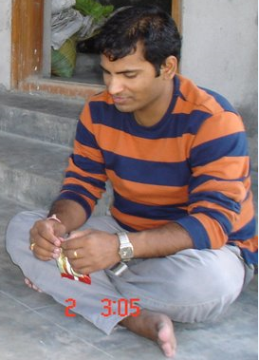
Patient Registration Window
Home → Patient Management → New Registration → Personal Details
Welcome: <first name> <last name>
Home
Miscellaneous
Reports
Settings
Help
Change Password
Logout
Personal Details
Contact Details
Emergency Contact
Sponsors
Other Details
Reg. Date :
mm/dd/yyyy
Reg. Type :
Emergency
Reg. Number :
1232132
Patient Photo :
Title :
Mr
Registration Status:
Active
First Name * :
Alok
Last Name :
Ranjan
Gold
Middle Name :
Patient Rating
Sex :
Male
Patient Category
Management Discount
Date of Birth * :
Age :
Years
Months
Days
04/04/1978
31
0
24
(+) Additional details
-----------------------------------
Marital Status:
Married
Height:
171 CM
Father/Husband Name :
Arun Kumar Thakur
Weight
83 Kg
Blood Donor ID :
56232886
ID Proof:
Passport Number
Blood Group
O+
ID No. :
Z232886
Religion :
Hindu
Valid Upto :
02/01/2012
Mother Tongue:
Hindi
Patient Occupation
Director
Referred By
Sandeep Kumar
Monthly Income
25400
Cancel
Reset
Save
Notes:
City field will have auto complete feature

Slide 12
Patient Registration Window
Home → Patient Management → New Registration → Contact Details
Welcome: <first name> <last name>
Home
Miscellaneous
Reports
Settings
Help
Change Password
Logout
Personal Details
Contact Details
Emergency Contact
Sponsors
Other Details
Current Address
Permanent Address
Same as Current Address
House Name/No * :
F-503, Block-12, Rain Tree Park
House Name/No * :
F-503, Block-12, Rain Tree Park
Place/Street * :
Malaysian Township, Kukatpally
Place/Street * :
Malaysian Township, Kukatpally
Country * :
India
Country * :
India
State * :
Andhra Pradesh
State * :
Andhra Pradesh
City/District * :
Hyderabad
City/District * :
Pin Code * :
50073
Hyderabad
Duration of Stay :
Years
Pin Code * :
50073
2
Duration of Stay :
2
Years
Phone Number :
04066881253
Phone Number :
04066881253
Mobile Number:
919848473539
Mobile Number:
919848473539
Fax Number :
04065881253
Fax Number :
04065881253
Email Address :
alok.ranjan@walkingtree.in
Email Address :
alok.ranjan@walkingtree.in
Cancel
Reset
Save
Notes:
City field will have auto complete feature

Slide 13
Patient Registration Window
Home → Patient Management → New Registration → Emergency Contacts
Welcome: <first name> <last name>
Home
Miscellaneous
Reports
Settings
Help
Change Password
Logout
Personal Details
Contact Details
Emergency Contact
Sponsors
Other Details
Title :
Mr
Address of Emergency Contact
Same as Patient’s Current Address
First Name * :
Ajit
House Name/No * :
1st Floor, 201, RK Nagar
Last Name :
Kumar
Place/Street * :
West Marredpally
Middle Name :
Country * :
India
State * :
Andhra Pradesh
Sex :
Male
City/District * :
Secunderabad
Pin Code * :
50083
Phone Number :
04027716612
Duration of Stay :
4
Years
Mobile Number:
919441955210
Fax Number :
04065881253
Email Address :
ajit.kumar@walkingtree.in
Relationship with patient:
Friend
Add Secondary Contact Details (+)
Cancel
Reset
Save
Notes:
City field will have auto complete feature

Slide 14
Patient Registration Window
Home → Patient Management → New Registration → Sponsor
Welcome: <first name> <last name>
Home
Miscellaneous
Reports
Settings
Help
Change Password
Logout
Personal Details
Contact Details
Emergency Contact
Sponsors
Other Details
Sponsor Type :
Third Party Administrators
House Name/No * :
H No:6-2-984,
Sponsor Name:
Place/Street * :
Khairatabad
Paramount Health Group
Country * :
India
Insurance Company:
Future Generali India Insurance
State * :
Andhra Pradesh
Policy Type :
Individual
Group
City/District * :
Hyderabad
Policy No. :
40332322323
Pin Code * :
50004
Effective From :
04/01/2009
Phone Number :
04066366721
Mobile Number:
919848473539
Effective To:
03/31/2010
Fax Number :
04065881253
Company:
Walking Tree Consultancy
Email Address :
pjohn@phmhealth.com
Sponsor Status:
Active
Sum Insured:
200000
Premium Amount:
3000
Sum Already Exhausted:
67000
Mediclaim Percentage:
80 %
Add zero or more sponsors for the patient (+)
Cancel
Reset
Save
Notes:
The address will be automatically selected from the sponsor details configured into the system
Employer name should be automatically populated
The system should allow configuring more than one sponsors for the patient
Some already exhausted will give some idea about whether patient has enough coverage or not. However, this is not necessarily the correct figure as patient may visit other hospitals as well
The secondary contact will have similar information, as we have for the primary contacts

Slide 15
Patient Registration Window
Home → Patient Management → New Registration → Other Details
Welcome: <first name> <last name>
Home
Miscellaneous
Reports
Settings
Help
Change Password
Logout
Personal Details
Contact Details
Emergency Contact
Sponsors
Other Details
Patient doesn’t have any known allergy
Unable to obtain information from patient or family
Patient has known allergies
(-) Known Allergy
Itchy ears and throat
allergic conjunctivitis
Smoking habit
Don’t Smoke
Drinks alcohol
Don’t Drink
Fitness Activity
Yoga
Food Preference
Morning Tea :
Breakfast :
Lunch :
Snacks :
Tea :
Dinner :
Cancel
Reset
Save
Notes:
An allergy refers to a misguided reaction by our immune system in response to bodily contact with certain foreign substances. It is misguided because these foreign substances are usually harmless and remain so to nonallergic people. Allergy-producing substances are called "allergens."
Allergy Information shall serve as the official database for in-patient allergy information and shall be referred to for allergy information requests
Known Allergy will allow user to add one or more allergy and corresponding category
Patient Care Providers shall update this information any time that the patient presents with a new allergy. Click on (+) symbol against the last allergy to add more entries
There are two categories of allergies
Category A include anaphylaxis, rash and other significant reactions to the medication
Category B are side effect of the medication and usually patient prefers to avoid
If the patient or a family member cannot provide the allergy information, the health care provider (HCP) may enter the following information into MIS in the allergy pathway “ UNABLE TO OBTAIN INFO FROM PT/FAMILY”.
This information should be updated as soon as allergy information is available.
This serves as a reminder to the nurse, physician or pharmacist to put the data into MIS as soon as the patient or family is able to provide the information
“Allergy Name” will be an auto complete drop down. If the new entry has been added then it must be added into the system

Slide 16
Welcome: <first name> <last name>
Home
Miscellaneous
Reports
Settings
Help
Change Password
Logout
Registration
Appointments
Outpatient
Inpatient
History
VAS
New Registration
View/Edit Registration
Transfer Emergency to Normal
Patient Management

Slide 17
Patient Registration Window
Home → Patient Management → View/Edit Registration → Personal Details
Welcome: <first name> <last name>
Home
Miscellaneous
Reports
Settings
Help
Change Password
Logout
Personal Details
Contact Details
Emergency Contact
Sponsors
Other Details
Reg. Date :
03/23/2009
Reg. Type :
Emergency
Reg. Number :
1232132
Patient Photo :
Title :
Mr
First Name * :
Alok
Registration Status:
Active
Last Name :
Ranjan
Middle Name :
Patient Rating
Gold
Sex :
Male
Patient Category
Management Discount
Date of Birth * :
Age :
Years
Months
Days
04/04/1978
31
0
24
(+) Additional details
-----------------------------------
Marital Status:
Married
Height:
171 CM
Father/Husband Name :
Arun Kumar Thakur
Weight
83 Kg
ID Proof:
Passport Number
Blood Donor ID :
56232886
ID No. :
Z232886
Blood Group
O+
Valid Upto :
02/01/2012
Religion :
Hindu
Mother Tongue:
Hindi
Patient Occupation
Director
Referred By
Sandeep Kumar
Monthly Income
25400
Cancel
Reset
Save
Notes:
Registration Date, Type and Number will not be editable
The registration can be in following status
Active
Suspended
Canceled
Patient Rating will be initially set to “Regular”. Based on his usage of services and payments history, he/she can be moved to “Silver”, “Gold” and “Platinum” customers
Referred by patient will be auto-complete text box

Slide 18
Patient Registration Window
Home → Patient Management → View/Edit Registration → Contact Details
Welcome: <first name> <last name>
Home
Miscellaneous
Reports
Settings
Help
Change Password
Logout
Personal Details
Contact Details
Emergency Contact
Sponsors
Other Details
Current Address
Permanent Address
Same as Current Address
House Name/No * :
F-503, Block-12, Rain Tree Park
House Name/No * :
F-503, Block-12, Rain Tree Park
Place/Street * :
Malaysian Township, Kukatpally
Place/Street * :
Malaysian Township, Kukatpally
Country * :
India
Country * :
India
State * :
Andhra Pradesh
State * :
Andhra Pradesh
City/District * :
Hyderabad
City/District * :
Pin Code * :
50073
Hyderabad
Duration of Stay :
Years
Pin Code * :
50073
2
Duration of Stay :
2
Years
Phone Number :
04066881253
Mobile Number:
919848473539
Fax Number :
04065881253
Email Address :
alok.ranjan@walkingtree.in
Cancel
Reset
Save
Notes:
City field will have auto complete feature

Slide 19
Patient Registration Window
Home → Patient Management → View/Edit Registration → Emergency Contacts
Welcome: <first name> <last name>
Home
Miscellaneous
Reports
Settings
Help
Change Password
Logout
Personal Details
Contact Details
Emergency Contact
Sponsors
Other Details
Title :
Mr
Address of Emergency Contact
Same as Patient’s Current Address
First Name * :
Ajit
House Name/No * :
1st Floor, 201, RK Nagar
Last Name :
Kumar
Place/Street * :
West Marredpally
Middle Name :
Country * :
India
State * :
Andhra Pradesh
Sex :
Male
City/District * :
Secunderabad
Pin Code * :
50083
Phone Number :
04027716612
Duration of Stay :
4
Years
Mobile Number:
919441955210
Fax Number :
04065881253
Email Address :
ajit.kumar@walkingtree.in
Relationship with patient:
Friend
Add Secondary Contact Details (+)
Cancel
Reset
Save
Notes:
City field will have auto complete feature

Slide 20
Patient Registration Window
Home → Patient Management → View/Edit Registration → Sponsor
Welcome: <first name> <last name>
Home
Miscellaneous
Reports
Settings
Help
Change Password
Logout
Personal Details
Contact Details
Emergency Contact
Sponsors
Other Details
Sponsor Type :
Third Party Administrators
House Name/No * :
H No:6-2-984,
Sponsor Name:
Place/Street * :
Khairatabad
Paramount Health Group
Country * :
India
Insurance Company:
Future Generali India Insurance
State * :
Andhra Pradesh
Policy Type :
Individual
Group
City/District * :
Hyderabad
Policy No. :
40332322323
Pin Code * :
50004
Effective From :
04/01/2009
Phone Number :
04066366721
Mobile Number:
919848473539
Effective To:
03/31/2010
Fax Number :
04065881253
Company:
Walking Tree Consultancy
Email Address :
pjohn@phmhealth.com
Sponsor Status:
Active
Sum Insured:
200000
Premium Amount:
3000
Sum Already Exhausted:
67000
Mediclaim Percentage:
80 %
Add zero or more sponsors for the patient (+)
Cancel
Reset
Save
Notes:
The address will be automatically selected from the sponsor details configured into the system
Employer name should be automatically populated
The system should allow configuring more than one sponsors for the patient
Some already exhausted will give some idea about whether patient has enough coverage or not. However, this is not necessarily the correct figure as patient may visit other hospitals as well
The secondary contact will have similar information, as we have for the primary contacts

Slide 21
Patient Registration Window
Home → Patient Management → View/Edit Registration → Other Details
Welcome: <first name> <last name>
Home
Miscellaneous
Reports
Settings
Help
Change Password
Logout
Personal Details
Contact Details
Emergency Contact
Sponsors
Other Details
Patient doesn’t have any known allergy
Unable to obtain information from patient or family
Patient has known allergies
(-) Known Allergy
Itchy ears and throat
allergic conjunctivitis
Smoking habit
Don’t Smoke
Drinks alcohol
Don’t Drink
Fitness Activity
Yoga
Food Preference
Morning Tea :
Breakfast :
Lunch :
Snacks :
Tea :
Dinner :
Cancel
Reset
Save
Notes:
An allergy refers to a misguided reaction by our immune system in response to bodily contact with certain foreign substances. It is misguided because these foreign substances are usually harmless and remain so to nonallergic people. Allergy-producing substances are called "allergens."
Allergy Information shall serve as the official database for in-patient allergy information and shall be referred to for allergy information requests
Known Allergy will allow user to add one or more allergy and corresponding category
Patient Care Providers shall update this information any time that the patient presents with a new allergy. Click on (+) symbol against the last allergy to add more entries
There are two categories of allergies
Category A include anaphylaxis, rash and other significant reactions to the medication
Category B are side effect of the medication and usually patient prefers to avoid
If the patient or a family member cannot provide the allergy information, the health care provider (HCP) may enter the following information into MIS in the allergy pathway “ UNABLE TO OBTAIN INFO FROM PT/FAMILY”.
This information should be updated as soon as allergy information is available.
This serves as a reminder to the nurse, physician or pharmacist to put the data into MIS as soon as the patient or family is able to provide the information
“Allergy Name” will be an auto complete drop down. If the new entry has been added then it must be added into the system

Slide 22
Welcome: <first name> <last name>
Home
Miscellaneous
Reports
Settings
Help
Change Password
Logout
Registration
Appointments
Outpatient
Inpatient
History
VAS
New Registration
View/Edit Registration
Transfer Emergency to Normal
Patient Management

Slide 23
Patient Registration Window
Home → Patient Management → Transfer to Normal Registration
Welcome: <first name> <last name>
Home
Miscellaneous
Reports
Settings
Help
Change Password
Logout
Emergency Reg. ID :
00023223
To Normal Registration

Slide 24
Appointments
Welcome: <first name> <last name>
Home
Miscellaneous
Reports
Settings
Help
Change Password
Logout
Registration
Appointments
Outpatient
Inpatient
History
VAS
New Appointment
Manage Appointments

Slide 25
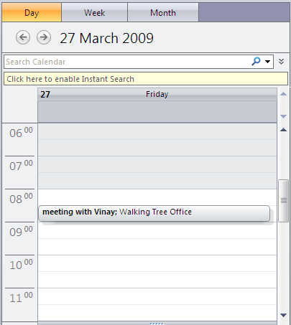

New Appointment Window
Home → Patient Management → New Appointment
Welcome: <first name> <last name>
Home
Miscellaneous
Reports
Settings
Help
Change Password
Logout
Patient ID :
2300023223
Patient Name:
Ajit Kumar
Department:
Eye Department
View patient details
Primary Doctor:
Vinay Kurudi
View Dr Vinay Kurudi’s Calendar
Session:
Morning
Old Appointment Details
Appointment Date :
03/27/2009
Start Time:
8:30
End Time:
9:00
Appointment Remarks:
Something about the nature of the problem
Confirm
Reset
The details will be shown based on the role. For example – a nurse can see the details, while a patient taking online appointment may only see a color corresponding to blocked appointment.
Notes:
The address will be automatically selected from the sponsor details configured into the system
Employer name should be automatically populated
The system should allow configuring more than one sponsors for the patient
Some already exhausted will give some idea about whether patient has enough coverage or not. However, this is not necessarily the correct figure as patient may visit other hospitals as well
The secondary contact will have similar information, as we have for the primary contacts

Slide 26
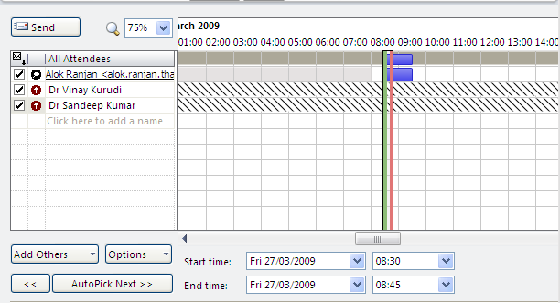

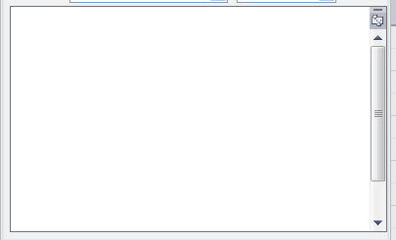
Appointment Details
Home → Patient Management → New Appointment
Welcome: <first name> <last name>
Home
Miscellaneous
Reports
Settings
Help
Change Password
Logout
Registration
Appointments
Outpatient
Inpatient
History
VAS
Add Doctor:
Sandeep Kumar
Add
Details about the appointment

Slide 27
Appointment Management

Slide 28
Manage Appointments
Welcome: <first name> <last name>
Home
Miscellaneous
Reports
Settings
Help
Change Password
Logout
Registration
Appointments
Outpatient
Inpatient
History
VAS
New Appointment
Manage Appointments

Slide 29
Appointment Management
Home → Patient Management → Manage Appointments
Welcome: <first name> <last name>
Home
Miscellaneous
Reports
Settings
Help
Change Password
Logout
Appointment From
mm/dd/yyyy
Appointment to:
mm/dd/yyyy
Patient ID :
23000232
Search
Patient’s First Name :
Patient’s Last Name :
Kumar
Time From
8:00
Doctor’s Name :
Vinay Kurudi
Appointment Status:
Rescheduled
Booking Type :
Phone
Time To
8:00
 | S.N. | Patient ID | Name | Session | Appointment Date | From Time | To Time | Appointment Status | Department Name | Booking Type | Doctor Name
 | 1 | 230002232 | Ajit Kumar | Morning | 04/02/2008 | 8:30 | 8:45 | Rescheduled | Eye | Phone | Vinay Kurudi
 | 2 | 00022337 | Sujit Kumar | Morning | 04/02/2009 | 9:00 | 9:15 | Rescheduled | Eye | Online | Vinay Kurudi
 | 3
 | 4
 | 5
 | 6
 | 7
 | 8
v
v
New Appointment
View/Edit
Print Visit Slip
Reschedule
Cancel
Configure Reminder
Notes:
The booking type can be one of following:
Phone
Online
InPerson
Print Visit Slip will be a jasper reports. In addition, it will also mark the consultation status as “Patient came to visit Consultant”

Slide 30
View/Edit Appointment
Home → Patient Management → View/Edit Appointment Details
Welcome: <first name> <last name>
Home
Miscellaneous
Reports
Settings
Help
Change Password
Logout
Patient ID :
2300023223
Patient Name:
Alok Ranjan
Department:
Eye Department
Primary Doctor:
Vinay Kurudi
View Dr Vinay Kurudi’s Calendar
Session:
Morning
Old Appointment Details
We can have following booking status:
Confirmed
Rescheduled
Cancelled
Booking Date :
03/27/2009
Appointment Date :
03/27/2009
Start Time:
8:30
End Time:
9:00
Appointment Status:
Confirmed
Remarks :
Any remarks by the person editing the appointment details
We can have following consultation status:
Programmed
Free Consultation
Patient Arrived at the Counter
Patient Visited Consultant
Consultant has seen the patient
Consultation Status:
The details will be shown based on the role. For example – a nurse can see the details, while a patient taking online appointment may only see a color corresponding to blocked appointment.
Programmed
Update Consultation Status
Print Visit Slip
Patient came to visit consultant
Patient visited consultant
Consultant has seen the patient
Notes:
Initially consultation status will be in “Programmed” status. Once consultant sees the patient, he marks the status as captured
Only nurses and doctors should have permission to update consultation status and print visit slip

Slide 31
Reschedule Appointment Window
Home → Patient Management → Manage Appointments → Reschedule Appointment
Welcome: <first name> <last name>
Home
Miscellaneous
Reports
Settings
Help
Change Password
Logout
Patient ID :
2300023223
Patient Name:
Alok Ranjan
Department:
Eye Department
Primary Doctor:
Vinay Kurudi
View Dr Vinay Kurudi’s Calendar
Session:
Afternoon
Old Appointment Details
Booking Date :
03/25/2009
Appointment Date :
03/27/2009
Start Time:
8:30
End Time:
9:00
Rescheduled Appointment Details
Appointment Date :
03/27/2009
Start Time:
8:30
End Time:
9:00
The details will be shown based on the role. For example – a nurse can see the details, while a patient taking online appointment may only see a color corresponding to blocked appointment.
Confirm
Reset
Notes:
If the appointment is with the new doctor then it will not be considered as reschedule. The existing appointment must be cancelled and new appointment must be taken.

Slide 32
Reschedule Appointment Details
Home → Patient Management → Reschedule Appointment
Welcome: <first name> <last name>
Home
Miscellaneous
Reports
Settings
Help
Change Password
Logout
Registration
Appointments
Outpatient
Inpatient
History
VAS
Add Doctor:
Sandeep Kumar
Add
Details about the rescheduled appointment

Slide 33
Cancel Appointment
Home → Patient Management → Manage Appointments → Cancel Appointment
Welcome: <first name> <last name>
Home
Miscellaneous
Reports
Settings
Help
Change Password
Logout
Patient ID :
2300023223
Patient Name:
Alok Ranjan
Department:
Eye Department
Primary Doctor:
Vinay Kurudi
View Dr Vinay Kurudi’s Calendar
Session:
Morning
Old Appointment Details
Booking Date :
03/25/2009
Booking Type:
Phone
Appointment Date :
03/27/2009
Start Time:
8:30
End Time:
9:00
Details about the rescheduled appointment
Appointment Remarks:
Appointment Status:
Confirmed
Cancellation Reason:
Going to other hospitals
Confirm
Reset
The details will be shown based on the role. For example – a nurse can see the details, while a patient taking online appointment may only see a color corresponding to blocked appointment.
Notes:
If the appointment is with the new doctor then it will not be considered as reschedule. The existing appointment must be cancelled and new appointment must be taken.

Slide 34
Configure Appointment Reminder
Home → Patient Management → Manage Appointments → Configure Reminders
Welcome: <first name> <last name>
Home
Miscellaneous
Reports
Settings
Help
Change Password
Logout
Patient ID :
2300023223
Patient Name:
Alok Ranjan
Appointment Date :
03/27/2009
Session:
Morning
Department:
Eye Department
Primary Doctor:
Vinay Kurudi
Start Time:
8:30
End Time:
9:00
Appointment Status:
Confirmed
Details about the rescheduled appointment
Appointment Remarks:
Remind Doctor
Send Email before
2
Days
Send SMS before
3
Hours
Call on doctor’s phone before
15
Minutes
Remind Patient
Send Email before
2
Days
Send SMS before
3
Hours
Call on patient’s phone before
15
Minutes
Save
Reset
Notes:
If the appointment is with the new doctor then it will not be considered as reschedule. The existing appointment must be cancelled and new appointment must be taken.

Slide 35
Outpatient Management
This module supports doctors and administrators to take better and timely consultation decisions by providing instant access to comprehensive patient information.
Patient visits are divided into
Primary Consultation
Secondary Consultation
Follow-up
If a patient visits same doctor after one month (this rule will be configurable by the hospital) or he/she makes more than three visits (this is configurable by the hospital) in the same month then the corresponding visit qualifies for Primary Consultation
If the patient is availing consultation from other doctor then it will always qualify for Primary Consultation

Slide 36
Outpatient Management

Slide 37
Manage Appointments
Welcome: <first name> <last name>
Home
Miscellaneous
Reports
Settings
Help
Change Password
Logout
Registration
Appointments
Outpatient
Inpatient
History
VAS
Appointments
Treatment History
Configure Alerts
Consultation Duty Roster
Billing Details

Slide 38
Appointment Management
Home → Patient Management → Outpatient → Manage Appointments
Welcome: <first name> <last name>
Home
Miscellaneous
Reports
Settings
Help
Change Password
Logout
Appointment From
mm/dd/yyyy
Appointment to:
mm/dd/yyyy
Patient ID :
23000232
Search
Patient’s First Name :
Patient’s Last Name :
Kumar
Session :
Morning
Time From
8:00
Doctor’s Name :
Vinay Kurudi
Appointment Status:
Rescheduled
Booking Type :
Phone
Time To
8:00
 | S.N. | Patient ID | Name | Session | Appointment Date | From Time | To Time | Appointment Status | Department Name | Booking Type | Doctor Name
 | 1 | 230002232 | Ajit Kumar | Morning | 04/02/2008 | 8:30 | 8:45 | Rescheduled | Eye | Phone | Vinay Kurudi
 | 2 | 00022337 | Sujit Kumar | Morning | 04/02/2009 | 9:00 | 9:15 | Rescheduled | Eye | Online | Vinay Kurudi
 | 3
 | 4
 | 5
 | 6
 | 7
 | 8
v
v
New Appointment
View/Edit
Print Visit Slip
Reschedule
Cancel
Configure Reminder
Notes:
If the user is a patient then his/her details should be automatically populated in the search criteria

Slide 39
Manage Appointments
Welcome: <first name> <last name>
Home
Miscellaneous
Reports
Settings
Help
Change Password
Logout
Registration
Appointments
Outpatient
Inpatient
History
VAS
Appointments
Treatment History
Configure Alerts
Consultation Duty Roster
Billing Details

Slide 40
Search Treatment History
Home → Patient Management → Outpatient → Treatment History
Welcome: <first name> <last name>
Home
Miscellaneous
Reports
Settings
Help
Change Password
Logout
Registration
Appointments
Outpatient
Inpatient
History
VAS
Treatment From
mm/dd/yyyy
Treatment to:
mm/dd/yyyy
Patient ID :
23000232
Patient’s First Name :
Patient’s Last Name :
Kumar
Doctor’s Name :
Vinay Kurudi
Patient Type
Outpatient
Search
 | S. N. | Patient Name | Patient ID | In/Out Patient | Primary Doctor Name | Consultation Date | Admission Date | Discharge Date | Reason for Appointment | Final Remarks
 | 1 | Vinay Kurudi | 12323232 | O | Rohit Sharma | 02/22/2009 |  |  | Ear infection | Should be fine after 5 days. Consult again next week.
 | 2 | Vinay Kurudi | 12323232 | I | Sandeep Kumar | 12/22/2008 | 12/22/2008 | 12/25/2008 | Viral Fever | Should be fine after 5 days. Consult again next week.
 | 3
View Treatment Details

Slide 41
Treatment Details
Home → Patient Management → Outpatient → Treatment Details
Welcome: <first name> <last name>
Home
Miscellaneous
Reports
Settings
Help
Change Password
Logout
Registration
Appointments
Outpatient
Inpatient
History
VAS
Patient Name :
Vinay Kurudi
Patient ID :
23000232
Doctor’s Name :
Vinay Kurudi
Patient Type
Inpatient
Consultation Date
12/22/2008
Admission Date
12/22/2008
Discharge Date
12/25/2008
Reason for Treatment
Doctor’s Remarks
Viral Fever
Should be fine after 5 days. Consult again next week.
(+) Consultation Details
(+) Medical Prescription
(+) Diagnosis Details & Reports
(-) Medical Observation Details
* Nasal congestion, long standing, one side only
* Swollen ankle(s), in one ankle only
(+) Triage Parameter Details (for casualty cases)
(+) Procedures used during treatment
Notes:
Diagnosis details and reports will include the reports and images saved and prepared by the diagnosis departments. It will be a link to those documents.
We can have following triage parameters and it will be decided by doctors/hospitals
Able to talk?
Able to walk?
Breathing?
Palpable pulse?

Slide 42
Medical Prescription
Home → Patient Management → Outpatient → Treatment Details
Welcome: <first name> <last name>
Home
Miscellaneous
Reports
Settings
Help
Change Password
Logout
Registration
Appointments
Outpatient
Inpatient
History
VAS
Patient ID :
23000232
Patient Name :
Vinay Kurudi
Consultation Date
12/22/2008
Patient Type
Inpatient
Department Name :
Eye
Doctor’s Address:
Rain Tree Park, Malaysian Township, Kukatpally, Hyderabad-500072
Doctor Name :
Rohit Sharma
S.N. | Medicine Name | Strength | Form | Dose (per day) | Repeats | Remarks & Directions
1 | Metron Fort | 50mg |  | 3 x 1-tablets | 5 days | Must be taken before 30 minutes of having a meal
2 | Cold Plus | 100 mg |  | 4 x 1-tea spoon | 2 weeks | The syrup must be taken after taking the food
Tablets
Syrup
Save
Cancel
Print

Slide 43
Medical Observation
Home → Patient Management → Outpatient → Treatment Details
Welcome: <first name> <last name>
Home
Miscellaneous
Reports
Settings
Help
Change Password
Logout
Registration
Appointments
Outpatient
Inpatient
History
VAS
Patient ID :
23000232
Patient Name :
Vinay Kurudi
Consultation Date
12/22/2008
Patient Type
Outpatient
Department Name :
Eye
Doctor Name :
Rohit Sharma
S.N. | Observation | Remarks
1
2
Save
Cancel
Print
Notes:
We can have following triage parameters and it will be decided by doctors/hospitals
Able to talk?
Able to walk?
Breathing?
Palpable pulse?

Slide 44
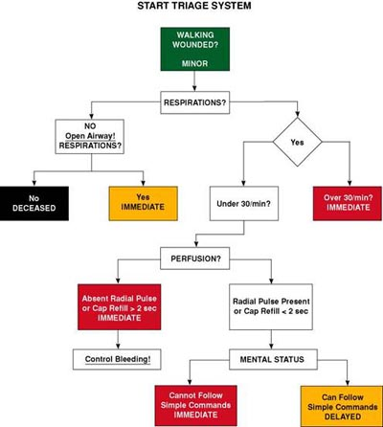
Managing Triage Parameters
We may implement this later on

Slide 45
Manage Appointments
Welcome: <first name> <last name>
Home
Miscellaneous
Reports
Settings
Help
Change Password
Logout
Registration
Appointments
Outpatient
Inpatient
History
VAS
Appointments
Treatment History
Configure Alerts
Consultation Duty Roster
Billing Details

Slide 46
Configure Reminder
Home → Patient Management → Outpatient → Configure Reminders
Welcome: <first name> <last name>
Home
Miscellaneous
Reports
Settings
Help
Change Password
Logout
V
Doctor
Reminder For morning
Send Email before
3
Days
Send SMS before
3
Hours
Call on patient’s phone before
15
Minutes
Reminder For Afternoon
Send Email before
2
Days
Send SMS before
3
Hours
Call on patient’s phone before
30
Minutes
Save
Reset

Slide 47
Manage Appointments
Welcome: <first name> <last name>
Home
Miscellaneous
Reports
Settings
Help
Change Password
Logout
Registration
Appointments
Outpatient
Inpatient
History
VAS
Appointments
Treatment History
Configure Alerts
Consultation Duty Roster
Billing Details

Slide 48
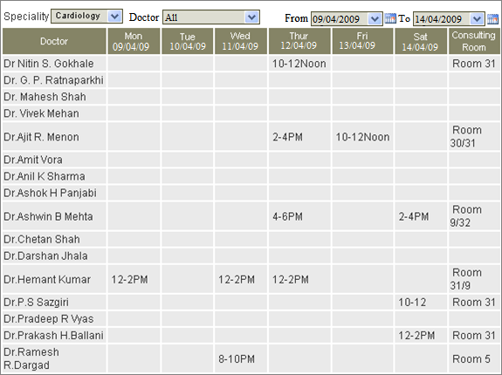
Manage Rooster
Welcome: <first name> <last name>
Home
Miscellaneous
Reports
Settings
Help
Change Password
Logout
Registration
Appointments
Outpatient
Inpatient
History
VAS
Notes:
1) The roster should also consider multiple time period on the same day for the same doctor

Slide 49
Manage Appointments
Welcome: <first name> <last name>
Home
Miscellaneous
Reports
Settings
Help
Change Password
Logout
Registration
Appointments
Outpatient
Inpatient
History
VAS
Appointments
Treatment History
Configure Alerts
Consultation Duty Roster
Billing Details

Slide 50
Managing Referral
Do not need to configure referring doctor’s detail
NO
Patient takes appointment and specifies the referring doctor’s name
Appointment Confirmed?
YES
Configure referring doctor’s detail including his account number for any financial transactions with him.

Slide 51
Managing Referral
Health care provider is able to manage the referring doctor’s details
Create, Read, Update and Delete referring doctor
Configure charges
Absolute amount or
Percentage amount
Provider is able to
view account details of the referring doctor
appointments referred by the doctor
Treatment performed by the referring doctor
Provider is able pay the referral charges
create charges for a period
store the period information to ensure that referal charges are not paid again for the same period
create payable in the systems
Provider makes payment to the referring doctor to partially or completely close the payables

Slide 52
Bill Details
Will be developed as part of Billing Module. The caller should provide following parameters:
Patient Type (Out/In)
Patient Id
Consultation Date
Consultation Time

Slide 53




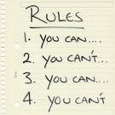

Human Resource Management
Employee Details
Attendance & Leave Management
Pay-Roll
Appraisal & Skills Management
Recruitment
Rules and Policies
Notes:
http://en.wikipedia.org/wiki/List_of_human_resource_management_topics

