Slide 1
Service and Group Management
For HCIS
Notes:
http://www.aiims.edu/aiims/hosp-serv/revised-rate-list.htm#_Toc471767131

Slide 2
Services
Healthcare industry is a wide and intensive form of services which are related to well being of human beings
Most of the facility/care/tests in hospital is provided through services
Whether it is a health care or retails – services are the key for success
Services marketing is marketing based on relationship and value
In case of service based business
The buyer purchases are intangible
The service may be based on the reputation of a single person
It's more difficult to compare the quality of similar services
The buyer cannot return the service
Health care service is the combination of tangible and intangible aspect with the intangible aspect dominating (specially if you think the consultancy provided by Doctors) the tangible aspect. The tangible things are bed, equipments, etc.

Slide 3
CHARACTERISTICS OF HOSPITAL INDUSTRY
Intangibility: Health care services being highly intangible, to beat this intangibility the irony of modern marketing takes place such as use of more tangible features to make things real and believable
Inconsistency: Quality of service offered differs from one extreme to another. This is because of total dependence on human interactivity and related interpretation
Inseparability: Service transaction becomes unique because it mandates, during transaction, the physical presence of the provider and the consumer
Perishability: Services are intangible, they cannot be packed & neither can be stored nor can they be inventoried. The implication is that the service has to be produced and consumed instantly; there is no scope of storage.

Slide 4
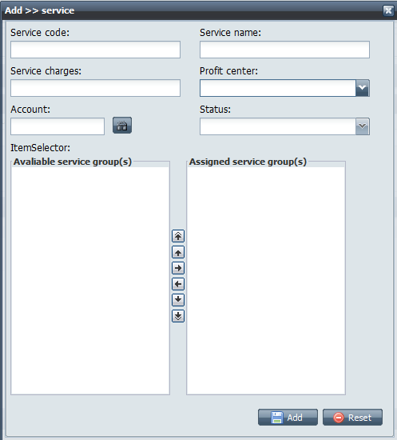
Add Service
A profit center is a unit of a hospital that generates revenue through the sale of goods (e.g. medicines, equipments, etc.) or services. Ideally, one department should be assigned a profit center. This will allow hospitals to measure performance of individual departments. If the department is big and hospital wants to create a hierarchy within the same department then the sub-departments will have a profit center assigned to them. Hence, it would make more sense to associate the services with the departments.
We do not need this area and related functionality. Probably, it will make some sense to have similar area for package where we can make new service as part of those packages
At any time, one service will be part of one service group.
Service group may have hierarchy built among them.
Services should be associated with a department
There should be a description attribute as well
We do not need Account field mentioned over here
Add service should also have an interface to list out the procedures involved in that service. For example – some of the services require patient to remain empty stomach, while some other service may require patient to perform some steps at home. Something like HTML Editor should be good enough.

Slide 5
Service Status
CONCEPT – the service is just in conceptual state and it is not available for rendering or assignment
ACTIVE – the service is available for assignment and usage
SUSPENDED – the service is in a suspended status. If the service is in this status then we must maintain
Suspension effective date and
Suspension expiration date)
If the service assignment date is falling in between the suspension effective and expiration date then the assignment must now be allowed. Ideally, such services must not be available for assignment. If such assignments are part of a package then that package should also be considered as suspended and it should not be available for assignment and rendering.
EXPIRED – the service is no longer available for assignment and associated package must also be considered expired on that date

Slide 6
Service Status State Diagram
Concept
Just an idea
Ready to launch the new service
Active
Available for assignment and usage
Suspended
Temporarily unavailable
Can not be assigned to a patient
The package will also get suspended
Expired
Service is not going to be used ever
Can be part of an active package
Package will not be user ever
The suspended services can be reactivated and corresponding services and package may become available for the assignment to the patients

Slide 7
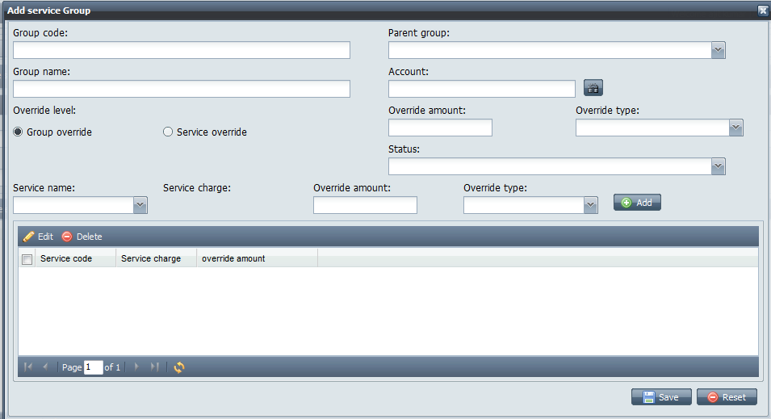
Add Service Group
Remove all the attributes which looks suitable for package, for example – override related attributes
Remove account as well. The service will use department’s account number
Service name store must contain only the services which has General (default) group assigned to it
Along with service name, we should also show service description and service status. Also, instead of drop-down and single selection, we should have something like item selector which should allow moving more than one services into the group in one click.
Why do we need pagination over here. I think, scrolling will be easier, when we have more services being added into a group.

Slide 8
Creation of Package
One or more services can be grouped together to create a package
A package will have an effective date and expiration date
Same package name can be used again and again, while they will have different package identifier to ensure integrity of the rendered package
The system must provide ways to filter active as well as expired package
The system should also allow creation of package, which will be effective in future
If a package expiration date is set to null or some future date then it must be first expired on previous date
The prices can be overridden at two level
At service level : You can decide price of individual services in the package
At package level : The individual service will not have separate price
Amounts can be mentioned in two ways:
Absolute amount
Percentage amount – in case percentage amount is decided at the package level then first you need to add the base price of all the included services and apply percentage calculation on that

Slide 9
Assigned Services
There must be an interface to manage assigned services
We should be able to cancel a request, which has not yet been rendered
There must be a status to move partially rendered service request to a status, which indicates that service was cancelled, however, it was partially rendered
We must maintain requested unit and rendered unit counts for individual services as well as the services which are part of the package
If a service is part of a package and it is rendered (or partially rendered) then the whole package will be considered rendered (or partially rendered)
There must be a way to record the number of units and rendering time for a service request. Something like service activity will be useful

Slide 10
Assigned Service Status
REQUESTED
the service has been assigned to a patient
PARTRENDERED
service is partially rendered
RENDERED
service is completely rendered
PARTCANCELED
service was partially rendered and then it was canceled
CANCELED
service was canceled without rendering
REPLACED
this service was replaced by some other service
PARTREPLACED
Partially rendered and remaining was replaced by some other service

Slide 11
Assigned Service State Diagram
REQUESTED
PARTRENDERED
PARTCANCELED
PARTREPLACED
RENDERED
CANCELED
REPLACED
RENDERED

Slide 12
Package State Diagram
Concept
Just an idea
Ready to launch the new package
Available for assignment and usage
Suspended
Temporarily unavailable
Can not be assigned to a patient
Expired
Package is not going to be used ever
Published
Active
Modification not allowed
The suspended packages can be reactivated it may become available for the assignment to the patients

Slide 13
Assigned Package Status
REQUESTED
the service has been assigned to a patient
RENDERED
service is completely rendered
CANCELED
service was canceled without rendering

Slide 14
Assigned Package Status
REQUESTED
RENDERED
CANCELED

Slide 15
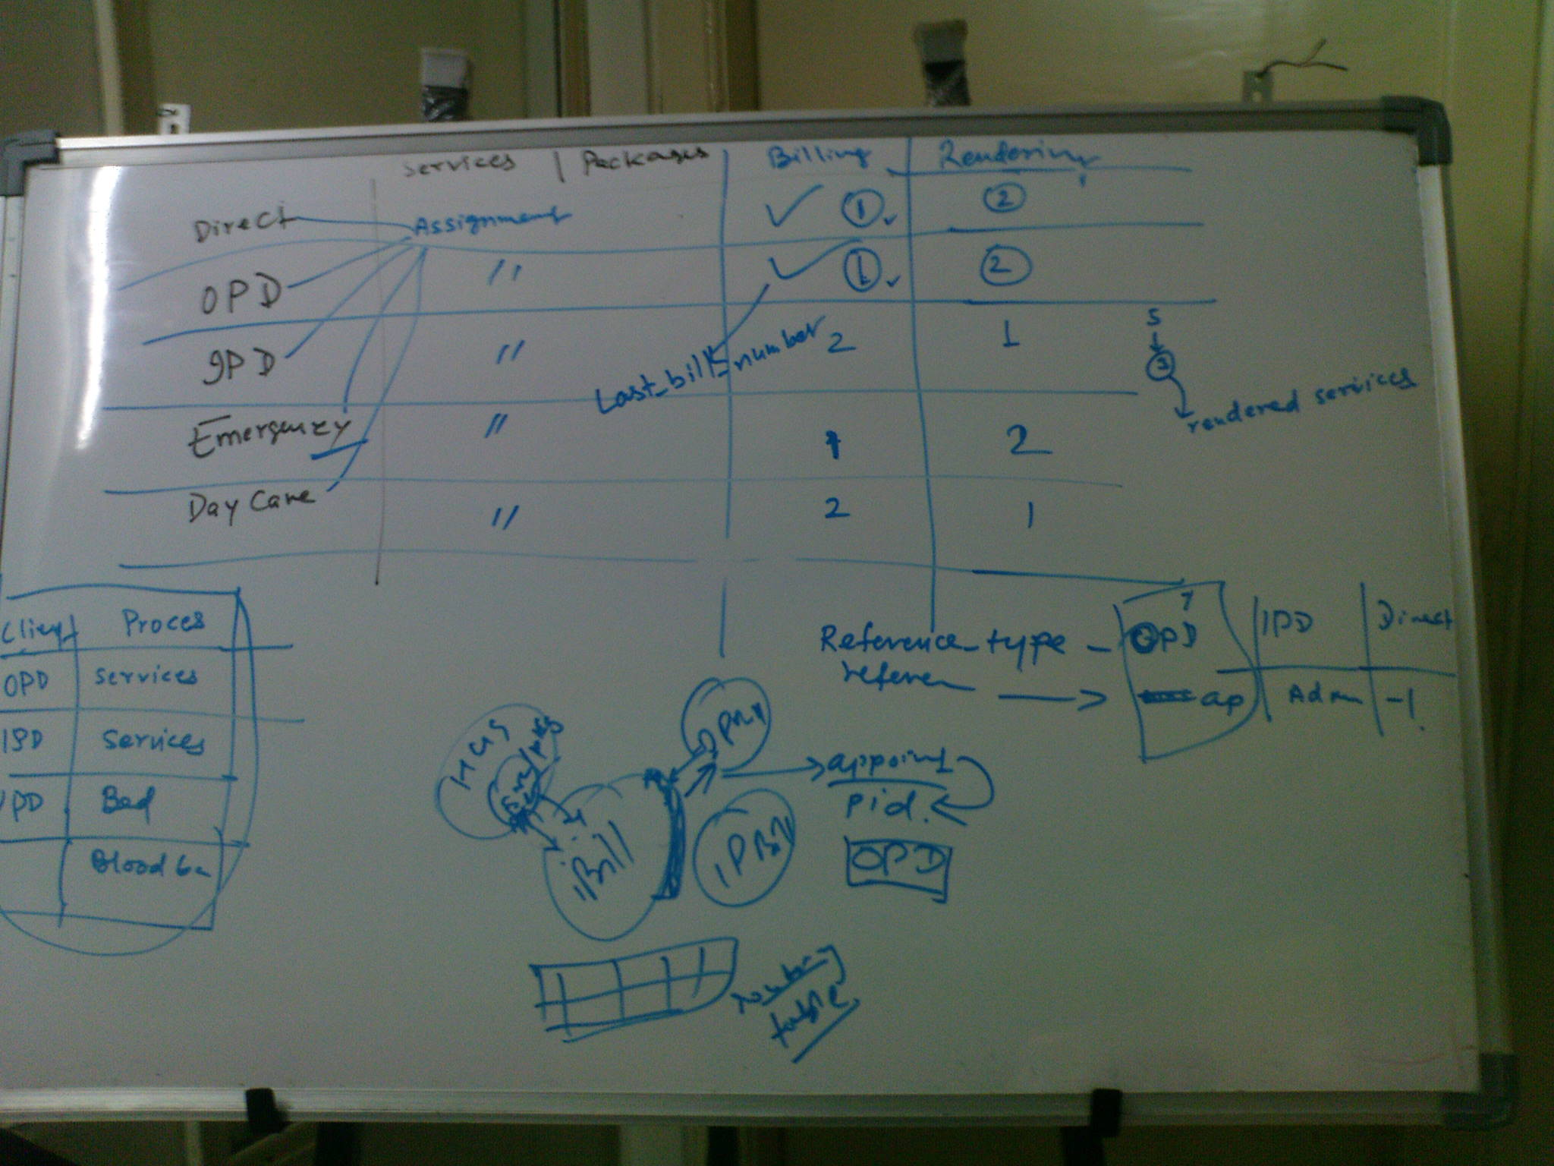
Service & Package Assignment Source
The digit 1 indicates the order. In case of IPD, first you use the service and then you bill that service. While in other cases – you first bill the service and then render that service.
The last bill number is used to indicate that the service has been partially (IPD case) or completely billed by this bill number

Slide 16
Reference Type and Number
Reference type and number has been used to be able to bill the assigned services correctly
Assignment Source | Reference Type | Reference Number | Rationale
Outpatient | OPD | Appointment Number | We have two choices here. Patient ID or Appointment Number. Appointment number gives you exact idea about what services were rendered during which consultation. Hence, this number is used.
Inpatient | IPD | Patient Admission Request Number | For inpatient to avail services we must have an admission request number and all the orders are linked to that. Hence, this is the number which needs to be used.
Emergency | EMERGENCY | Emergency code | Every emergency patient will have an emergency code assigned to them.
Direct | DIRECT | Patient ID | Since we happen to register patient as well, with REGISTRATION TYPE as “DIRECT”, so patient ID is the most suitable value to use.
Day Care | DAYCARE |  | Similar to IPD (this needs to be updated at later stage)

Slide 17
OP Billing
If patient is already registered then entering patient id should populate complete patient details otherwise patient also gets registered at the time of billing itself
Patients can buy following
Services
Packages
Services + Packages
When the services and packages are confirmed, the assigned services table will have corresponding service request created
For packages, the services should get exploded and an optional package assignment code field would indicate whether the service is part of the package or not
The individual department should be responsible for marking the services as rendered
Services may be requested by a doctor during the consultation in the OPD and it will be billed at the OPD billing counter
The department should render services only when it is marked as billed

Slide 18
IP Billing
As part of doctor order – if a doctor has chosen a service to be part of the order then corresponding service request should get created in the assigned services entry
When the billing runs, if the service is not rendered then it should not be marked as billed
If the service is partially rendered then it should be moved to partially billed status, and corresponding services activity should be marked billed and considered as contributor during the receivable creation
If the service is completely rendered then it should be marked as billed and corresponding services activity should also be billed and all of them should be included as a contributor for receivable
If a service is part of the package then the whole package should be billed, even if the single service of that package has been rendered. However, if none of the service of the package has been rendered then it should not be billed

Slide 19
Assignment during IP
During IP, it is expected that a valid admission request exist. Without this, services cannot be assigned to an order
The admission request number will be used as reference number
If the services are assigned to admission order itself then
first the admission order should be created
Retrieve admission request from there and place an order for assigning the services

Slide 20
Radiology
X-ray
Sonography
Magnetic Resonance Imaging (MRI)
Digital Substraction Angiography (DSA)
Radionuclide Scanning (Gamma Camera)
Ultra-Sonography
Computerized Tomography (CT) Scan

Slide 21
Reference
http://www.daykimball.org/services/index.shtml

Slide 22
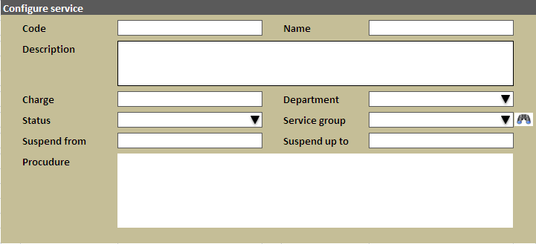

Slide 23
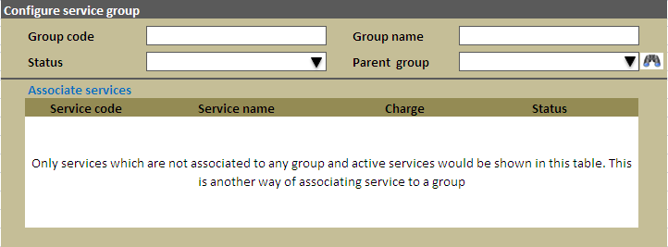

Slide 24
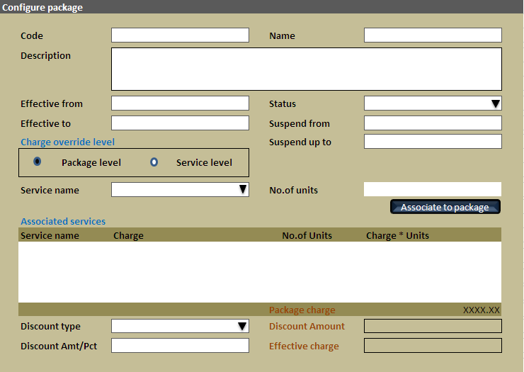

Slide 25
