Slide 1
Health Care Information System
empowering hospitals and nursing homes!

Slide 2
Overview
Walking Tree Health Care Information System (HCIS) intends to provide features to facilitate easier access to the relevant health information for
  Patients
  Doctors
  Nurses
  Administrators and
  Business stake holders
The web-based solution coupled with role-based access facilitates the user to access the relevant contents from anywhere and at anytime
The KabOta framework enables elegant reporting and analysis

Slide 3
Sample Screens

Slide 4
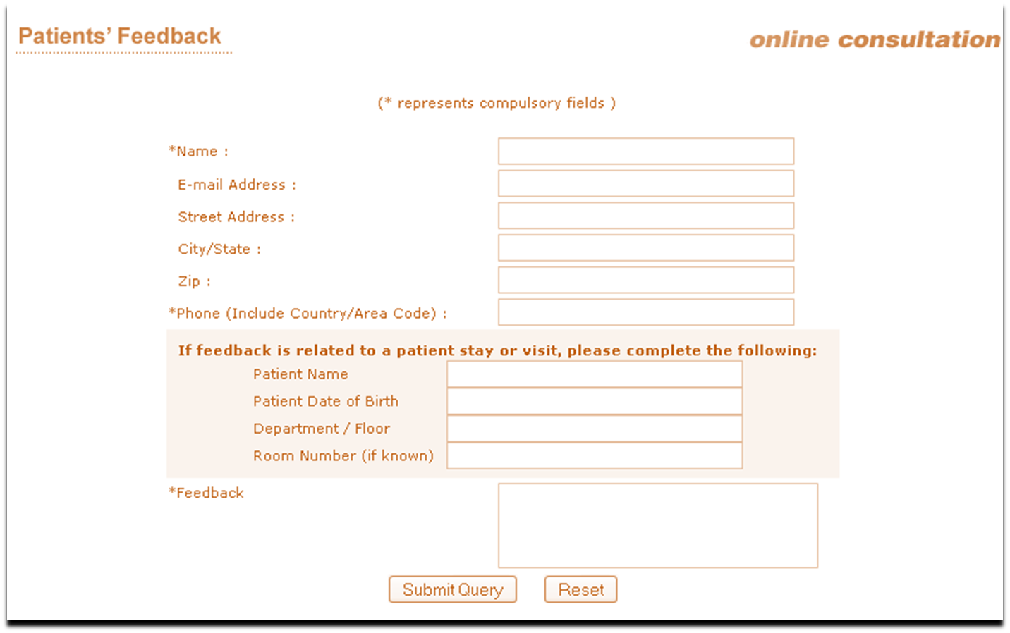
Patient Feedback

Slide 5
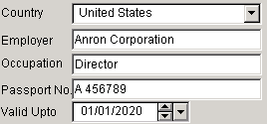
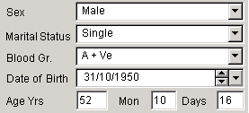



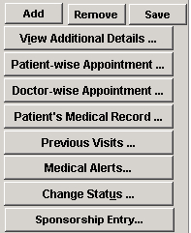









Patient Registration
Hospital No
1243
Hospital Name
Lavania Hospital
Registration Number
1000010212
MR
Name
Ajit
Kumar
Azad
Registration Date: 10/08/2007
India
Walking Tree
31
Phone
9441955210
Flat No.
102
Email
ajit.kumar.azad@gmail.com
Address
RadhaKrishna Nagar
City
Secunderabad
Fax
State
Andhra Pradesh
Country
India
Pin Code
5000083

Slide 6
Functional Overview Cont…
Patient (in-patient and out-patient) Information Management
  Registration
  Emergency contacts
  Attendant Information
Managing medical services
  Appointments
  Consultation
  Surgery
  Laboratory
  Radiology
  Etc.
Managing Resources
  Doctors, Nurses, Ward boys, Support Staffs and Administrators
  Patients, Attendants and their Visitors
  Transports and Ambulances
  Blood bank, Pharmacy, Departments, Rooms and Beds

Slide 7
Functional Overview Cont…
Managing Maternity
  Case Number
  Patient test and reports
  Delivery
Mortality Management
Medical Legal Case Management
Accident and Emergency Management
Food and Diet Management
Medical Waste Management
Billing
  Rating, charging and bill generation
  Payments, Adjustments and deposit management
  Insurance, discounts and loyalty management
Pharmacy Management
Waste Management
Application User and Role Management

Slide 8
Functional Overview Cont…
Effective blood bank management module with optional messaging system
  Maintains Stocks-Blood Group wise ,Area wise and Expiry date wise
  Maintains (Rejected) Donor Database-Blood Group wise and Area wise
  Track and maintain all the donor types
Patient feedback mechanism improves the overall process of the hospital
Reports
  Provides set of inbuilt reports
  The system is flexible to allow development of new report
  Provides analysis on the existing cubes

Slide 9
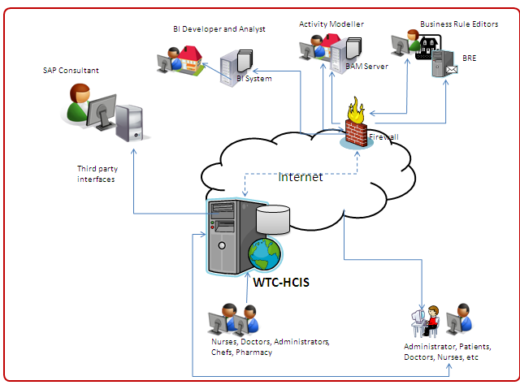
How does it work?

Slide 10
Advantage of WTC– HCIS
Enables hospitals and doctors to better serve their patients
Improved quality of patient care
Increased nursing productivity
Better quality of care, procedures and service to Patients
Reducing the time spent by staff filling out forms
Effective management of limited resources like bed, operation theaters, ICU, etc.
Effective management and maintenance of equipments
Provides transparent accounting across the departments
Role-based access enables contents to be accessed by the intended users

Slide 11
Advantage of WTC– HCIS
Support for maintaining medical records electronically
Provides roster for maintaining schedules of doctors, nurses and ward boys
24 X 7 X 365 support ensure that system is available for continuous use
The application server clustering ensure that system has high availability and it is load balanced
Usage of Jasper Analysis through KabOta framework enables business stake holders to analyze the data effectively
The extensive list of web services allows integration with 3rd party vendors

Slide 12
Contact Details
ajit.kumar.azad@gmail.com
plavania@gmail.com
alok.ranjan.thakur@gmail.com

