Slide 1

Machine learning
for mobile developers
Neo Shi，Email: shiwx@nankai.edu.cn, Wechat: 13920561100

Slide 2
1. Introduction
ML Kit brings Google’s machine learning expertise to mobile developers in a powerful and easy-to-use package.
Make your iOS and Android apps more engaging, personalized, and helpful with solutions that are optimized to run on device.
See: https://developers.google.com/ml-kit

Slide 3
Optimized for mobile
ML Kit’s processing happens on-device.
This makes it fast and unlocks real-time use cases like processing of camera input.
It also works while offline and can be used for processing images and text that need to remain on the device.

Slide 4
Built with Google expertise: Take advantage of the machine learning technologies that power Google's own experiences on mobile.
Easy to use: We combine best-in-class machine learning models with advanced processing pipelines and offer these through easy-to-use APIs to enable powerful use cases in your apps.

Slide 5

Vision APIs
Video and image analysis APIs to label images and detect barcodes, text, faces, and objects.

Slide 6

Barcode scanning
Scan and process barcodes. Supports most standard 1D and 2D formats.

Slide 7

Face detection
Detect faces and facial landmarks.

Slide 8

Image labeling
Identify objects, locations, activities, animal species, products, and more. Use a general-purpose base model or tailor to your use case with a custom TensorFlow Lite model.

Slide 9

Object detection and tracking
Localize and track in real time one or more objects in the live camera feed.

Slide 10

Text recognition
Recognize and extract text from images.

Slide 11

Digital Ink Recognition
Recognizes handwritten text and handdrawn shapes on a digital surface, such as a touch screen. Recognizes 300+ languages, emojis and basic shapes.

Slide 12

Pose detection
Detect the position of the human body in real time.

Slide 13

Selfie segmentation
Separate the background from users within a scene and focus on what matters.

Slide 14
Natural Language APIs
Natural language processing APIs to identify and translate between 58 languages and provide reply suggestions.

Slide 15

Language ID
Determine the language of a string of text with only a few words.

Slide 16

On-device translation
Translate text between 58 languages, entirely on device.

Slide 17

Smart Reply
Generate reply suggestions in text conversations.

Slide 18

Entity Extraction
Detect and locate entities (such as addresses, date/time, phone numbers, and more) and take action based on those entities. Works in 15 languages.

Slide 19
Start building today
Use on-device machine learning in your apps to easily solve real-world problems.

Slide 20
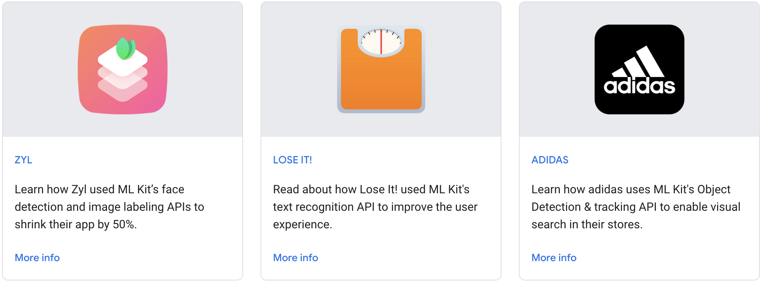
Case studies
https://developers.google.com/ml-kit/case-studies

Slide 21
What's new
We launched the beta of Text Recognition v2, which adds support for Chinese, Devanagari, Japanese and Korean scripts and greatly increases range of supported languages.
At Google I/O 2021 we presented ML Kit: Turnkey APIs to use on-device ML in mobile apps (12 minutes) .
We also launched a new On-device Machine Learning page that helps mobile and web app developers getting started with on-device ML.

Slide 22
Learn more
Explore the ready-to-use APIs: text recognition, face detection, barcode scanning, image labeling, object detection and tracking, pose detection, selfie segmentation, smart reply, text translation, and language identification.
Learn how to use custom TensorFlow Lite image labeling models in your apps. Read Custom models with ML Kit.
Take a look at our sample apps and codelabs. They help you get started with all of the APIs.

