Slide 1
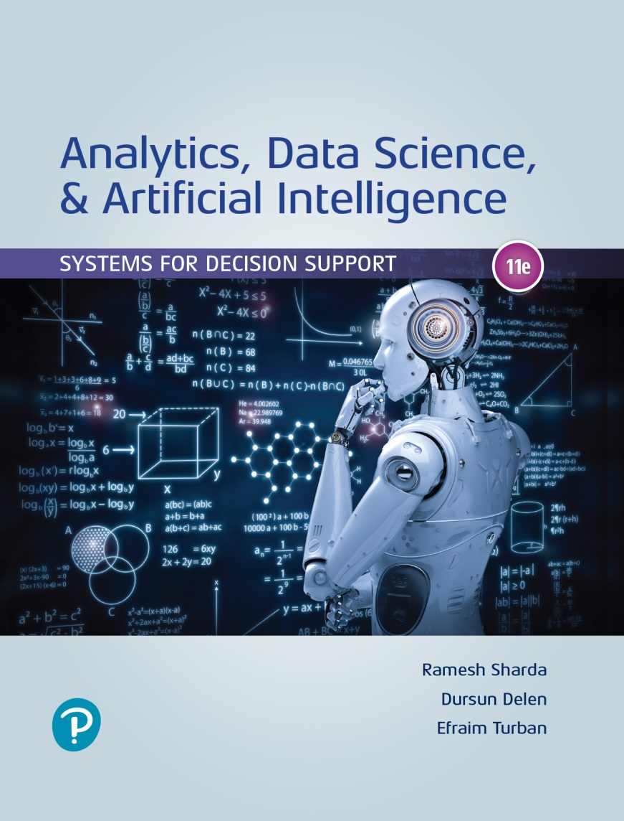
Analytics, Data Science and A I: Systems for Decision Support
Eleventh Edition
Chapter 6
Deep Learning and Cognitive Computing
Slide in this Presentation Contain Hyperlinks. JAWS users should be able to get a list of links by using INSERT+F7
Copyright © 2020, 2015, 2011 Pearson Education, Inc. All Rights Reserved
Notes:
If this PowerPoint presentation contains mathematical equations, you may need to check that your computer has the following installed:
1) Math Type Plugin
2) Math Player (free versions available)
3) NVDA Reader (free versions available)

Slide 2
Learning Objectives (1 of 2)
6.1 Learn what deep learning is and how it is changing the world of computing
6.2 Know the placement of deep learning within the broad family of A I learning methods
6.3 Understand how traditional “shallow” artificial neural networks (A N N) work
6.4 Become familiar with the development and learning processes of A N N
6.5 Develop an understanding of the methods to shed light into the A N N black box
Notes:
Slide 2 is list of textbook LO numbers and statements

Slide 3
Learning Objectives (2 of 2)
6.6 Know the underlying concept and methods for deep neural networks
6.7 Become familiar with different types of deep learning methods
6.8 Understand how convolutional neural networks (C N N), recurrent neural networks (R N N), and long short-memory networks (L S T M) work
6.9 Become familiar with the computer frameworks for implementing deep learning
6.10 Know the foundational details about cognitive Computing and I B M Watson
Notes:
Slide 2 is list of textbook LO numbers and statements

Slide 4
Opening Vignette (1 of 4)
Fighting Fraud with Deep Learning and Artificial Intelligence
Business problem
Danske Bank
Predictive analytics in banking
Fraud detection
The solution
Deep learning
The results

Slide 5
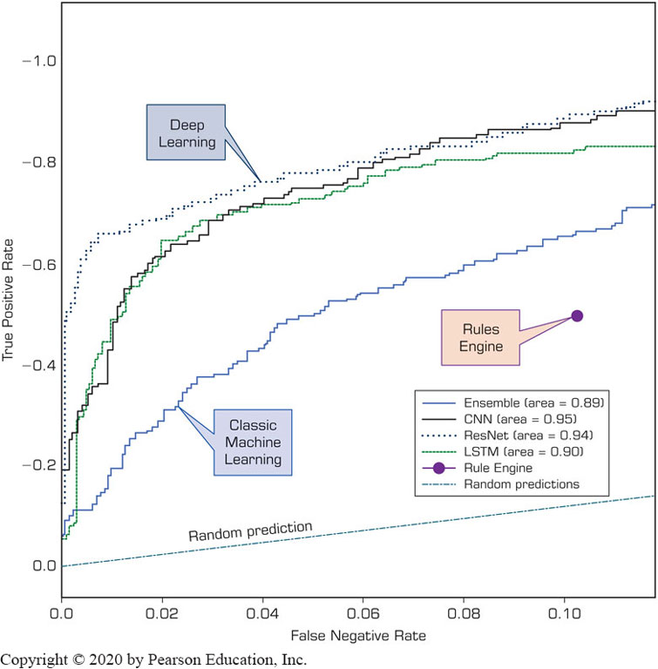
Opening Vignette (2 of 4)
Fighting Fraud with Deep Learning and Artificial Intelligence
Accuracy
R O C curve
D L vs traditional M L techniques

Slide 6
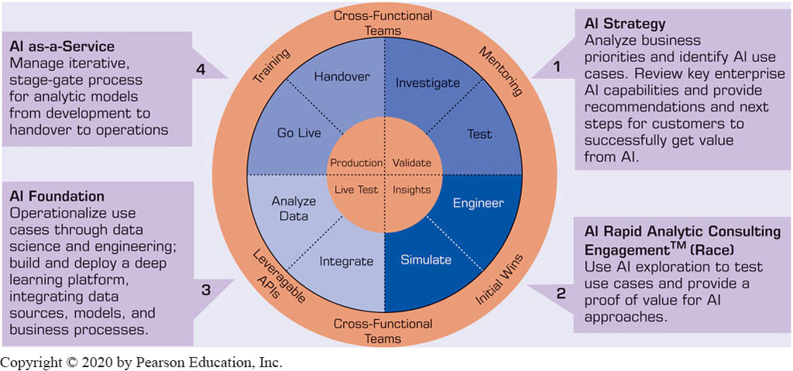
Opening Vignette (3 of 4)
Fighting Fraud with Deep Learning and Artificial Intelligence
A Generalized Framework for A I and Deep Learning–Based Analytics Solutions

Slide 7
Opening Vignette (4 of 4)
Discussion Questions:
What is fraud in banking?
What are the types of fraud that banking firms are facing today?
What do you think are the implications of fraud on banks and on their customers?
Compare the old and new methods for identifying and mitigating fraud.
Why do you think deep learning methods provided better prediction accuracy?
Discuss the trade-off between false positive and false negative (type 1 and type 2 errors) within the context of predicting fraudulent activities.

Slide 8
Introduction to Deep Learning (1 of 3)
Imaginative things in the SciFi movies are turning into realities-tanks to A I and Machine Learning
Siri, Google assistant, Alexa, Google home, …
Deep learning is the newest member of the A I/Machine Learning family
Learn better than ever before
The reason for Deep Learning superiority
Automatic feature extraction and representation

Slide 9
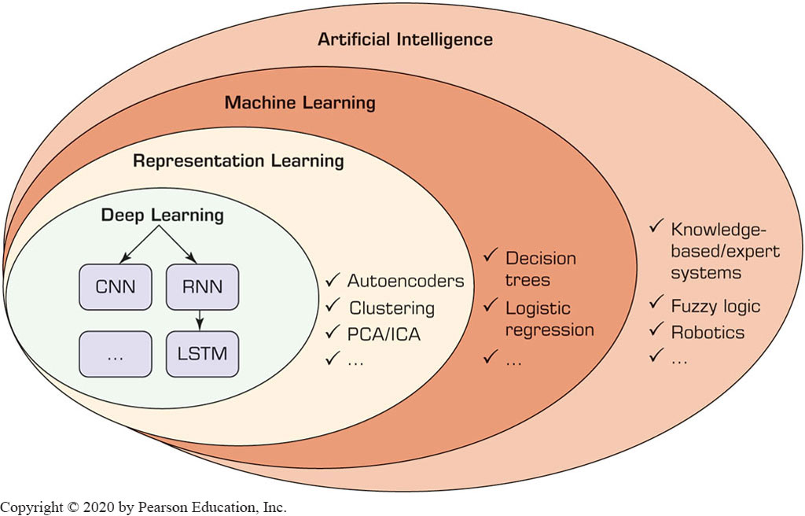
Introduction to Deep Learning (2 of 3)
The placement of Deep Learning within the overarching A I-based learning methods

Slide 10
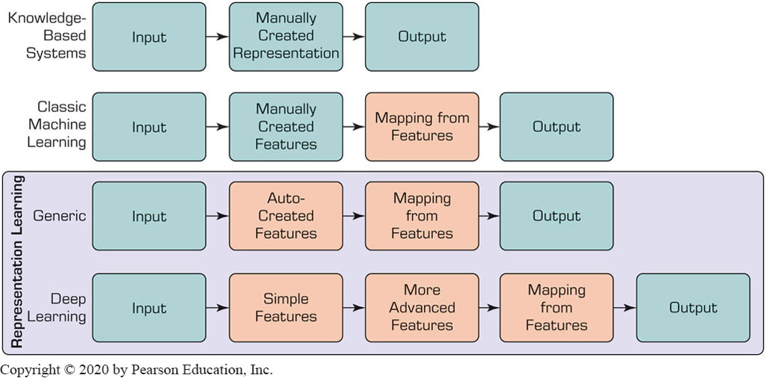
Introduction to Deep Learning (3 of 3)
Differences between Classic Machine-Learning Methods and Representation Learning/Deep Learning

Slide 11
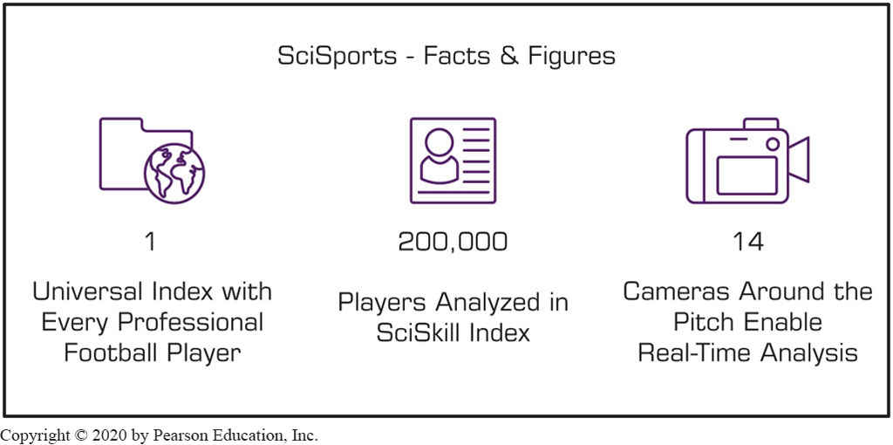
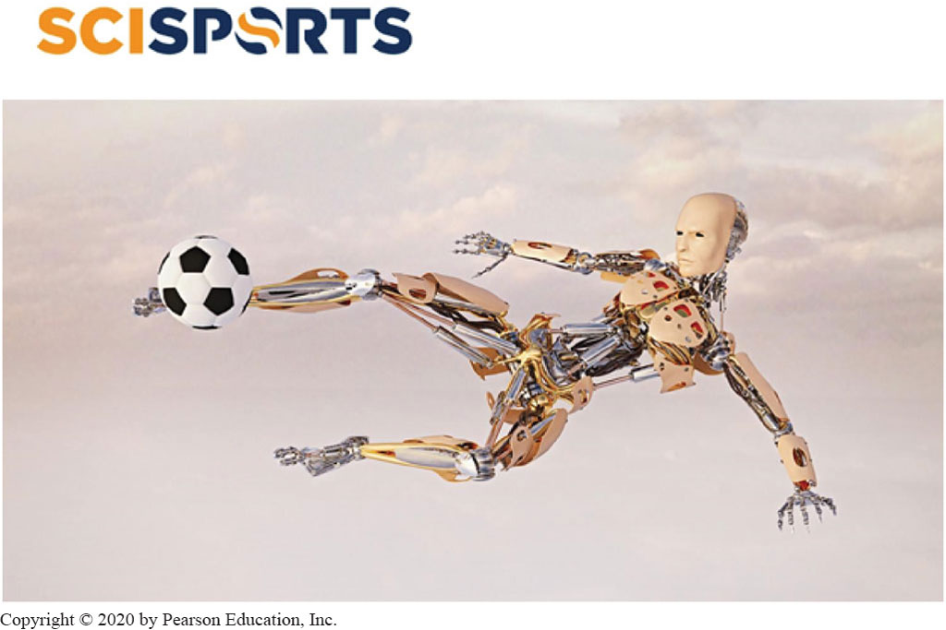
Application Case 6.1 (1 of 2)
Finding the Next Football Star with Artificial Intelligence

Slide 12
Application Case 6.1 (2 of 2)
Finding the Next Football Star with Artificial Intelligence
Discussion Questions:
What does SciSports do? Look at its Web site for more information.
How can advanced analytics help football teams?
What is the role of deep learning in solutions provided by SciSports?

Slide 13
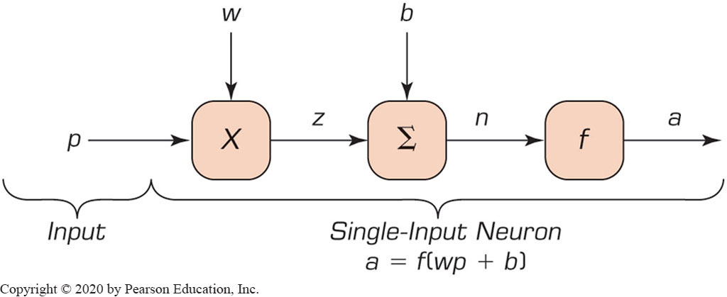
Basics of “Shallow” Learning (1 of 4)
Artificial Neural Networks – abstractions of human brain and its complex biological network of neurons
Neurons = Processing Elements (P E s)
Single-input and single-output neuron/P E

Slide 14
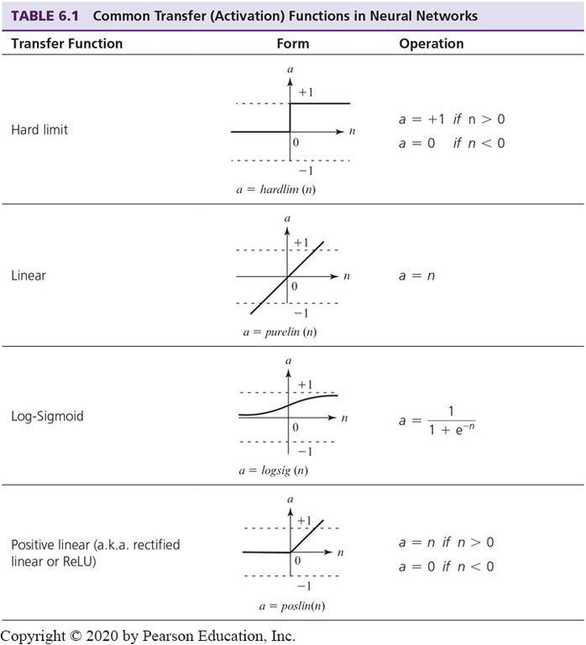
Basics of “Shallow” Learning (2 of 4)
Common transfer (activation) functions

Slide 15
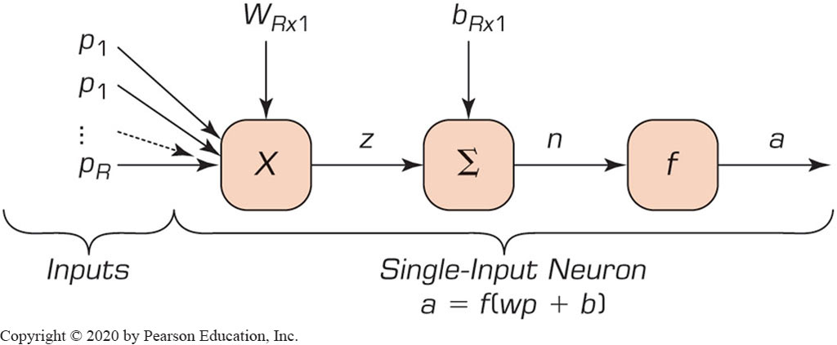
Basics of “Shallow” Learning (3 of 4)
Typical multiple-input neuron with R individual inputs

Slide 16
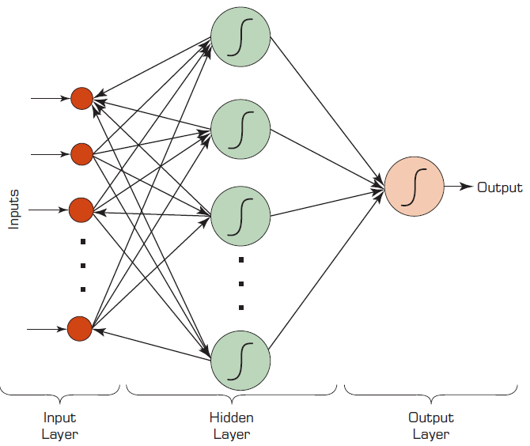
Basics of “Shallow” Learning (4 of 4)
Typical Neural Network with three layers and eight neurons

Slide 17
Application Case 6.2
Gaming Companies Use Data Analytics to Score Points with Players
Watch: Art of Analytics – The Sword
Discussion Questions:
What are the main challenges for gaming companies?
How can analytics help gaming companies stay competitive?
What types of data can gaming companies obtain and use for analytics?

Slide 18
Technology Insight 6.1 (1 of 3)
Elements of an Artificial Neural Network
Processing element (P E)
Network structure
Hidden layer(s)
Input
Output
Connection weights
Summation function
Transfer function

Slide 19
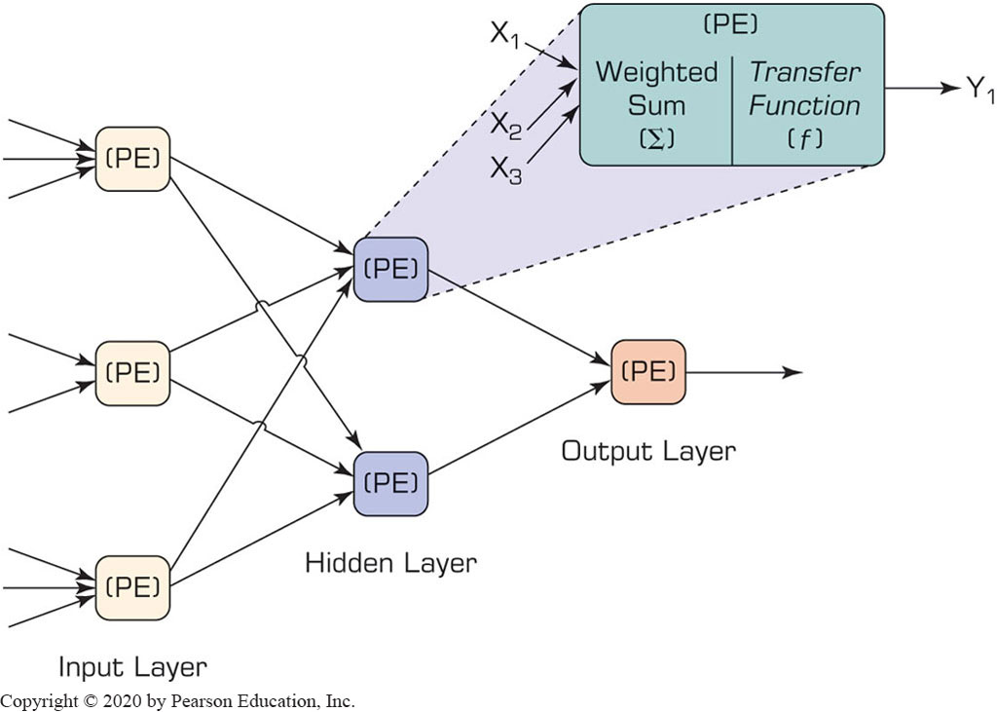
Technology Insight 6.1 (2 of 3)
Elements of an Artificial Neural Network
Neural Network with One Hidden Layer

Slide 20
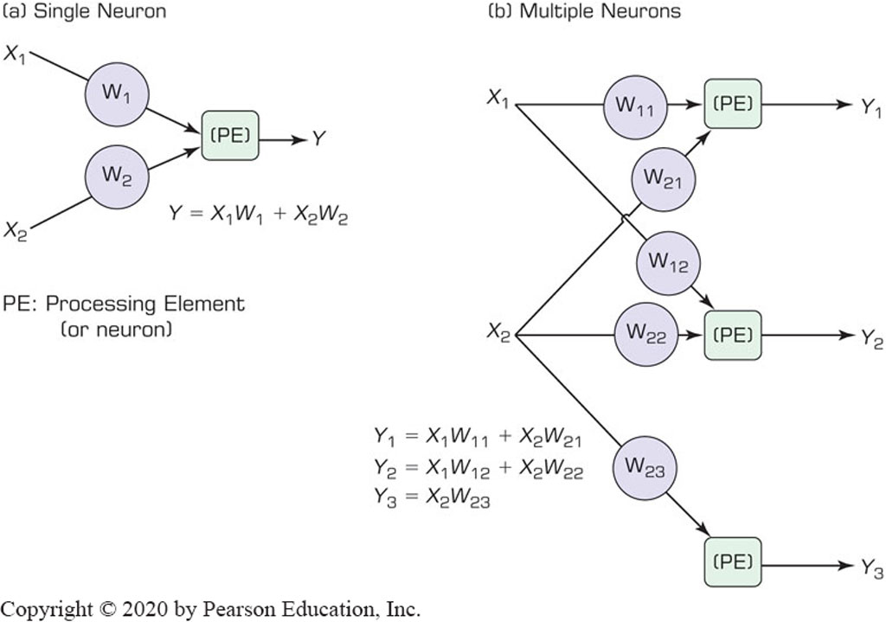
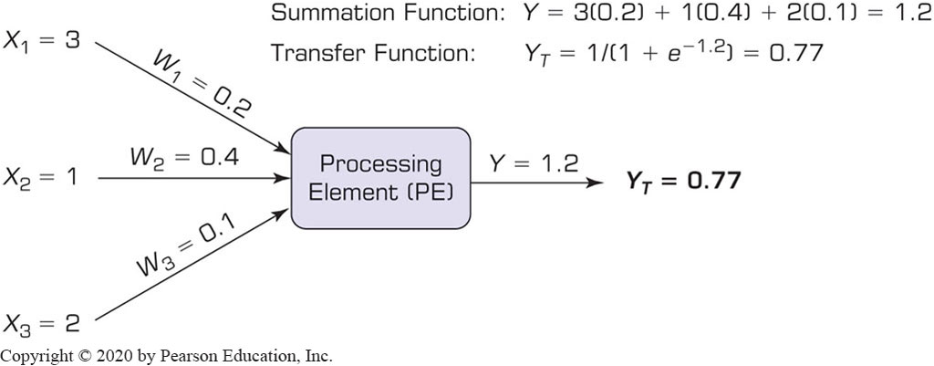
Technology Insight 6.1 (3 of 3)
Elements of an Artificial Neural Network
Summation Functions
Transfer Function

Slide 21
Application Case 6.3
Artificial Intelligence Helps Protect Animals from Extinction
Watch: WildTrack
Discussion Questions
What is WildTrack and what does it do?
How can advanced analytics help WildTrack?
What are the roles that deep learning plays in this application case?

Slide 22
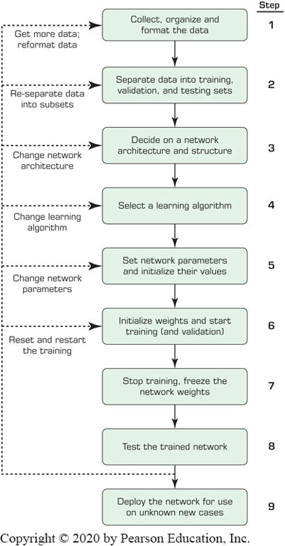
Process of Developing Neural-Network Based Systems
A process with constant feedbacks for changes and improvements!

Slide 23
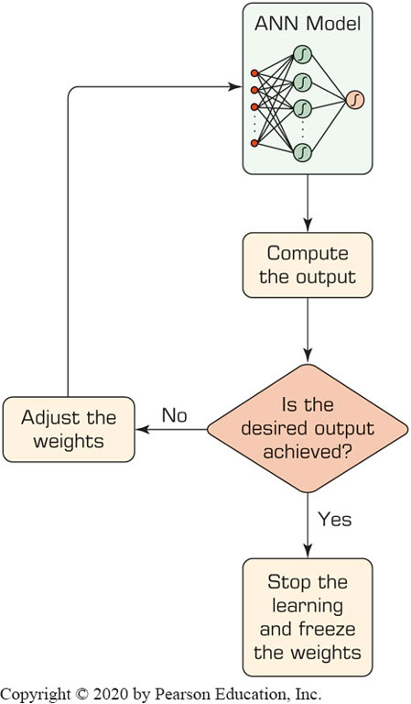
Learning Process in A N N
Compute temporary outputs.
Compare outputs with desired targets.
Adjust the weights and repeat the process.

Slide 24
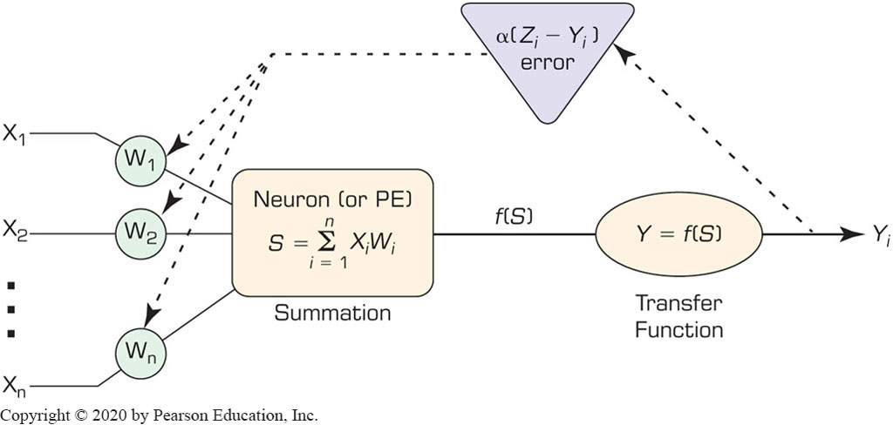
Backpropagation for A N N Training (1 of 2)
Initialize weights with random values
Read in the input vector and the desired output
Compute the actual output via the calculations
Compute the error.
Change the weights by working backward

Slide 25
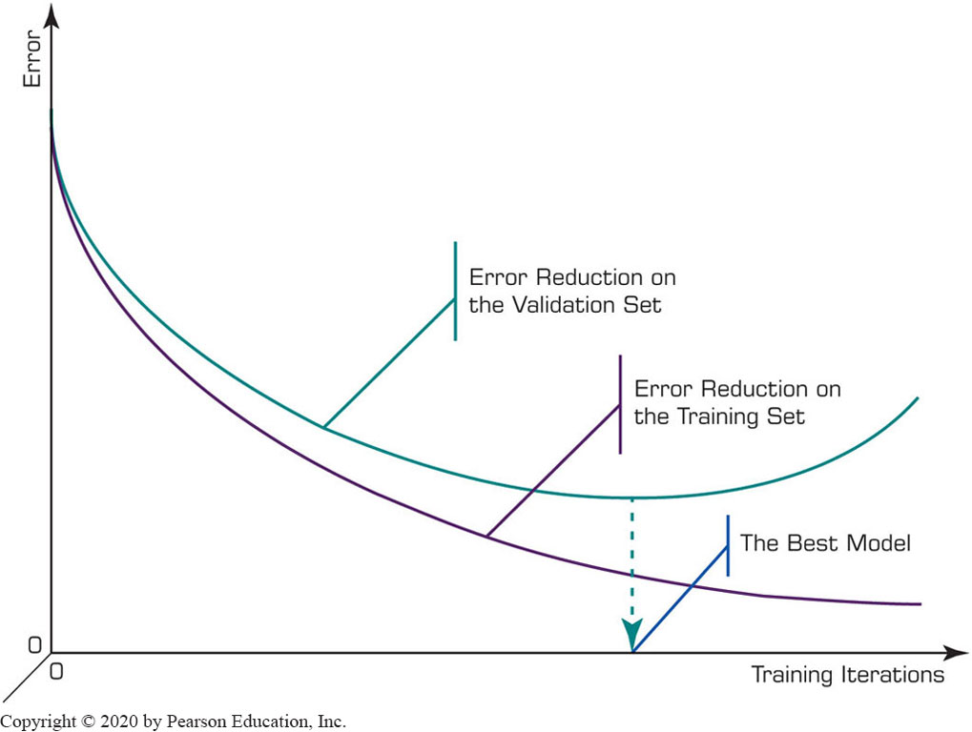
Backpropagation for A N N Training (2 of 2)
Illustration of the Overfitting in A N N

Slide 26
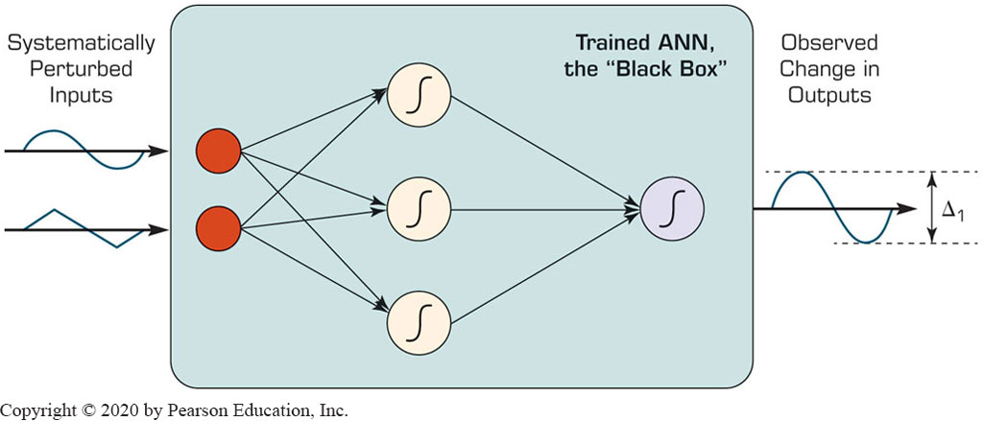
Illuminating the Black Box of A N N
A N N are typically known as black boxes
Sensitivity analysis can shed light to the black-box

Slide 27
Application Case 6.4 (1 of 2)
Sensitivity Analysis Reveals Injury Severity Factors in Traffic Accidents
Discussion Questions:
How does sensitivity analysis shed light on the black box (i.e., neural networks)?
Why would someone choose to use a black-box tool such as neural networks over theoretically sound, mostly transparent statistical tools like logistic regression?
In this case, how did neural networks and sensitivity analysis help identify injury-severity factors in traffic accidents?

Slide 28
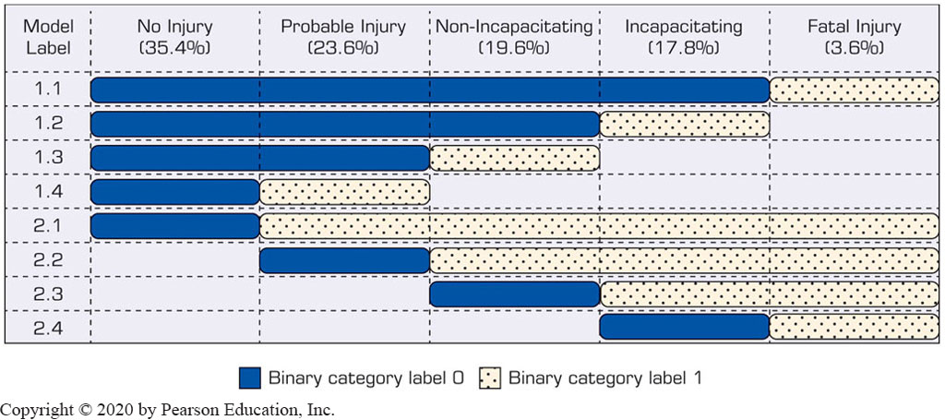
Application Case 6.4 (2 of 2)
Sensitivity Analysis Reveals Injury Severity Factors in Traffic Accidents
Graphical representation of the sensitivity analysis results for the eight binary A N N model configurations

Slide 29
Deep Neural Networks (1 of 3)
Deep: more hidden layers
In addition to C P U, it also uses G P U
With programming languages like C U D A by N V I D I A
Needs large datasets
Deep learning uses tensors as inputs
Tensor: N-dimensional arrays
Image representation with 3-D tensors
There are different types and capabilities of Deep Neural Networks for different tasks/purposes

Slide 30
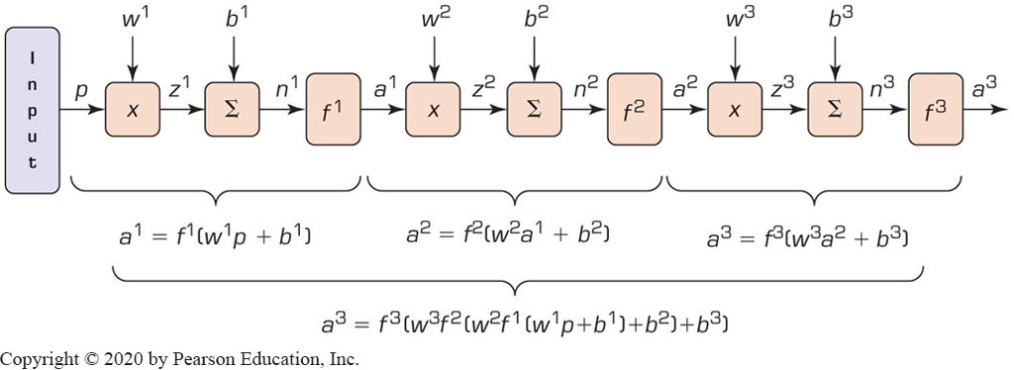
Deep Neural Networks (2 of 3)
Feedforward Multilayer Perceptron (M L P)-Type Deep Networks
Most common type of deep networks
Vector Representation of the First Three Layers in a Typical M L P Network.

Slide 31
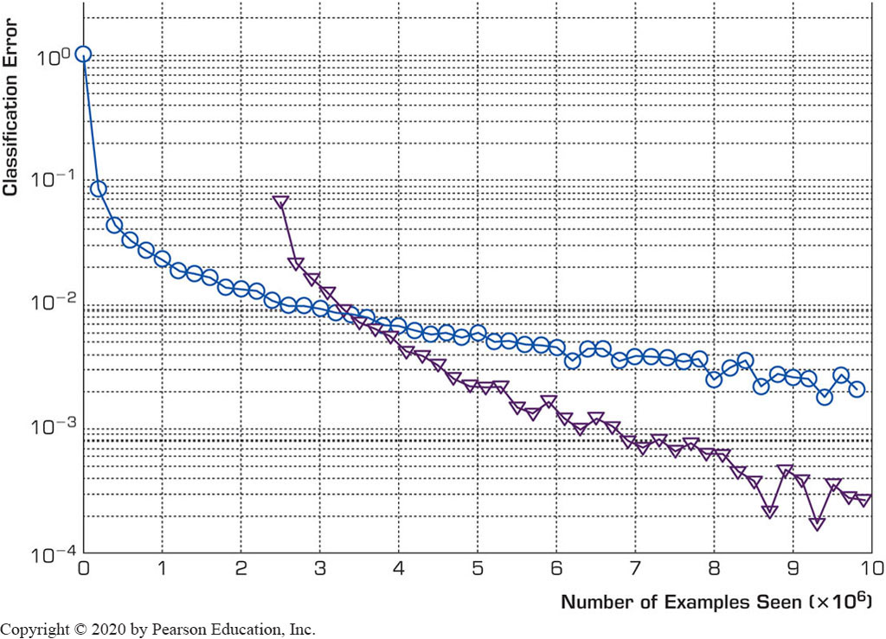
Deep Neural Networks (3 of 3)
Impact of Random Weights in Deep M L P
The Effect of Pre-training Network Parameters on Improving Results of a Classification-Type Deep Neural Network.
More hidden layers versus more neurons?

Slide 32
Application Case 6.5 (1 of 2)
Georgia D O T Variable Speed Limit Analytics Help Solve Traffic Congestions
Discussion Questions:
What was the nature of the problems that G D O T was trying to solve with data science?
What type of data do you think was used for the analytics?
What were the data science metrics developed in this pilot project? Can you think of other metrics that can be used in this context?

Slide 33
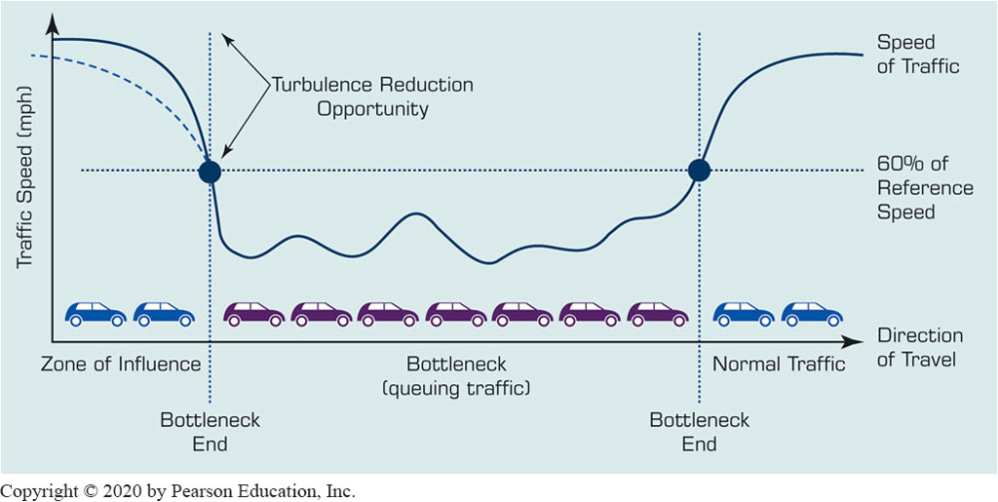
Application Case 6.5 (2 of 2)
Georgia D O T Variable Speed Limit Analytics Help Solve Traffic Congestions

Slide 34
Convolutional “Deep” Neural Networks
Most popular M L P-base D L method
Used for image/video processing, text recognition
Has at least one convolution weight function
Convolutional layer
Convolutional layer → Polling (sub-sampling)
Consolidating the large tensors into one with a smaller size-and reducing the number of model parameters while keeping only the important features
There can be different types of polling layers

Slide 35
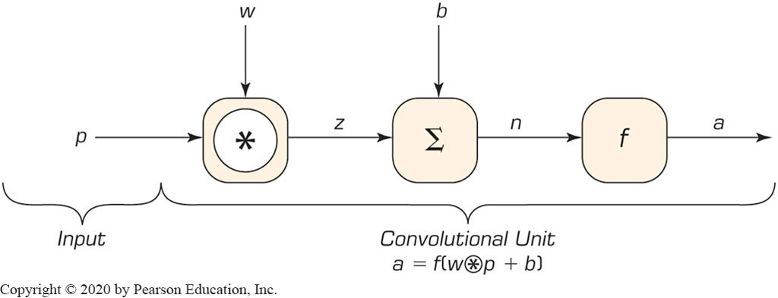
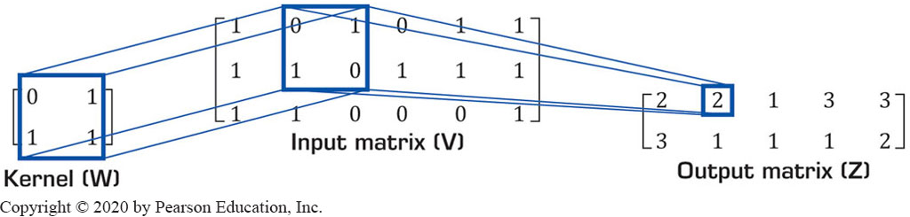
Convolution Function
Typical Convolutional Network Unit
Convolution of a 2 x 2 Kernel by a 3 x 6 Input Matrix

Slide 36
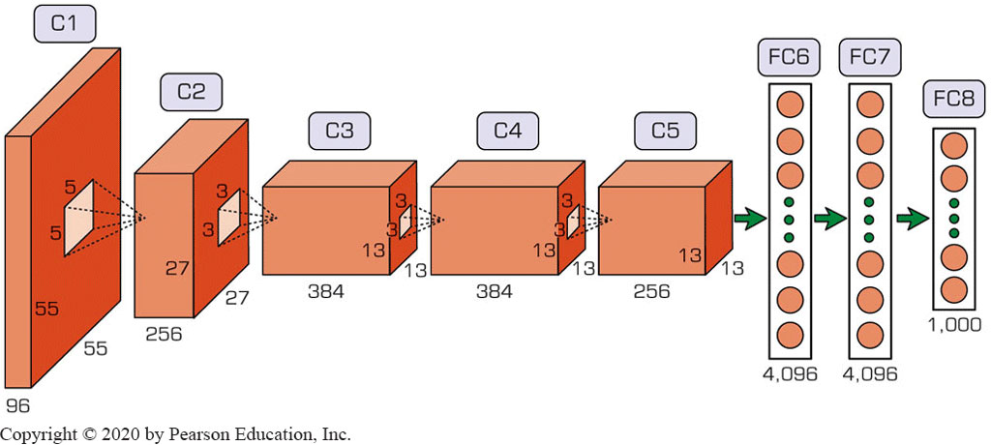
Image Processing Using C N N (1 of 3)
ImageNet (http://www.image-net.org)
Architecture of AlexNet, a C N N for Image Classification

Slide 37
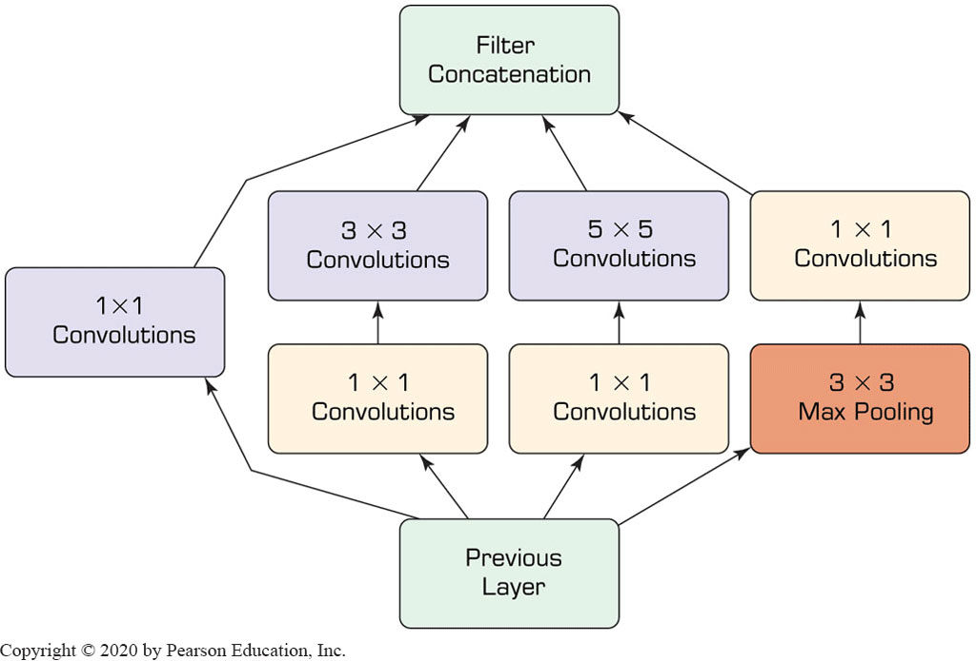
Image Processing Using C N N (2 of 3)
Conceptual Representation of the Inception Feature in GoogLeNet

Slide 38

Image Processing Using C N N (3 of 3)
Examples of Using the Google Lens
Figure 6.28 Two Examples of Using the Google Lens, a Service Based on Convolutional Deep Networks for Image Recognition.
Source: ©2018 Google L L C, used with permission. Google and the Google logo are registered trademarks of Google L L C.

Slide 39
Application Case 6.6
From Image Recognition to Face Recognition
Discussion Questions:
What are the technical challenges in face recognition?
Beyond security and surveillance purposes, where else do you think face recognition can be used?
What are the foreseeable social and cultural problems with developing and using face recognition technology?

Slide 40
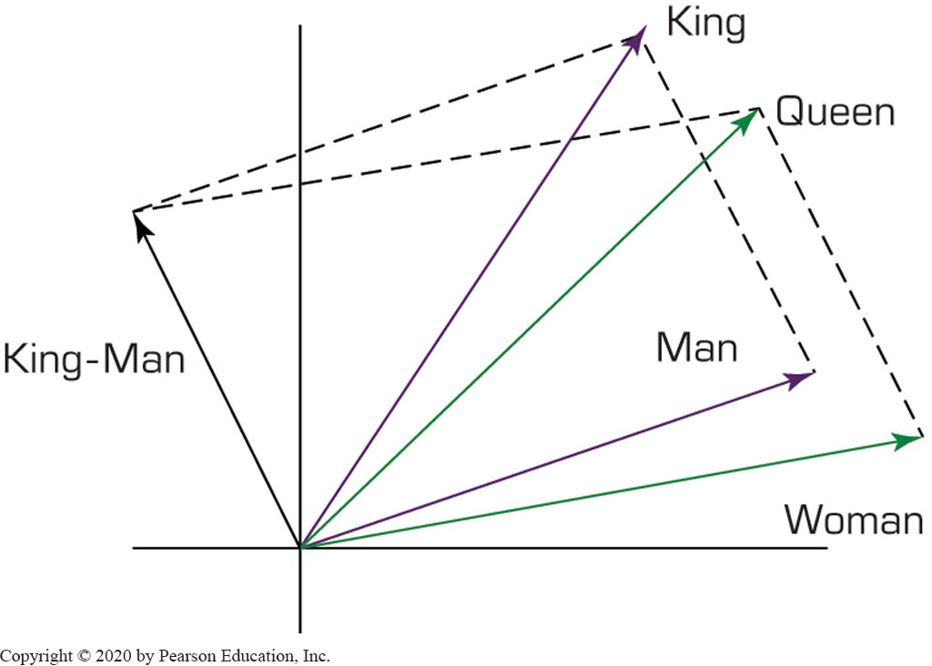
Text Processing Using C N N (1 of 2)
Google word2vec project
Word embeddings
Typical Vector Representation of Word Embeddings in a Two-Dimensional Space

Slide 41
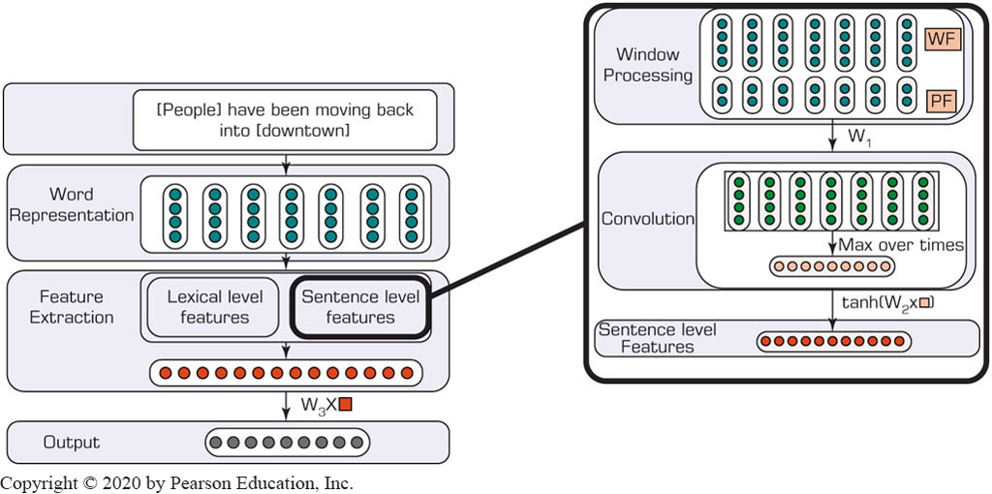
Text Processing Using C N N (2 of 2)
C N N Architecture for Relation Extraction Task in Text Mining

Slide 42
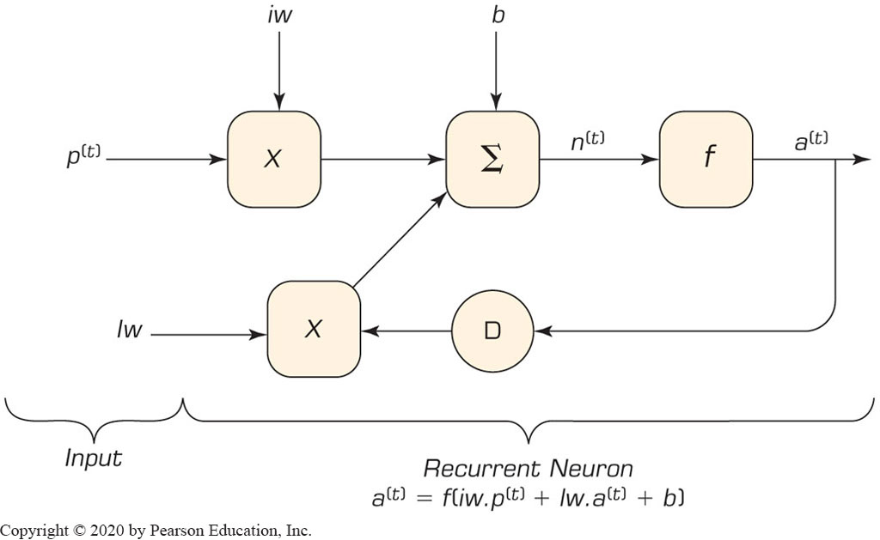
Recurrent Neural Networks (R N N) & Long Short-Term Memory (L S T M) (1 of 3)
R N N designed to process sequential inputs
Typical recurrent unit

Slide 43
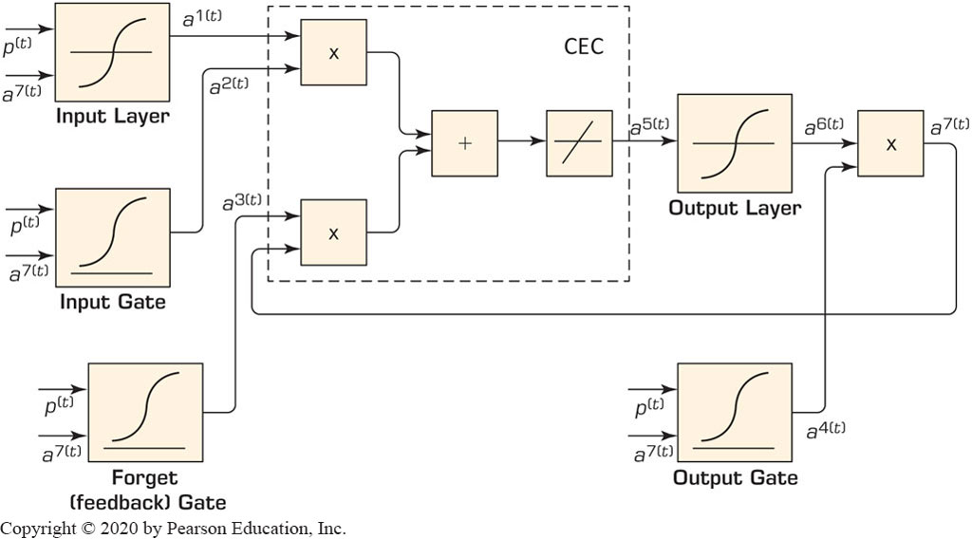
Recurrent Neural Networks (R N N) & Long Short-Term Memory (L S T M) (2 of 3)
L S T M is a variant of R N N
In a dynamic network, the weights are called the long-term memory while the feedbacks role is the short-term memory
Typical Long Short-Term Memory (L S T M) Network Architecture

Slide 44
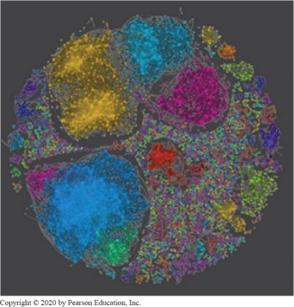
Application Case 6.7 (1 of 4)
Deliver Innovation by Understanding Customer Sentiments
Discussion Questions:
Why do you think sentiment analysis is gaining overwhelming popularity?
How does sentiment analysis work? What does it produce?
In addition to the specific examples in this case, can you think of other businesses and industries that can benefit from sentiment analysis? What is common among the companies that can benefit greatly from sentiment analysis?

Slide 45
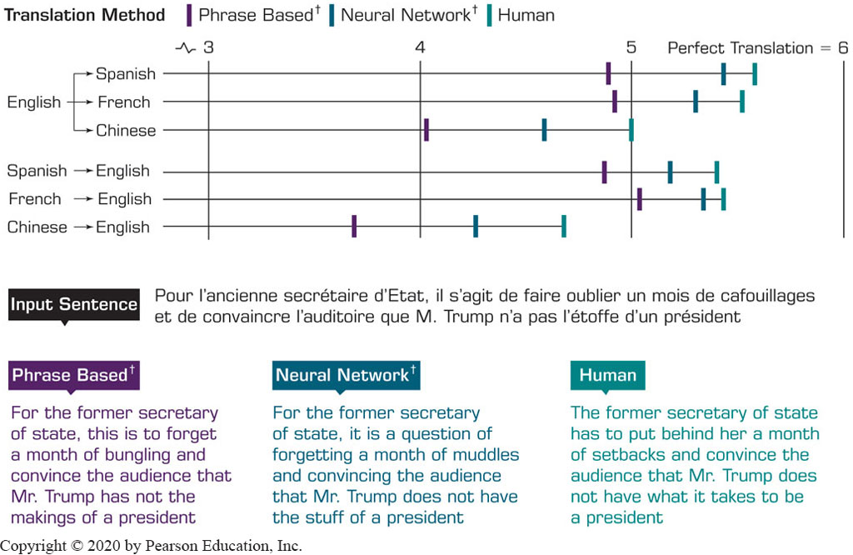
Recurrent Neural Networks (R N N) & Long Short-Term Memory (L S T M) (3 of 3)
L S T M Network Applications
Example Indicating the Close-to-Human Performance of the Google Neural Machine Translator (G N M T)

Slide 46
Computer Frameworks for Implementation of Deep Learning
Torch (http://www.torch.ch)
M L with G P U
Caffe (caffe.berkeleyvision.org)
Facebook’s improved version (www.caffe2.ai)
TensorFlow (www.tensorflow.org)
Google - Tensor Processing Units (T P U s)
Theano (deeplearning.net/software/theano)
Deep Learning Group at the University of Montreal
Keras (keras.io)
Application Programming Interface

Slide 47
Cognitive Computing (1 of 3)
Systems that use mathematical models to emulate (or partially simulate) the human cognition process to find solutions to complex problems and situations where the potential answers can be imprecise
I B M Watson on Jeopardy!
How does cognitive computing work?
Adaptive
Interactive
Iterative and stateful
Contextual
Data mining,
Pattern recognition,
Deep learning, and
N L P
Mimic the way the human brain works

Slide 48
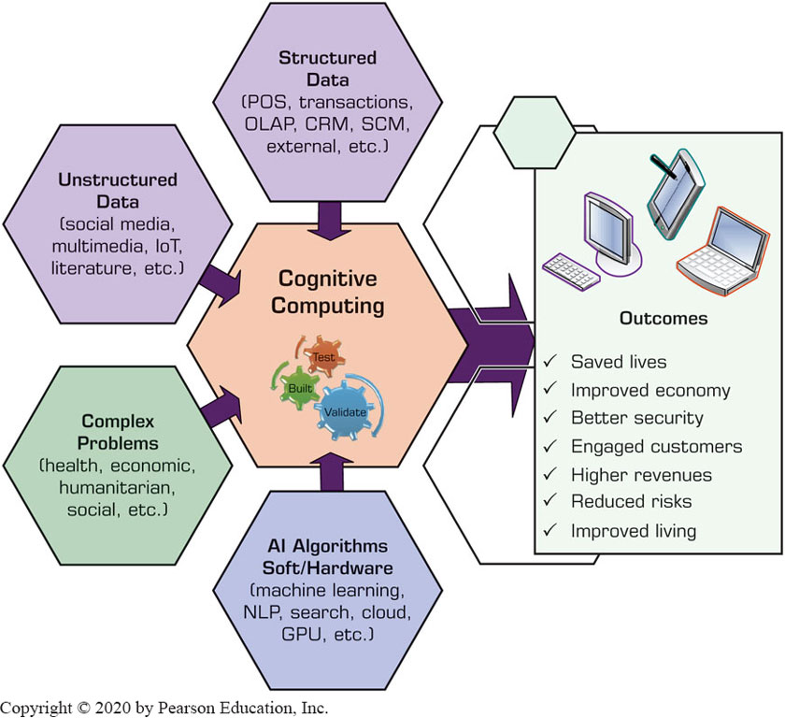
Conceptual Framework for Cognitive Computing and Its Promises

Slide 49
Cognitive Computing (2 of 3)
How does cognitive computing differ from A I?
Table 6.3 Cognitive Computing versus Artificial Intelligence (A I).
Characteristic | Cognitive Computing | Artificial Intelligence (A I)
Technologies used | • Machine learning • Natural language processing • Neural networks • Deep learning • Text mining • Sentiment analysis | • Machine learning • Natural language processing • Neural networks • Deep learning
Capabilities offered | Simulate human thought processes to assist humans in finding solutions to complex problems | Find hidden patterns in a variety of data sources to identify problems and provide potential Solutions
Purpose | Augment human capability | Automate complex processes by acting like a human in certain Situations
Industries | Customer service, marketing, healthcare, entertainment, service Sector | Manufacturing, finance, healthcare, banking, securities, retail, government

Slide 50
Cognitive Computing (3 of 3)
Cognitive computing use cases
Development of smart and adaptive search engines
Effective use of natural language processing
Speech recognition
Language translation
Context-based sentiment analysis
Face recognition and facial emotion detection
Risk assessment and mitigation
Fraud detection and mitigation
Behavioral assessment and recommendations, …
Cognitive analytics?

Slide 51
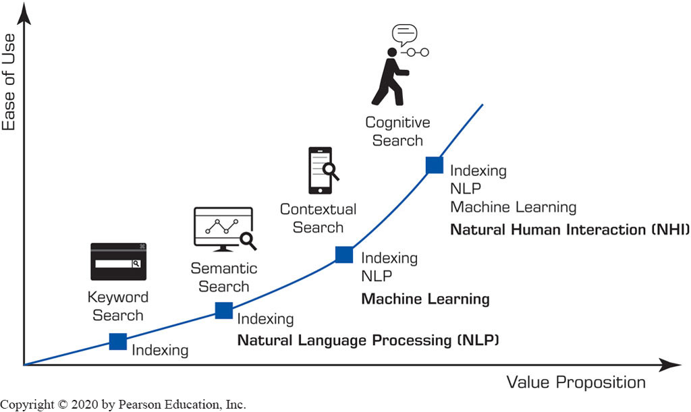
Cognitive Search
Can handle a variety of data types
Can contextualize the search space
Employ advanced A I technologies.
Enable developers to build enterprise-specific search applications

Slide 52
Application Case 6.7 (2 of 4)
I B M Watson Competes against the Best at Jeopardy!
Discussion Questions:
In your opinion, what are the most unique features about Watson?
In what other challenging games would you like to see Watson compete against humans? Why?
What are the similarities and differences between Watson’s and humans’ intelligence?

Slide 53
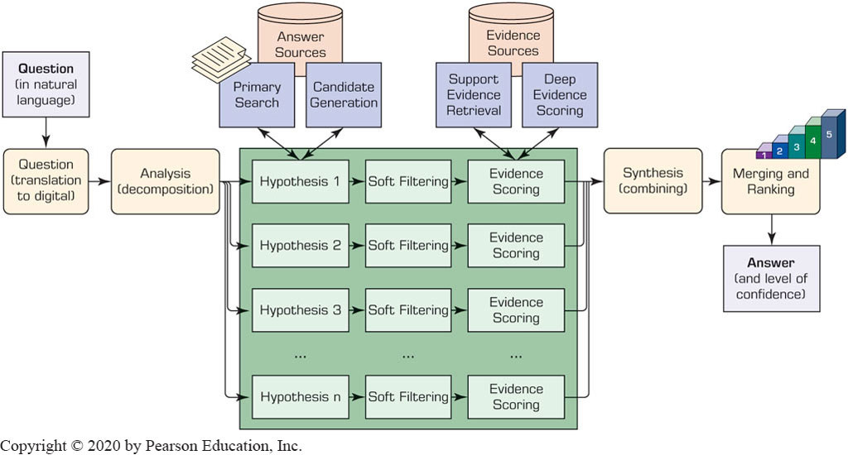
Application Case 6.7 (3 of 4)
I B M Watson Competes against the Best at Jeopardy!
A High-Level Depiction of Watson’s DeepQ A Architecture

Slide 54
Application Case 6.7 (4 of 4)
I B M Watson Competes against the Best at Jeopardy!
How does Watson do it?
Massive parallelism
Many experts
Pervasive confidence estimation
Integration of shallow and deep knowledge
Future of Watson and Cognitive Computing
Healthcare and medicine
Security and Government
Finance and Retail
Education and Scientific Research, …

Slide 55
End of Chapter 6
Questions / Comments

Slide 56

Copyright
This work is protected by United States copyright laws and is provided solely for the use of instructors in teaching their courses and assessing student learning. Dissemination or sale of any part of this work (including on the World Wide Web) will destroy the integrity of the work and is not permitted. The work and materials from it should never be made available to students except by instructors using the accompanying text in their classes. All recipients of this work are expected to abide by these restrictions and to honor the intended pedagogical purposes and the needs of other instructors who rely on these materials.

