Slide 1
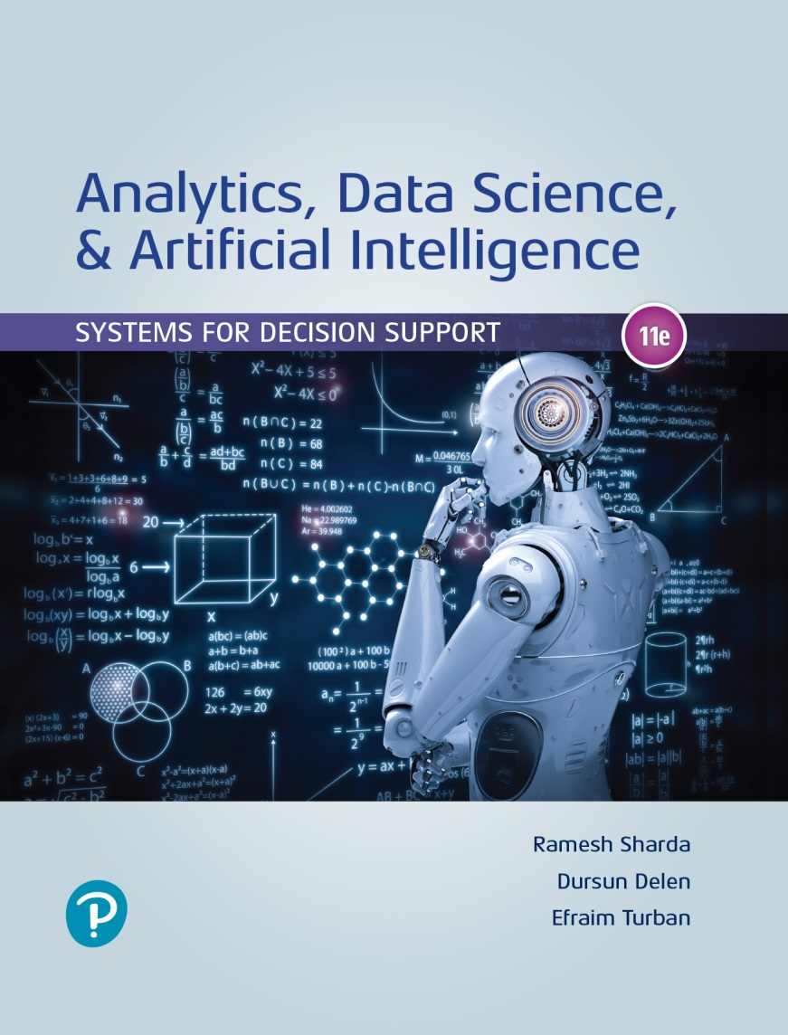
Analytics, Data Science and A I: Systems for Decision Support
Eleventh Edition
Chapter 1
Overview of Business Intelligence, Analytics, Data Science, and Artificial Intelligence: Systems for Decision Support
Slide in this Presentation Contain Hyperlinks. JAWS users should be able to get a list of links by using INSERT+F7
Copyright © 2020, 2015, 2011 Pearson Education, Inc. All Rights Reserved
Notes:
If this PowerPoint presentation contains mathematical equations, you may need to check that your computer has the following installed:
1) Math Type Plugin
2) Math Player (free versions available)
3) NVDA Reader (free versions available)

Slide 2
Learning Objectives (1 of 2)
1.1 Understand the need for computerized support of managerial decision making.
1.2 Understand the development of systems for providing decision-making support.
1.3 Recognize the evolution of such computerized support to the current state of analytics/data science and artificial intelligence.
1.4 Describe the business intelligence (B I) methodology and concepts.
1.5 Understand the different types of analytics and review selected applications.
Notes:
Slide 2 is list of textbook LO numbers and statements

Slide 3
Learning Objectives (2 of 2)
1.6 Understand the basic concepts of artificial intelligence (A I) and see selected applications.
1.7 Understand the analytics ecosystem to identify various key players and career opportunities.
Notes:
Slide 2 is a list of textbook LO numbers and statements

Slide 4
Opening Vignette (1 of 2)
How Intelligent Systems Work for KONE Elevators and Escalators Company
The problem…
The solution…
The results…

Slide 5
Opening Vignette (2 of 2)
How Intelligent Systems Work for KONE Elevators and Escalators Company
Questions For The Opening Vignette
It is said that K O N E is embedding intelligence across its supply chain and enables smarter buildings. Explain.
Describe the role of I o T in this case.
What makes I B M Watson a necessity in this case?
Check I B M Advanced Analytics. What tools were included that relate to this case?
Check I B M cognitive buildings. How do they relate to this case?

Slide 6
Changing Business Environments And Evolving Needs For Decision Support And Analytics
Big-bet, high-risk decisions.
Cross-cutting decisions, which are repetitive but high risk that require group work.
Ad hoc decisions that arise episodically.
Delegated decisions to individuals or small groups.

Slide 7
Decision Making Process (1 of 2)
The four step managerial process:
Define the problem
Construct a model
Identify and evaluate possible solutions
Compare, choose, and recommend a solution to the problem

Slide 8
Decision Making Process (2 of 2)
A more detailed process is offered by Quain (2018):
Understand the decision you have to make.
Collect all the information.
Identify the alternatives.
Evaluate the pros and cons.
Select the best alternative.
Make the decision.
Evaluate the impact of your decision.

Slide 9
The Influence of the External and Internal Environments on the Process
Technology, I S, Internet, globalization, …
Government regulations, compliance, …
Political factors
Economic factors
Social and psychological factors
Environment factors
Need to make rapid decision, changing market conditions, …

Slide 10
Technologies for Data Analysis and Decision Support
Group communication and collaboration
Improved data management
Managing giant data warehouses and Big Data
Analytical support
Overcoming cognitive limits
Knowledge management
Anywhere, anytime support
Innovation and artificial intelligence

Slide 11
Decision-making Processes And Computerized Decision Support Framework
What is “Decision making”?
Simon’s Decision Making Process
Proposed in 1977 by Herbert Alexander Simon (an American economist and political scientist)
Includes three phases:
Intelligence
Design
Choice
[+] Implementation
[+] Monitoring

Slide 12
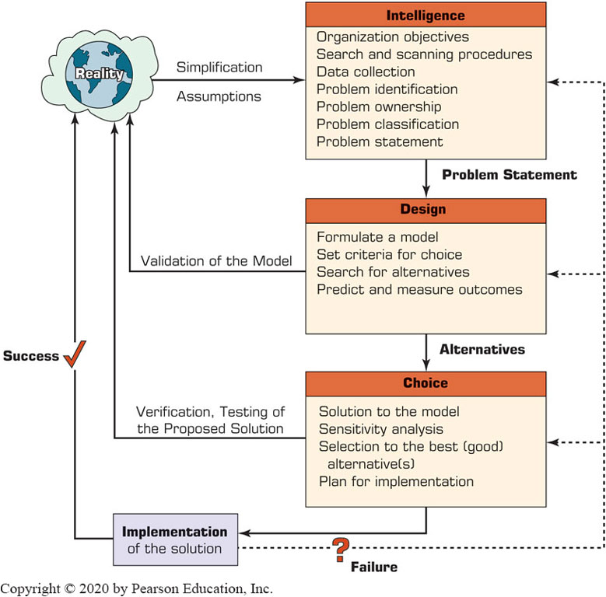
The Decision-Making Process

Slide 13
Decision-making Processes (1 of 2)
Phase 1 - The Intelligence Phase: Problem (or Opportunity) Identification
Issues in data collection
Problem classification
Problem decomposition
Problem ownership

Slide 14
Application Case 1.1
Making Elevators Go Faster!
Questions for Discussion:
Why this is an example relevant to decision making?
Relate this situation to the intelligence phase of decision making.

Slide 15
Decision-Making Processes (2 of 2)
Phase 2 - The Design Phase
Models
Phase 3 - The Choice Phase
Evaluating alternatives
Phase 4 - The Implementation Phase
Implementing the solution
Phase 5 – Monitoring
Phase 4 and 5 were not part of Simons’ original model

Slide 16
The Classical Decision Support System Framework
Degree of structuredness
Structured, unstructured, semistructured problems
Type of control
Operational, managerial, strategic
The decision Support matrix
Computer support for …
Structured decisions
Unstructured decisions
Semistructured problems

Slide 17
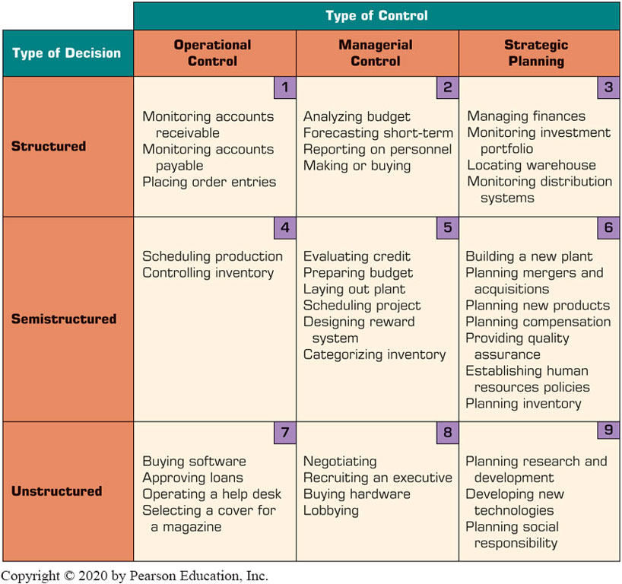
Decision Support Framework

Slide 18
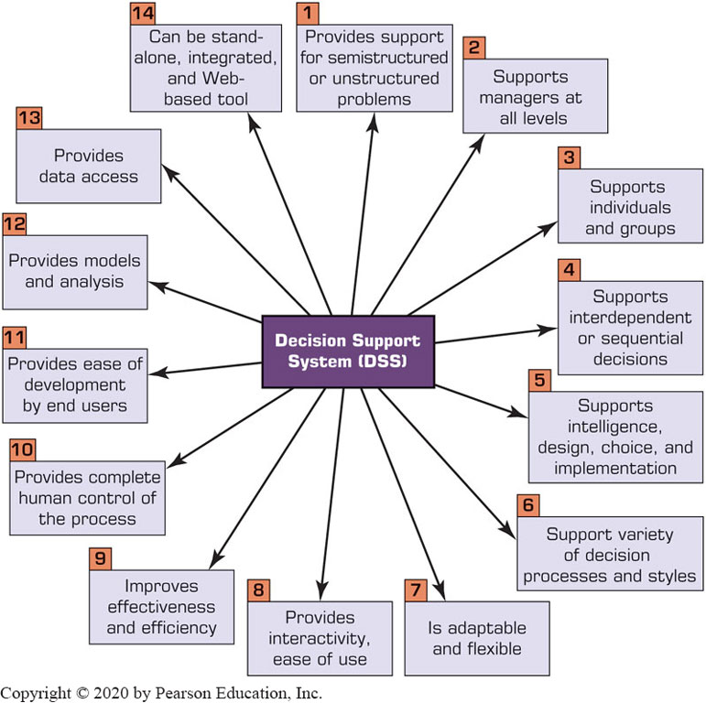
Key Characteristics and Capabilities of Decision Support System (D S S)

Slide 19
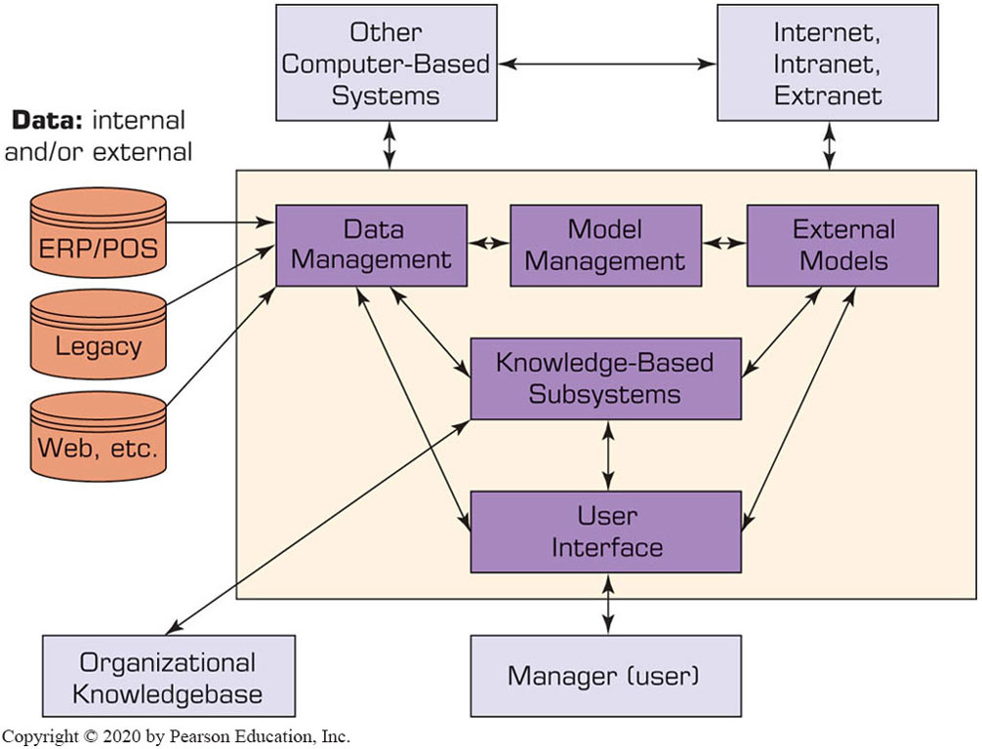
Components of a D S S (1 of 2)
The Data Management System
D S S database
Database management system (D B M S)
Data directory
Query facility

Slide 20
Components of a D S S (2 of 2)
The Model Management Subsystem
Model base
M B M S
Modeling language
Model directory
Model execution, integration, and command processor
The User Interface Subsystem
The Knowledge-Based Subsystem

Slide 21
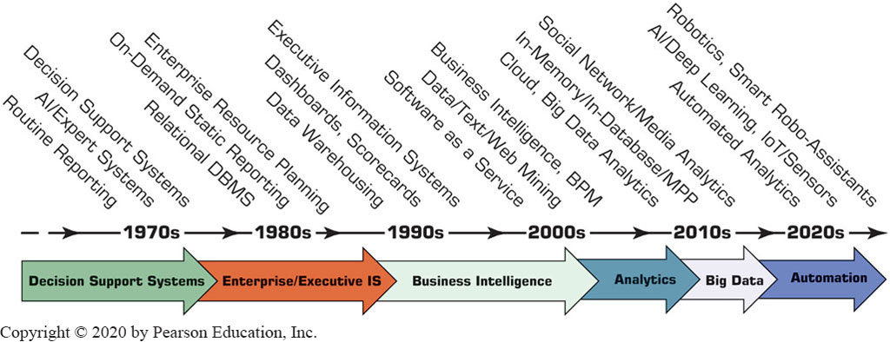
Evolution of Computerized Decision Support to Business Intelligence, Analytics, Data Science
Figure 1.5 Evolution of Decision Support, Business Intelligence, Analytics, and A I.

Slide 22
A Framework for Business Intelligence
Definitions of business intelligence (B I)
A brief history of B I
The architecture of B I
Data warehousing (D W) [as a foundation of B I]
Business performance management (B P M)
User interface (dashboard)
Transaction processing versus analytics processing
Appropriate planning and alignment of B I with the business strategy

Slide 23
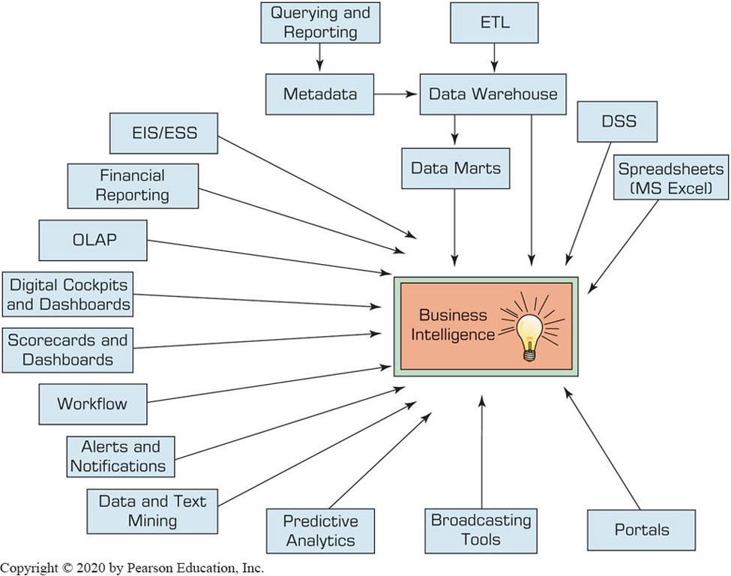
Evolution of Business Intelligence (B I)

Slide 24
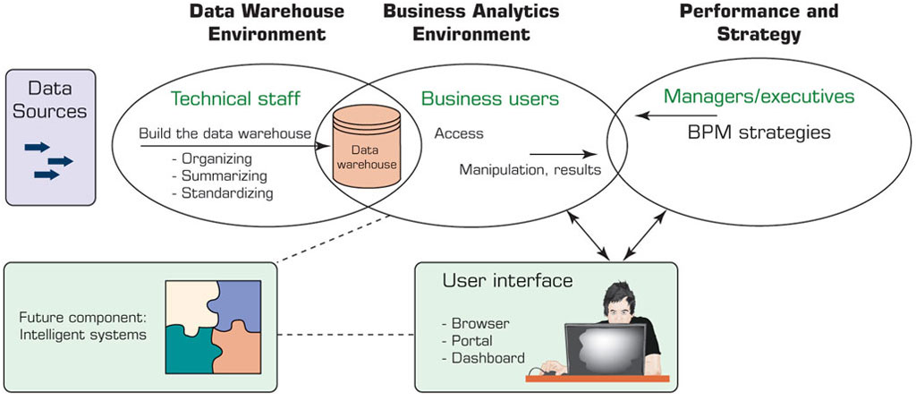
The Origins and Drivers of B I
Figure 1.7 A High-Level Architecture of B I.
Source: Based on W. Eckerson. (2003). Smart Companies in the 21st Century: The Secrets of Creating Successful Business Intelligent Solutions Seattle, W A: The Data Warehousing Institute, p. 32, Illustration 5.

Slide 25
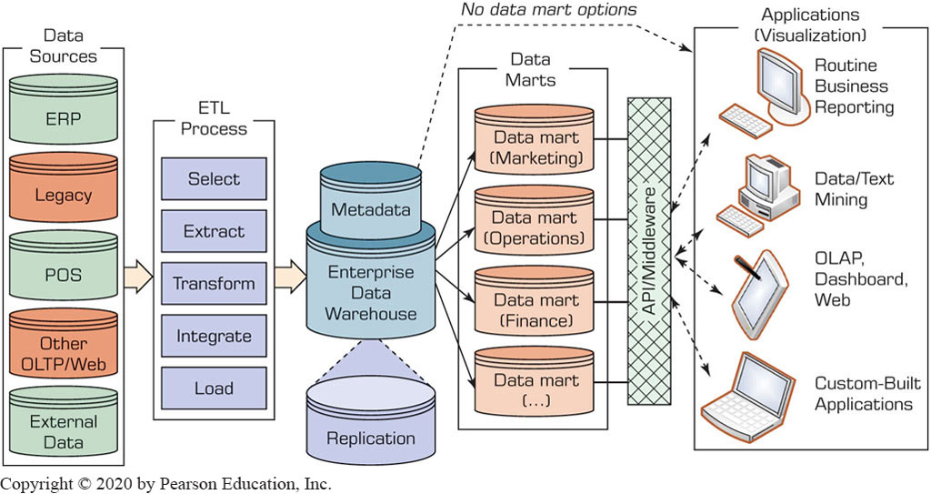
Data Warehouse Framework

Slide 26
A Multimedia Exercise in B I
Teradata University Network (T U N)
B S I (Business Scenario Investigations) [like C S I]
Watch the video - https://www.youtube.com/watch?v=NXEL5F4_aKA
Analyze the video - https://www.slideshare.net/teradata/bsi-how-we-did-it-the-case-of-the-misconnecting-passengers

Slide 27
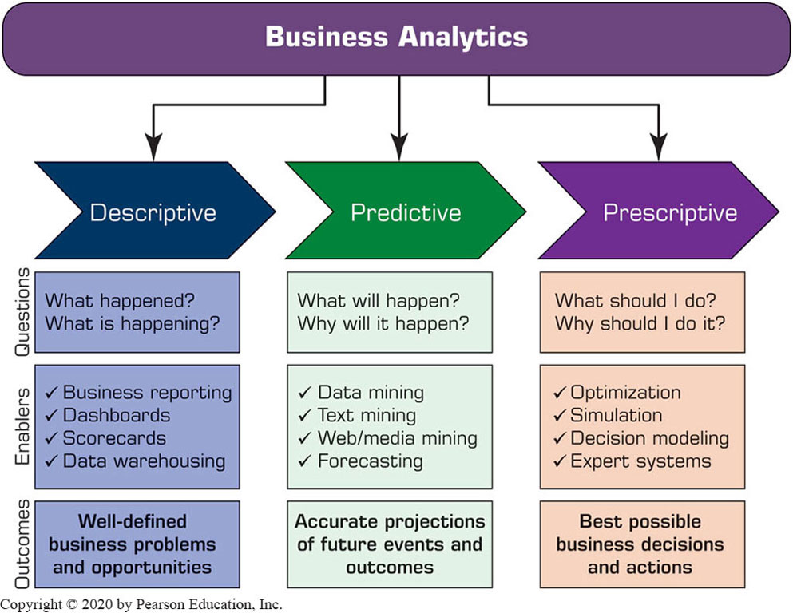
Analytics Overview (1 of 2)

Slide 28
Analytics Overview (2 of 2)
Three types of analytics
Descriptive (or reporting) analytics …
Predictive analytics …
Prescriptive analytics …
Analytics applied to different domains
Analytics or data science?
What is Big Data?

Slide 29
Application Case 1.3
Silvaris Increases Business with Visual Analysis and Real-Time Reporting Capabilities
Questions for Discussion:
What was the challenge faced by Silvaris?
How did Silvaris solve its problem using data visualization with Tableau?

Slide 30
Application Case 1.4
Siemens Reduces Cost with the Use of Data Visualization
Questions for Discussion:
What challenges were faced by Siemens visual analytics group?
How did the data visualization tool Dundas B I help Siemens in reducing cost?

Slide 31
Application Case 1.5
Analyzing Athletic Injuries
Questions for Discussion:
What types of analytics are applied in the injury analysis?
How do visualizations aid in understanding the data and delivering insights into the data?
What is a classification problem?
What can be derived by performing sequence analysis?

Slide 32
Application Case 1.6
A Specialty Steel Bar Company Uses Analytics to Determine Available-to-Promise Dates
Questions for Discussion:
Why would reallocation of inventory from one customer to another be a major issue for discussion?
How could a D S S help make these decisions?

Slide 33
Analytics Examples in Selected Domains (1 of 2)
Sports Analytics—An Exciting Frontier for Learning and Understanding Applications of Analytics
Example 1: Business office
Example 2: The Coach
Healthcare—Humana Examples
Example 1: Preventing Falls in a Senior Population
Example 2: Define the Right Metrics
Example 3: Predictive Models to Identify the Highest Risk Membership in a Health Insurer
Retail—Retail Value Chain …
Image Analytics

Slide 34
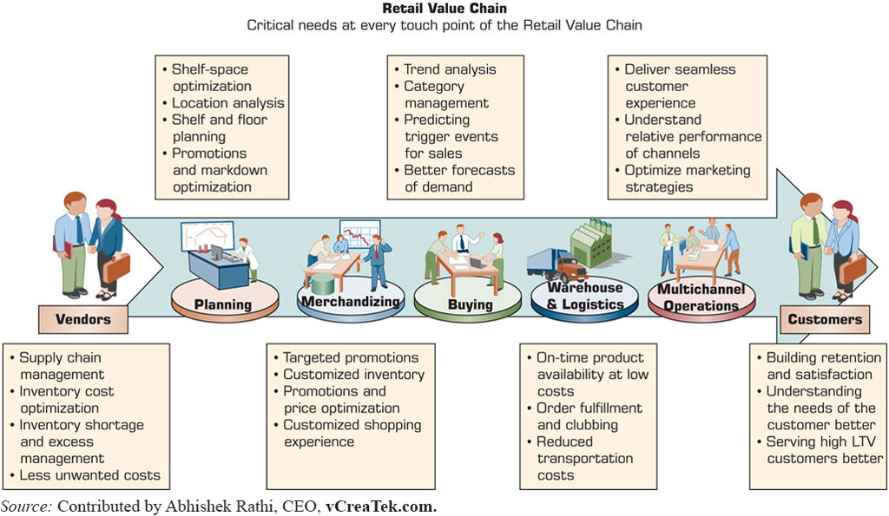
Analytics Examples in Selected Domains (2 of 2)
Retail …
Figure 1.15 Example of Analytics Applications in a Retail Value Chain.
Source: Contributed by Abhishek Rathi, C E O, vCreaTek.com.

Slide 35
Application Case 1.7
Image Analysis Helps Estimate Plant Cover
Questions for Discussion:
What is the purpose of knowing how much ground is covered by green foliage on a farm? In a forest?
Why would image analysis of foliage through an app be better than a visual check?
Explore research papers to understand the underlying algorithmic logic of image analysis. What did you learn?
What other applications of image analysis can you think of?

Slide 36
Artificial Intelligence Overview
What Is artificial intelligence (A I)?
Technology that can learn to do things better over time.
Technology that can understand human language.
Technology that can answer questions.
The major benefits of A I
Reduction in the cost of performing work.
Work can be performed much faster.
Work is more consistent than human work.
Increased productivity, profitability, …

Slide 37
The Landscape of A I
Major technologies
Knowledge-based technologies
Biometric related technologies
Tools and platforms …
A I applications …
Narrow (weak) versus general (strong) A I
The three flavors of A I decisions
Assisted intelligence
Autonomous A I
Augmented Intelligence

Slide 38
Application Case 1.8
A I Increases Passengers’ Comfort and Security in Airports and Borders
Questions for Discussion:
List the benefits of A I devices to travelers.
List the benefits to governments and airline companies.
Relate this case to machine vision and other A I tools that deal with people’s biometrics.

Slide 39
Societal Impacts of A I
Impact on agriculture
Contribution to health and medical care
Other societal applications
Transportation
Utilities
Education
Social services
Also see Chapter 13 for smart cities

Slide 40
Application Case 1.9
Robots Took the Job of Camel-Racing Jockeys for Societal Benefits
Questions for Discussion:
It is said that the robots eradicated the child slavery. Explain.
Why do the owners need to drive by their camels while they are racing?
Why not duplicate the technology for horse racing?
Summarize ethical aspects of this case (Read Boddington, 2017). Do this exercise after you have read about ethics in Chapter 14.

Slide 41
Convergence of Analytics and A I
Major differences between analytics and a i
Why combine intelligent systems?
How convergence can help?
Big Data Is empowering A I technologies
The convergence of A I and the IoT
The convergence with blockchain and other technologies
I B M and Microsoft support for intelligent systems convergence

Slide 42
Application Case 1.10
Amazon Go Is Open for Business
Questions for Discussion:
Watch the video. What did you like and/or dislike?
Compare the process described here to a self-check available today in many supermarkets and “big box” stores (Home Depot, etc.).
The store was opened in downtown Seattle. Why was the downtown location selected?
What are the benefits to customers? To Amazon?
Will customers be ready to trade privacy for convenience? Discuss.

Slide 43
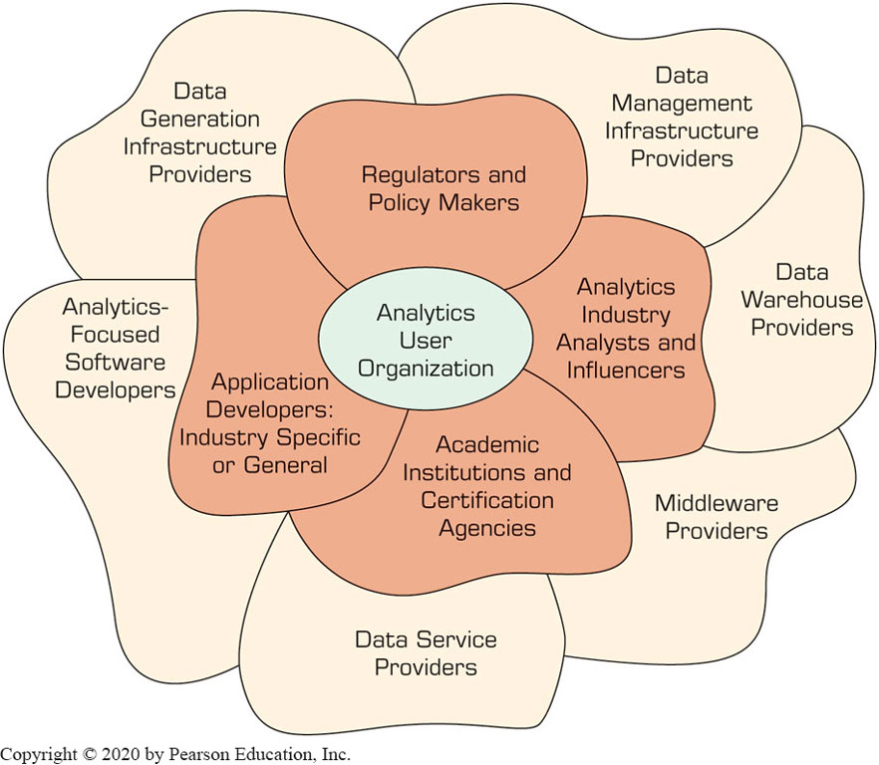
Overview of Analytics Ecosystem

Slide 44
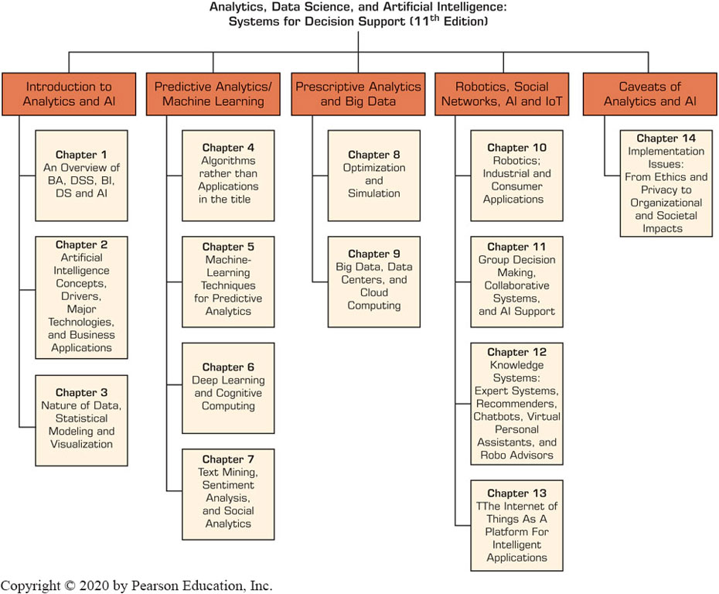
Plan of the Book

Slide 45

Copyright
This work is protected by United States copyright laws and is provided solely for the use of instructors in teaching their courses and assessing student learning. Dissemination or sale of any part of this work (including on the World Wide Web) will destroy the integrity of the work and is not permitted. The work and materials from it should never be made available to students except by instructors using the accompanying text in their classes. All recipients of this work are expected to abide by these restrictions and to honor the intended pedagogical purposes and the needs of other instructors who rely on these materials.

