Slide 1
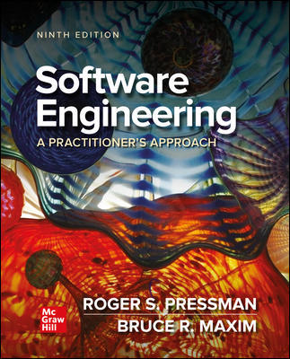
Chapter 18
Software Security Engineering
Part Three - Quality and Security

Slide 2
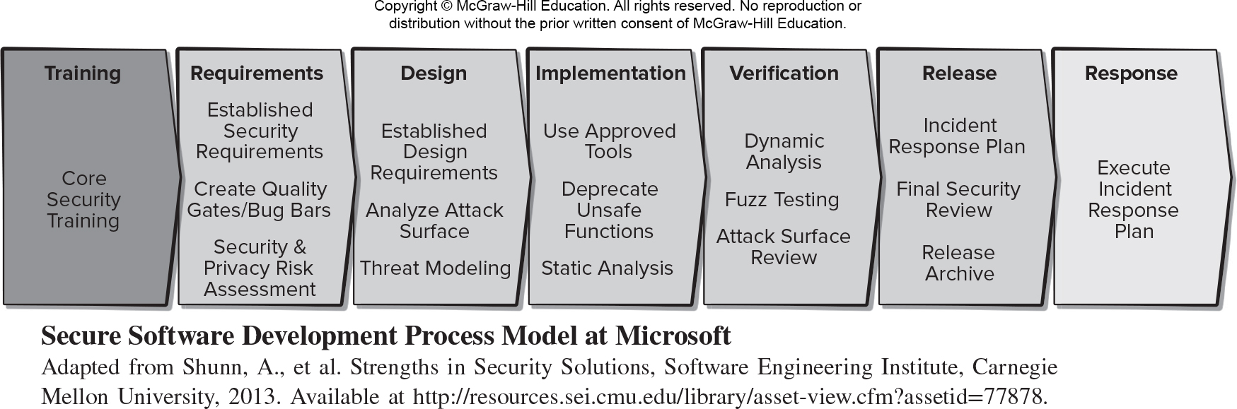
Secure Software Development Process Model
Access the text alternative for slide images.

Slide 3
Microsoft Secure by Design
Secure architecture, design, and structure. Developers consider security issues part of the software architectural design process.
Threat modeling and mitigation. Threat models created and mitigations are present in all design and functional specifications.
Elimination of vulnerabilities. This review includes the use of analysis and testing tools to eliminate classes of vulnerabilities presents in the code.
Improvements in security. Less secure legacy protocols and code are deprecated, users are provided with secure alternatives consistent.

Slide 4
Microsoft Secure by Default
Least privilege. All components run with the fewest possible permissions.
Defense in depth. Components do not rely on a single threat mitigation solution that exposes users if it fails.
Conservative default settings. Development team minimizes attack surface in default configuration.
Avoidance of risky default changes. Applications do not make any changes that reduce computer security.
Less commonly used services off by default. If fewer than 80 percent of a program’s users use a feature, that feature should not be activated by default.

Slide 5
Microsoft Secure in Deployment
Deployment guides. Prescriptive deployment guides outline how to deploy each feature of a program securely, including providing users with information that enables them to assess the security risk of activating non-default options.
Analysis and management tools. Security analysis and management tools enable administrators to configure the optimal security level for a release.
Patch deployment tools. Deployment tools aid in patch deployment.

Slide 6
Communications
Security response. Development teams respond promptly to reports of security vulnerabilities and communicate information about security updates.
Community engagement. Development teams proactively engage with users to answer questions about security vulnerabilities, security updates, or changes in the security landscape.

Slide 7
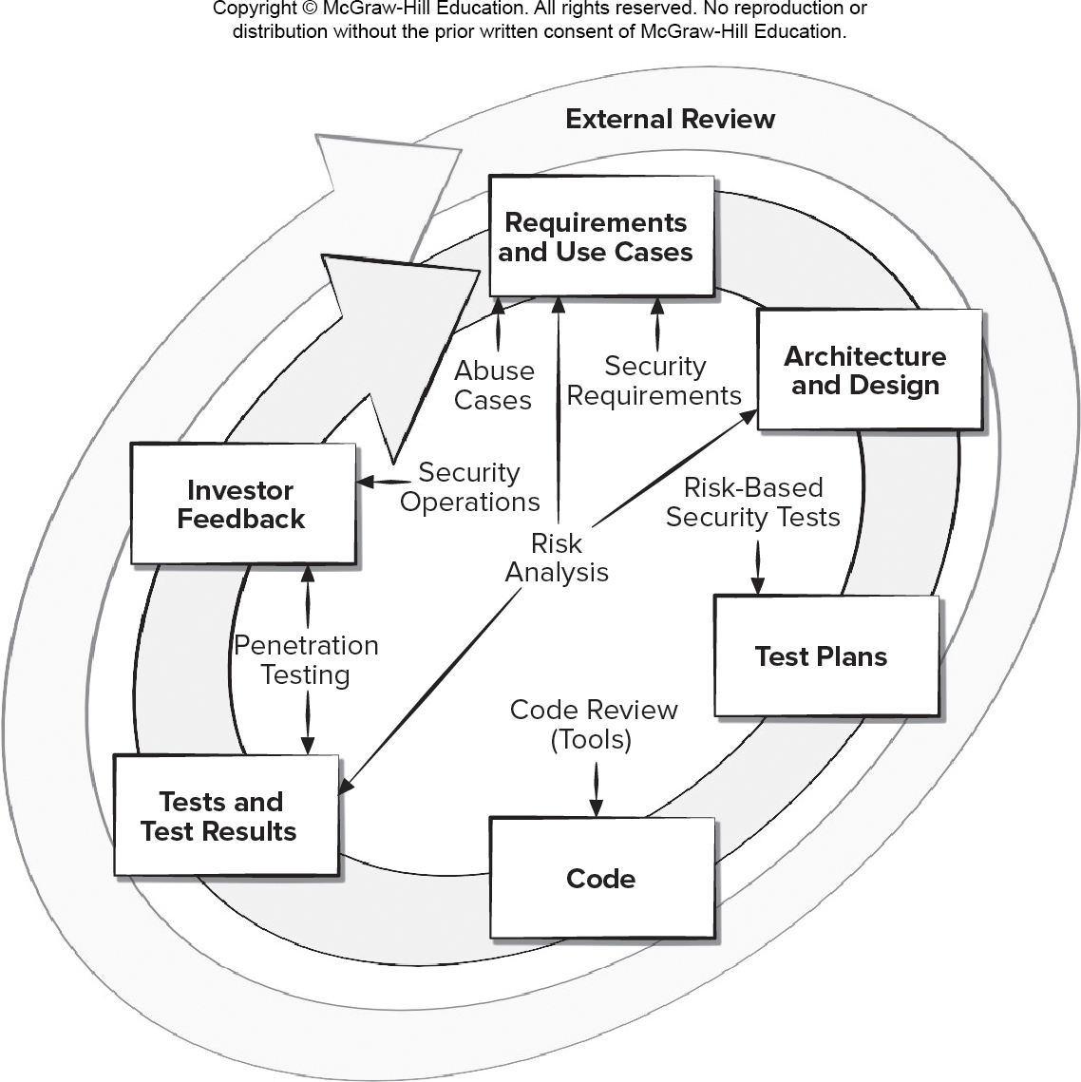
Software Security Touchpoints (Activities)
Access the text alternative for slide images.

Slide 8
SQUARE Security Requirements Engineering 1
Step 1. Agree on definitions. Needed as a prerequisite to security requirements engineering so there is no semantic confusion.
Step 2. Identify assets and security goals. Step occurs at project organizational level and needed to support software development.
Step 3. Develop artifacts. Often, organizations do not have key documents needed to support requirements definition, or they may not be up to date.
Step 4. Perform risk assessment. Requires an expert in risk assessment methods, support of stakeholders, and support of a security requirements engineer.

Slide 9
SQUARE Security Requirements Engineering 2
Step 5. Select elicitation technique. This step becomes important when there are diverse stakeholders.
Step 6. Elicit security requirements. This builds on the artifacts that were developed in earlier steps.
Step 7. Categorize requirements. Allows security requirements engineer to identify essential requirements.
Step 8. Prioritize requirements. Performs a cost-benefit analysis to determine security requirements with a high payoff relative to their cost.
Step 9. Requirements inspection.

Slide 10
Misuse (Abuse) Cases
A misuse case can be thought of as a use case that the attacker initiates.
Misuse cases need to be prioritized as generated.
Trying to answer such questions like these help developers to analyze their assumptions and allows them to fix problems up front:
How can the system distinguish between valid and invalid input data?
Can it tell whether a request is coming from a legitimate application or a rogue application?
Can an insider cause a system to malfunction?

Slide 11
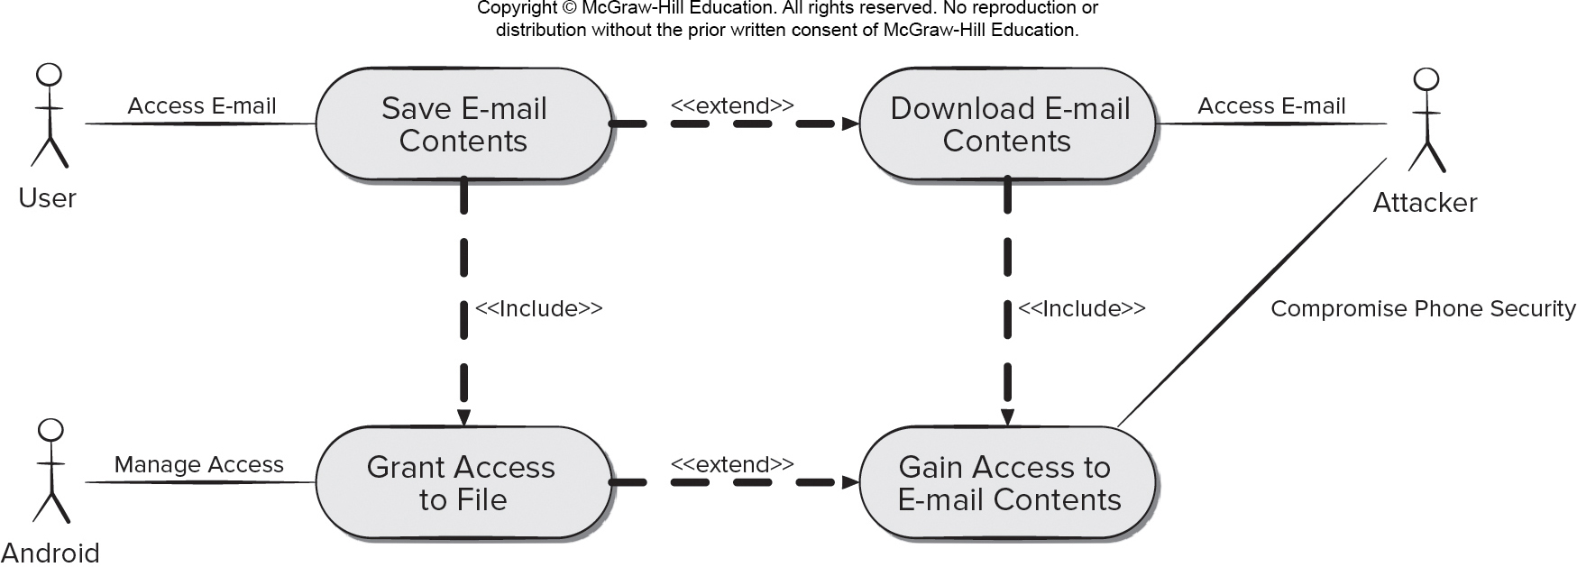
Misuse Case Example
Access the text alternative for slide images.

Slide 12
Attack Patterns
Attack patterns can provide some help by providing a blueprint for creating an attack.
For example, buffer overflow is one type of security exploitation.
Attackers trying to capitalize on a buffer overflow make use of similar steps.
Attack patterns can document these steps (for example, timing, resources, techniques) as well as practices software developers can use to prevent or mitigate their success.
When you’re trying to develop misuse cases, attack patterns can help.

Slide 13
Risk Management Framework (R M F) Steps
Categorize the information system and the information processed, stored, and transmitted by that system based on an impact analysis.
Select an initial set of baseline security controls for the information system based on the security categorization.
Implement the security controls and describe how the controls are employed within the information system and its environment.
Assess security controls to determine the extent to which they are operating to meeting system security requirements.
Authorize information system operation based on a determination that the risk to organization, assets, and individuals is acceptable.
Monitor the security controls in the information system on an ongoing basis including assessing control effectiveness, documenting changes to the system.

Slide 14
STRIDE Threat Categories
Threat
Spoofing
Tampering
Repudiation
Information disclosure
Denial of service
Elevation of privilege
Security Property
Authentication
Integrity
Nonrepudiation
Confidentiality
Availability
Authorization

Slide 15
STRIDE Threat Modeling Steps
Typical STRIDE implementation includes modeling a system with data flow diagrams (D F Ds):
Mapping the D F D elements to the six threat categories,
Determining the specific threats via checklists or threat trees.
Documenting the threats and steps for their prevention.
In the next stage, the STRIDE user works through a checklist of specific threats that are associated with each match between a D F D element and threat category.
Once the threats have been identified, mitigation strategies can be developed and prioritized.
Typically, prioritization is based on cost and value considerations of implementing or not implementing a mitigation strategy,

Slide 16
Attack Surface
The attack surface of an application is:
The sum of all paths for data/commands into and out of the application.
The code that protects these paths.
All valuable data used in the application.
The code that protects these data.
Attack Surface Analysis involves mapping the parts of a system need to be reviewed and tested for security vulnerabilities with the intention of minimizing risks to the attack surface.

Slide 17
Secure Coding Practices 1
Validate input. Validate input from all untrusted data sources.
Heed compiler warnings. Compile code using the highest warning level available for your compiler and eliminate warnings by modifying the code.
Architect and design for security policies. Create a software architecture and design your software to implement and enforce security policies.
Keep it simple. Keep the design as simple and as small as possible.
Default deny. Base access decisions on permission rather than exclusion.

Slide 18
Secure Coding Practices 2
Adhere to the principle of least privilege. Every process should execute with the least set of privileges necessary to complete the job.
Sanitize data sent to other systems. Sanitize all data passed to complex subsystems such as command shells, relational databases, and commercial off-the-shelf (COTS) components.
Practice defense in depth. Manage risk with multiple defensive strategies.
Use effective quality assurance techniques.
Adopt a secure coding standard.

Slide 19
Measurement
Measures of software quality can go a long way toward measuring software security.
Defect and vulnerability count are useful measures.
Not all software defects are security problems, vulnerabilities in software generally result from a defect of some kind in the requirements, architecture, or code.
To assess software vulnerabilities and associated security issues, data must be collected data so that patterns can be analyzed over time.
Without collecting data about software security issues, it is impossible to measure its improvement.

Slide 20
Security Measure Examples
Percentage of security requirements covered by attack patterns, misuse and abuse cases, and other specified means of threat modeling and analysis (Requirements Engineering).
Percentage of architectural and design components subject to attack surface analysis and measurement (Architecture and Design).
Financial and/or human safety estimate of impact for each threat category (Risk).
Number of (vetted) trusted suppliers in the supply chain by level (Trusted Dependencies).

Slide 21
Software Assurance Maturity Model (SAMM)
SAMM is an open framework with the following objectives:
Evaluate an organization’s existing software security practices.
Build a balanced software security assurance program in well-defined iterations.
Demonstrate concrete improvements to a security assurance program.
Define and measure security-related activities throughout an organization.

Slide 22
End of Main Content

Slide 23
Accessibility Content: Text Alternatives for Images

Slide 24
Secure Software Development Process Model – Text Alternative
Return to parent-slide containing images.
An illustration displays a secure software development process model. The steps in the model are training, requirement, design, implementation, verification, release, and response. Training has core security training. The requirement needs are: established security requirements, create quality gates or bug bars, security and privacy risk assessments. The design requirements are: established design requirements, analyze attack surface, and threat modeling. During implementation use: approved tools, deprecate unsafe functions, and static analysis. The verification process needs: dynamic analysis, fuzz testing, and attack surface review. During release have an: incident response plan, final security review, and release archive. The response needs to have an execute incident response plan.
Return to parent-slide containing images.

Slide 25
Software Security Touchpoints (Activities) – Text Alternative
Return to parent-slide containing images.
An illustration displays software security touchpoints for a risk analysis. The outer level displays an external review circle. The inner circular model displays following processes: requirements and use cases, architecture and design, test plans, code, test and test results, and investor feedback. The requirements and use cases include: risk analysis, abuse cases, and security requirements. Architecture and design has risk analysis. The test plan includes risk based security test. The code includes a code review or tools. The tests and test results, and investor feedback include penetration testing. The investor feedback include security operations. The requirements and use cases, architecture and design, and tests and test results contain risk analysis.
Return to parent-slide containing images.

Slide 26
Misuse Case Example – Text Alternative
Return to parent-slide containing images.
The diagram shows a misuse case example. A user accesses e-mail and gives the command save e-mail contents which has an include relationship with grant access to file and an extend relationship to download e-mail contents. Download e-mail contents has an include relationship with gain access to e-mail contents. The grant access to file is managed by the android; and has an extend relationship with gain access to e-mail contents. An attacker can access e-mail at download email contents and a compromised phone security gives him access to gain access to e-mail contents.
Return to parent-slide containing images.

