Slide 1

Chapter 24
Project Management Concepts
Part Four – Managing Software Projects

Slide 2
Management Spectrum – Four P’s
People — the most important element of a successful project.
Product — the software to be built.
Process — the set of framework activities and software engineering tasks to get the job done.
Project — all work required to make the product a reality.

Slide 3
Stakeholders
Senior managers - define the business issues that often have significant influence on the project.
Project (technical) managers - who must plan, motivate, organize, and control the practitioner.
Practitioners - who deliver the technical skills that are necessary to engineer a product or application.
Customers - specify requirements for the software to be engineered and other interested product stakeholders.
End-users - interact with the software once it is released for production use.

Slide 4
Team Leaders
Kouzes exemplary practices for technology leaders:
Model the way. Leaders must practice what they preach. They demonstrate commitment to team and project by shared sacrifice.
Inspire and shared vision. Motivate team members to tie their personal aspirations to team goals. Involve stakeholders early.
Challenge the process. Encourage team members to experiment and take risks by helping them generate frequent small successes while learning from their failures.
Enable others to act. Increase the team’s sense of competence through sharing decision making and goal setting.
Encourage the heart. Build community (team) spirit by celebrating shared goals and victories (individual and team).

Slide 5
Factors Affecting Software Team Structure
Difficulty of the problem to be solved.
Size of the resultant program(s) in lines of code or function points.
Team lifetimes - time that the team will stay together.
Degree to which the problem can be modularized.
Required quality and reliability of the system to be built.
Rigidity of the delivery date.
Communication (degree of sociability) required.

Slide 6
Team Toxicity Factors
Frenzied work atmosphere team members waste energy and lose focus on work objectives.
High frustration caused by personal, business, or technological factors causing team member friction.
Fragmented or poorly coordinated procedures poorly defined or improperly chosen process model.
Unclear definition of roles resulting in lack of accountability and resultant finger-pointing.
Continuous and repeated exposure to failure leads to a loss of confidence and a lowering of morale.

Slide 7
Agile Teams
Team members must have trust in one another.
The distribution of skills must be appropriate to the problem.
Mavericks may have to be excluded from the team, if team cohesiveness is to be maintained.
Team is “self-organizing.”
An adaptive team structure.
Planning is kept to a minimum.
Team select its own approach constrained by business requirements and organizational standards.

Slide 8
Team Coordination and Communication Issues
Scale of many development efforts is large, leading to complexity, confusion, and significant difficulties in coordinating team members.
Uncertainty is common, resulting in a continuing stream of changes that ratchets the project team.
Interoperability - new software must communicate with existing software and conform to constraints imposed by existing systems or products.

Slide 9
Team Coordination and Communication
To accomplish this, mechanisms for formal and informal communication among team members and between multiple teams must be established.
Formal communication is accomplished through writing, structured meetings, and other relatively non-interactive and impersonal communication channels.
Informal communication is more personal and allow team members to interact with one another on a daily basis - share ideas on an ad hoc basis and ask for help as problems arise.

Slide 10
Software Scope
Software project scope must be unambiguous and understandable at management and technical levels.
Context. How does the software to be built fit into a larger system, product, or business context and what constraints are imposed as a result of the context?
Information objectives. What customer-visible data objects are produced as output from the software? What data objects are required for input?
Function and performance. What function does the software perform to transform input data into output? Are any special performance characteristics to be addressed?

Slide 11
Problem Decomposition
Sometimes called partitioning or problem elaboration.
Once scope is defined …
It is decomposed into constituent functions.
It can be decomposed into user-visible data objects.
or
It can be decomposed into a set of problem classes.
Decomposition process continues until all functions or problem classes have been defined.

Slide 12
Process
Your team must decide which process model is most appropriate for.
the customers who have requested the product.
the people who will do the work.
the characteristics of the product itself.
the project environment in which the software team works.
Team selects process model and defines a preliminary project plan (based set of process framework activities).
Once the preliminary plan is established, process decomposition begins.

Slide 13
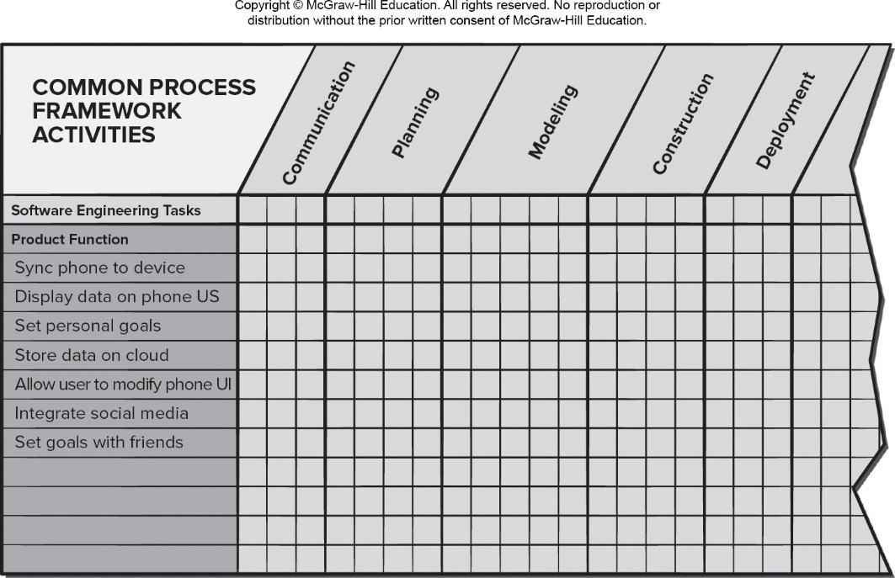
Melding Product and Process
Access the text alternative for slide images.

Slide 14
Successful Project Characteristics 1
Clear and well-understood requirements accepted by all stakeholders.
Active and continuous participation of users throughout the development process.
A project manager with required leadership skills who is able to share project vision with the team.
A project plan and schedule developed with stakeholder participation to achieve user goals.
Skilled and engaged team members.

Slide 15
Successful Project Characteristics 2
Development team members with compatible personalities who enjoy working in a collaborative environment.
Realistic schedule and budget estimates which are monitored and maintained.
Customer needs that are understood and satisfied.
Team members who experience a high degree of job satisfaction.
A working product that reflects desired scope and quality.

Slide 16
W⁵HH Principle
Why is the system being developed?
What will be done?
When will it be accomplished?
Who is responsible?
Where are they organizationally located?
How will the job be done technically and managerially?
How much of each resource (for example, people, software, tools, database) will be needed?

Slide 17
Critical Practices
Formal risk management.
Empirical cost and schedule estimation.
Metrics-based project management.
Earned value tracking.
Defect tracking against quality targets.
People aware project management.

Slide 18
End of Main Content

Slide 19
Accessibility Content: Text Alternatives for Images

Slide 20
Melding Product and Process – Text Alternative
Return to parent-slide containing images.
The figure shows a table for melding product and process. The table has 6 columns. The first column labeled common process framework activities lists the various activities. The other columns are labeled: communication, planning, modelling, construction and deployment. The listed activities are: software engineering tasks; product functions like: sync phone to device; display data on phone U S; set personal goals; store data on cloud; allow user to modify phone U I; integrate social media and set goals with friends.
Return to parent-slide containing images.

