Slide 1
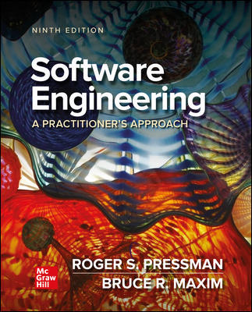
Chapter 27
A Strategy for Software Support
Part Four – Managing Software Projects

Slide 2
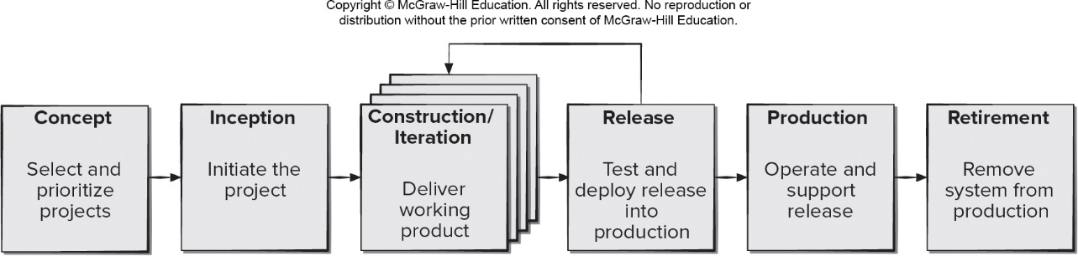
Prototype Evolution Process Model
Access the text alternative for slide images.

Slide 3
Lehman’s Laws of Software Evolution
Law of continuing change (19 74). Software implemented in a real-world will therefore evolve over time and must be continually adapted. Law of increasing complexity (19 74). As a system evolves its complexity increases unless work is done to maintain or reduce it.
Law of conservation of familiarity (19 80). As a system evolves all associated with it, all stakeholders must maintain knowledge of its content and behavior to achieve satisfactory evolution. Excessive growth diminishes that knowledge.
Law of continuing growth (19 80). The functional content of systems must be continually increased to maintain user satisfaction.
Law of declining quality (19 96). The quality of systems will appear to be declining unless they are rigorously maintained and adapted to operational environment changes.

Slide 4
Software Support
Software support can be considered an umbrella activity that includes:
Change management.
Proactive risk management.
Process management.
Configuration management.
Quality assurance.
Release management.

Slide 5
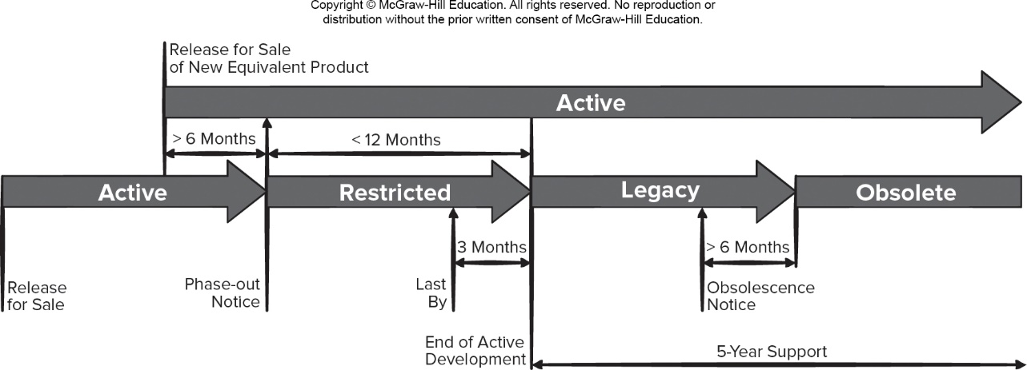
Software Release and Retirement
Access the text alternative for slide images.

Slide 6
Release Management
Release management - process that brings high-quality code from developer’s workspace to the end user includes:
Code change integration.
Continuous integration.
Build system specifications.
Infrastructure-as-code.
Deployment and release.
Retirement.

Slide 7
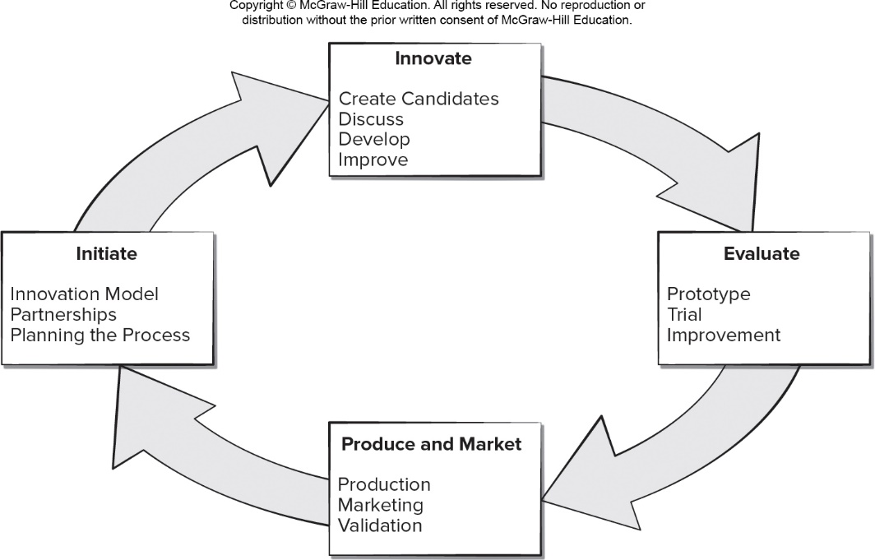
Iterative Software Support Model
Access the text alternative for slide images.

Slide 8
Software Supportability
Capability of supporting software over its whole lifetime.
Implies satisfying all necessary requirements and also the provision of resources, support infrastructure, additional software, facilities, and manpower needed to ensure software is capable of performing its functions.
Software should contain facilities to assist support personnel when a defect is encountered in the operational environment.
Support personnel should have access to a database containing records of all defects that have already been encountered—their characteristics, cause, and cure.

Slide 9
Software Maintenance
Software is released to end-users, and:
Within days, bug reports filter back to the software engineering organization.
Within weeks, one class of users indicates that the software must be changed so that it can accommodate the special needs of their environment.
Within months, another corporate group who wanted nothing to do with the software when it was released, now recognizes that it may provide them with benefits and want few enhancements to make it work better for their needs.
All of this work is software maintenance

Slide 10
Maintainable Software
Maintainable software exhibits effective modularity.
It makes use of design patterns that allow ease of understanding.
It has been constructed using well-defined coding standards, leading to understandable source code.
It has undergone quality assurance techniques that uncovered maintenance problems before release.
It was created by software engineers who recognize that they may not be around when changes must be made.
The design and implementation of the software must “assist” the person who is making the change.

Slide 11
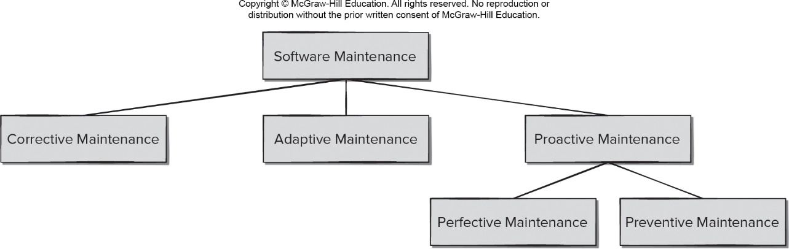
Maintenance Types
Access the text alternative for slide images.

Slide 12
Maintenance and Support
Reverse engineering - process of analyzing a software system to create representations of the system at a higher level of abstraction. Often to used rediscover and redocument system design elements prior to modifying the system source code.
Refactoring - process of changing a software system to improves its internal structure without altering its external behavior. Often used to improve the quality of a software product and make it easier to understand and maintain.
Reengineering (evolution) - process of taking an existing software system and generating a new system that has the same quality as software created using modern software engineering practices.

Slide 13
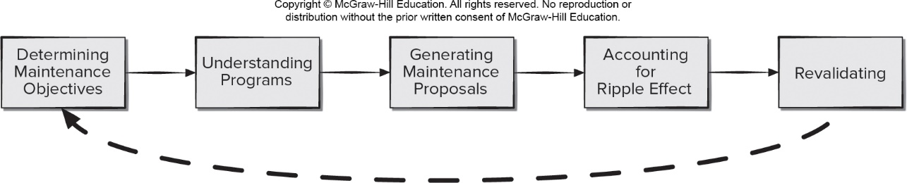
Maintenance Tasks
Access the text alternative for slide images.

Slide 14
Agile Maintenance 1
Use sprints to organize the maintenance work. Balance the goal of keeping customers happy with technical needs of the developers.
Allow urgent customer requests to interrupt scheduled maintenance sprints, make time for them during sprint planning.
Facilitate team learning by ensuring that more experienced developers are able to mentor less experienced team members.
Allow multiple team members to accept customer requests as they and coordinate their processing with maintenance team members.

Slide 15
Agile Maintenance 2
Balance the use of written documentation with face-to-face communication to ensure planning meeting time is used wisely.
Write informal use cases to supplement documentation being used for communications with stakeholders.
Have developers test each other’s work (both defect repairs and new feature implementations).
Make sure developers are empowered to share knowledge with one another. Motivates people to improve the skills and knowledge.
Keep planning meetings short, frequent, and focused.

Slide 16
Reverse Engineering
Reverse Engineering to Understand Data - first reengineering task often begins by constructing U M L class diagram.
Reverse Engineering of Internal Data Structures - focuses on the definition of object classes.
Reverse Engineering of Database Structure - reengineering one database schema into another requires an understanding of existing objects and their relationships.
Reverse engineering to understand processing - attempts to understand procedural abstractions in source code.
Reverse engineering to understand user interfaces - may need to be done as part of the maintenance task (for example, adding a G U I).

Slide 17
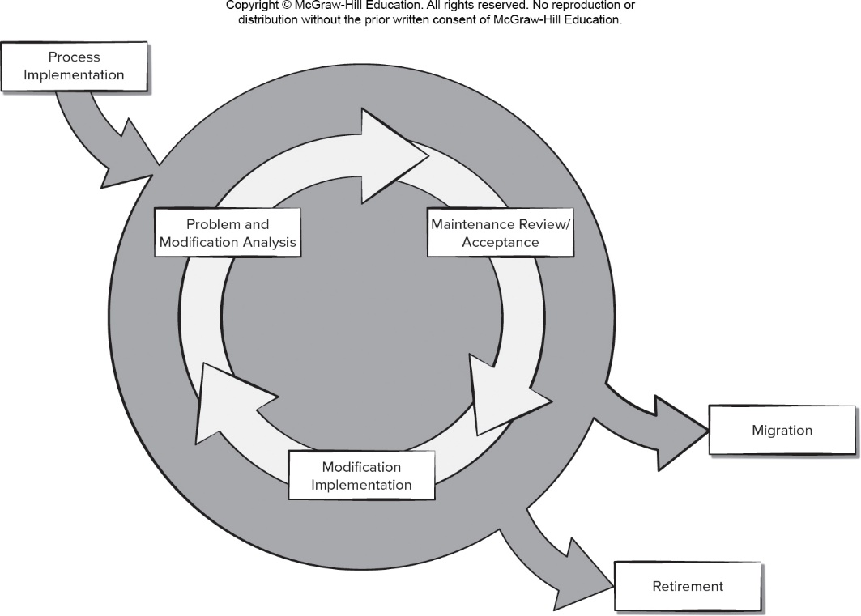
Proactive Software Support Model
Access the text alternative for slide images.

Slide 18
Software Analytics and Proactive Maintenance
Be sure you are using analytics to identify meaningful development problems, or you will get no buy-in from the software engineers.
The analytics must make use of application domain knowledge to be useful to developers (this implies the use of experts to validate the analytics).
Developing analytics requires iterative and timely feedback from the intended users.
Make sure the analytics are scalable to larger problems and customizable to incorporate new discoveries made over time.
Evaluation criteria used needs to be correlated to real software engineering practices.

Slide 19
Role of Social Media
Many online stores allow users to provide feedback on the apps by posting ratings or comments.
The feedback found in these reviews may contain usage scenarios, bug reports, or feature requests.
Mining these reports can help developers identify potential maintenance and software evolution tasks.
Many companies maintain Facebook pages or Twitter feeds to support their user communities.
Some companies encourage product users to send program crash information for analysis by the support team members.
Some companies use the questionable practice of tracking how and where products are used by customers without their knowledge.

Slide 20
Cost of Support 1
Nine parameters are defined:
P₁ = current annual maintenance cost for an application.
P₂ = current annual operation cost for an application.
P₃ = current annual business value of an application.
P₄ = predicted annual maintenance cost after reengineering.
P₅ = predicted annual operations cost after reengineering.
P₆ = predicted annual business value after reengineering.
P₇ = estimated reengineering costs.
P₈ = estimated reengineering calendar time.
P₉ = reengineering risk factor (P₉ = 1.0 is nominal).
L = expected life of the system.

Slide 21
Cost of Support 2
The cost associated with continuing maintenance of a candidate application (that is, reengineering is not performed) can be defined as:
The costs associated with reengineering are defined using the following relationship:
Using the costs presented in equations above, the overall benefit of reengineering can be computed as:

Slide 22
Data Refactoring
Data refactoring should be preceded by source code analysis.
Data analysis requires the evaluation of programming language statements containing data definitions, file descriptions, I/O, and interface descriptions are evaluated.
Data redesign involves a data record standardization which clarifies data definitions to achieve consistency among data item names or physical record formats, data name rationalization ensures that data naming conventions conform to local standards.
When refactoring moves beyond standardization and rationalization, physical modifications to existing data structures are made to make the data design more effective.
This may mean a translation from one file format to another, or in some cases, translation from one type of database to another.

Slide 23
Code Refactoring
Code refactoring is performed to yield a design that produces the same function but with higher quality than the original program.
The objective is to take “spaghetti-bowl” code and derive a design that conforms to the quality factors defined for the product.
Another approach relies on the use of anti-patterns to identify bad code design practices and suggest possible solutions.
Code refactoring can alleviate immediate problems associated with debugging or small software changes it is not reengineering.
Real benefit of code refactoring is achieved only when data and architecture are refactored as well.

Slide 24
Architectural Refactoring
Architectural refactoring as one of the design trade-off options for dealing with a messy program:
You can struggle through modification after modification, fighting the ad hoc design and tangled source code to implement the necessary changes.
You can attempt to understand the broader inner workings of the program to make modifications more effectively.
You can revise (redesign, recode, and test) those portions of the software that require modification, applying a meaningful software engineering approach to all revised segments.
You can completely redo (redesign, recode, and test) the program, using reengineering tools to understand the current design.

Slide 25
Software Evolution
The cost to maintain one line of source code may be 20 to 40 times the cost of initial development of that line.
Redesign of the software architecture (program and/or data structure), using modern design concepts, can greatly facilitate future maintenance.
Because a prototype of the software already exists, development productivity should be much higher than average.
Tools for reengineering will automate some parts of the job.
Users now have experience with the software so new requirements and change direction can be ascertained with greater ease.
A complete software configuration (documents, programs and data) when the evolutionary preventive maintenance is done.

Slide 26
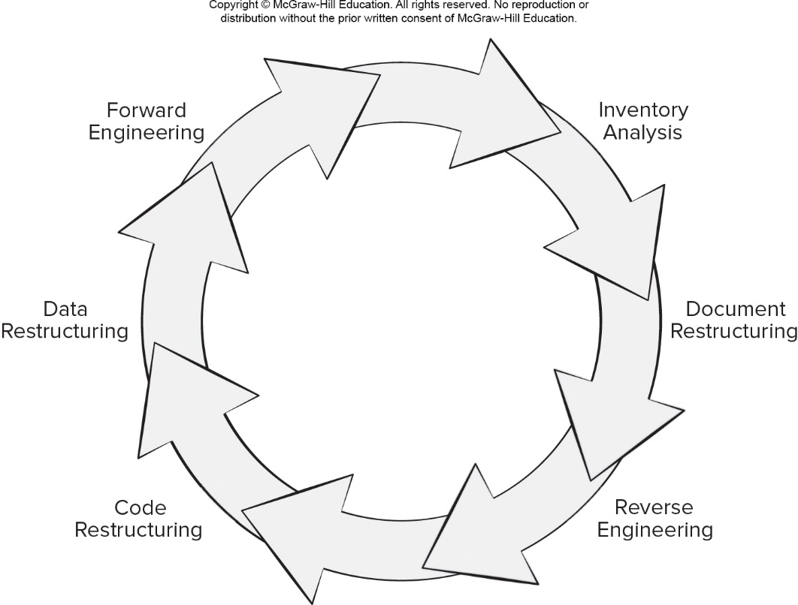
Reengineering Process Model
Access the text alternative for slide images.

Slide 27
Inventory Analysis
Every software organization should have an inventory of all applications.
The inventory can a spreadsheet model containing information that provides a detailed description (For example size, age, business criticality) of every active application.
Sorting this information according to business criticality, longevity, current maintainability, and other criteria, helps to identify candidates for reengineering appear.
Resources can then be allocated to candidate applications for reengineering work.
The inventory should be revisited on a regular basis.

Slide 28
Document Restructuring
Weak documentation is the trademark of many legacy systems.
In some cases, creating documentation when none exists is simply too costly.
In other cases, some documentation must be created, but only when changes are made.
If a modification occurs, document it - try to reign in technical debt. There are situations in which a critical system must be fully documented, but documents to an essential minimum.

Slide 29
Code Restructuring
Source code is analyzed using a refactoring tool.
Poorly design code segments are redesigned.
Violations of structured programming are noted and code is refactored (this can be done automatically).
The resultant refactored code is reviewed and tested to ensure that no anomalies have been introduced.
Internal code documentation is updated.

Slide 30
Data Restructuring
Data refactoring is a full-scale reengineering activity.
The current data architecture is analyzed and necessary data models are defined.
Data objects and attributes are identified, and existing data structures are reviewed for quality.
When data structure is weak (for example, flat files are currently implemented, when a relational approach would greatly simplify processing), the data are reengineered.
Data architecture has a strong influence on program architecture and the algorithms that populate it, changes to the data result in architectural or code-level changes.

Slide 31
Forward Engineering
In an ideal world, applications would be rebuilt using an automated “reengineering engine.
Forward engineering recovers design information from existing software and uses this information to alter or reconstitute the existing system to improve its overall quality.
Reengineered software re-creates the function of the existing system and adds new functions and/or improves overall performance.
Forward engineering does not simply create a modern equivalent of an older program - the redeveloped program extends the capabilities of the older application.

Slide 32
End of Main Content

Slide 33
Accessibility Content: Text Alternatives for Images

Slide 34
Prototype Evolution Process Model – Text alternative
Return to parent-slide containing images
An illustration displays a prototype evolution process model. The steps in the process are concept, inception, construction or iteration, release, production, and retirement. In the concept phase the product is selected and prioritized. The inception stage initiates the project. The construction or iteration phase delivers working product. The release phase will test and deploy release into production. The process may return to construction phase or move on to the production phase. The production phase will operate and support release. At the final stage of retirement, the system is removed from the production.
Return to parent-slide containing images

Slide 35
Software Release and Retirement – Text alternative
Return to parent-slide containing images
A timeline displays the phases of a software release and retirement. An active software is released for sale. A release for sale of a new equivalent product should be announced at least 6 months before the phase out notice of the existing software is announced. After the phase out notice the software has a restricted period of less than 12 months. The last by to End of active development period is of 3 months. After the restricted phase the legacy and obsolete phases last for 5 years wherein a five-year support is provided. An Obsolescence notice, in the legacy phase, has to be provided at least 6 months before a software is rendered obsolete.
Return to parent-slide containing images

Slide 36
Iterative Software Support Model – Text alternative
Return to parent-slide containing images
A circular flowchart displays an iterative software support model. The components in the model are innovate, evaluate, produce and market, and initiate. The innovate phase create, discuss, develop, and improve. The evaluate phase include prototype, trial, and improvement. The produce and market include production, marketing, and validation. The intiate include innovation model, partnerships, and planning the process.
Return to parent-slide containing images

Slide 37
Maintenance Types – Text alternative
Return to parent-slide containing images
An illustration displays maintenance types. Software maintenance is divided into corrective maintenance, adaptive maintenance, and proactive maintenance. The proactive maintenance is further divided into perfective maintenance and preventive maintenance.
Return to parent-slide containing images

Slide 38
Maintenance Tasks – Text alternative
Return to parent-slide containing images
An illustration displays maintenance tasks. The steps include determining maintenance objectives, understanding programs, generating maintenance proposals, accounting for ripple effect, and revalidation. After revalidation, the tasks repeated with determining maintenance objectives.
Return to parent-slide containing images

Slide 39
Proactive Software Support Model – Text alternative
Return to parent-slide containing images
A circular flowchart displays proactive software support model. The outer level of the process displays the inputs of process implementation, and the outputs after the software support model of migration, and retirement. The proactive software support model include problem and modification analysis, maintenance review or acceptance, and modification implementation. The model continues with problem and modification analysis.
Return to parent-slide containing images

Slide 40
Reengineering Process Model – Text alternative
Return to parent-slide containing images
A circular flowchart displays reengineering process model. The components in the model are forward engineering, inventory analysis, document restructuring, reverse engineering, code restructuring, and data restructuring. The process continues with forward engineering after data restructuring.
Return to parent-slide containing images

