Slide 1
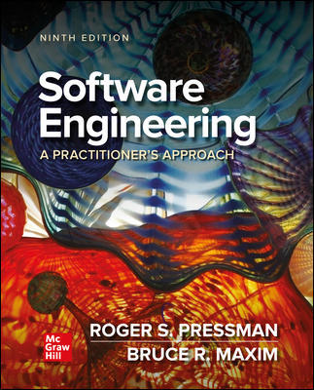
Chapter 28
Software Process Improvement
Part Five – Advanced Topics

Slide 2
What is Software Process Improvement?
S P I implies that:
Elements of an effective software process can be defined in an effective manner.
An existing organizational approach to software development can be assessed against those elements, and
A meaningful strategy for improvement can be defined.
The S P I strategy transforms the existing approach to software development into something that is more focused, more repeatable, more reliable (in terms of the quality of the product produced and the timeliness of delivery), and is cost effective.

Slide 3
SPI Framework
A set of characteristics that must be present if an effective software process is to be achieved.
A method for assessing whether those characteristics are present.
A mechanism for summarizing results of assessment.
A strategy for assisting an organization implementing process characteristics found to be weak or missing.
An SPI framework assesses the “maturity” of an organization’s software process and provides a qualitative indication of a maturity level.

Slide 4
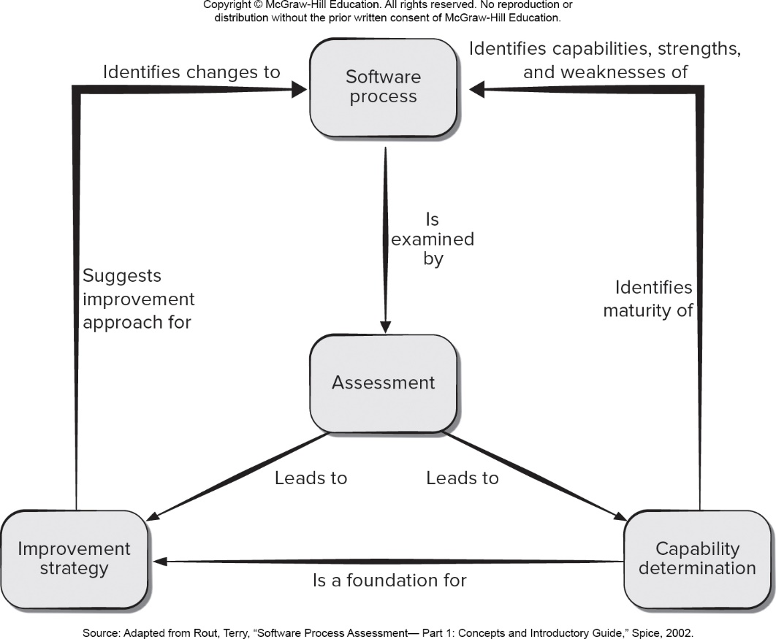
SPI Framework Elements
Access the text alternative for slide images.

Slide 5
Establishing SPI Frameworks 1
As an SPI framework is applied, an organization must establish mechanisms to:
Support technology transition.
Determine the degree to which an organization is ready to absorb process changes that are proposed.
Measure the degree to which changes have been adopted.

Slide 6
Establishing SPI Frameworks 2
A maturity model is applied within the context of an S P I framework.
The intent of the maturity model is to provide an overall indication of the “process maturity” exhibited by a software organization by showing:
An indication of the quality of the software process.
The degree to which practitioner’s understand and apply the process,
The general state of software engineering practice.

Slide 7
Is SPI for Everyone?
Can a small company initiate SPI activities and do it successfully?
Answer: a qualified “yes.”
It should come as no surprise that small organizations are more informal, apply fewer standard practices, and tend to be self-organizing.
S P I will be approved and implemented only after its proponents demonstrate financial leverage.

Slide 8
S P I Process 1
Assessment examines a wide range of actions and tasks that will lead to a high-quality process.
Consistency. Are important activities, actions and tasks applied consistently across all software projects and by all software teams?
Sophistication. Are management and technical actions performed with a level of sophistication that implies a thorough understanding of best practice?
Acceptance. Is the software process and software engineering practice widely accepted by management and technical staff?
Commitment. Has management committed the resources required to achieve consistency, sophistication and acceptance?
Gap analysis—The difference between local application and best practice represents a “gap” that offers opportunities for improvement.

Slide 9
S P I Process 2
Three types of Education and Training:
Generic concepts and methods. Directed toward both managers and practitioners, this category stresses both process and practice.
Specific technology and tools. Directed primarily toward practitioners, this category stresses technologies and tools that have been adopted for local use.
Business communication and quality-related topics. Directed toward all stakeholders, this category focuses on “soft” topics that help enable better communication among stakeholders and foster a greater quality focus.

Slide 10
S P I Process 3
Selection and Justification:
Choose the process model that best fits your organization, its stakeholders, and the software that you build.
Decide on the set of framework activities that will be applied, the major work products that will be produced and the quality assurance checkpoints that will enable your team to assess progress.
Develop a work breakdown for each framework activity (for example, modeling), defining the task set that would be applied for a typical project.
Time and money must be expended to implement the choice made by an organization and these expenditures should be justified.

Slide 11
S P I Process 4
Installation/Migration:
Software process redesign (S P R) is concerned with identification, application, and refinement of new ways to dramatically improve and transform software processes.
Three different S P R process models are considered:
The existing (“as-is”) process,
A transitional (“here-to-there”) process, and
The target (“to be”) process.

Slide 12
S P I Process 5
Evaluation:
Assesses the degree to which changes have been instantiated and adopted.
The degree to which such changes result in better software quality or other tangible process benefits.
The overall status of the process and the organizational culture as S P I activities proceed.
Quantitative metrics are collected from projects that have used the transitional or “to be” process and compared with similar metrics that were collected for projects that were conducted under the “as is” process.

Slide 13
S P I Risk Assessment
Risk factors for S P I:
Budget and cost.
Content and deliverables culture.
Maintenance of S P I deliverables.
Mission and goals.
Organizational management and organizational stability.
Process stakeholders.
Schedule for S P I development.
S P I development environment and process.
S P I project management and S P I staff.

Slide 14
S P I Risk Management
Manage risk at three key points in the S P I process:
Prior to the initiation of the S P I roadmap,
During the execution of S P I activities (assessment, education, selection, installation), and
During the evaluation activity that follows the instantiation of some process characteristic.

Slide 15
Capability Security Model Integration (C M M I)
process meta-model that is predicated on a set of system and software engineering capabilities that should be present in organizations at each maturity level:
As a “continuous” model.
As a “staged” model.
Defines each process area in terms of “specific goals” and the “specific practices” required:
Specific goals establish the characteristics that must exist if the activities implied by a process area are to be effective.
Specific practices refine a goal into a set of process-related activities.

Slide 16
C M M I Process Levels 1
Level 0: Incomplete. Does not achieve all goals and objectives defined by the C M M I for level 1 capability for the process area.
Level 1: Performed. All the specific goals of the process have been satisfied. Work tasks required to produce defined work products are being conducted.
Level 2: Managed. All capability level 1 criteria have been satisfied and all work associated with the process area conforms to an organizationally defined policy; all people have access to adequate resources to get the job done; stakeholders are actively involved; all work tasks and products are monitored, controlled, and reviewed.

Slide 17
C M M I Process Levels 2
Level 3: Defined. All capability level 2 criteria have been achieved and the process is tailored according to the organization’s guidelines. Contributes process-improvement information to the organizational process assets.
Level 4: Quantitatively managed. All capability level 3 criteria have been achieved and the process area is controlled and improved using measurement and quantitative assessment. Quantitative objectives for quality and process performance are used to manage the process.
Level 5: Optimized. All capability level 4 criteria have been achieved and the process area is adapted and optimized using quantitative means to meet changing customer needs

Slide 18
People C M M
Provides a roadmap for implementing workforce practices that continuously improve the capability of an organization’s workforce.
Defines a set of five organizational maturity levels that provide an indication of the relative sophistication of workforce practices and processes.

Slide 19
Other S P I Frameworks
SPICE - an international initiative to support the International Standard I S O 15504-5:2015 and I S O 12207:2017
SPICE provides a framework to assess a process and provide information on the strengths, weaknesses, and capabilities to help an organization achieve its goals.
TickIT - an auditing method [Tic05] that assesses an organization compliance to I S O Standard 9001:2015
I S O 9001:2015 has adopted a “plan-do-check-act” cycle that is applied to the quality management elements of a software project.

Slide 20
S P I Return on Investment
How do you know that we’ll achieve a reasonable return for the money we’re spending?
Benefits include the cost savings associated with higher product quality (fewer defects), less rework, reduced effort associated with changes, and the income that accrues from shorter time-to-market.
Costs include both direct S P I costs (for example, training, measurement) and indirect costs associated with greater emphasis on quality control and change management activities and more rigorous application of software engineering methods (for example, the creation of a design model).

Slide 21
S P I Trends
S P I frameworks must become significantly more agile.
Rather than an organizational focus (that can take years to complete successfully), contemporary S P I efforts should focus on the project level.
To achieve meaningful results (even at the project level) in a short time frame, complex framework models may give way to simpler models.
Rather than dozens of key practices and hundreds of supplementary practices, an agile S P I framework should emphasize only a few pivotal practices.

Slide 22
End of Main Content

Slide 23
Accessibility Content: Text Alternatives for Images

Slide 24
SPI Framework Elements – Text Alternative
Return to parent-slide containing images.
An illustration displays S P I framework elements. The elements are software process, assessment, capability determined, and improvement strategy. The Software process is examined by assessment and that leads to improvement strategy, and capability determination. The capability determination is a foundation for improvement strategy. The capability determination identifies capabilities, strengths, and weakness of the software process, and identifies maturity of it. The improvement strategy identifies changes to software process, and suggest improvement approach for it.
Return to parent-slide containing images.

