Slide 1
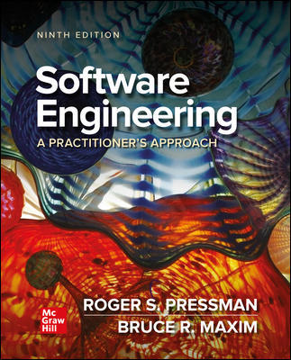
Chapter 30
Concluding Comments
Part Five – Advanced Topics

Slide 2
Importance of Software
The functionality delivered by software differentiates products, systems, and services and provides competitive advantage in the marketplace.
The programs, documents, and data that are software help to generate the most important commodity that any individual, business, or government can acquire—information.
The growing pervasiveness of computer software will present dramatic challenges for society as a whole.
Whenever a technology has broad impact (to help or harm) it must be handled with care.

Slide 3
The Way People Build Systems
As program sizes continue to increase team sizes will increase as well.
Experience indicates that as the number of people on a project team increases, the overall productivity of the group will suffer because of communications issues.
Too much time is spent sharing small amounts of information among teams and team members, and important information may falls through the cracks.
Software engineers must plan for radical changes in the ways individuals and teams communicate with one another (for example, uses of social media and cloud services).

Slide 4
Knowledge Transfer
Communication is the transfer of knowledge, and the acquisition (and transfer) of knowledge is changing in profound ways.
Sophisticated search engines may allow social networking and crowd sourcing to morph into serious developer tools.
As mobile applications provide better for better developer synergy, the speed and quality of knowledge transfer will grow exponentially.
People themselves are likely to be slow to embrace the changes needed for a new software development culture.

Slide 5
Knowledge Discovery 1
Data is raw information - collections of facts that must be processed to be meaningful.
Information is derived by associating facts within a given context.
Knowledge relates information obtained in one context with other information obtained in a different context.
Most software has been built to process data or information.
Software engineers are now equally concerned with systems that process knowledge.
Knowledge discovery focuses on methodologies for extracting useful relationships from data.

Slide 6
Knowledge Discovery 2
The knowledge discovered using data mining may suggest practice improvements to developers working on similar projects.
Machine learning has been used in many areas of software engineering for behavior extraction, design pattern recognition, program generation, test-case generation, and defect detection.
Genetic algorithms make use of automated search techniques and can be used to grow improved software products or processes by combining elements of existing software products and processes.

Slide 7
Long View
Two conflicting views:
Ray Kurzweil—digital utopia and immortality as human capabilities (and life spans) are amplified using technology.
Bill Joy—digital distopia and human extinction as machines become more and more capable.
Both visions should be considered as software engineers take one of the leading roles in defining a long view for the human race.

Slide 8
Software Engineering Ethics 1
An ACM/IEEE-CS Joint Task Force produced a Software Engineering Code of Ethics and Professional Practices (Version 5.1):
Software engineers shall commit themselves to making the analysis, specification, design, development, testing, and maintenance of software a beneficial and respected profession. In accordance with their commitment to the health, safety and welfare of the public.
The Code went on to define Eight Principles that all software engineers are required to follow.

Slide 9
Software Engineering Ethical Principles
1. PUBLIC – SE’s shall act consistently with the public interest.
2. CLIENT AND EMPLOYER – SE’s shall act in a manner that in best interests of their client and employer consistent with the public interest.
3. PRODUCT – SE’s shall ensure that their products and related modifications meet the highest professional standards possible.
4. JUDGMENT – SE’s shall maintain integrity and independence in their professional judgment.
5. MANAGEMENT - SE managers and shall promote an ethical approach to management of software development and maintenance.
6. PROFESSION – SE’s shall advance the integrity and reputation of the profession consistent with the public interest.
7. COLLEAGUES – SE’s shall be fair and supportive of colleagues.
8. SELF – SE’s shall participate in lifelong learning regarding the practice of their profession and promote an ethical approach to the practice of the profession.

Slide 10
Ethics on Personal Level
Never steal data for personal gain.
Never distribute or sell proprietary information obtained as part of your work on a software project.
Never maliciously destroy or modify another person’s programs, files, or data.
Never violate the privacy of an individual, a group, or an organization.
Never hack into a system for sport or profit.
Never create or promulgate a computer virus or worm.
Never use computing technology to facilitate discrimination or harassment.

Slide 11
End of Main Content

