Slide 1
Rockbuster Stealth LLC - Key Business Data
Country performance and key genres and ratings
June 4, 2025 | Magi Apostoli

Slide 2
Summary Stats of Rockbuster
Min. release : 2006
Max. release: 2019
Min. rental : 3 days
Max. rental : 7 days
Avg. rental: 5 days
Min. rental rate: 0.99
Max. rental rate: 4.99
Avg. Rental rate: 3

Slide 3

Rockbuster‘s Financial Performance in Markets

Slide 4
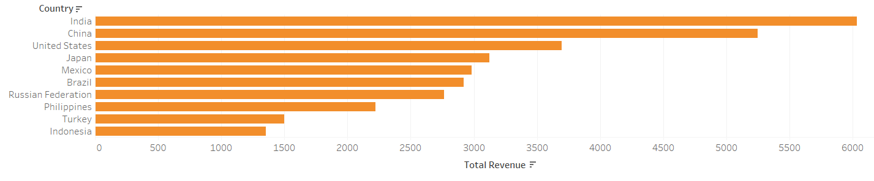
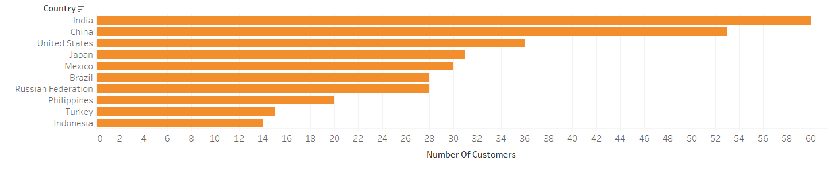
Top 10 Countries by Customers and Revenue
We see correlation between numbers of customers and revenue, so increasing awareness of Rockbuster is a good way to increase revenue

Slide 5
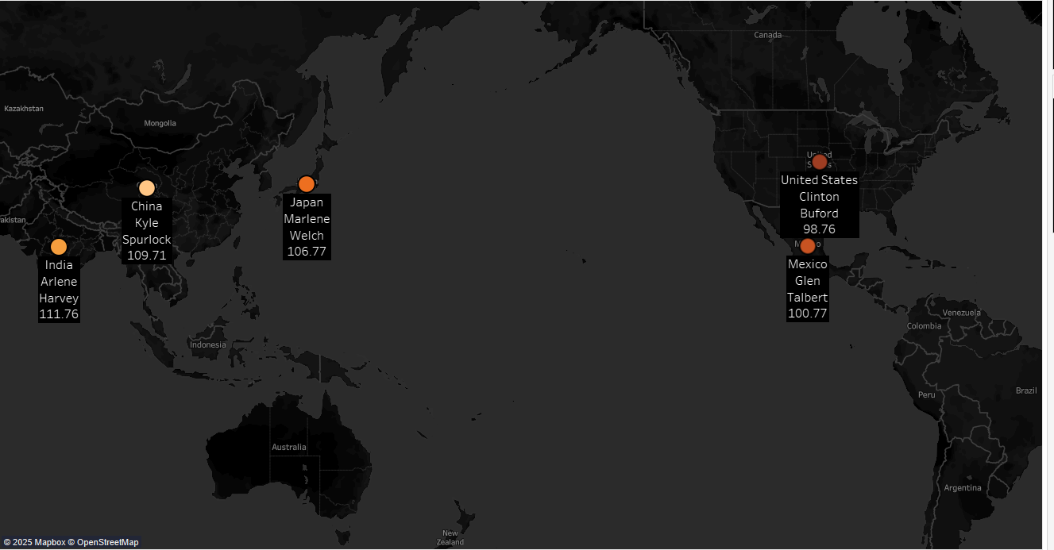
Top 5 customers worldwide
A reward is in order for Rockbuster‘s highest spending customers worldwide. These are their names!

Slide 6
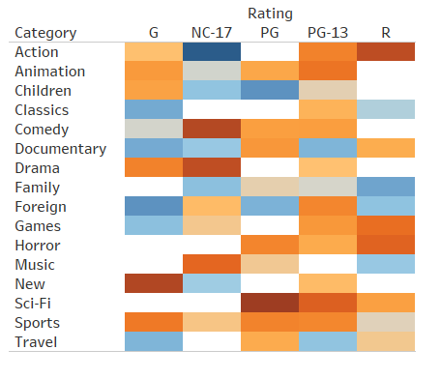

Average Rental Revenue by Genre and Rating (≥10 Films)
R-Action, NC-17 Comedy and Drama, PG Sci-Fi are good choices to add to the catalogue. Less so NC-17 Action, G-rated Travel and PG Children movies.

Slide 7
Recommendations
1) Conduct Competitor Analysis in Top 10 Markets Identify regions with untapped growth potential vs. market saturation to guide geographic focus and investment.
2) Launch a Reward Program for High-Spending Customers Incentivize loyalty by offering exclusive promotions to top customers. → Next step: Define spending threshold to qualify as a “loyal” customer.
3) Optimize Film Catalogue Based on Revenue Insights Prioritize high-performing genre/rating combinations (e.g., R-rated Action, NC-17 Comedy/Drama, PG-rated Sci-Fi) for future acquisitions. Deprioritize consistently low performers (e.g., NC-17 Action, G-rated Travel, PG Children’s titles).

