Slide 1

Networks and Systems Management
Alexandre Cunha up202400086

Slide 2
Motivation
As part of our LGP (Laboratório de Gestão de Projetos) class, we’re simulating a startup that delivers a mobile-first solution for journalists to share video reports on the go.
The app supports mobile uploads (recorded or ingested content), backed by a service architecture that includes:
A backend application
The tusd resumable upload server
All traffic managed by a nginx reverse proxy

Slide 3
Motivation Cont.
To ensure a production-ready and scalable environment, we identified key needs:
Automated deployment of new backend versions with minimal human intervention
Dynamic nginx configuration updates without downtime
Robust monitoring for observability and service health tracking
This setup not only serves our current simulated startup needs but also lays the groundwork for container orchestration with Kubernetes

Slide 4
Problems
Human Error: Manual deployment and configuration increases the risk of mistakes, such as incorrect environment settings or misconfigured services.
Deployment Inconsistency: Without automation, it’s hard to guarantee that each deployment is identical, leading to unpredictable bugs and behavior.
Downtime During Updates: Manual changes to services like nginx can cause temporary service outages or downtime during reloads.
Compatibility Issues: Integrating new services (e.g., tusd) without structured workflows may introduce version conflicts or misalignments.

Slide 5
More Problems
Lack of Scalability: Without automated scaling, the system cannot respond dynamically to changes in demand, leading to performance bottlenecks or resource waste.
Inefficient Rollbacks: In the case of a failed deployment, manually rolling back is slow and error-prone.
Poor Observability: Without monitoring integration, diagnosing issues requires digging through logs manually, which slows down incident response.
Onboarding Complexity: New team members face a steep learning curve when deploying or debugging the system manually.

Slide 6
Solutions
CI/CD Pipeline
Automate backend deployments using continuous integration and delivery tools (e.g., GitHub Actions, GitLab CI, or Jenkins) to ensure consistency and reduce manual intervention.
Dynamic nginx Configuration Reloads
Use automation tools or hot-reloading strategies (like nginx -s reload or configuration templates) to update routes without downtime.
Infrastructure as Code (IaC)
Define service configurations (e.g., using Docker Compose) to make deployments reproducible and version-controlled.
Rollback Mechanisms
Incorporate version tagging and automated rollback steps in the CI/CD process to quickly revert faulty deployments.

Slide 7
Solutions Cont.
Health Monitoring Stack
Containerization
Auto-Scaling Readiness
Integrate a monitoring stack (e.g., Prometheus + Grafana + cAdvisor) to track system metrics, visualize performance, and alert on anomalies.
Containerize all services to ensure environment consistency and simplify dependency management across environments.
Design the architecture to be compatible with Kubernetes, enabling horizontal or vertical scaling in future iterations.
Service Discovery & Health Checks
Implement service discovery and health checks (e.g., via nginx, load balancers, or K8s probes) to route traffic only to healthy instances.

Slide 8
Key Benefits
Increased Reliability
Automated deployments and dynamic configuration reduce downtime and eliminate human errors during updates.
Scalability by Design
The architecture supports integration with Kubernetes, allowing for automatic scaling based on load.
Improved Observability
Monitoring dashboards and health checks provide real-time visibility into service status and performance metrics.
Reproducible Environments
Containerization and Infrastructure as Code make it easy to reproduce production setups locally or in staging.

Slide 9
Tech Stack Application Services
Rust App – Main backend logic, handling uploads and processing.
tusd – Resumable upload server implementing the TUS protocol with webhook hooks into the Rust backend.
Workers – ML Models tailored to the business need
Caption
Quality
Transcription

Slide 10
Tech Stack Network & Proxy
Nginx (OpenResty) – Acts as a reverse proxy to route external traffic to internal services, with future support for SSL and stub_status for metrics.

Slide 11
Tech Stack Monitoring
Prometheus – Collects system and application metrics from exporters.
Grafana – Dashboards and alerting based on Prometheus metrics.
cAdvisor – Provides detailed container-level resource usage metrics.
nginx-exporter – Exposes Nginx metrics (e.g., requests per second, connections) to Prometheus.
rust-prometheus – Export app metrics to Prometheus.

Slide 12
Tech Stack Infrastructure
Docker & Docker Compose – Core toolchain for service definition and orchestration
Multi-service architecture
Inter-service communication via custom networks (tusd-network, mon-net)
Mounting local directories for live development
Enabling:

Slide 13
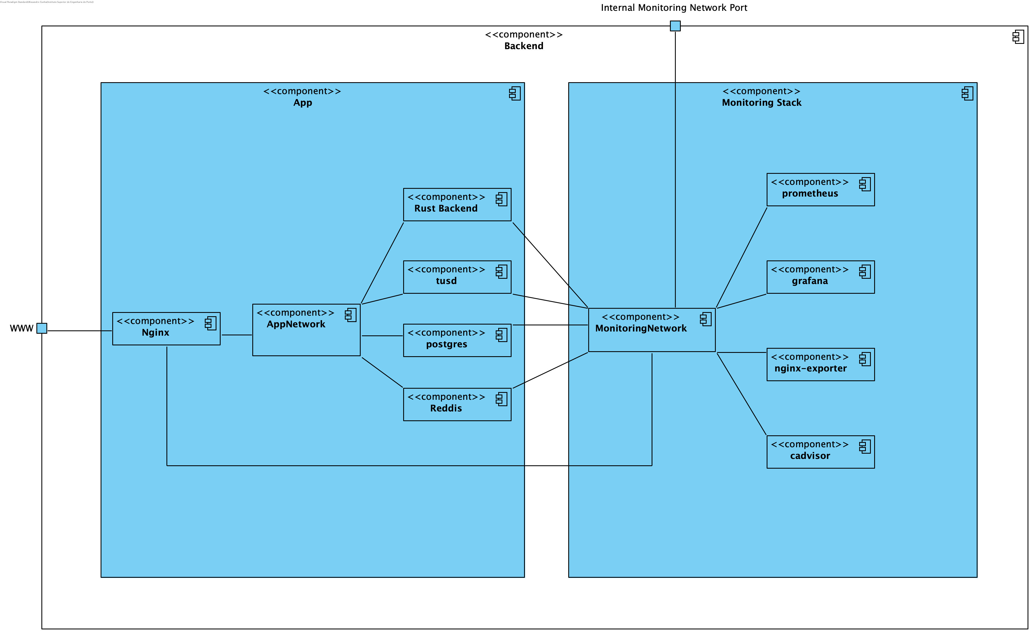
Architectural Overview

Slide 14
App Compose
The base docker-compose file defines and deploys the main application stack:
Rust App – Core backend service for upload handling and business logic.
tusd – Handles resumable file uploads; forwards post-finish hooks to the Rust backend.
Nginx (OpenResty) – Acts as reverse proxy; routes requests to both app and tusd services.
workers – do multiple analyses to the uploaded videos
Redis – Supports caching or transient data if needed.
Postgres – Database for persistence

Slide 15
Monitoring Stack Compose
A separate docker-compose file is used to deploy the monitoring stack, which includes:
Prometheus – Collects metrics from all instrumented containers.
Grafana – Provides real-time dashboards for visualization and alerting.
cAdvisor – Exposes resource usage metrics (CPU, memory, disk I/O) per container.
nginx-exporter – Converts Nginx stub_status into Prometheus-friendly metrics.

Slide 16
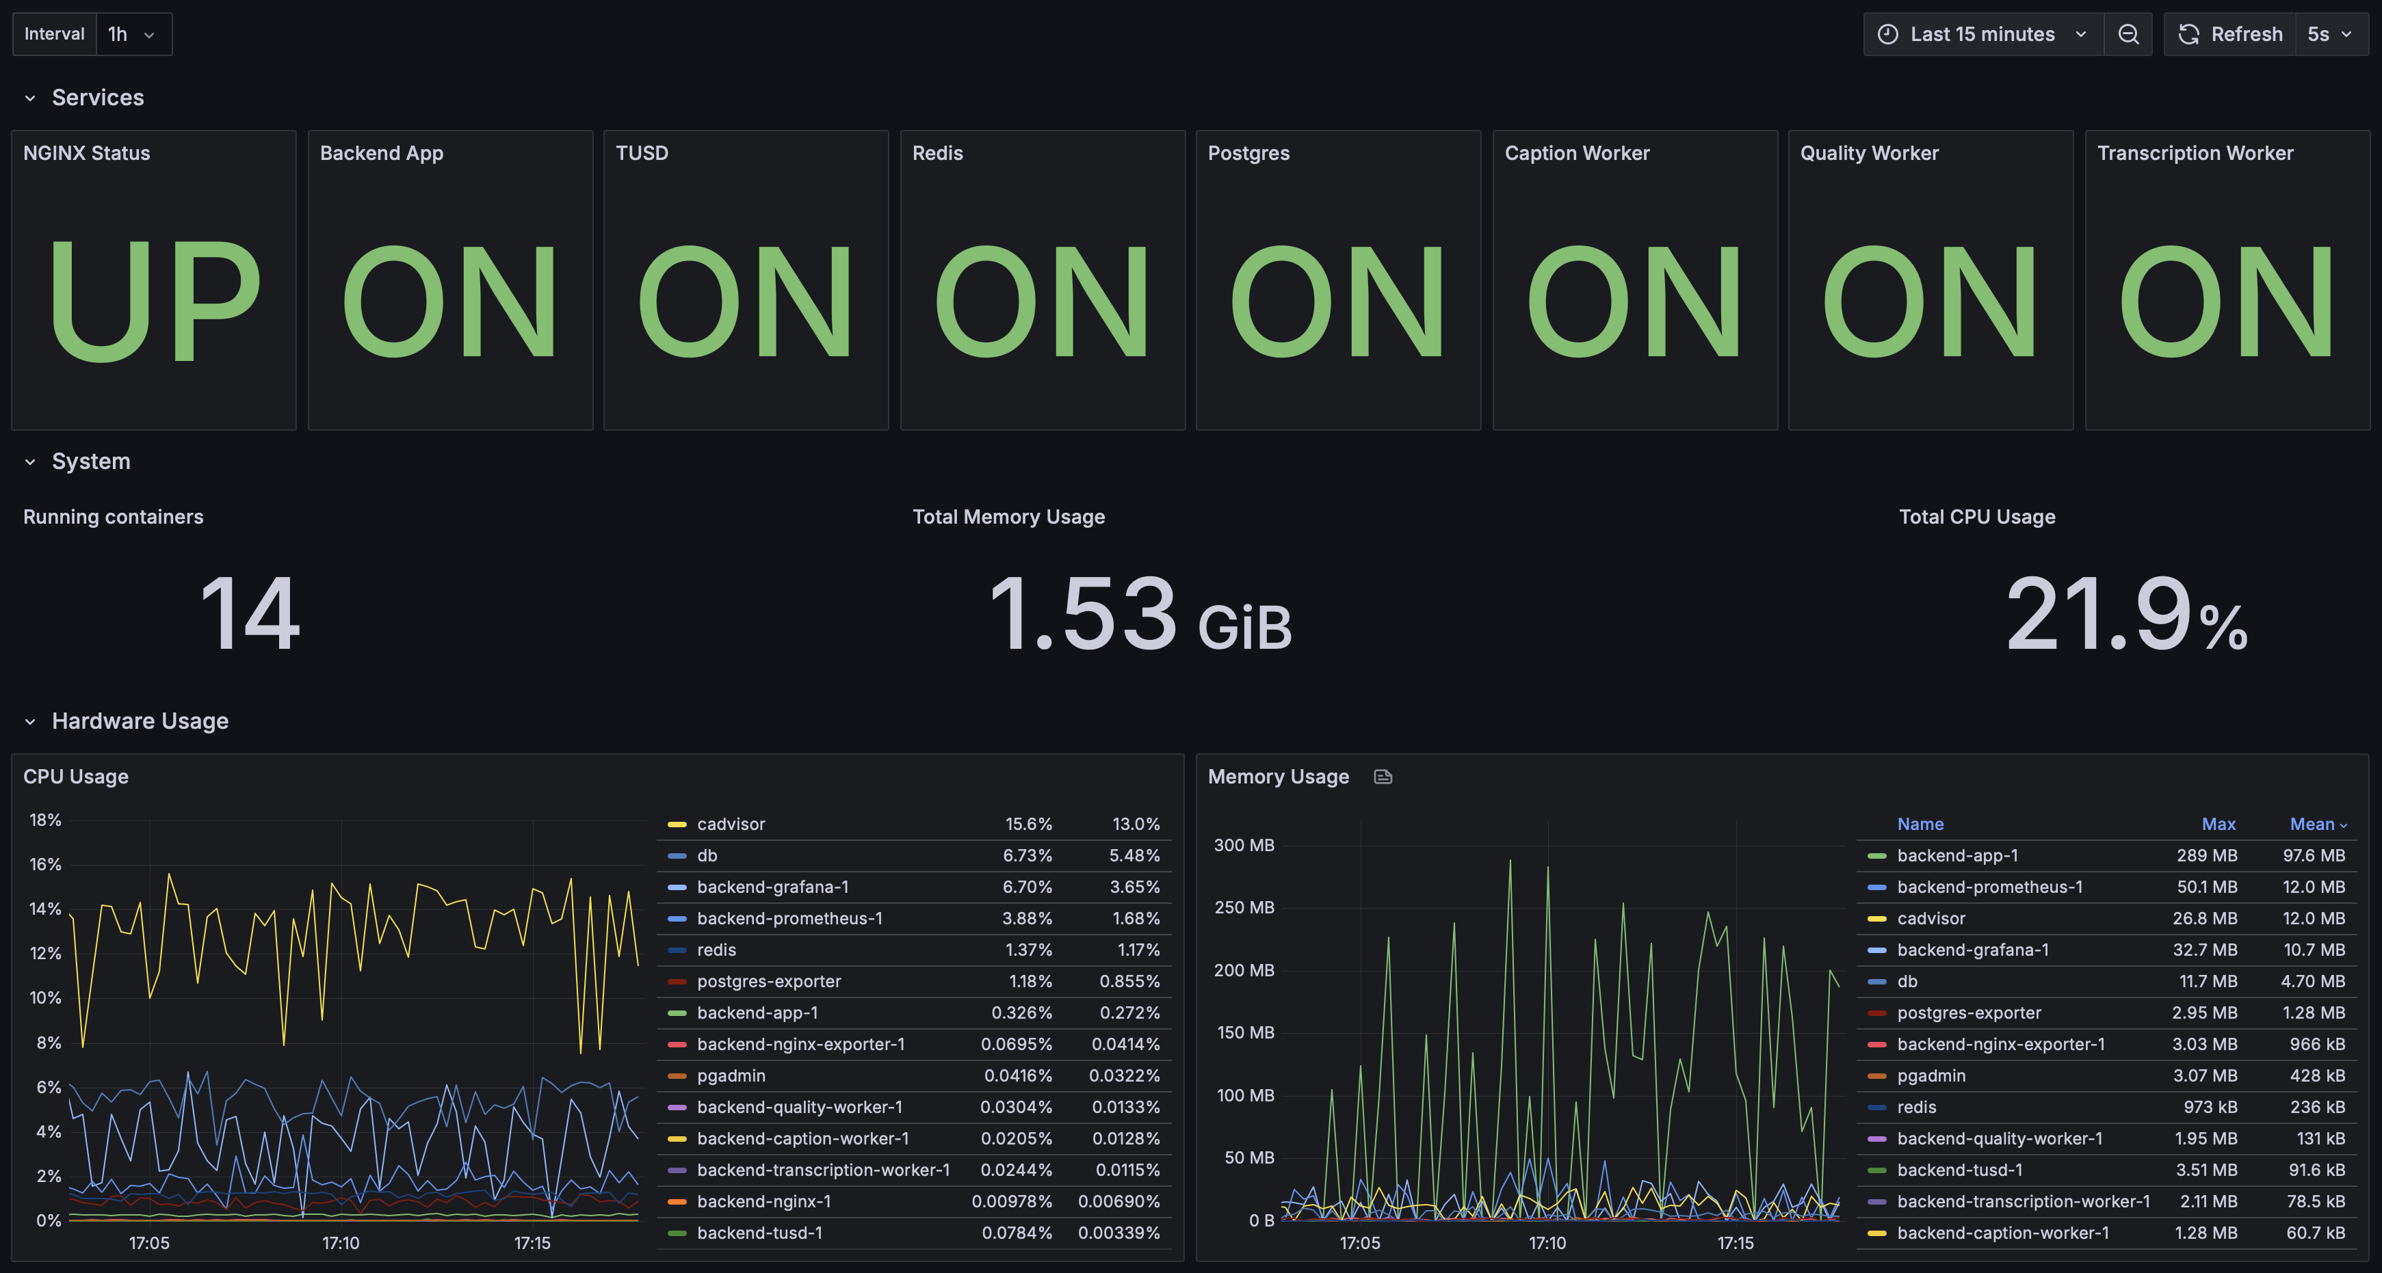
Dashboard Under normal circumstances Part 1

Slide 17
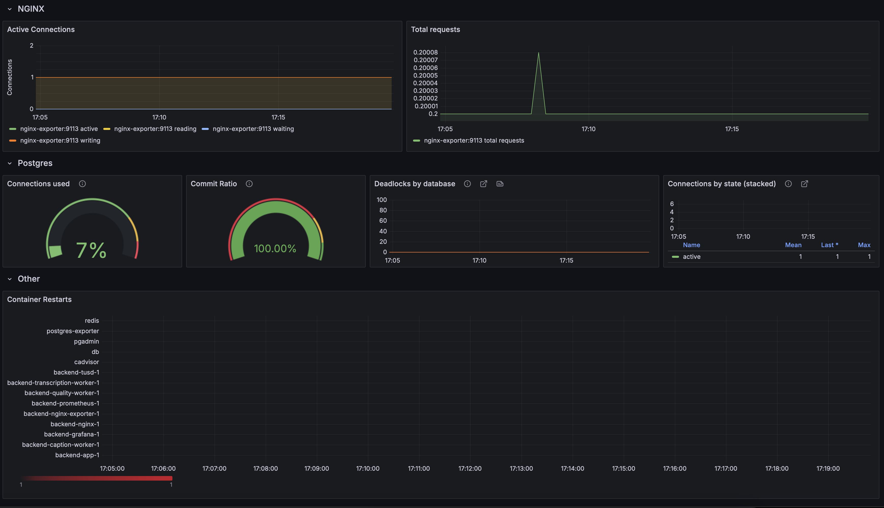
Dashboard Under normal circumstances Part 2

Slide 18
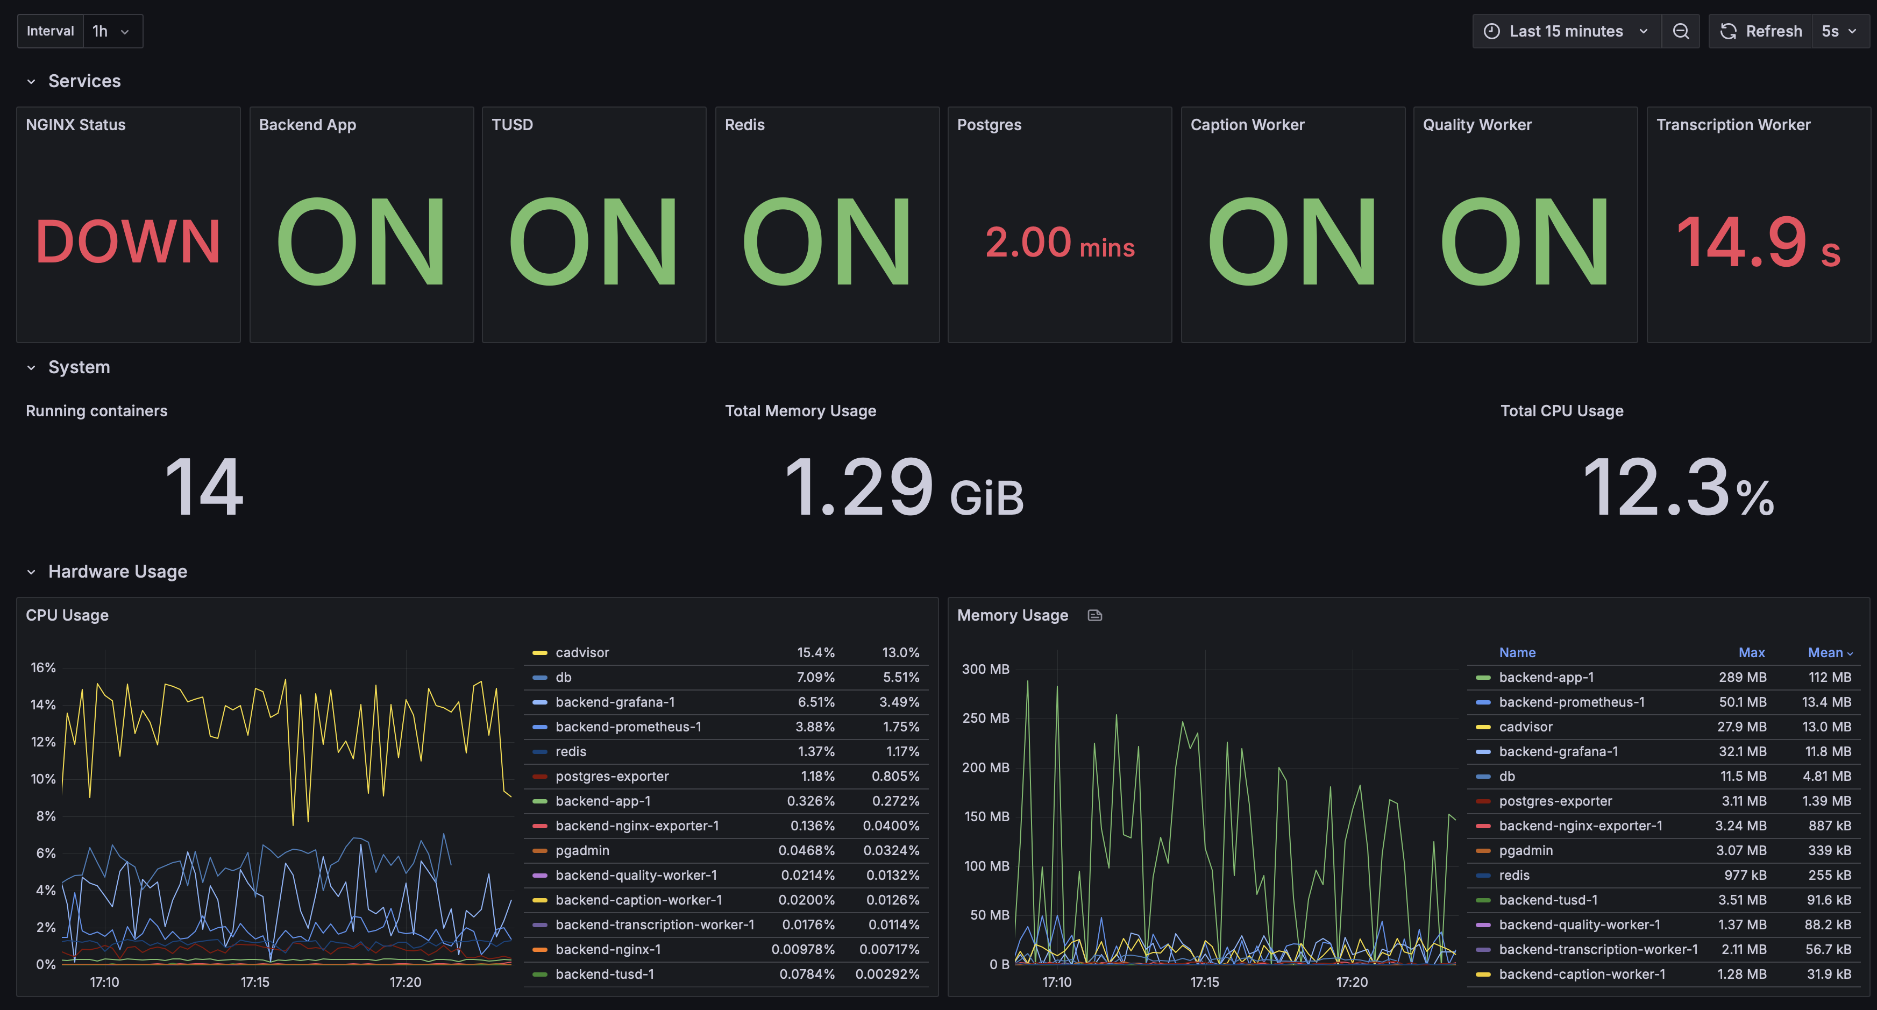
Dashboard if services goes down

Slide 19
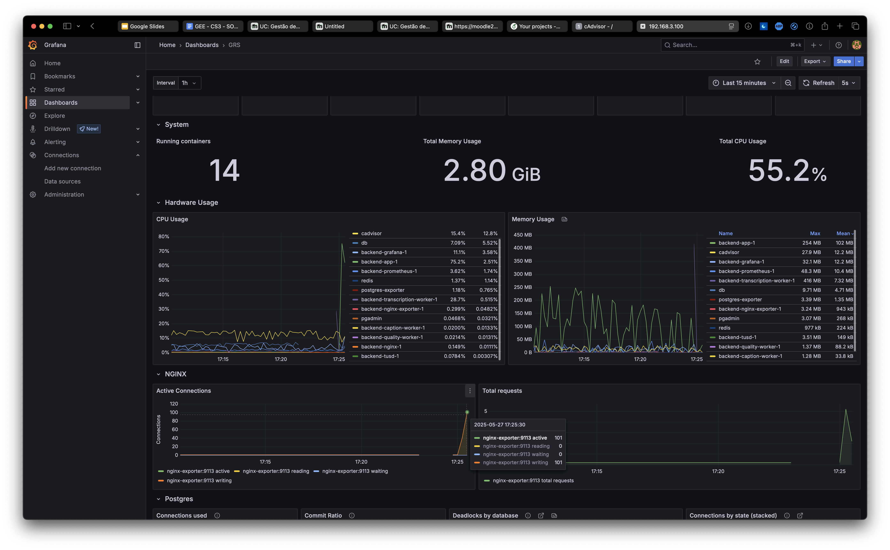
Dashboard if under load

Slide 20
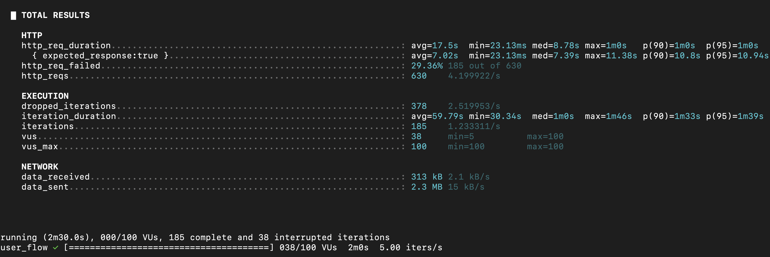
Stress Test Load Testing Summary (k6)
Duration: 2 minutes 30 seconds
Max Virtual Users (VUs): 100
Objective: Test system under extreme concurrency
Test simulates: Account creation; Multiple logins; Video uploads

Slide 21
Stress Test HTTP Request Metrics
HTTP Performance:
Total Requests: 630
Success Rate: 70.64%
Failures: 29.36% (185 failed)
Request Duration:
Average: 17.5s
Median: 8.78s
Max: 1 minute
95th Percentile: 1 minute
Expected responses only:
Average: 7.02s
Max: 11.38s

Slide 22
Stress Test Execution Details
Execution & Iteration Stats:
Completed Iterations: 185
Dropped Iterations: 378
Iteration Duration:
Average: 59.79s
Median: 1 minute
95th Percentile: 1m 39s
Virtual Users:
Active: Up to 100
Stable at 38 during peak
So out of the total 563 iterations attempted, only 185 (≈32.8%) completed successfully under load.
What is an Iteration?
An iteration is one full execution of the script by a virtual user (VU).
In this script, one iteration does:
Register a new user
Login 10 times
Upload 5 files in PATCH chunks (2MB each)

Slide 23
Stress Test Key Observations
System Behavior Under Load:
App remained resilient under heavy load
Faced performance bottlenecks with DB driver:
Crashed under sustained peak
Required manual restart
Bottlenecks seen especially with concurrent logins and video uploads

Slide 24
Stress Test Conclusion
Final Thoughts & Realistic Expectations:
This test simulated a worst-case load
Expected real-world peak: 20–30 concurrent users
App functioned for ~1 minute under full 100-user pressure
Acceptable performance for anticipated usage
Next steps:
Optimize DB interactions
Add graceful failure handling
Implement automatic recovery

Slide 25
END
Alexandre Cunha, up202400086
Q&A?

