Slide 1
Analyzing the impact of Hurricane Katrina
By: Servando Balderas, Ashtyn Aldrete, and Connor McMullen

Slide 2
Research Question & Motivation
How did Hurricane Katrina impact the population of New Orleans, Louisiana?
How much did the population shift?
What was the rate of recovery of New Orleans, LA?
What can be learned from this event?
Motivation
Relevance to all who live near the gulf.
The stress of population evacuation.
Relevance to Houston, Texas.

Slide 3
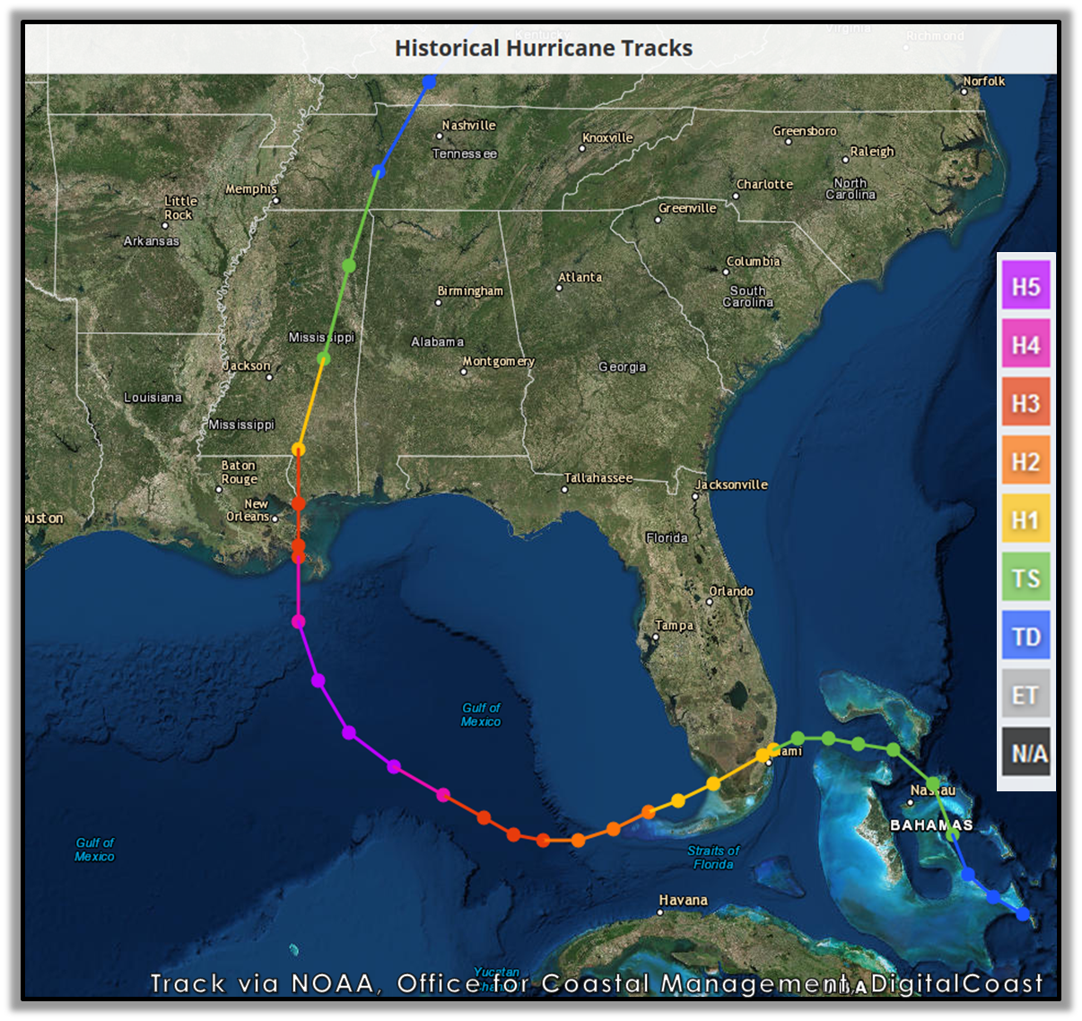
Data Overview
Two Groups of interest.
New Orleans, LA (Impacted)
Made landfall as a Category 3 storm.
Birmingham, AL (Control)
Reached area as a Tropical Storm.
Data focuses on population.
Annual Observations from FRED.
Why population?
Measure displacement effects from Katrina.
Indicator for recovery.
https://www.weather.gov/mob/katrina

Slide 4
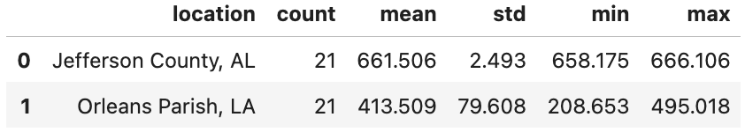
Key Variables
Variable | FRED Series | Description
Resident Population in Orleans Parish, LA | LAORLE0POP | Annual estimates of the resident population. Thousands of Persons, Not Seasonally Adjusted.
Resident Population in Jefferson County, AL | ALJEFF5POP | Annual estimates of the resident population. Thousands of Persons, Not Seasonally Adjusted.
Jefferson County, AL as a control group.
Similar population sizes of southern urban area.
Not as affected by Hurricane Katrina directly.
Evacuation movements minimal.
Descriptive Statistics
Sample size
Min/Max
Standard Deviations

Slide 5
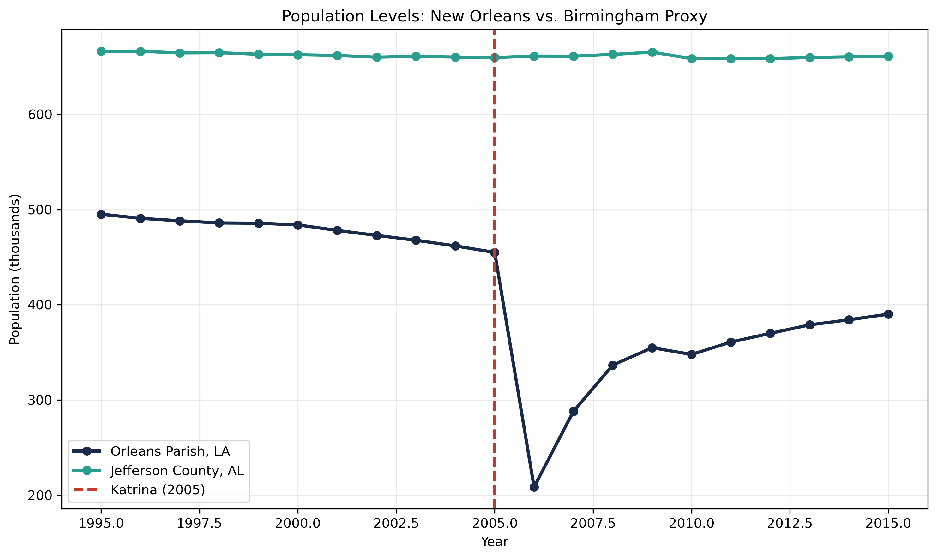
Exploratory Data Analysis + Time Series
Trends for both counties.
Orlean Parish, LA trends before impact.
Steady trends for Birmingham Proxy.
Impact from Hurricane Katrina.
Outcome from both counties?

Slide 6
Methodology
Used a Difference-in-Differences (DiD) design to estimate Katrina’s impact on New Orleans population.
Treated group: Orleans Parish, LA.
Control group: Jefferson County, AL (Birmingham proxy).
Data source: FRED annual population series, 1995–2015.
Pre-period: 1995–2005. Post-period: 2006–2015.
Estimated both:
Levels model for resident change
Log model for percent change
Included visual checks:
population trend plot
indexed 2005 plot
event-study-style gap plot

Slide 7
Main Results
54.13% drop from 2005 to 2006
DiD effect: -134.458k residents
Log effect: -29.32%
Recovery by 2015: 85.76% of 2005 level
Katrina had a severe long-run population impact

Slide 8
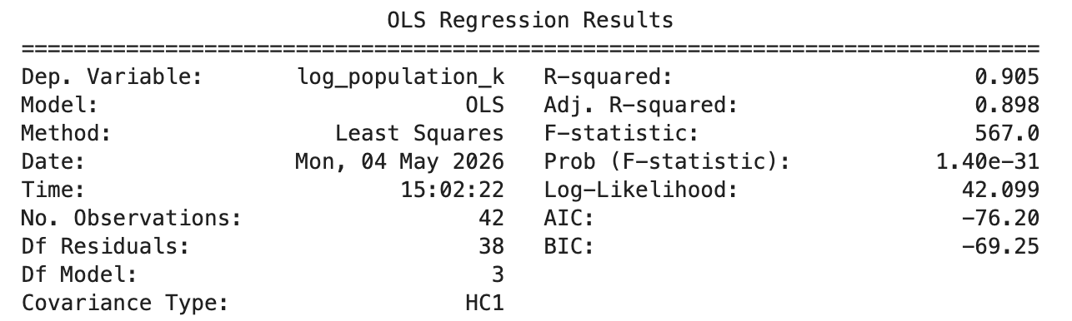
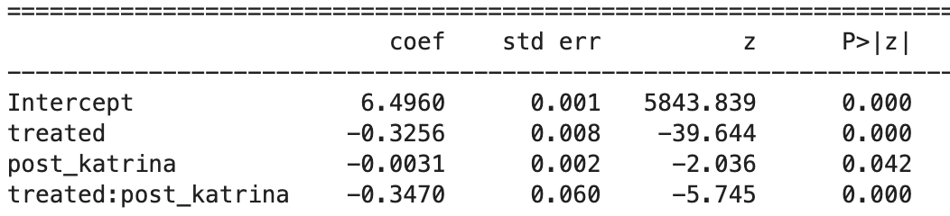
Residual / Model Fit
OLS regression shows all variables to be statistically significant.
Adjusted R-Squared shows 89% variability is explained by the independent variables.
Post-Katrina population level in Orleans Parish was about -0.347 lower relative to the control group.

Slide 9
Limitations
There are several limitations that must be considered within our study. The most significant is the concerns we face with violations of the parallel trends assumption.
For the difference in difference methods to produce estimates we can redeem reliable, the control and treated groups should follow the same trends before the event occurred. Orleans Parish was already undergoing decline before Katrina occurred while Jefferson County population sustained throughout. Pre-existing divergence means our data is inflated.
Our analysis also used a single control group, which disallows more in depth and correct analysis.

Slide 10
Practitioner Implications
The findings of this study carry implications practitioners can take heed to. A significant source of Katrina's damage came from lackluster infrastructure and poor urban planning prior to Katrina's land fall. Policy makers should account and adjust their urban planning to expect hurricanes and how to mitigate their damage, without this foreberrence, a similar event is bound to happen in the future.
Emergency managers should emphasize pre-distortion planning and pair it with long term recovery strategies that address housing, infrastructure, and economic opportunity to avoid the mass displacement that occurs.

Slide 11
Conclusion
This study examined the impact of Hurricane Katrina on the population of Orleans Parish, Louisiana using Jefferson County, Alabama as a control group and a difference in difference research design. The Analysis covered the period from 1995 to 2015.
Hurricane Katrina displaced 134,458 people for a total decline of 54.13% between 2005 and 2006. Though recovery has occurred, as of 2015 Orleans Parish has only recovered 86% of the pre Katrina population. The presistent gap highlights that natural disasters can have a lasting impact on populations if they are not planned for in advance.

