Slide 1
Project Presentation
Advanced Machine Learning
Exploring Laplacian Attention Functions for Text Classification
Simon Klaassen, Dario Küffer, Samuel Wallace

Slide 2
Table of Contents
Advanced Machine Learning
Problemsetting
Baseline Models
Using GAAM/LAAM in GPT2
Proprietary Gaussian/Laplacian Attention Mechanisms

Slide 3
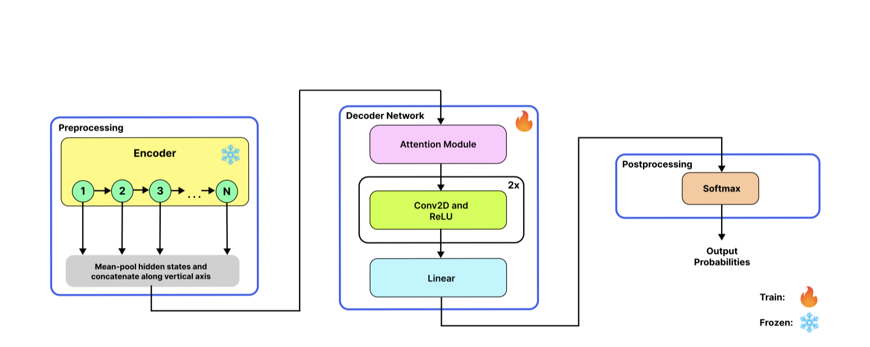
Problemsetting
Advanced Machine Learning
Image from Ioannides et al., P. 4
We aim to investigate novel attention mechanisms in existing pre-trained transformer architectures.

Slide 4
Motivation
Advanced Machine Learning
Extend research on a novel self-attention mechanism from - Gaussian Adaptive Attention is All You Need: Robust Contextual Representations Across Multiple Modalities arXiv:2401.11143
Develop own novel attention mechanism using the Laplacian Distribution. This is sensible because:
Both distributions are symmetric around their mean
They are both part of the family of exponential distributions
In some applications, the Laplacian distribution can be used as an alternative to the Gaussian distribution, especially when the data has heavier tails or more outliers
Replicate findings from the paper

Slide 5
Modality
Advanced Machine Learning
Original Paper experimented across many Modalities - (text, speech and vision)
Planned to experiment with
Text - "ag-news"-dataset
Focused on text
Relative ease of implementation compared to images
Availability of pre-trained tokenizers (GPT2Tokenizer, LlamaTokenizer)

Slide 6
Choosing a Model
Advanced Machine Learning
Computationally, training a transformer is not feasible
Fine-tune a pre-trained model instead
First attempt: Llama2
Rougly ~7B parameters on the smallest model
Even with most of the pre-trained layers frozen it was not realistic to use
Second attempt: GPT2
We utilised the GPT2ForSequenceClassification-model from the transformers library
And planned to replace the self-attention block with the GAAM-block introduced in the paper

Slide 7
Baseline Models
Advanced Machine Learning

Slide 8
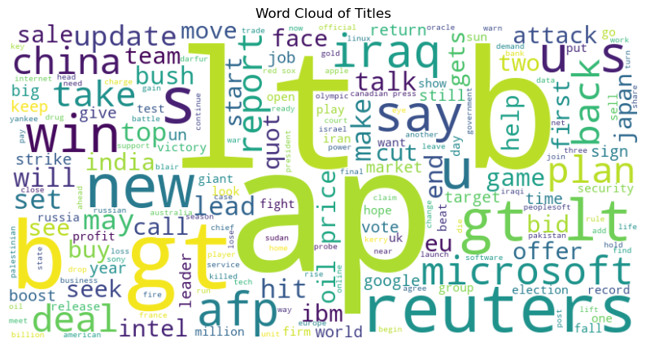
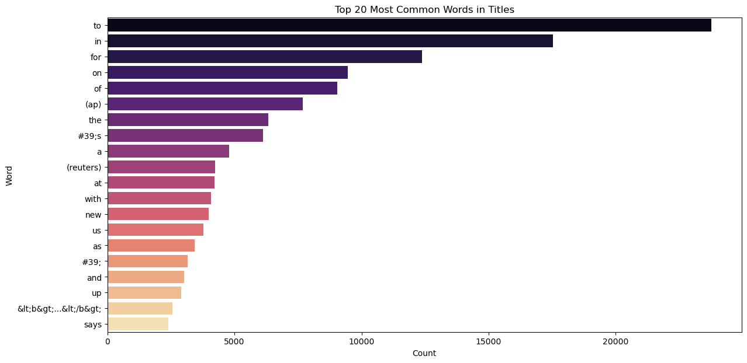
Dataset
Advanced Machine Learning
AG-News
A collection of more than 1 million news articles
The class ids are numbered 1-4, where 1 represents World, 2 represents Sports, 3 represents Business, and 4 represents Sci/Tech
In Depth
In terms of data distribution, each category contributed 30,000 articles to the training set and 1,900 articles to the validation set
Found that certain characters where present more than expected, e.g. "#39;s". Upon investigation, this is HTML representing (')
Decide to ignore these as they should not effect the overall learning of the model
Images from notebook "01-random-forest-classifier.ipynb"

Slide 9
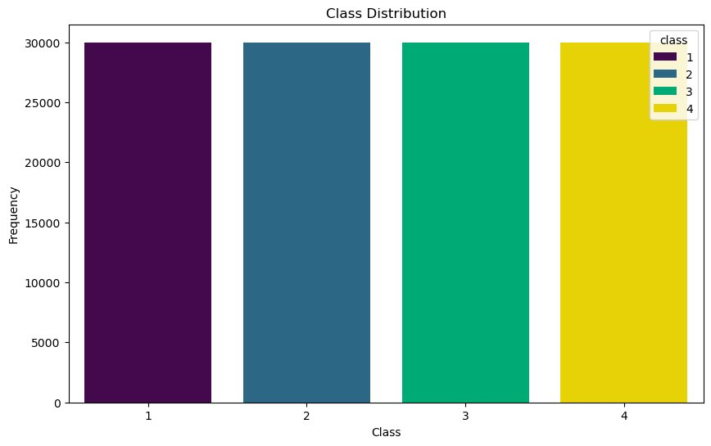
Dataset Exploration
Advanced Machine Learning
We identified the class proportionality to be 25%
Due to the balanced nature of the dataset, a majority classifier will produce an accuracy of 25% similar to a random classifier
Felt this baseline was too low of a target to achieve
Opted for a more sophisticated statistical baseline
Image from notebook "01-random-forest-classifier.ipynb"

Slide 10
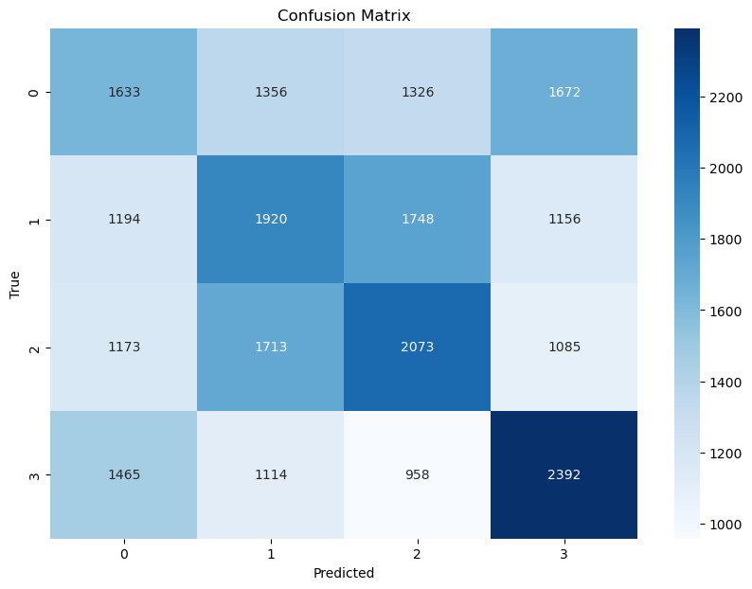
Random Forest
Advanced Machine Learning
Used GloVe text embeddings
We experimented with different dimensionalities of GloVe embeddings to find the optimal balance between performance and computational efficiency. Specifically, we tested embeddings with dimensions of 50, 100, 200, and 300. Chose 100 dimensional
Achieved an accuracy of roughly 35%, this is statisitcally significant and above the random classifier of 25%
Serves as a baseline for our models
Image from notebook "01-random-forest-classifier.ipynb"

Slide 11
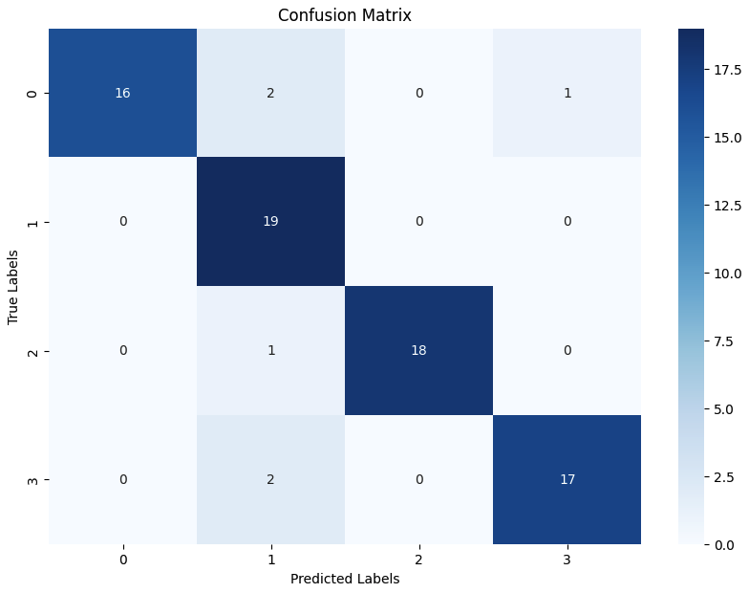
GPT2 Classifier
Advanced Machine Learning
Additional baseline: See how well the regular GPT2-model performs on the classification task
Training: Fine-tuning pre-trained GPT2-model for 5 epochs on 1% of the training data
Accuracy on the test set: 92.1%
Conclusion: With little fine-tuning, GPT2-model already performs really well
Comparison: The paper reports achieving an accuracy of 94.5% with GAAM
Image from notebook "02-baseline-gpt2-model.ipynb"

Slide 12
Integration of GAAM and LAAM into the GPT2-Architecture
Advanced Machine Learning

Slide 13
Hyperparameter Tuning
Advanced Machine Learning
Hyperparameters in GAAM
The number of Gaussians (suggested: 5)
The number of Heads (suggested: 4)
Question: Does increasing the number of heads and Gaussians increase the capabilities of GAAM?
Training on 0.2% of the training dataset, for 5 epochs
Models | Validation Loss | Accuracy
Gaussians = 5 Heads = 4 | 1.39 | 25%
Gaussians = 10 Heads = 8 | 1.39 | 25%
Gaussians = 20 Heads = 16 | 1.39 | 25%
Results from notebook "03-gpt2-with-GAAM-hyp-tuning.ipynb"

Slide 14
Hyperparameter Tuning
Advanced Machine Learning
Hyperparameters in GAAM
The number of Gaussians (suggested: 5)
The number of Heads (suggested: 4)
Check: Does increasing the number of heads and Gaussians increase the capabilities of GAAM?
On 0.2% of the data, for 5 epochs
Models | Validation Loss | Accuracy
Gaussians = 5 Heads = 4 | 1.39 | 25%
Gaussians = 10 Heads = 8 | 1.39 | 25%
Gaussians = 20 Heads = 16 | 1.39 | 25%
Conclusion
Higher numbers of Gaussians and heads do not yield better results
=> Stick with the smallest model.
Results from notebook "03-gpt2-with-GAAM-hyp-tuning.ipynb"

Slide 15
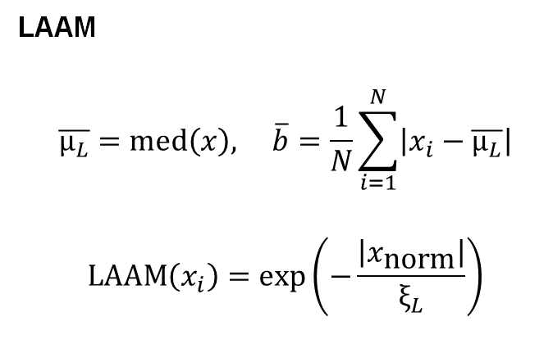
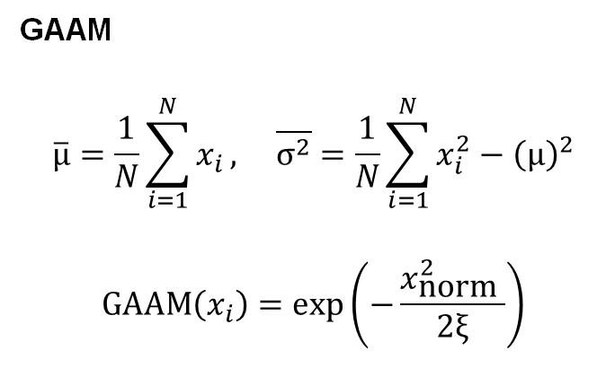
GPT2-Models With GAAM/LAAM
Advanced Machine Learning
Approach: Replace the GPT2-Attention blocks with GAAM/LAAM blocks, respectively
Implementation of the GAAM block provided by the paper
GAAM block adjusted according to our problemsetting to obtain a LAAM block
GAAM
$$\overline{μ}=\frac{1}{N}\sum_{i=1}^{N}{x_{i}}, \overline{σ^{2}}=\frac{1}{N}\sum_{i=1}^{N}{x_{i}^{2}}−{\left(μ\right)}^{2}$$
$$\text{GAAM}\left(x_{i}\right)=\exp\left(−\frac{x_{\text{norm} }^{2}}{2ξ}\right)$$
LAAM
$$\overline{μ_{L}}=\text{med}\left(x\right), \overline{b}=\frac{1}{N}\sum_{i=1}^{N}{\left|x_{i}−\overline{μ_{L}}\right|}$$
$$\text{LAAM}\left(x_{i}\right)=\exp\left(−\frac{\left|x_{\text{norm}}\right|}{ξ_{L}}\right)$$

Slide 16
GPT2-Models With GAAM/LAAM - Results
Advanced Machine Learning
Training: 10 epochs on 1% of the dataset
GPT2 With GAAM | Validation Loss | Accuracy
Epoch 1 | 1.390 | 25%
Epoch 5 | 1.387 | 25%
Epoch 10 | 1.386 | 25%
GPT2 With LAAM | Validation Loss | Accuracy
Epoch 1 | 1.388 | 25%
Epoch 5 | 1.389 | 25%
Epoch 10 | 1.386 | 25%
Results from notebook "04-gpt2-with-GAAM.ipynb"
Results from notebook "05-gpt2-with-LAAM.ipynb"
Barely any improvement, same accuracy can be achieved by random guessing
How can the performance be this bad?

Slide 17
GPT2-Models With GAAM/LAAM - Interpretation of the Results
Advanced Machine Learning
The GPT2-Models with GAAM/LAAM always predict the label to be 2, before and after training, explaining the consistently bad accuracy of the model
What might cause this erroneous behavior?

Slide 18
GPT2-Models With GAAM/LAAM - Interpretation of the Results
Advanced Machine Learning
The GPT2-Models with GAAM/LAAM always predict the label to be 2, before and after training, explaining the consistently bad accuracy of the model
What might cause this erroneous behavior?
We asked the authors of the paper
Feedback: Suggestion of two new approaches
Add GAAM before GPT2-Attention layer, rather than replacing it
Extract deep features from the GPT2-Model, then create a separate, GAAM-based classifier on top of that

Slide 19
Approach 1: GPT2-Models With Regular Attention and GAAM
Advanced Machine Learning
Approach: Create a new attention mechanism that first applies GAAM and second GPT2's regular attention mechanism
Training: 10 epochs on 1% of the dataset
Conclusion: No improvement compared to just using GAAM
GPT2 With Combined Attention Mechanism | Validation Loss | Accuracy
Epoch 1 | 1.391 | 25%
Epoch 5 | 1.387 | 25%
Epoch 10 | 1.386 | 25%
Results from notebook "06-gpt2-with-normal-attention-and-GAAM.ipynb"

Slide 20
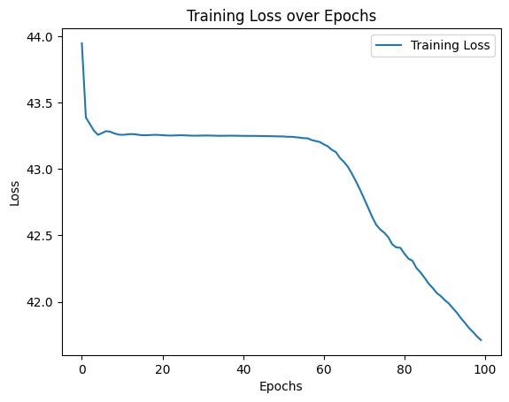
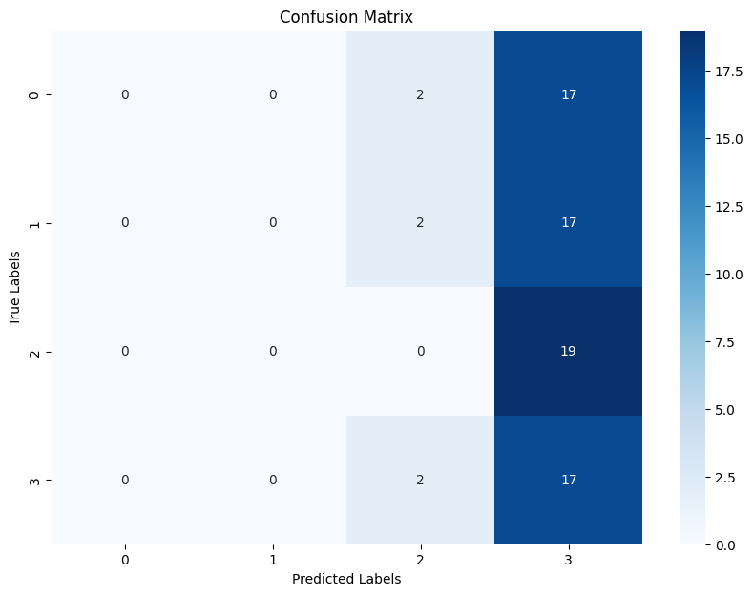
Approach 2: Two-Model Architecture
Advanced Machine Learning
Approach: Extract intermediate outputs from GPT2, convert to tensor and build a classifier that uses GAAM > Conv2d > Conv2d > Linear Layer
Training: 100 epochs on 1% of the dataset
Conclusion: Predicts label 3 most of the time, but training for more epochs could improve the results
Images from notebook "07-two-model-architecture.ipynb"

Slide 21
Proprietary Gaussian/Laplacian Attention Mechanisms
Advanced Machine Learning

Slide 22
Two-Model Architecture with our own Gaussian/Laplacian Attention Mechanism (1)
Advanced Machine Learning
Approach: Instead of using the code from the researcher, we implement our own Gaussian/Laplacian attention mechanism
Training: 100 epochs on 1% of the dataset
Conclusion: Both models are able to predict the labels on the training dataset with 100% accuracy, but the model overfits.
Model | Accuracy Train Data | Accuracy Test Data
Gaussian | 100% | 31.58%
Laplacian | 100% | 23.68%
Results from notebook "08-two-model-architecture-with-proprietary-att-mechanism.ipynb"

Slide 23
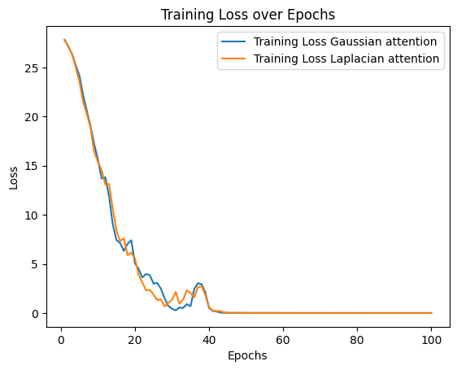
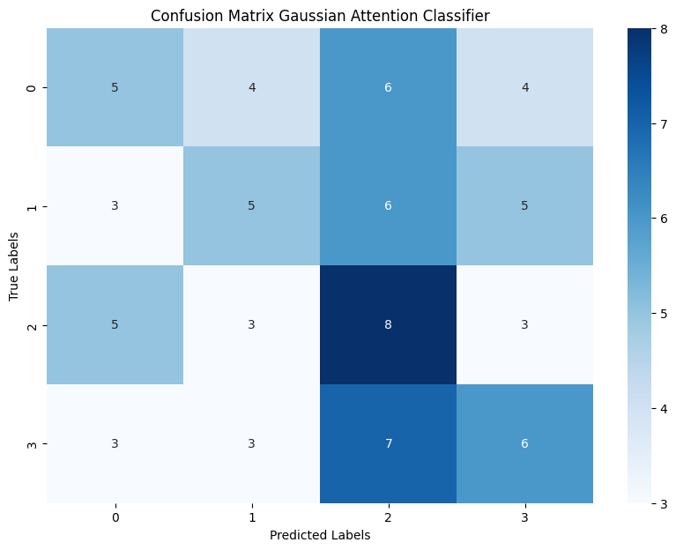
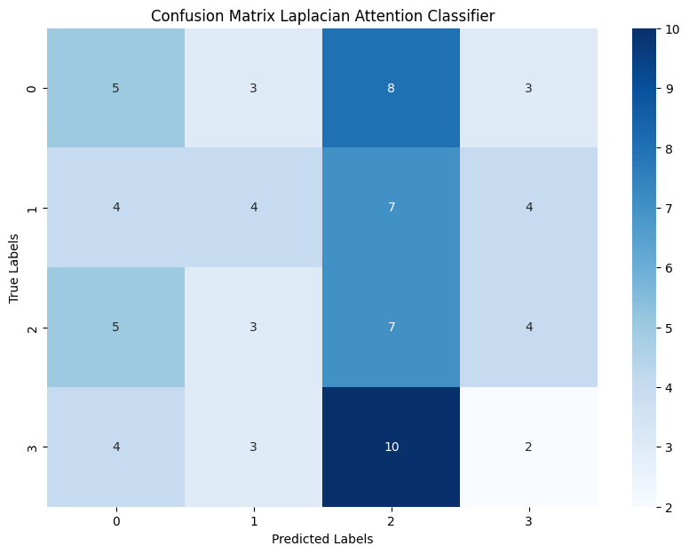
Two-Model Architecture with our own Gaussian/Laplacian Attention Mechanism (2)
Advanced Machine Learning
Approach: Instead of using the code from the researcher, we implement our own Gaussian/Laplacian attention mechanism
Training: 100 epochs on 1% of the dataset
Conclusion: Strong tendency to predict label 2.
Images from notebook "08-two-model-architecture-with-proprietary-att-mechanism.ipynb"

Slide 24
Discussion
Advanced Machine Learning

Slide 25
Discussion – Review of GAAM/LAAM
Advanced Machine Learning
Within the scope of this project, we could not replicate the results achieved with GAAM
Potential reasons:
Full code used in the paper was not provided as indicated. Because of that, GAAM remained, to some extent, a black box for us
Insufficient training / suboptimal training setup
Incompatability with the GPT2-Architecture
Changing the internal distribution from a Gaussian to a Laplacian distribution did not affect the results much

Slide 26
Discussion – Potential of Gaussian/Laplacian Attention Mechanisms
Advanced Machine Learning
However, our own implementations of a Gaussian/Laplacian attention mechanism show that Gaussian/Laplacian attention mechanisms have potential
We would be interested to see how they perform when trained on larger amounts of data with well-tuned hyperparameters
Difficult to tell whether Laplacian or Gaussian attention mechanisms are more adequate
Requires further research

Slide 27
References
Advanced Machine Learning
Ioannides, G., Chadha, A., & Elkins, A. (2024). Gaussian Adaptive Attention is All You Need: Robust Contextual Representations Across Multiple Modalities. arXiv preprint arXiv:2401.11143.

