Slide 1
Share Copilot Capacity, Not Accounts
Spec-driven delegation for teams with uneven AI budgets
Wallace Espindola
Sr. Software Engineer / Solution Architect
wallace.espindola@gmail.com
linkedin.com/in/wallaceespindola | github.com/wallaceespindola
Notes:
Hi, I'm Wallace. I'm going to present a proposal: a lightweight process for teams where AI coding assistance is unevenly distributed. There are no results in this talk, only the process and the reasoning behind it.
The short version: people with spare GitHub Copilot capacity implement tasks that colleagues without it have specified. The handoff is a Markdown spec in the repository. Nobody shares accounts or moves credits around.
Everything I show is in a public repo with the PRD, a sample task and a sample design doc. Link at the end.

Slide 2
The problem: one contract, uneven use
1
Company contract
Copilot usually comes through a company contract with Microsoft/GitHub.
2
Personal limit
Each developer has a personal limit per period: an allowance, or a budget admins set on the pool.
3
Uneven use
Some hit their limit early. Others end the period with credits left.
4
Limits are per user
Leftover credits do nothing for a colleague who ran out.
5
No license at all
Some developers have no Copilot license.
2
Notes:
Most teams get Copilot through a company agreement with Microsoft or GitHub. Copilot now bills in GitHub AI Credits. On Business and Enterprise plans, the credits each license brings are pooled for the organization, and admins can set budgets per user, per cost center or for the whole enterprise. In practice each developer ends up working against a personal limit for the billing period.
Usage is uneven. Some people hit their limit early in the period, others finish it with credits to spare. Because the limit belongs to one user, those spare credits can't help the colleague who ran out. And some developers have no license yet.
If your organization pools credits with no per-user caps, the credit argument is weaker, but the case for developers without a license still holds. Check your own plan and settings.

Slide 3
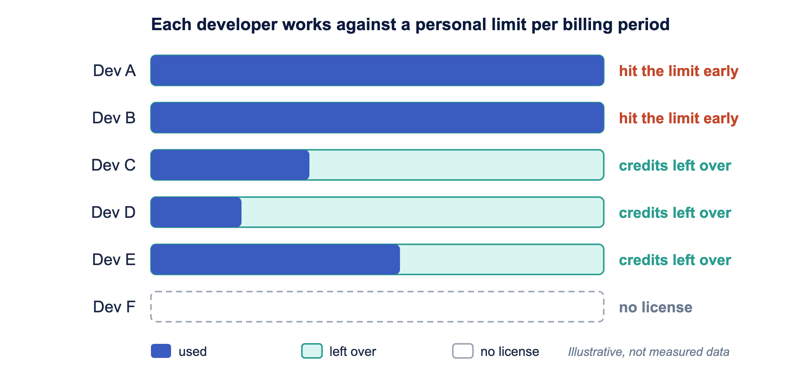
Credits the company already paid for
Routing work to people who still have credits gets more value from the same contract, without buying extra seats.
3
Notes:
This picture is illustrative, not measured data from any team. Each bar is one developer's personal limit for the period. Some are used up, some are mostly empty, one developer has no license.
Unused credits are capacity the company has already paid for. If work can move to the people who still have credits, the team gets more out of the contract it already has, without extra seats or extra credits.
The rest of the talk is about how to move the work safely.

Slide 4
"Can you run this through Copilot for me?"
The informal version does not scale:
Chat message
Missing context
Wasted credits
Lost knowledge
No visibility
The request lives in a chat thread
Copilot has to guess
The delegate pays for clarifying questions
It disappears with the Copilot conversation
Nobody sees who is waiting on whom
Goal: make the handoff cheap, explicit and repeatable.
4
Notes:
Teams already do this informally. Someone pings a colleague and asks them to "just Copilot it".
It can work once. Then the context is missing, the delegate spends their own credits asking questions, and when it is done nothing is written down, so the next request starts from zero.
So the question is how to make the handoff cheap, explicit and repeatable.

Slide 5
Key principle
Nobody transfers tokens or shares accounts.
The owner delegates a task to a colleague with Copilot capacity and stays responsible for validating and delivering it.
The task file, not the chat history, carries everything the delegate needs.
Notes:
Licenses stay personal and nobody logs into someone else's account. What moves is a piece of work, the same way you would hand a ticket to a colleague.
And the handoff medium is a file in the repo, which a human or an AI can read equally well.

Slide 6
Why this split works
Costs no AI credits
Where Copilot saves the most time
• Understanding the requirement
• Writing a clear spec
• Reviewing the spec
• Validating the result
• Writing the implementation
• Generating the test suite
• Boilerplate, mappers, migrations
• Mechanical refactors across files
Owner: thinking and checking. Delegate: spends credits only where they pay off.
6
Notes:
Writing a good spec and validating the result are human work. They cost zero credits. Implementation is where Copilot helps most.
So the owner keeps the parts that need judgement and context, and the delegate spends credits only on the part that benefits most from AI.

Slide 7
Spec-driven development, team edition
GitHub Spec Kit step | In this process
/speckit-constitution (once) | Team standards in /docs: architecture, coding, testing guides
/speckit-specify | Business requirements, written up by the owner
/speckit-plan + /speckit-tasks | The approved TASK-NNN.md file
/speckit-implement | The delegate's Copilot session
/speckit-converge | The owner's validation loop
$ uv tool install specify-cli
$ specify init <project> --integration copilot
7
Notes:
This process is spec-driven development, the GitHub Spec Kit flow, with the steps split across people.
In Spec Kit you write the constitution once, then for each feature you run specify, plan, tasks, implement and converge.
Here the constitution is the team's standards in /docs. Specify is the business requirements, written up by the owner. Plan and tasks end up as the approved task file. Implement is the delegate's Copilot session, and converge is the owner's validation loop.
Spec Kit supports Copilot directly: install the specify CLI with uv and run specify init with the Copilot integration. You can also follow the same flow by hand with plain Markdown files, which is what the sample repo does.

Slide 8
Four roles
Business
Owner
Product owner or analyst
Dev with no license or a used-up limit
Requirements and acceptance criteria
Writes the task, validates, final commit and PR
Reviewer
Delegate
Architect, tech lead or another dev
Dev with Copilot credits to spare
Approves the task before any credits are spent
Implements with Copilot, including tests and docs
8
Notes:
Four roles. One person can hold different roles on different tasks: today's owner can be next sprint's delegate.
Note the reviewer's position: before any credits are spent. A bad spec caught in review costs nothing. A bad spec caught after implementation costs the delegate's credits and everyone's time.
And ownership never moves. The owner commits and opens the PR.

Slide 9
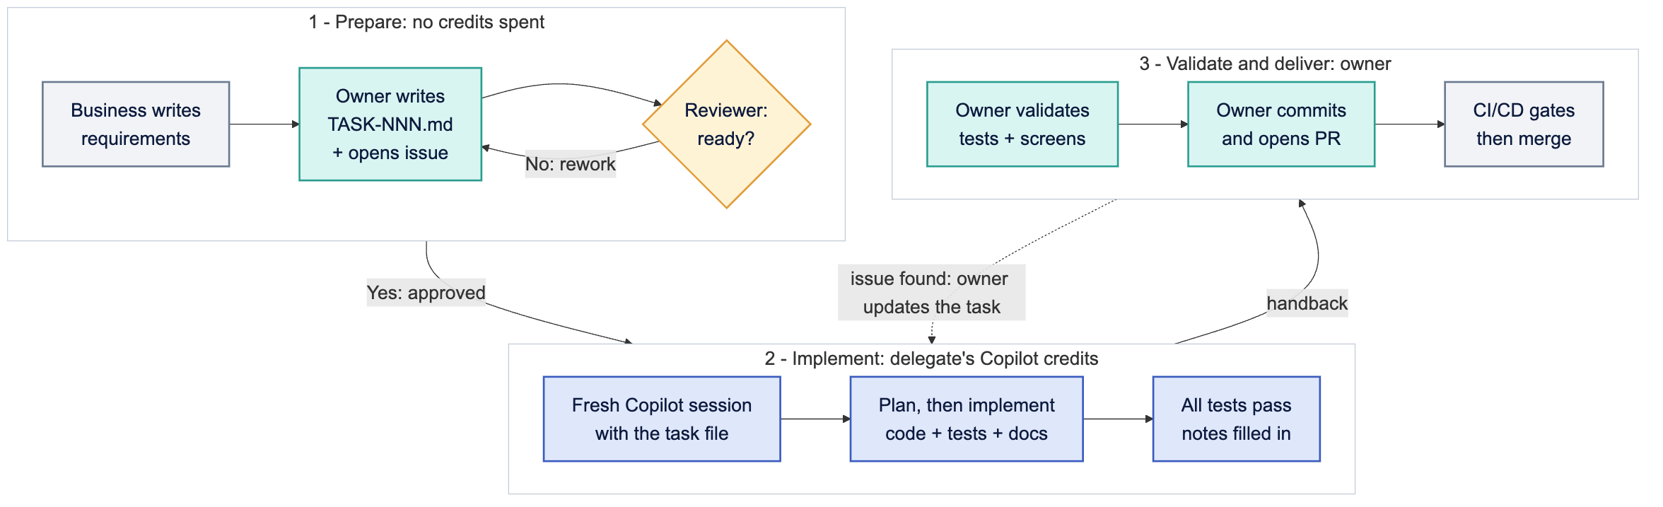
The flow
9
Notes:
Three stages.
Prepare: business requirements, the owner writes the task file and opens an issue, the reviewer checks it against the definition of ready. No credits spent yet.
Implement: the delegate opens a fresh Copilot session with the task file, plans, implements, runs the full test suite, fills in implementation notes.
Validate and deliver: the owner validates, fixes small issues, commits and opens the PR. CI/CD runs as usual. If something bigger is wrong, the owner updates the task file and it goes back to the delegate.

Slide 10
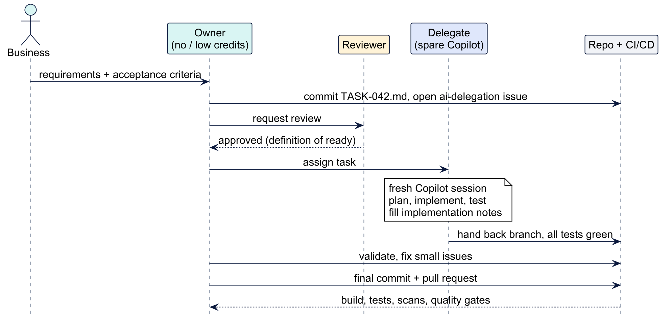
Who talks to whom
10
Notes:
Same flow, seen as messages. Two things to notice.
First, everything that matters goes through the repository: the task file, the branch, the PR. Chat is for coordination only.
Second, the owner is at both ends. They start the task and they finish it.

Slide 11
Anatomy of a task file
# TASK-042: Generate order summary report
Status: Approved Owner: <name> Reviewer: <name> Delegate: <name>
## Objective
Generate the order summary report from normalized order records.
## Expected behavior
1. Load the report configuration. 2. Retrieve the eligible orders.
3. Generate the report. 4. Store the delivery metadata.
## Acceptance criteria
- [ ] The report is generated for all eligible orders.
- [ ] The job can be restarted after a failure.
- [ ] A failed run is recorded.
## Out of scope
- File transport, customer notification
## Implementation notes (filled in by the delegate at handback)
Concrete steps
Each behavior is a step Copilot can follow.
Checkable criteria
Each one maps to a test or a visible result.
Out of scope
Stops Copilot wandering into unrequested work.
Notes at handback
Knowledge comes back into the repo.
11
Notes:
This is the sample task from the repo, trimmed for the slide. The full version also lists the tech stack, inputs, architecture constraints and references to ARCHITECTURE.md, TESTING_GUIDE.md and a design doc.
The steps are concrete and the criteria can be checked. The out of scope list stops Copilot from wandering into work nobody asked for.
The implementation notes section is how knowledge comes back from the delegate.

Slide 12
Definition of ready
The reviewer approves only when all of these hold:
Objective fits in one or two sentences
Every referenced doc exists and is current
✓
✓
Each expected behavior is a concrete step
Input/output examples where format matters
✓
✓
Each acceptance criterion is checkable
No secrets, credentials or production data
✓
✓
Out of scope is listed
Fits one session: a PR reviewable in under an hour
✓
✓
12
Notes:
A delegate's credits are wasted when Copilot has to guess. This checklist is what stops that.
The size rule is a rule of thumb: if one person can't review the PR in under an hour, split the task.
The reviewer can be another developer. It doesn't need to be an architect every time, but it does need to be someone who did not write the task.

Slide 13
What to delegate, what to keep
Delegate
Keep with the owner
• New endpoints, services or jobs with a clear spec
• Test suites for existing code
• Mechanical refactors and migrations
• Boilerplate: DTOs, mappers, repositories
• Docs generated from existing code
• One-line fixes and config changes
• Exploratory work, design still open
• Production incidents that need someone now
• Changes needing access the delegate lacks
Delegation has a fixed overhead. It pays off when the work is large and well defined.
13
Notes:
Writing a task, a review, a handoff and a validation all take time. For a one-line fix, that overhead is bigger than the work.
Delegate the big, well-defined chunks. Keep the small, the urgent and the fuzzy.

Slide 14
Naming and tracking
docs/backlog/TASK-042-order-summary-report.md
• One file per task: TASK-NNN-short-slug.md, NNN zero-padded and never reused
• Heading repeats ID and title: # TASK-042: Generate order summary report
• Each task gets a GitHub issue labeled ai-delegation linking the file
• The issue board shows what waits for a delegate and who took what
• Delegates post their capacity, for example "can take 2 tasks this sprint"
14
Notes:
The conventions are deliberately plain: a predictable file name, a label and the issue board.
With the capacity note, delegates say up front how much they can take, so owners know who to ask. The "2 tasks" is an example of what someone might write, not a target.

Slide 15
Spend credits well
One task per session
Reference, don't paste
Shared prompt
Start fresh. Long sessions carry old context.
Point Copilot at #file and #codebase.
implement-task prompt, so nobody re-explains conventions.
Plan before editing
Right model per step
Stuck in a loop?
A wrong plan costs one request. A wrong implementation costs many.
Included models for routine work, pricier ones only for the hard parts.
Stop and fix the task file instead of retrying.
15
Notes:
The delegate's credits are the scarce resource, so each session should get as far as possible with as few requests as possible.
On models: per-model credit rates change, so check the current Copilot docs rather than trusting a number on a slide.
These tips also help owners make their own limited allowance last.

Slide 16
Repository setup
Asset | Location
Custom instructions | .github/copilot-instructions.md
Path instructions | .github/instructions/*.instructions.md
Guidance for other agents | AGENTS.md
implement-task prompt | .github/prompts/implement-task.prompt.md
Custom agents | .github/agents/*.agent.md
Skills | .github/skills/<name>/SKILL.md
Every delegate gets the same setup from the repo.
16
Notes:
Custom instructions hold the stack, conventions and links to ARCHITECTURE.md, CODING_GUIDE.md and TESTING_GUIDE.md. They are loaded into every Copilot request.
The implement-task prompt reads a task file, plans, implements, runs the tests and fills in the implementation notes.
A custom agent can act as a reviewer that checks the definition of ready before a human looks at it.

Slide 17
Public agents, skills and MCP servers
Workflow and agents
MCP servers
GitHub Spec Kit
/speckit-constitution /speckit-specify
/speckit-plan /speckit-tasks
/speckit-implement /speckit-converge
Copilot agent mode in the IDE
Copilot coding agent on the issue
Copilot code review on the PR
awesome-copilot, anthropics/skills, addyosmani/agent-skills
GitHub MCP
Issue, linked PRs, CI results
Context7
Current library docs, no outdated APIs
Playwright MCP
Drives the UI during validation
17
Notes:
All public. Spec Kit is the spec-driven development toolkit this process is based on. Its commands produce and consume the same kind of Markdown specs as our task files.
Copilot coding agent: the delegate can assign the issue to Copilot, which opens a draft PR in the background. The credits are charged to the delegate. The owner validates the draft PR as usual.
From the skill collections, pick what fits your stack and copy it into the repo. Don't install everything.

Slide 18
Guardrails
Same access
Delegates already have repository access. Nobody gains access they did not have.
Synthetic data
Task files hold synthetic examples, never secrets or production data.
Approved AI policy
Public code filtering and content exclusions stay as configured.
Same gates
Same review, CI/CD and quality gates as any other change.
Repo is the truth
/docs is the source of truth, not Copilot conversations.
18
Notes:
Expect security and management to ask about this, so it gets its own slide.
Nothing in this process changes who can see what, and nothing bypasses the pipeline. If your policy forbids something, this process doesn't make it allowed.

Slide 19
Is it working? Track per sprint
Tasks delegated and merged
Iterations per task
Is the process being used?
More than two usually means the task was not ready
Approval to merge time
Tasks waiting for a delegate
Compare with similar tasks done by hand
Growing queue: more capacity or smaller tasks
A proposal: these are the measures to track from the first sprint.
19
Notes:
I'm not going to show numbers, because this is a proposal and I don't have results to share yet. These are the measures I'd track from the first sprint.
Iterations per task is the most useful early signal. If tasks keep bouncing back, fix the definition of ready, not the delegates.

Slide 20
Key takeaways
1
Share work, not accounts or tokens
2
Spec-driven development with the steps split across people
3
The spec is the handoff, committed in the repo
4
Owners think and check, delegates spend credits on implementation
5
A reviewer gate before credits are spent
6
Same PR, CI/CD and quality gates as every other change
20
Notes:
My main suggestion: put a definition of ready in front of your Copilot credits.
Even teams where everyone has a license can use this. Clear task files make any AI session cheaper and any human handoff easier.

Slide 21
Resources
Repo (PRD + sample task + design doc):
github.com/wallaceespindola/share-tokens-using-spec-driven-dev
GitHub Spec Kit:
github.com/github/spec-kit
Wallace Espindola
wallace.espindola@gmail.com
linkedin.com/in/wallaceespindola | github.com/wallaceespindola
Thanks! Questions?
Notes:
The repo has the full PRD, including the 13-step process, the task template and the recommended tools, plus TASK-042 and its design doc as a worked example.
Feedback welcome, especially if you try this with your team. Thanks.

