Slide 1

Modcom
Institute of Technology

Slide 2
Student Name: Wallace Shem
Project Name: Shop Jewels

Slide 3
Slide 2: Problem Definition
Every Project Begins with a Problem Definition.
“Jewellery shops don’t have a proper online presence especially for youths or people who like jewelleries this will help growing middle-income population, access to affordable, high-quality, and authentic jewelry remains limited for many consumers.”

Slide 4
Slide 3: Your Solution
I have Create a web app where customers can easily order approved, real made accessories while using their phones from any place.
The app will feature product information, including benefits (for everyone), pricing, and delivery details.

Slide 5
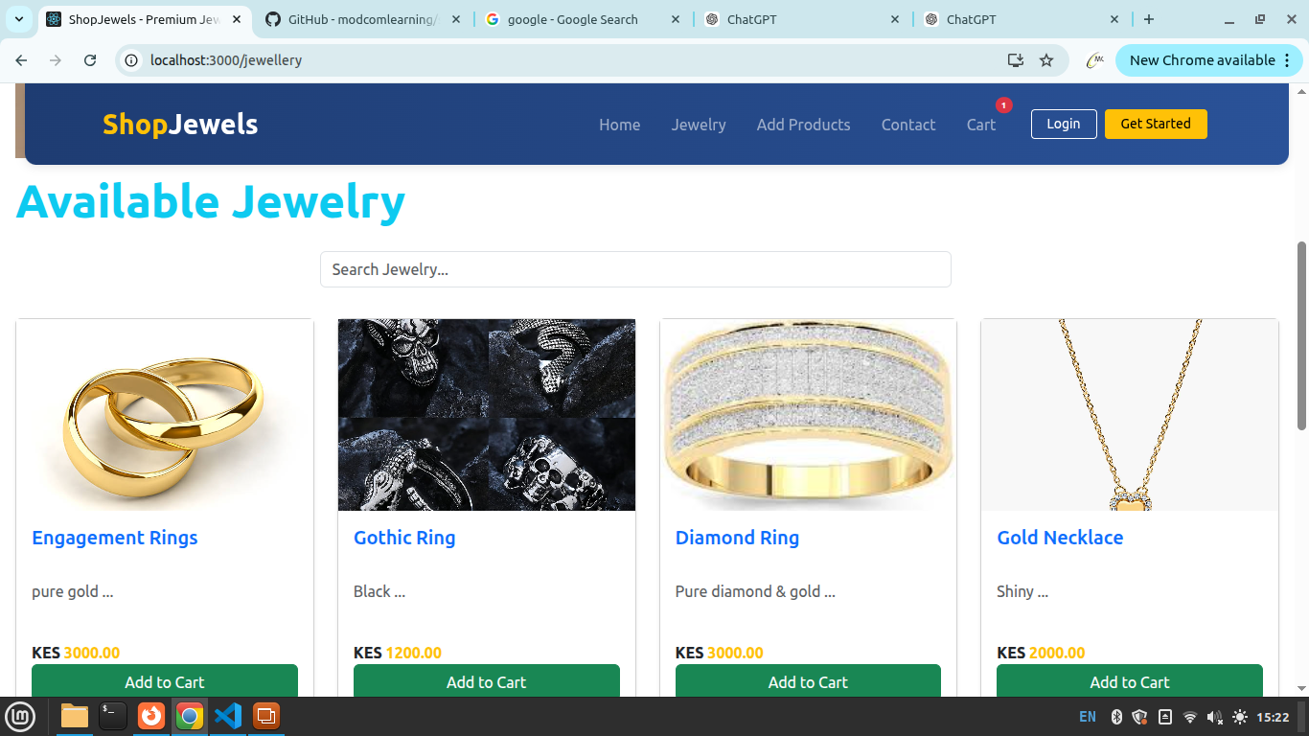
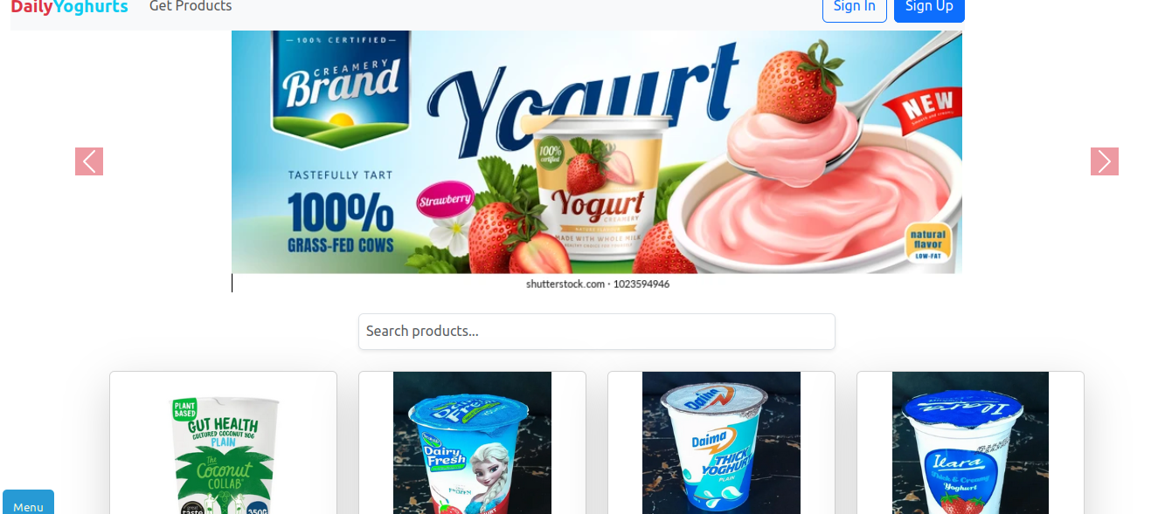
Slide 4: Screenshots

Slide 6
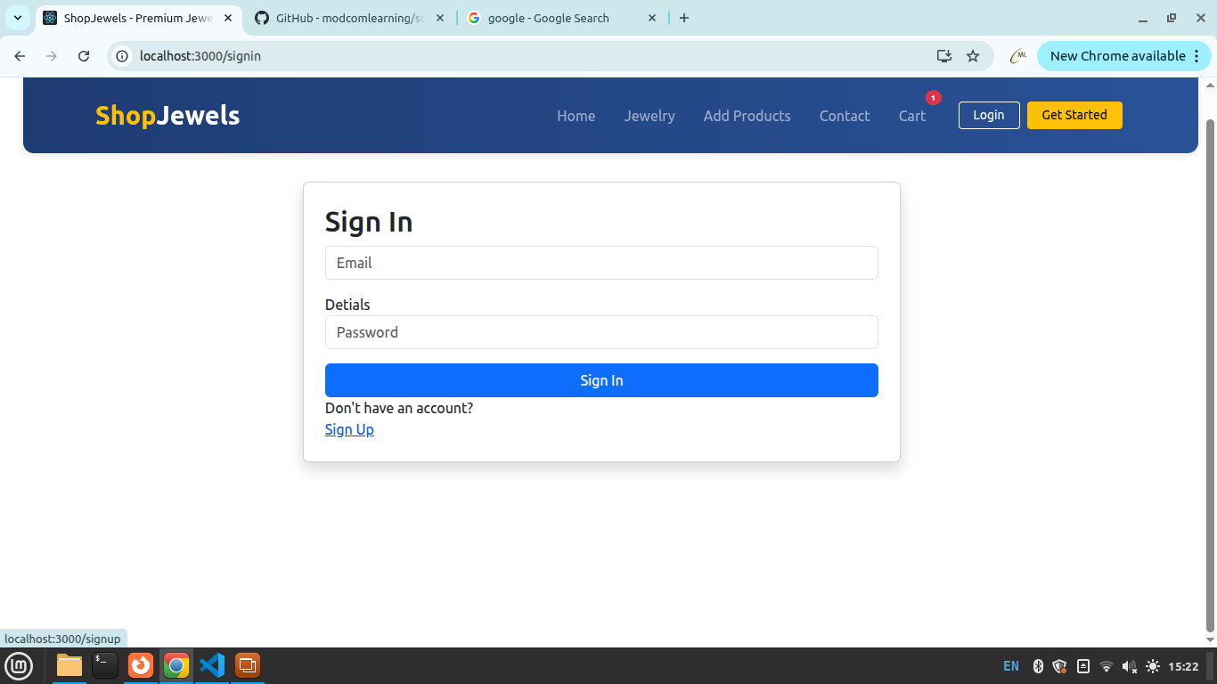
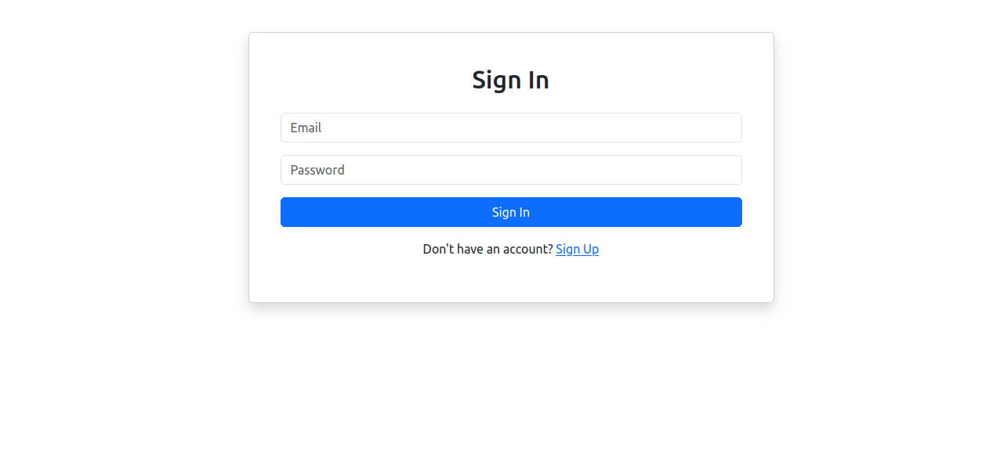
Slide 5: Screenshots

Slide 7
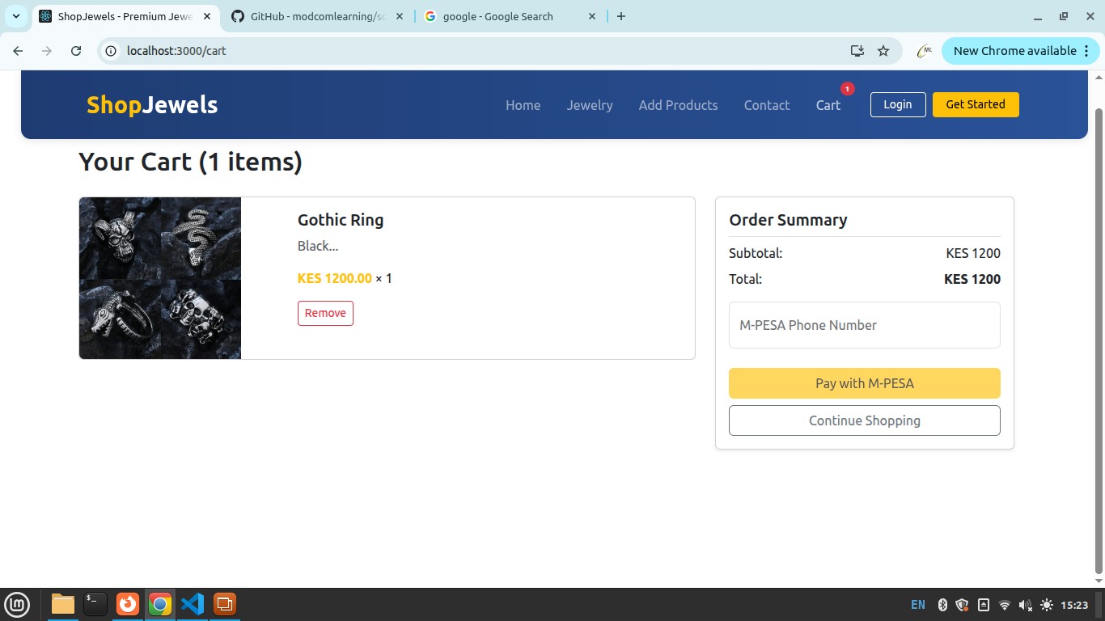
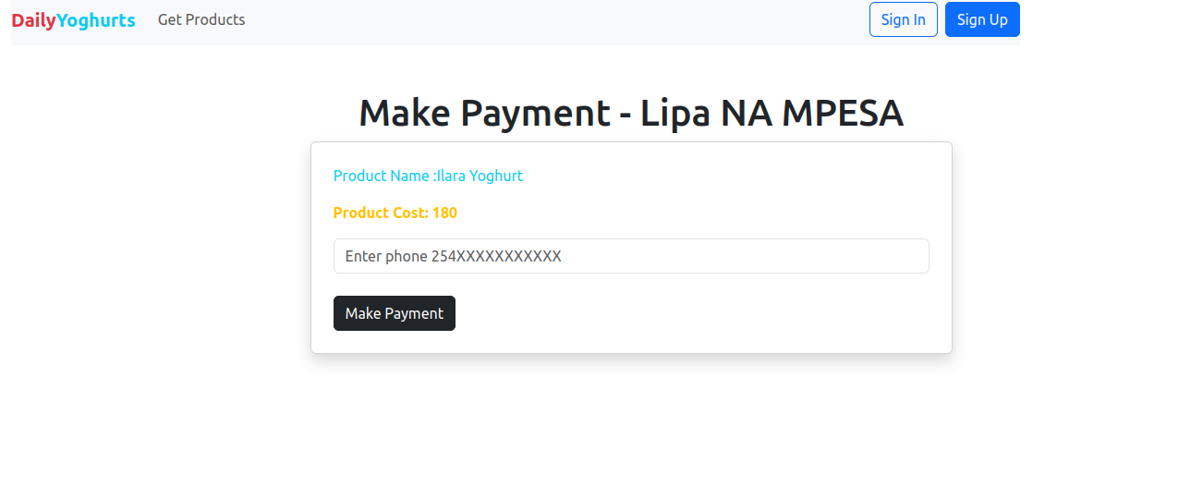
Slide 5: Screenshots
For Android, Show Apps Screenshots
For Data Science and ML – Show 3 Graphs, Model Used, Score, Prediction

Slide 8
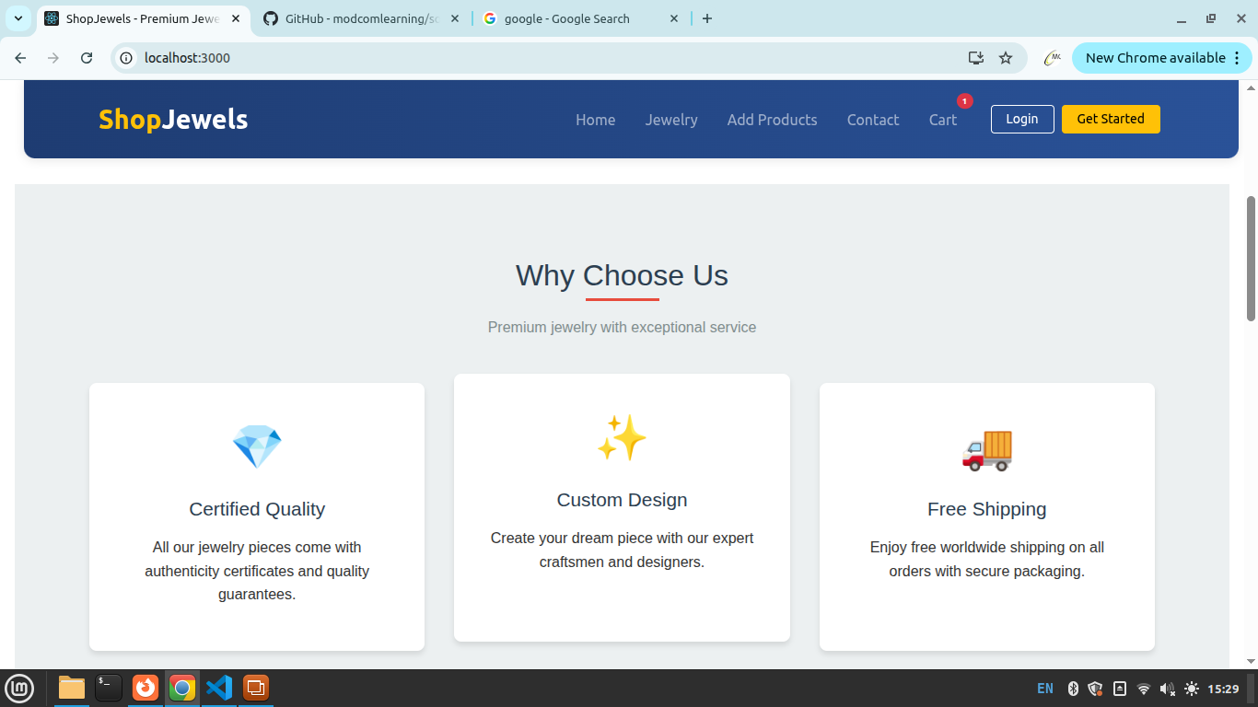
THANK YOU

Slide 9
Slide 6: Target Market
This website will be more useful the current generation and the generations to come because they are the most users of jewelleries and internet..and also the jewellery lovers

Slide 10
Slide 7: Revenue Model
Product Sales: Direct online sales of gold, diamond, silver & fashion jewellery
Custom Orders: Personalized jewellery with premium pricing
Making Charges & Add-ons: Design, certification, packaging & delivery fees
Membership Plans: Paid subscriptions with exclusive offers and discounts
Seasonal Collections: Higher sales during weddings and festivals
Partnerships: Affiliate marketing and brand collaborations

