Slide 1


QUALITY : TOOLS FOR SUCCESS
July 2024

Slide 2
Quality : TooLs for success
Generic Butcher – An Introduction
Product Demo – the GBC Solution
Project Overview
Considerations and Future Features
Questions
Notes:
Page 1
-We’re here as the Generic Butcher Company quality control team to give a quick run down on a problem and a solution we’re facing.
-The team is all here- Abigail, Saad, Kevin, Josh, and myself, Caite.
-We’re looking for permission to move forward with managing a new QC database and web-hosted dashboard.
-We’ll give a demo in a few minutes, how it’s implemented, some wants and then open everyone up for questions.

Slide 3



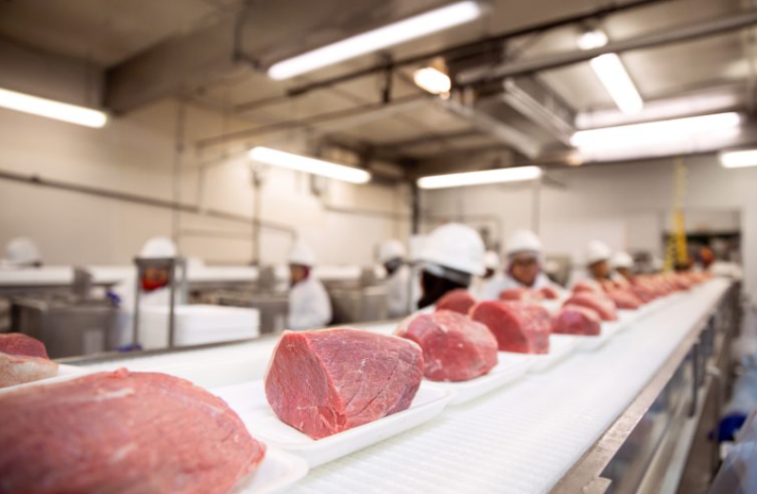





Generic Butcher – An Introduction
Production Line
Meter Read
CSV Format
Operations Reports
Notes:
Pg 2
So what actually did we do?
We have created a prototype tool that dynamically calls our monthly quality report for weight and height of all our products. It helps us find insights quickly and it cuts manual work alongside some security concerns.
I’m sure you’re wondering why that matters.
We cut meat to spec– that’s it. We sell our process. I know it may have been a long time since you’ve been in the plant but the way our process works is that we:
Unload giant hunks of beef
cut to customer specifications
Then we weigh them, and send those steaks through a conveyor belt that has a camera to determine the height of the steaks- basically their thickness.
We try to keep this weight and height within a 95% of the customer’s spec, and over time if we can keep within spec AND serve slightly smaller steaks on average, we gain larger profits.
Because we sell our process, it is EXTREMELY important we know when our product is out of compliance vs customer requirements. That quality is all we have to our name. We need a tool that can quickly show our compliance issues so we can address them internally before we serve data to the customer.
Currently, our metrics are only available in CSV format ---- we still have to transform and clean it ad hoc.
We hate this. It takes FOREVER! This tool we’ve created will save so much time.
When we are looking to report to you as management, we just don’t have robust or custom visualizations. We have a list of “wants” that excel just is hateful about when we ask it to perform.
And honestly, those monthly reports we have to wait on Janet to finish, and anyone can accidentally delete them.
When we find errors we delete them right now. That’s been the standard. Beyond obvious ethical considerations, this means if we want to go back and look at historical trends, and where errors are, we can’t. They’re lost forever.
Segue - We are really pushing to set up a database and dashboard for our reporting. So we banded together and came up with what we want to see- Kevin’s going to speak to our solution---

Slide 4


Product Demo – the GBC Solution
Tester blocks– not a product…
Steaks the thickness of a dime???
800 pound pork chops???
ACTION > OVERVIEW > PRODUCTS
Notes:
Kevin – Introduction to our solution– - As we went through the data our focus was to provide a list of all areas that needed immediate attention. So, this was our focus as we cleaned and analyzed the data. - During the cleaning process we removed: - TEST BLOCKS. - steaks that were < .05 inches. - steaks that were > 50 oz - After the data was cleaned the data was loaded to our “ACTION” page. - action page quickly identifies products that are not meeting standard - provides the production team areas that need immediate attention. - allows them to conduct root cause analysis to determine if it was a problem with the process, equipment, training, or the individual themselves. - Segue- now Josh will live demo the action page
Josh –
- We designed our landing page so that if there are products out of spec, this page highlights them bright red.
If nothing is out of spec, we show that. I know immediately which products I should review and address.
Those products pop up in the card here and I can know what I’m looking for if I want to drill down into a more robust overview.
Segue- Abigail will speak to our overview report page.
_______________________________________________
Abigail – Overview Page – discuss the features in Overview
CARD HERE
Segue- TO KEVIN
__________________________
Kevin – - Going to give a quick refresher on histograms - 95% compliance goal. - On our the x-axis for height steps by a 10th of an inch - and quarter oz for weight - Our products page provides histogram that center on the average which should be close to product spec - goal post - each of these columns represents the count of the steaks - give an example of a curve we might want to look at even though it’s in compliance Segue – As we ask for the opportunity to move forward with this project, we were not without some challenges that Abigail can speak to.
________________________________________
Abigail- Challenges
CARD HERE
Segue- TO SAAD

Slide 5

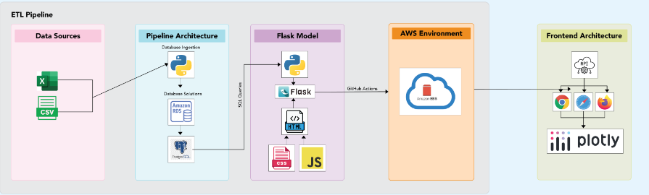
Project OVERVIEW
Notes:
Thanks Abigail. Hey everyone!
To give you a bit of background, we have been grueling through the same errors and time sinks, month over month every time we get a new csv from the production line. We decided, why don't we band together and solve these problems.
After a bunch of dedicated research, we put together a model that would keep our data safer, standardize reporting amongst the department, and overall gain trust with our data.
The first step to tackle was where. Storing data in local CSV files is risky. By moving our data to a cloud database, we gain enhanced security features like encryption, automated backups and data constraints. Our data is now secure from those scary hackers.
On top of that, we can be confident that the data that passes the checks to be stored in the database is reliable, allowing us to trust the data unlike being in doubt whether the csv populated properly.Second- Security. CSVs are hacker food. Our application keeps data password protected and uses secureAPI endpoints (in lamens terms, multiple layers between all the data and what we need to see day in day out).
Third - Time. Automating data processes with our application saves significant time, reducing manual labor and human error. This allows our team to focus on more critical tasks.Developing this prototype has been a sound decision; It ensures data security, reliability, and time-efficiency. Our application safeguards our valuable data and puts us in a position to leverage the future, that in 2024 and beyond, seems to be data.
Speaking of the future, as our youngest team member, its only fair that Josh is brought in to talk about the future endless possibilities of this application. He will discuss a few of them with you.

Slide 6
Considerations and Future Features
DATE FILTERING
OUTLIER LISTs
CUSTOMER VIEWS
EMAILS
CSV DOWNLOAD
LOGINS PAGE
Notes:
Josh –FINALE
If we get permission to move forward, some future features we’d really like to explore are:
Adding quarterly view, monthly, view, weekly, daily ingestion and view
Adding outliers lists by product and date
Transforming data differently based on who the stakeholder is(customer or internal)
It might also be nice to have emails when data is uploaded to the database or reports that we can pull CSVs from here.
- Segue – Enough talk, does anyone have any questions?

Slide 7
Questions
Notes:
QUESTION TIME

