Slide 1
VLANS
Institute of IT Professionals
Instructor:
Muhammad Naeem
(MSIT/RHCE/CCNP/CCNA/MCSE)
Cell: 0345-5238281
E-Mail: mna571@yahoo.com

Slide 2
Lecture Overview
What is a VLAN?
VLAN Memberships
VLAN links
Frame tagging
VTP
Trunking
Configuring VLANs
Configuration examples

Slide 3
VLANS (Virtual LANS)
Multiple LANs in a single LAN are created to overcome the major LAN Problems like;
Broadcast Problem
Security Problem
Broadcast is generated in a LAN generally as a result of ARP when the destination MAC is needed, or when a server advertising its services to its clients. In case of broadcast every node has to process.
VLANs are created to minimize the processing of extra nodes in order to make the boost up performance of a network.

Slide 4
VLANS
Distributing broadcast domain in LAN
VLANS are created to make Logical grouping of different departments like HR, MKT, IT etc
Trunk Link belongs to all VLANs
All the ports are in VLAN1 by default

Slide 5
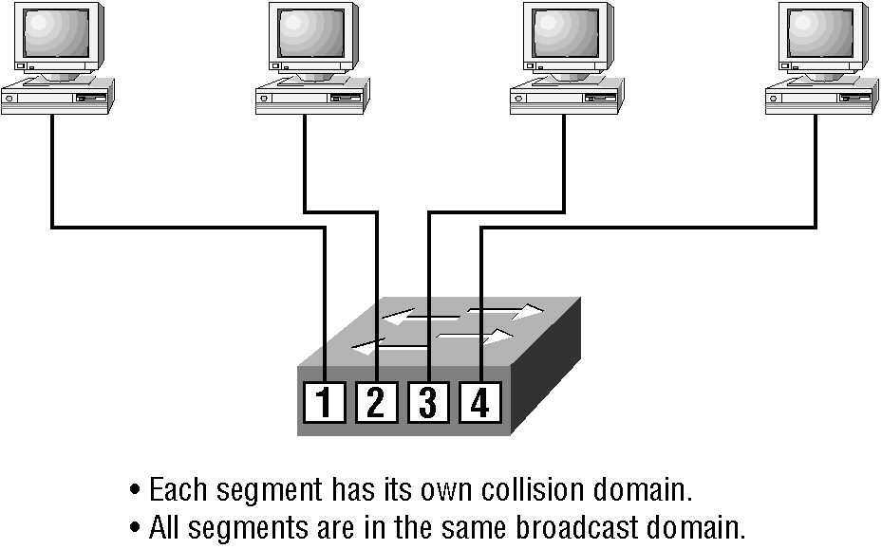
Switches

Slide 6
Features of VLANs
Simplify network management
Provides a level of security over a flat network
Flexibility and Scalability

Slide 7
Broadcast Control
Broadcasts occur in every protocol
Bandwidth & Broadcasts
Flat network
VLANs & Broadcasts

Slide 8
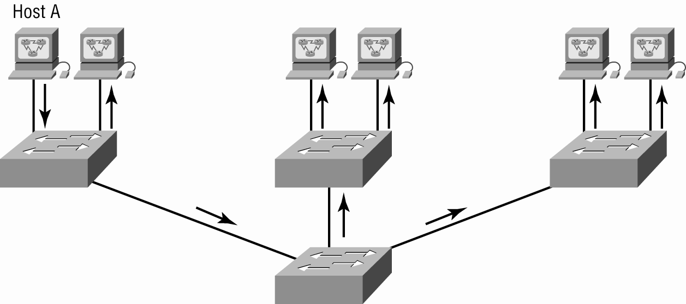
Flat Network Structure

Slide 9
Security
Flat network problems
VLANs

Slide 10
Flexibility & Scalability
Layer-2 switches only read frames
Can cause a switch to forward all broadcasts
VLANs
Essentially create broadcast domains
Greatly reduces broadcast traffic
Ability to add wanted users to a VLAN regardless of their physical location
Additional VLANs can be created when network growth consumes more bandwidth

Slide 11
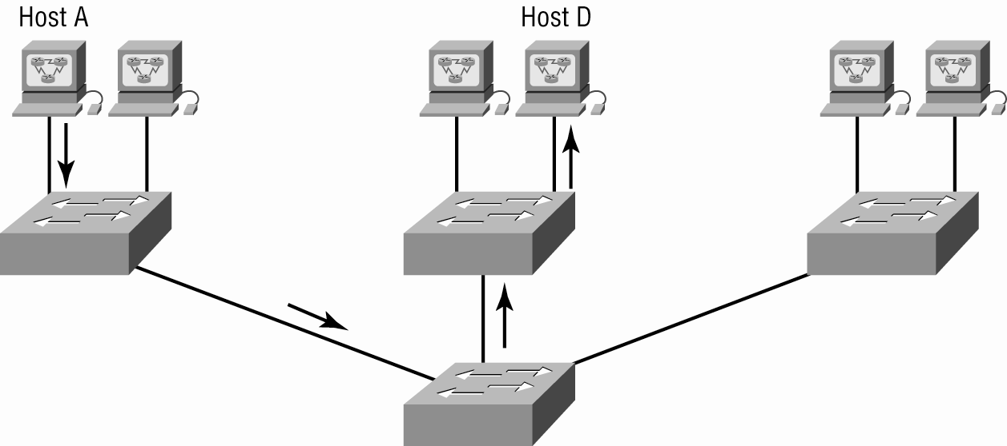
Switched Network

Slide 12
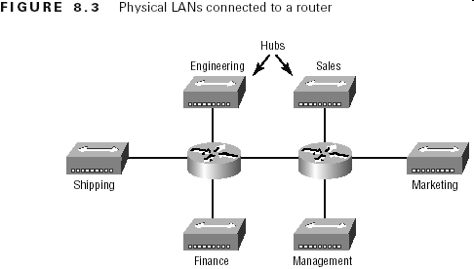
Physical LANs Connected To A Router

Slide 13
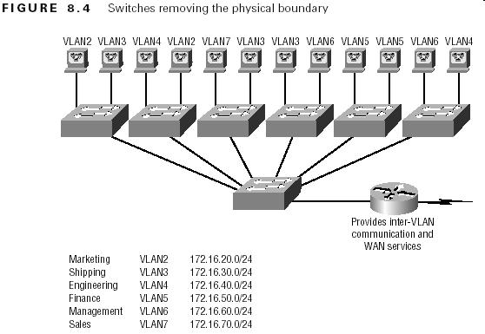
VLANs Remove The Physical Boundary

Slide 14
VLAN Memberships
Static VLANs
Typical method of creating VLANs
Most secure
A switch port assigned to a VLAN always maintains that assignment until changed
Dynamic VLANs
Node assignment to a VLAN is automatic
MAC addresses, protocols, network addresses, etc
VLAN Management Policy Server (VMPS)
MAC address database for dynamic assignments
MAC-address to VLAN mapping

Slide 15
Identifying VLANs
Access links
A link that is part of only one VLAN
Trunk links
Carries multiple VLANs

Slide 16
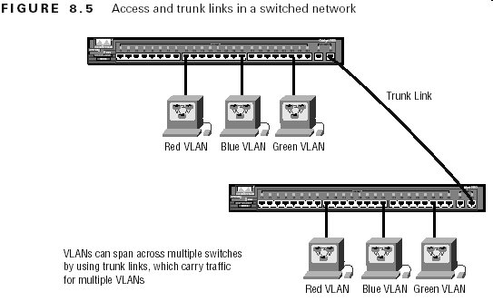
Identifying VLANs (cont.)

Slide 17
Frame Tagging
Definition: A means of keeping track of users & frames as they travel the switch fabric & VLANs
User-defined ID assigned to each frame
VLAN ID is removed before exiting trunked links & access links

Slide 18
VLAN ID Methods
Inter-Switch Link (ISL)
Cisco proprietary
FastEthernet & Gibabit Ethernet only
IEEE 802.1q
Must use if trunking between Cisco & non-Cisco switch

Slide 19
VLAN ID Methods
Protocols at Trunk Links:
IEEE 802.1q or 802 dot1q:
ISL (Interswitching Link)
Frame tag=8 bytes
Dot1q=12 bytes
Encapsulation
Data
Tag
Data

Slide 20
VLAN ID Methods
v2
Example;
S1
v2
v8
Encapsulation on Trunk Link
802 dot1q
Access Link
S2

Slide 21
Configuring VLANs
Creating VLANs
Assigning Switch Ports to VLANs
Configuring Trunk Ports
Configuring Inter-VLAN routing

Slide 22
Configuring VLANs
Switch#show vlans
Switch#conf t
Switch (config): VLAN2
Switch (config-vlan): name IT
Switch (config-vlan):exit
Switch (config): VLAN3
Switch (config-vlan): name HR

Slide 23
Configuring VLANs
Adding Ports into VLAN:
Switch(config)#interface fastethernet 0/2
Switch(config-if)#switchport mode access
Switch(config-if)#switchport access vlan2
Selecting Range of Ports:
Switch(config)#interface range fastethernet 0/2 - 10
Selecting Specific Ports:
Switch(config)#interface range fa0/2 , fa0/3 , fa0/5

Slide 24
VTP (VLAN Trunking Protocol)

Slide 25
VTP (VLAN Trunking Protocol)
Purpose: to manage all configured VLANs across a switch internetwork & maintain consistency
Allows an administrator to add, delete, & rename VLANs
VTP send information of VLANs via trunk links to all other switches
To Synchronize the information to each other which are in same domain

Slide 26
VTP Benefits
Benefits
Consistent configuration
Permits trunking over mixed networks
Accurate tracking
Dynamic reporting
Plug-and-Play
A VTP server must be created to manage VLANs

Slide 27
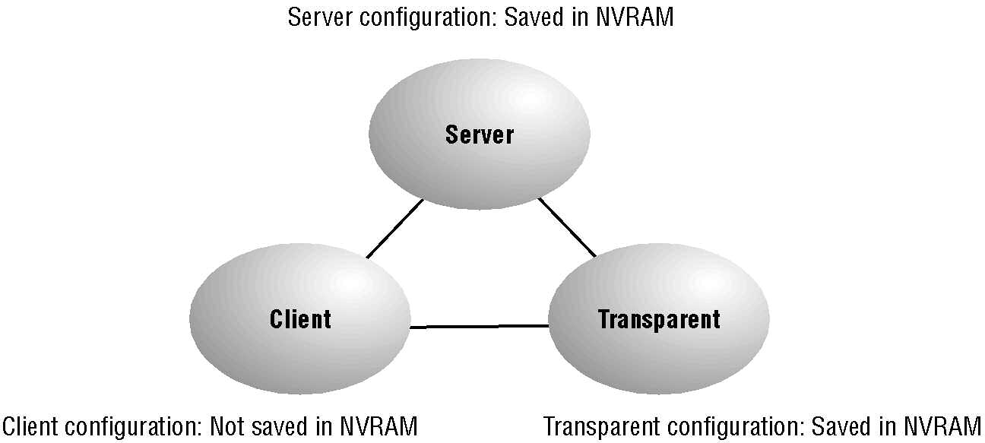
VTP Modes

Slide 28
VTP Modes
VTP Server:
Default for all Catalyst switches
Minimum one server for a VTP domain
Functions ;
VTP Server can create VLANs
Can Delete VLANs
Can Modify VLANs

Slide 29
VTP Modes
VTP Client:
When one switch is configured as VTP server the remaining all are configured as VTP Client
Receives information + sends/receives updates
VTP client has no functionality like VTP Server.
Cannot make any changes

Slide 30
VTP Modes
VTP Transparent:
It is having almost all the functionality of VTP server except it doesn’t synchronize its own information to other switches
Does not participate in a VTP domain but forwards VTP advertisements
Can add/delete VLANs
Important Info:
VTP Domain name must be same
Password must be same

Slide 31
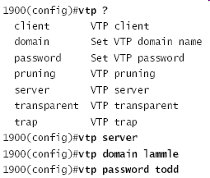
Configuring VTP
Switches are configured to be VTP servers by default.

