Slide 1
CCNA (200-125)
CDP (Cisco Discovery Protocol)
Instructor:
Muhammad Naeem
(MSIT/RHCE/CCNP/CCNA/MCSE)
Cell: 0345-5238281
E-Mail: mna571@yahoo.com

Slide 2
Lecture Overview
CDP (Cisco Discovery Protocol)
LLDP (Link Layer Discovery Protocol)

Slide 3
CDP (Cisco Discovery Protocol)

Slide 4
The “CDP”
It’s a Cisco's proprietary protocol called the Cisco Discovery Protocol, that gives you a summary of all the directly connected Cisco devices. CDP is a L2 protocol, that discovers neighbor regardless of which protocol suite they are running. When a cisco device boots up, the CDP is loaded by default, but can be disabled at interface level.
* The CDP is limited to the immediate neighbors only…
The summary includes Device Identifier(eg. Switch configured name or domain name), Port Identifier (eg. Ethernet 0 and serial 0.), Capabilities list (eg. The device can act as a source route bridge as well as a router), Platform (eg. Cisco 2600).

Slide 5
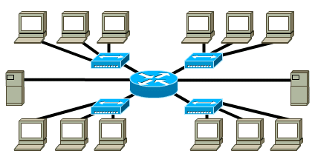
CDP (Cisco’s Discovery Protocol)

Slide 6
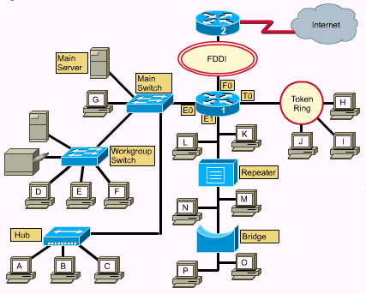

Slide 7
Using CDP
Router# sh cdp neighbor (shows neighboring devices)
Router# sh cdp entry 192.168.10.1 (shows detailed information about this perticular neighbor.)
Router# sh cdp interface(shows the details of the interface of the local decive.)
Router# sh cdp traffic (shows the packet sent, received, lost etc.)
To disable CDP….,
Router(config)#no cdp run
Router(config)#int s0
Router(config-if)#no cdp enable

Slide 8
LLDP (Link Layer Discovery Protocol)

Slide 9
The “LLDP”
LLDP is a layer two discovery protocol, similar to Cisco's CDP. The big difference between the two is that LLDP is a standard while CDP is a Cisco proprietary protocol. Cisco devices support the IEEE 802.1ab version of LLDP. This allows non-Cisco devices to advertise information about themselves to our network devices

Slide 10
The “LLDP” Commands
Commands;
To enable LLDP at configuration mode
R(config)# lldp run
To enable LLDP at interface mode
R(config)#int s0/0
R(config-if)#lldp run
To show LLDP neighbors info at Privillege level
R# show lldp neighbors
R# show lldp neighbors detail

Slide 11
The “LLDP” Commands
To disable LLDP at configuration mode
R(config)# no lldp run
To disable LLDP at interface mode
R(config)#int s0/0
R(config-if)#no lldp run

