Slide 1
CCNA (200-125)
Routing
Instructor:
Muhammad Naeem
(MSIT/RHCE/CCNP/CCNA/MCSE)
Cell: 0345-5238281
E-Mail: mna571@yahoo.com

Slide 2
Lecture OVERVIEW
Routing
Types of Routing
Static Routing
Dynamic Routing

Slide 3
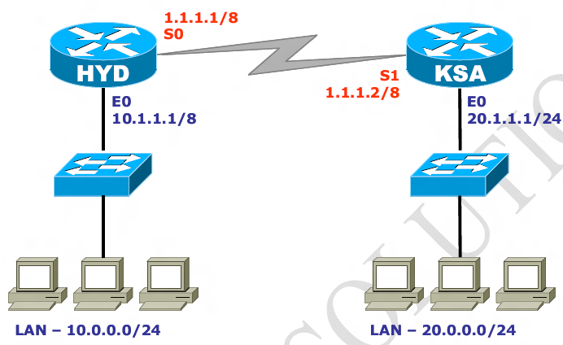
ROUTING
Forwarding of packets from one network to another network choosing the best path from the routing table.
Routing table consist of only the best routes for every destinations.

Slide 4
ROUTING
Rules of Routing:
HYD Ethernet interface should be in the same network as your HYD LAN and similarly on KSA side.
HYD S0 and KSA S1 should be in same network.
HYD LAN and KSA LAN should be in different Network.
All interfaces of Router should be in different network.

Slide 5
TYPES OF ROUTING
Static Routing
Dynamic Routing
Static Routing:
It is configured by Administrator manually.
Mandatory need of Destination Network ID
It is Secure & fast
Used for Small organizations with a network of 10-15 Routers.
Administrative distance for Static Route is 1.

Slide 6
TYPES OF ROUTING (Static Routing)
Administrative distance:
It is the “trustworthiness” of the routing information. Lesser the Administrative distance, higher the preference.
Disadvantages:-
Used for small network.
Everything to manually
Network change effects complete network

Slide 7
TYPES OF ROUTING (Static Routing)
Configuring Static Route:
Router(config)# ip route <Destination Network ID>
<Destination Subnet Mask><Next-hop IP address >
Or
Router(config)# ip route <Destination Network ID> <Destination Subnet Mask><Exit interface type><interface number>

Slide 8
TYPES OF ROUTING (Static Routing)
EXERCISE-1 (STATIC ROUTING):

Slide 9
TYPES OF ROUTING (Static Routing)
ON HYD :
HYD # config terminal
HYD(config) # ip routing
HYD(config) # ip route 20.0.0.0 255.255.255.0 1.1.1.2
HYD # show ip route
C 10.0.0.0/8 is directly connected on Ethernet 0
C 1.0.0.0/8 is directly connected on serial 0
S 20.0.0.0/8 via [1/0] 1.1.1.2

Slide 10
TYPES OF ROUTING (Static Routing)
ON KSA :
KSA # config terminal
KSA(config) # ip routing
KSA(config) # ip route 10.0.0.0 255.255.255.0 1.1.1.1
KSA # show ip route
C 20.0.0.0/8 is directly connected on Ethernet 0
C 1.0.0.0/8 is directly connected on serial 1
S 10.0.0.0/8 via [1/0] 1.1.1.1

Slide 11
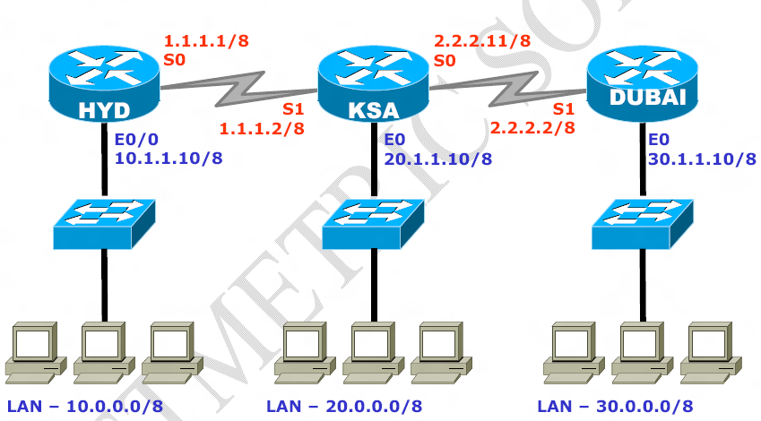
TYPES OF ROUTING (Static Routing)
EXERCISE-2 (STATIC ROUTING):

Slide 12
TYPES OF ROUTING (Static Routing)
ON HYD :
HYD # config terminal
HYD(config) # ip routing
HYD(config) # ip route 20.0.0.0 255.0.0.0 1.1.1.2
HYD(config) # ip route 30.0.0.0 255.0.0.0 1.1.1.2
HYD(config) # ip route 2.0.0.0 255.0.0.0 1.1.1.2
HYD # show ip route
C 10.0.0.0/8 is directly connected on Ethernet 0
C 1.0.0.0/8 is directly connected on serial 0
S 20.0.0.0/8 via [1/0] 1.1.1.2
S 30.0.0.0/8 via [1/0] 1.1.1.2
S 2.0.0.0/8 via [1/0] 1.1.1.2

Slide 13
TYPES OF ROUTING (Static Routing)
ON KSA:
KSA # config terminal
KSA(config) # ip routing
KSA(config) # ip route 10.0.0.0 255.0.0.0 1.1.1.1
KSA(config) # ip route 30.0.0.0 255.0.0.0 2.2.2.2
KSA # show ip route
C 20.0.0.0/8 is directly connected on Ethernet 0
C 1.0.0.0/8 is directly connected on serial 1
C 2.0.0.0/8 is directly connected on serial 0
S 30.0.0.0/8 via [1/0] 2.2.2.2
S 10.0.0.0/8 via [1/0] 1.1.1.1

Slide 14
TYPES OF ROUTING (Static Routing)
ON DUBAI :
DUBAI # config terminal
DUBAI(config) # ip routing
DUBAI(config) # ip route 10.0.0.0 255.0.0.0 2.2.2.11
DUBAI(config) # ip route 20.0.0.0 255.0.0.0 2.2.2.11
DUBAI(config) # ip route 1.0.0.0 255.0.0.0 2.2.2.11
DUBAI # show ip route
C 30.0.0.0/8 is directly connected on Ethernet 0
C 2.0.0.0/8 is directly connected on serial 1
S 20.0.0.0/8 via [1/0] 2.2.2.11
S 10.0.0.0/8 via [2/0] 2.2.2.11
S 1.0.0.0/8 via [1/0] 2.2.2.11

Slide 15
TYPES OF ROUTING
Default Route
Manually adding the single route for the entire destination. Default route is used when destination is unknown
Last preferred route in the routing table when there is no entry for the destination network in a routing table, the router will forward the packet to its default router.
Default routes help in reducing the size of your routing table.
You should use default routing only on stub networks ---those with only one exit path out of the network.

Slide 16
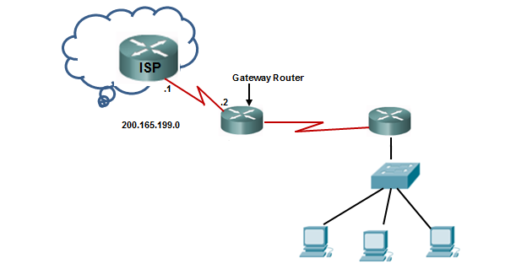
Default Route
In the following topology and configuration command examples, helps to explains how to configure a default route, or gateway of last resort:

Slide 17
TYPES OF ROUTING
Configuring Default Route
Router(config)# ip route <Destination Network ID> <Destination Subnet Mask><Next-hop IP address >
Or
Router(config)# ip route <Destination Network ID> <Destination Subnet Mask><Exit interface type><interface number>

Slide 18
Default Route
Use the following command to configure a default route on the gateway router:
Gateway(config)#ip route 0.0.0.0 0.0.0.0 200.165.199.1

Slide 19
Verify your configuration
Gateway#show ip route
[Output omitted]
Gateway of last resort is 200.165.199.1 to network 0.0.0.0
10.0.0.0/30 is subnetted, 1 subnets
C 10.10.11.0 is directly connected, Serial0/0/0
172.16.0.0/24 is subnetted, 1 subnets
S 172.16.10.0 [1/0] via 10.10.11.2
C 192.168.30.0/24 is directly connected, FastEthernet0/0
S* 0.0.0.0/0 [1/0] via 200.165.199.1

