Slide 1
CCNA (200-125)
OSPF
Instructor:
Muhammad Naeem
(MSIT/RHCE/CCNP/CCNA/MCSE)
Cell: 0345-5238281
E-Mail: mna571@yahoo.com

Slide 2
Objectives:
Introduction to OSPF Routing Protocol
Autonomous System
Classification of Routing Protocols
Characteristics of OSPF (Pros/Cons)
Hierarchical Design
Types of OSPF Routers
OSPF Terminology
Configuration of OSPF

Slide 3
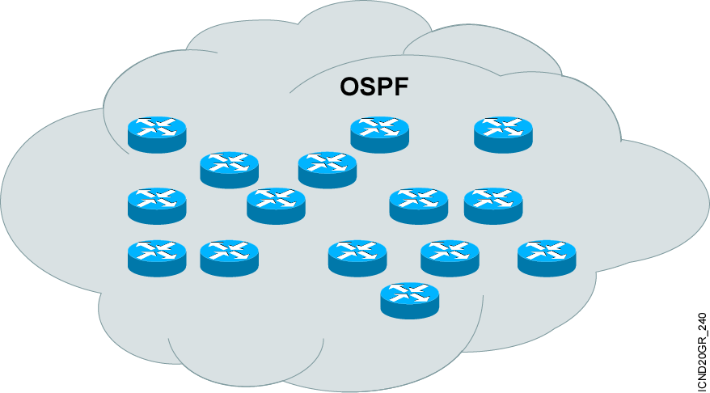
Introduction to OSPF
OSPF was created in mid 1980s
Overcome the deficiencies and Scalability problems
Open standard, So very popular
Shortest path first (SPF) algorithm
Link-state routing protocol
Can be used within an Autonomous Systems (AS)
Notes:
Open Shortest Path First (OSPF) is an open standards routing protocol that’s been implemented by a wide variety of network vendors, including Cisco. If you have multiple routers, and not all of them are Cisco (what!) then you can’t use EIGRP now can you? So your remaining options are basically RIP, RIPv2 or OSPF. If it’s a large network, then really, your only options are OSPF, or something called route redistribution—a translation service between routing protocols.
OSPF converges quickly, although perhaps not as quickly as EIGRP, and it supports multiple, equal-cost routes to the same destination. But unlike EIGRP, it only supports IP routing.

Slide 4
Autonomous System
An autonomous system (AS) is a group of networks under a single administrative control, which could be your company, a division within your company, or a group of companies.
Not every routing protocol understands the concept of an AS.
An AS can provide distinct boundaries for a routing protocol, and thus provides some advantages.
For instance, you can control how far a network can be propagated by routers. Plus, you can control what routes you will advertise to other autonomous systems and what routes you’ll accept from these systems.

Slide 5
Autonomous System (Cont.)
An autonomous system is a collection of networks under a common administrative domain
Ranges from 1- 65535
Public – 1 – 64512 Private – 64513 – 65535
There are public and private AS numbers. If you will be connected to the Internet backbone, are running BGP, and want to accept BGP routes from the Internet, you will need a public AS number.
However, if you only need to break up your internal network into different systems, you only need to use the private numbers

Slide 6
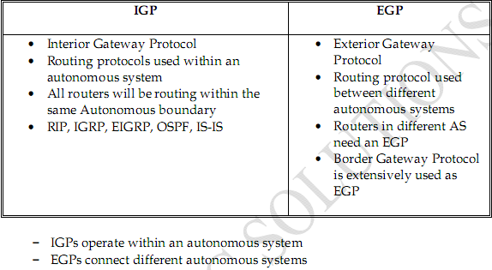
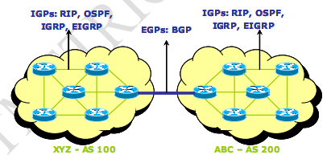
Routing Protocols Classification

Slide 7
Characteristics of OSPF: Pros
It will run on most routers, since it is based on an open standard.
It uses the SPF algorithm, developed by Dijkstra, to provide a loop-free topology.
It provides fast convergence with triggered, incremental updates via Link State Advertisements (LSAs).
It is a classless protocol and allows for a hierarchical design with VLSM and route summarization.

Slide 8
Characteristics of OSPF: Cons
It requires more memory to hold the adjacency (list of OSPF neighbors),topology (a link state database containing all of the routers and their routes), and routing tables.
It requires extra CPU processing to run the SPF algorithm, which is especially true when you first turn on your routers and they are initially building the adjacency and topology tables.
For large networks, it requires careful design to break up the network into an appropriate hierarchical design by separating routers into different areas.
It is complex to configure and more difficult to troubleshoot.

Slide 9
OSPF Hierarchical Design
To provide scalability to very large networks, OSPF supports two important concepts: AS and Area
Within an AS, areas are used to provide hierarchical routing. Basically, areas are used to control when and how much routing information is shared across your network.
In flat network designs, such as IP RIP, if a change occurs on one router, perhaps a flapping route problem, it affects every router in the entire network.
With a correctly designed hierarchical network, these changes can be contained within a single area.
OSPF implements a two-layer hierarchy: the backbone (area 0) and areas off of the backbone (areas 1–65,535), as is shown in Figure

Slide 10
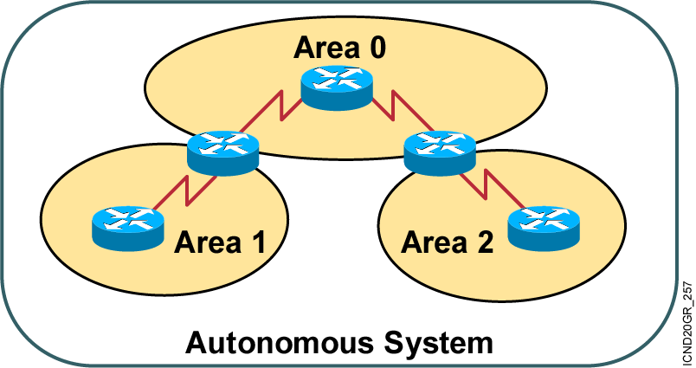

OSPF Hierarchical Routing
Consists of areas and autonomous systems
Minimizes routing update traffic
Supports VLSM
Unlimited hop count
Notes:
OSPF is supposed to be designed in a hierarchical fashion, which basically means that you can separate the larger internetwork into smaller Internetworks called areas.

Slide 11
Types of OSPF Routers
Area 1
Backbone Area 0
Area 2
ABR and Backbone Router
Backbone/ Internal Routers
Internal Routers
Internal Routers
ASBR and Backbone Router
ABR and Backbone Router
Internal Router
Area Border Router (ABR)
Autonomous System Boundary Router (ASBR)
External AS
Notes:
Notice how each router connects to the backbone—called area 0, or the backbone area.
OSPF must have an area 0, and all routers should connect to this area if at all possible, but routers that connect other areas within an AS together are called Area Boundary Routers (ABRs). Still, at least one interface must be in area 0.
OSPF runs inside an autonomous system, but can also connect multiple autonomous systems together. The router that connects these AS’s together is called an Autonomous System Boundary Router (ASBR).
Area 0 is called the backbone area
Hierarchical OSPF networks do not require multiple areas
You must have an area 0
Multiple OSPF areas must connect to area 0

Slide 12
OSPF maintains 3 tables
Neighbor Table: Neighbor table contains information about the directly connected ospf neighbors forming adjacency.
Database table: Database table contains information about the entire view of the topology with respect to each router.
Routing information Table: Routing table contains information about the best path calculated by the shortest path first algorithm in the database table.

Slide 13
Configuring Single Area OSPF
Router(config)#router ospf process-id
Defines OSPF as the IP routing protocol
Note: The process ID is locally significant and is needed
to identify a unique instance of an OSPF database
Router(config-router)#network address Wild mask area area-id
Assigns networks to a specific OSPF area
Notes:
Configuring basic OSPF isn’t as simple as RIP, IGRP and EIGRP, and it can get can really complex once the many options that are allowed within OSPF are factored in.
These two elements are the basic elements of OSPF configuration:
-Enabling OSPF
-Configuring OSPF areas
The easiest, and also least scalable way to configure OSPF is to just use a single area. Doing this requires a minimum of two commands as shown in the next slide.
The command you use to activate the OSPF routing process is:
Lab_A(config)#router ospf ?
<1-65535>
A value in the range 1– 65535 identifies the OSPF Process ID.
Process ID’s can be assigned any number from 0 to 65535
Area’s can be any number up to 2.4 billion

Slide 14
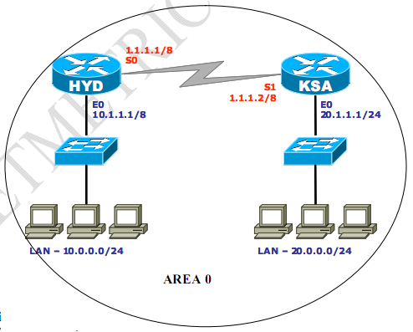
OSPF Example: Single Area OSPF
ON HYD: HYD(config)# ip routing HYD(config) # router ospf 2 HYD(config-router) # network 10.0.0.0 0.255.255.255 area 0 HYD(config-router) # network 1.0.0.0 0.255.255.255 area 0 | ON KSA: HYD(config)# ip routing KSA(config) # router ospf 2 KSA(config-router) # network 20.0.0.0 0.255.255.255 area 0 KSA(config-router) # network 1.0.0.0 0.255.255.255 area 0
Notes:
There are various ways to configure OSPF.
The configuration of R3 shows how the 0.0.0.0 wildcard is used to place each interface individually into area 0
R2 show how two interface can be configured into area 0 with one wildcard network statement of 0.255.255.255
R3 shows the wildcards of 0.0.255.255 and 0.0.0.0
It doesn’t matter how you configure the network statements, the results are the same.
Remember, the process ID is irrelevant and can be the same on each router, or different on each router, as they are in this example.

Slide 15
Verifying the OSPF Configuration
Router#show ip protocols
Verifies that OSPF is configured
Router#show ip route
Displays all the routes learned by the router
Router#show ip ospf interface
Displays area-ID and adjacency information
Router#show ip ospf neighbor
Displays OSPF-neighbor information on a per-interface basis
Notes:
There are several ways to verify proper OSPF configuration and operation, and this slides shows some basic verification commands that you will use in the next hands-on labs.

Slide 16
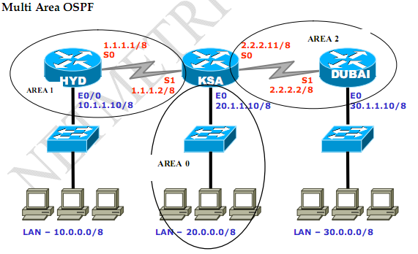

Slide 17
Multi Area OSPF
ON HYD:
HYD # config terminal
HYD(config) # ip routing
HYD(config) # router ospf 2
HYD(config-router) # network 10.0.0.0 0.255.255.255 area 1
HYD(config-router) # network 1.0.0.0 0.255.255.255 area 1
HYD(config-router) # exit
HYD(config) # exit
HYD # show ip route
HYD # show ip ospf database
HYD # show ip ospf neighbors

Slide 18
Multi Area OSPF
ON KSA:
KSA # config terminal
KSA(config) # ip routing
KSA(config) # router ospf 2
KSA(config-router) # network 20.0.0.0 0.255.255.255 area 0
KSA(config-router) # network 1.0.0.0 0.255.255.255 area 1
KSA(config-router) # network 2.0.0.0 0.255.255.255 area 2
KSA(config-router) # exit
KSA(config) # exit
KSA # show ip route
KSA # show ip ospf database
KSA # show ip ospf neighbors

Slide 19
Multi Area OSPF
ON DUBAI:
DUBAI # config terminal
DUBAI(config) # ip routing
DUBAI(config) # router ospf 2
DUBAI(config-router) # network 30.0.0.0 0.255.255.255 area 2
DUBAI(config-router) # network 2.0.0.0 0.255.255.255 area 2
DUBAI(config-router) # exit
DUBAI(config) # exit
DUBAI # show ip route
DUBAI # show ip ospf database
DUBAI # show ip ospf neighbors

Slide 20
OSFP Neighbors
OSPF uses hello packets to create adjacencies and maintain connectivity with neighbor routers
OSPF uses the multicast address 224.0.0.5
Hello?
224.0.0.5
Hello packets provides dynamic neighbor discovery
Hello Packets maintains neighbor relationships
Hello packets and LSA’s from other routers help build and maintain the topological database
Notes:
Neighbors
Neighbors are two or more routers that have an interface on a common network, such as two routers connected on a point-to-point serial link.
Adjacency
An adjacency is a relationship between two OSPF routers that permits the direct exchange of route updates. OSPF is really picky about sharing routing information, unlike EIGRP that directly shares routes with all of its neighbors.
Instead, OSPF directly shares routes only with neighbors that have also established adjacencies.
Link State Advertisement
A Link State Advertisement (LSA) is an OSPF data packet containing link-state and routing information that’s shared among OSPF routers.

Slide 21
OSPF Terminology
Neighbor
Adjacency
Neighbors
ABR
DR
Adjacencies
Non-DR
Cost=6
BDR
Notes:
Neighbor
Two routers that have an interface on a common network
Usually discovered by hello’s but can also be configured administratively
Adjacency
Relationship formed between selected neighbors in which routing information is exchanged. Not all neighbors are adjacent
Only Broadcast and Non-Broadcast network types have Designated and Backup Designated Routers!!!

Slide 22
Designated Router (DR)
On multi-access data links like LANs, an OSPF router elected by the routers on that data link to perform special functions.
These functions include the generation of LSAs representing the subnet, and playing a key role in the database exchange process.
Backup Designated Router (BDR):
A router on a multi-access data link that monitors the DR and becomes prepared to take over for the DR, should the DR fail.

Slide 23
Electing the DR and BDR
Multicast Hellos are sent and compared
Router with Highest Priority is Elected as DR
Router with 2nd Highest Priority is Elected as BDR
OSPF sends Hellos which elect DRs and BDRs
Router form adjacencies with DRs and BDRs in a multi-access environment
Notes:
The following outlines the process OSPF takes and rules that are followed when electing a Designated Router:
Routers elect a DR and BDR per network
All routers set by default to priority 1 (0-255)
Priority of zero (0) means router can not be elected as a DR
Router with highest priority wins BDR (1 – 255), if no other router has a higher priority the BDR will then become the DR
RouterID breaks tie, Router ID is either the Highest Loopback or Highest Configured IP address on any given active interface
If DR fails, BDR promoted to DR and a new BDR is elected
Existing DR will not be overthrown if “better” router is turned on after initial election
DRs and BDRs listen to multicast traffic on both multicast address 224.0.0.5 and 224.0.0.6 224.0.0.6 is exclusively listed to by DRs

Slide 24
Router ID (RID)
Each router in OSPF needs to be uniquely identified to properly arrange them in the Neighbor tables.
Notes:
Each router that is participating in OSPF needs to be uniquely identified. The method of identification that OSPF uses is Router IDs (RID).
32 bits that uniquely identifies an OSPF router
Highest IP address in router is RouterID
Overridden by Loopback interface if present
Even if Loopback address has lower value
Recommended to use loopback interface
Easier to manipulate this number
Always up
Interface loopback 0
Ip address 10.1.1.1 255.255.255.0
You can also Statically assign the Router ID in the OSPF router configuration mode:
(config)# router ospf 1
(config-router)# router-id
Do NOT use same loopback address on different routers

Slide 25
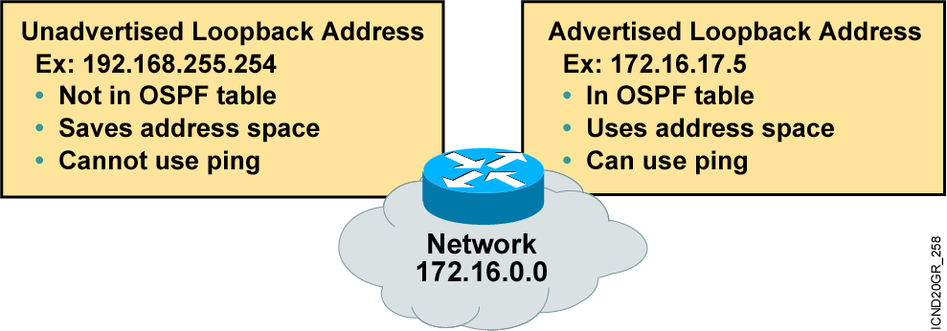
Configuring Loopback Interfaces
Router ID (RID):
Number by which the router is known to OSPF
Default: The highest IP address on an active interface at the moment of OSPF process startup
Can be overridden by a loopback interface: Highest IP address of any active loopback interface – also called a logical interface
Notes:
Configuring loopback interfaces when using the OSPF routing protocol is important and Cisco suggests using them whenever you configure OSPF on a router.
Loopback interfaces are logical interfaces, which means they are not real router interfaces. They can be used for diagnostic purposes as well as OSPF configuration.
The reason you want to configure a loopback interface on a router is because if you don’t, the highest IP address on a router will become that routers Router ID (RID).
The RID is used to advertise the routes as well as elect the designated router (DR) and backup designated router (BDR).

Slide 26
Interface Priorities
What is the default OSPF interface priority?
Router# show ip ospf interface ethernet0/0
Ethernet0 is up, line protocol is up
Internet Address 192.168.1.137/29, Area 4
Process ID 19, Router ID 192.168.1.137, Network Type BROADCAST,
Cost: 10 Transmit Delay is 1 sec, State DR, Priority 1
Designated Router (ID) 192.168.1.137, Interface address 192.168.1.137
No backup designated router on this network
Timer intervals configured, Hello 10, Dead 40, Wait 40, Retransmit 5
Hello due in 00:00:06
Index 2/2, flood queue length 0
Next 0x0(0)/0x0(0)
Last flood scan length is 0, maximum is 0
Last flood scan time is 0 msec, maximum is 0 msec
Neighbor Count is 0, Adjacent neighbor count is 0
Suppress hello for 0 neighbor(s)
Notes:
Sometimes it is desirable for a router to be configured so that it is not eligible to become the DR or BDR.
You can do this by setting the OSPF priority to zero with the ip ospf priority priority# interface subcommand.
Router(config-if)# ip ospf priority {0 – 255}
Change the priority of a router on an interface
0 means to not participate in election
1 is default, 255 is highest priority

Slide 27
Ensuring your DR
What options can you configure that will ensure that R2 will be the DR of the LAN segment?
Notes:
First, what is the RID of each router? Which router is the default DR for the 172.16.1.0 LAN?
There are three options that will ensure that R2 will be the DR for the LAN segment 172.16.1.0/24:
Configure the priority value of the Fa0/0 interface of the R2 router to a higher value than any other interface on the Ethernet network
Configure a loopback interface on the R2 with an IP address higher than any IP address on the other routers
Change the priority value of the Fa0/0 interface of R1 and R3 to zero

Slide 28
Configuring Wildcards
If you want to advertise a partial octet (subnet), you need to use wildcards.
0.0.0.0 means all octets match exactly
0.0.0.255 means that the first three match exactly, but the last octet can be any value
After that, you must remember your block sizes….
Notes:
This slides introduces the wildcards used in OSPF. These wildcards will also be used in access-list configurations.
A 0 octet in the wildcard mask indicates that the corresponding octet in the network must match exactly. On the other hand, a 255 indicates that you don’t care what the corresponding octet is in the network number. A network and wildcard mask combination of 1.1.1.1 0.0.0.0 would match 1.1.1.1 only, and nothing else. This is really useful if you want to activate OSPF on a specific interface in a very clear and simple way. If you insist on matching a range of networks, the network and wildcard mask combination of 1.1.0.0 0.0.255.255 would match anything in the range 1.1.0.0–1.1.255.255. Because of this, it’s simpler and safer to stick to using wildcard masks of 0.0.0.0 and identify each OSPF interface individually.

Slide 29
Wildcard
The wildcard address is always one less than the block size….
192.168.10.8/30 = 0.0.0.3
192.168.10.48/28 = 0.0.0.15
192.168.10.96/27 = 0.0.0.31
192.168.10.128/26 = 0.0.0.63
Notes:
This slides shows how to find a wildcard that can be used to configure a subnet in an octet.

Slide 30
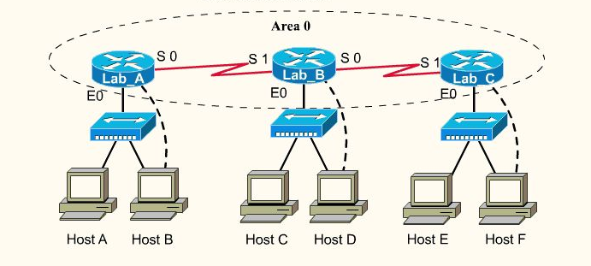
Wildcard Configuration of the Lab_B Router
Lab_B
E0: 192.168.40.1/24
S0: 192.168.10.10/30
S1: 192.168.10.6/30
Lab_C
E0: 192.168.50.1/24
S1: 172.16.10.9/30
Lab_A
E0: 192.168.30.1/24
S0: 172.16.10.5/30
Notes:
You need to understand wildcard configuration. Configure the Lab_B router using wildcards:
Router ospf 1
Network 192.168.40.1 0.0.0.0 area 0
Network 192.168.10.8 0.0.0.3 area 0
Network 192.168.10.4 0.0.0.3 area 0
NOTE: to remove a bad entry, use the following example:
Router(config)#router ospf 1
Router(config-router)#no network 192.168.10.4 0.0.0.4 area 0
Router(config-router)#network 192.168.10.4 0.0.0.3 area 0

