Slide 1
CCNA (200-125)
EIGRP
Instructor:
Muhammad Naeem
(MSIT/RHCE/CCNP/CCNA/MCSE)
Cell: 0345-5238281
E-Mail: mna571@yahoo.com

Slide 2
Objectives:
Introduction to EIGRP
Characteristics of EIGRP
Configuration of EIGRP

Slide 3
Introduction to EIGRP
Released in 1994 with IOS version 9.21
Cisco proprietary protocol
Classless routing protocol
Includes all features of IGRP
Metric (32 bit) : Composite Metric (BW + Delay + load + MTU + reliability)
Administrative distance is 90
Updates are through Multicast (224.0.0.10 )
Max Hop count is 255 (100 by default)
Supports IP, IPX and Apple Talk protocols
Hello packets are sent every 5 seconds
Convergence rate is fast
Support VLSM and CIDR
It uses DUAL (diffusion update algorithm)
Summarization can be done on every router
Supports equal and unequal cost load balancing
Notes:
Open Shortest Path First (OSPF) is an open standards routing protocol that’s been implemented by a wide variety of network vendors, including Cisco. If you have multiple routers, and not all of them are Cisco (what!) then you can’t use EIGRP now can you? So your remaining options are basically RIP, RIPv2 or OSPF. If it’s a large network, then really, your only options are OSPF, or something called route redistribution—a translation service between routing protocols.
OSPF converges quickly, although perhaps not as quickly as EIGRP, and it supports multiple, equal-cost routes to the same destination. But unlike EIGRP, it only supports IP routing.

Slide 4
EIGRP maintains 3 tables
Neighbor Table: Neighbor table contains information about the directly connected EIGRP neighbors forming adjacency.
Topology Table: Database table contains information about the entire view of the topology with respect to each router.
Routing Table: Routing table contains information about the best path calculated by the shortest path first algorithm in the database table.
Disadvantages of EIGRP:
Works only on Cisco Routers

Slide 5
Comparing EIGRP and IGRP
Similar metric
Same load balancing
Improved convergence time
Reduced network overhead
Maximum hop count of 255
EIGRP can differentiate between internal and external routes
Notes:
Enhanced IGRP (EIGRP) is a classless, enhanced distance-vector protocol that gives us a real edge over another Cisco proprietary protocol, Interior Gateway Routing Protocol (IGRP).
That’s basically why it’s called Enhanced IGRP. Like IGRP, EIGRP uses the concept of an autonomous system to describe the set of contiguous routers that run the same routing protocol and share routing information. But unlike IGRP, EIGRP includes the subnet mask in its route updates. And as you now know, the advertisement of subnet information allows us to use VLSM and summarization when designing our networks!

Slide 6
EIGRP for IP
No updates. Route updates sent only when a change occurs – multicast on 224.0.0.10
Hello messages sent to neighbors every 5 seconds (60 seconds in most WANs)
Enhanced IGRP
EIGRP
EIGRP
hello
Notes:
EIGRP doesn’t send link-state packets as OSPF does; instead, it sends traditional distance-vector updates containing information about networks plus the cost of reaching them from the perspective of the advertising router.
And EIGRP has link-state characteristics as well—it synchronizes routing tables between neighbors at startup, and then sends specific updates only when topology changes occur.

Slide 7
EIGRP Terminology
Neighbor Table—IP
Next Hop Interface Router
Topology Table—IP
Destination 1 Successor
Destination 1 Feasible Successor
Routing Table—IP
Destination 1 Successor
Note: A feasible successor is a backup route and stored in the Topology table
Notes:
The neighborship table (usually referred to as the neighbor table) records information about routers with whom neighborship relationships have been formed.
The topology table stores the route advertisements about every route in the internetwork received from each neighbor.
The route table stores the routes that are currently used to make routing decision. There would be separate copies of each of these tables for each protocol that is actively being supported by EIGRP, whether it’s IP, IPX, or AppleTalk.

Slide 8
EIGRP Tables
The neighbor table and topology table are held in RAM and are maintained through the use of hello and update packets.
Enhanced IGRP
EIGRP
EIGRP
hello
To see all feasible successor routes known to a router, use the show ip eigrp topology command
Notes:
The neighbor table and topology table are held in ram and are maintained through the use of hello and update packets.

Slide 9
Successor route
Successor route is used by EIGRP to forward traffic to a destination
A successor route may be backed up by a feasible successor route
Successor route is stored in both the topology table and the routing table
Topology Table—IP
Destination 1 Successor
Destination 1 Feasible Successor
Routing Table—IP
Destination 1 Successor
Notes:
Successor route is used by EIGRP to forward traffic to a destination
A successor routes may be backed up by a feasible successor route
Successor routes are stored in both the topology table and the routing table

Slide 10
Choosing Routes
IP
A
IP
B
19.2
AppleTalk
T1
T1
AppleTalk
IPX
T1
IPX
C
D
EIGRP uses a composite metric to pick the best path: bandwidth and delay of the line
EIGRP can load balance across six unequal cost paths to a remote network (4 by default)
Notes:
Like IGRP, EIGRP uses only bandwidth and delay of the line to determine the best path to a remote network by default. Cisco sometimes likes to call these path bandwidth value and cumulative line delay—go figure.

Slide 11
Best Route / Metric Calculation
EIGRP calculates best routes by two ways;
DUAL:
Uses Formula / Algorithm;
Composite Metric
Uses Multiple Metric Inputs;
K1-Bandwidth
K2-Delay
K3-Load
K4-Reliablity
Note: Bandwidth and Delay are used by default and also recommended by Cisco

Slide 12
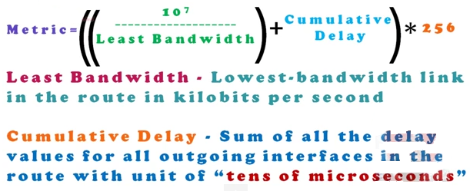
Metric Calculation Formula

Slide 13
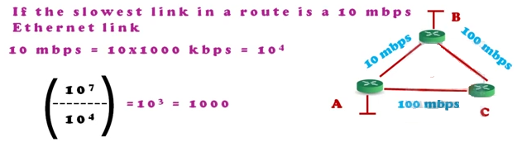

Metric Calculation Formula

Slide 14
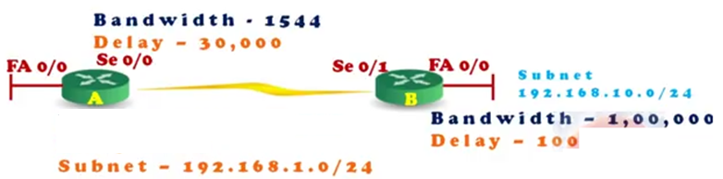


Example

Slide 15
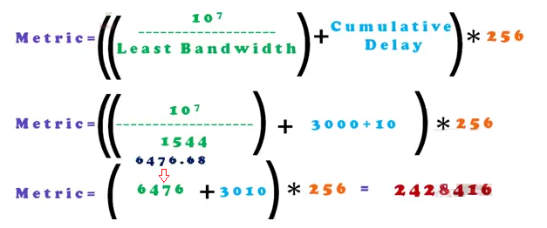
Example

Slide 16
Configuring EIGRP for IP
AS=10
A
C
10.110.1.0
B
172.16.10.0
192.168.0.0
192.168.0.0
Enable EIGRP
Assign networks
Router-A(config)#router eigrp 10 Router-A(config-router)#network 10.0.0.0 Router-A(config-router)#network 192.168.0.0
If you use the same AS number for EIGRP as IGRP, EIGRP will automatically redistribute IGRP into EIGRP
Notes:
To start an EIGRP session on a router, use the router eigrp command followed by the autonomous system number of your network. You then enter the network numbers connected to the router using the network command followed by the network number.

Slide 17
Autonomous System
An autonomous system (AS) is a group of networks under a single administrative control, which could be your company, a division within your company, or a group of companies.
Not every routing protocol understands the concept of an AS.
An AS can provide distinct boundaries for a routing protocol, and thus provides some advantages.
For instance, you can control how far a network can be propagated by routers. Plus, you can control what routes you will advertise to other autonomous systems and what routes you’ll accept from these systems.

Slide 18
Autonomous System (Cont.)
An autonomous system is a collection of networks under a common administrative domain
Ranges from 1- 65535
Public – 1 – 64512 Private – 64513 – 65535
There are public and private AS numbers. If you will be connected to the Internet backbone, are running BGP, and want to accept BGP routes from the Internet, you will need a public AS number.
However, if you only need to break up your internal network into different systems, you only need to use the private numbers

Slide 19
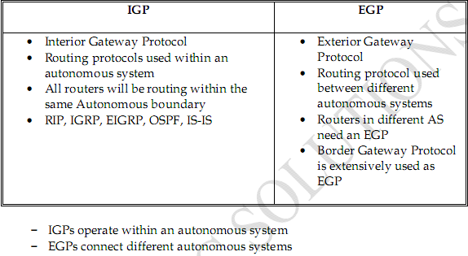
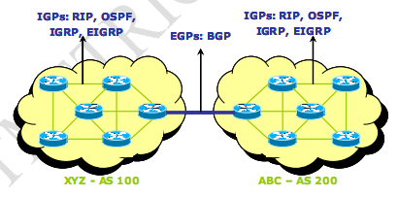
Routing Protocols Classification

Slide 20
Redistribution
Redistribution is translating one type of routing protocol into another.
EIGRP
IGRP
Router B
Router D
Router A
Router C
IGRP and EIGRP translate automatically, as long as they are both using the same AS number
Notes:
Redistribution is important, because if you want to use EIGRP and don’t have all Cisco router, you need to configure redistribution commands.
If you are using IGRP and want to migrate to EIGRP (yes, you should do this), configure EIGRP with the same AS number and EIGRP automatically redistributed IGRP into EIGRP routes.
These routes show up as external routes with an AS of 170.

Slide 21
Route Path
Assuming all default parameters, which route will RIP (v1 and v2) take, and which route will EIGRP take?
T1
T1
56K
10BaseT
100BaseT
100BaseT
Notes:
RIPv1 and RIPv2 use the same metric (hop count) and would find the 56K link the best path to the remote network.
EIGRP and IGRP use the same metric as well (bandwidth and delay of the line) and would use the path through the LAN interfaces, not the serial T1’s.

Slide 22
Verifying Enhanced IGRP Operation
Router#
show ip eigrp neighbors
Displays the neighbors discovered by IP Enhanced IGRP
Displays the IP Enhanced IGRP topology table
Displays current Enhanced IGRP entries in the routing table
Displays the parameters and current state of the active routing protocol process
Displays the number of IP Enhanced IGRP packets sent and received
Router#
show ip eigrp topology
Router#
show ip route eigrp
Router#
show ip protocols
show ip eigrp traffic
Router#
Notes:
Show ip route: Shows the entire routing table
show ip route eigrp: Shows only EIGRP entries in the routing table
show ip eigrp neighbors: Shows all EIGRP neighbors.
show ip eigrp topology: Shows entries in the EIGRP topology table.
Which EIGRP show command will provide you with the IP addresses of the devices with which the router has established an adjacency, as well as the transmit and queue counts for the adjacent routers?
Which command will display all the EIGRP feasible successor routes known to a router?

Slide 23
Show IP Route
P1R1#sh ip route
[output cut]
Gateway of last resort is not set
D 192.168.30.0/24 [90/2172] via 192.168.20.2,00:04:36, Serial0/0
C 192.168.10.0/24 is directly connected, FastEthernet0/0
D 192.168.40.0/24 [90/2681] via 192.168.20.2,00:04:36, Serial0/0
C 192.168.20.0/24 is directly connected, Serial0/0
D 192.168.50.0/24 [90/2707] via 192.168.20.2,00:04:35, Serial0/0
P1R1#
-D is for “Dual”
-[90/2172] is the administrative distance and cost of the route. The cost of the route is a composite metric comprised from the bandwidth and delay of the line
Notes:
The show ip route command, or the show ip route eigrp command, will show you the routing table the routes found by DUAL.
-D is for “Dual”
-[90/2172] is the administrative distance and cost of the route. The cost of the route is a composite metric comprised from the bandwidth and delay of the line

Slide 24
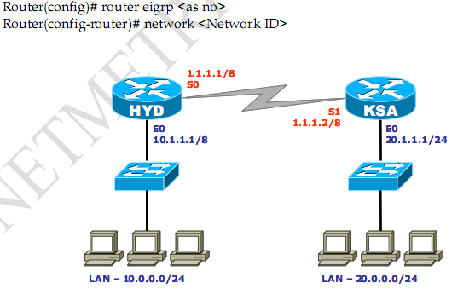
Configuring EIGRP: Lab- Scenario-1

Slide 25
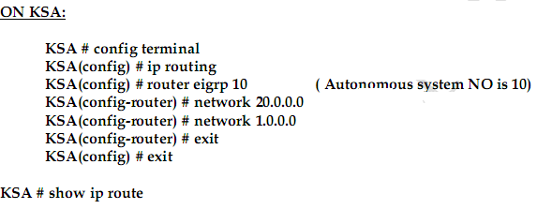
Configuring EIGRP

Slide 26
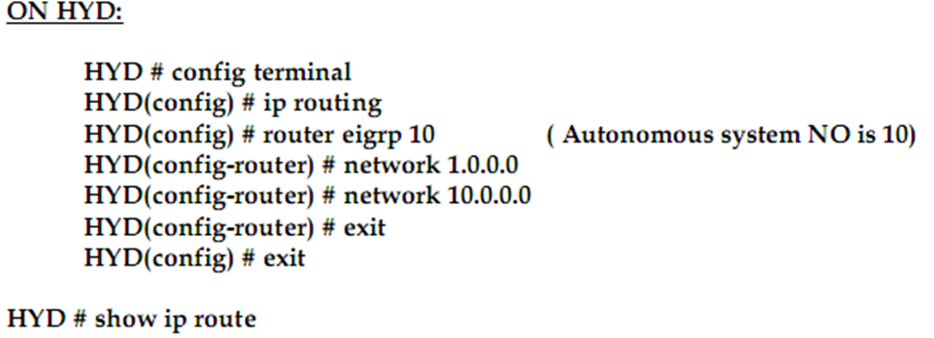
Configuring EIGRP

Slide 27
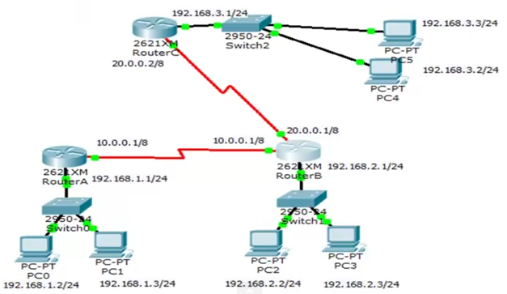
Lab- Scenario-2
Task: Configure EIGRP for the Given scenario below;

