Slide 1
CCNA (200-125)
ACL (Access Control List)
Instructor:
Muhammad Naeem
(MSIT/RHCE/CCNP/CCNA/MCSE)
Cell: 0345-5238281
E-Mail: mna571@yahoo.com

Slide 2
Objectives:
ACL (Access Control List)
Types of ACL
Standard ACL
Extended ACL
Named ACL

Slide 3
ACL (Access Control List)
ACL is a set of rules which will allow or deny the specific traffic moving through the router
It is a Layer 3 security which controls the flow of traffic from one router to another.
It is also called as Packet Filtering Firewall.

Slide 4
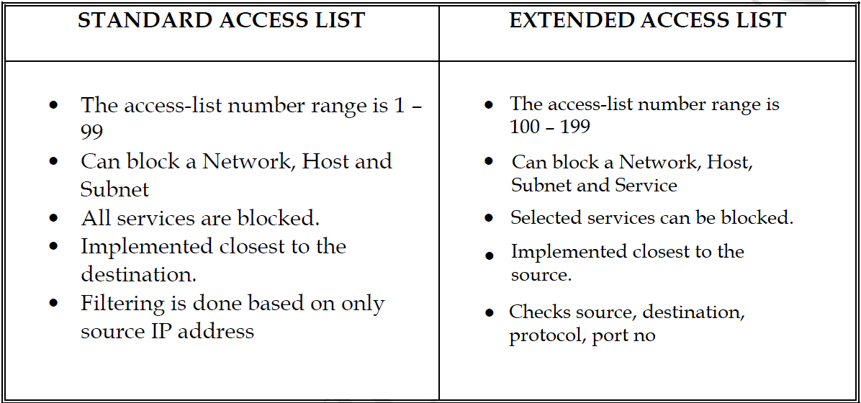
Types of ACL

Slide 5
Rules of Access List
All deny statements have to be given First
There should be at least one Permit statement
An implicit deny blocks all traffic by default when there is no match (an invisible statement).
Can have one access-list per interface per direction. (i.e.) Two access-lists per interface, one in inbound direction and one in outbound direction.
Works in Sequential order
Editing of access-lists is not possible (i.e) selectively adding or removing access list statements is not possible.

Slide 6
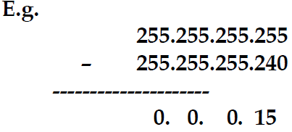
Wild Card Mask
Tells the router which addressing bits must match in the address of the ACL statement.
It’s the inverse of the subnet mask, hence is also called as Inverse mask.
A bit value of 0 indicates MUST MATCH (Check Bits)
A bit value of 1 indicates IGNORE (Ignore Bits)
Wild Card Mask for a Host will be always 0.0.0.0
A wild card mask can be calculated using the formula :
Global Subnet Mask
– Customized Subnet Mask
-------------------------------
Wild Card Mask

Slide 7
Creation of Standard Access List
Router(config)# access-list <acl no> <permit/deny> <source address><source WCM>
Implementation of Standard Access List
Router(config)# interface <interface type> <interface no>
Router(config-if)# ip access-group <number> <out/in>
To Verify :
Router# show access-list
Router# show access-list <no>

Slide 8
Creation of Extended Access List
Router(config)# access-list <acl no> <permit/deny> <protocol> <source address> <source wildcard mask> <destination address> < destination wildcard mask> <operator><service>
Implementation of Extended Access List
Router(config)#interface <interface type> <interface no>
Router(config-if)#ip access-group <number> <out/in>

Slide 9
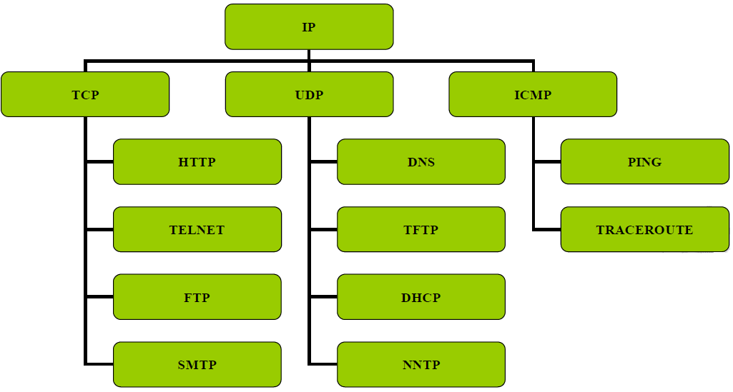

Slide 10
Operators
eq (equal to)
neq (not equal to)
lt (less than)
gt (greater than)

Slide 11
Named Access List
Access-lists are identified using Names rather than Numbers.
Names are Case-Sensitive
No limitation of Numbers here.
One Main Advantage is Editing of ACL is Possible (i.e) Removing a specific statement from the ACL is possible.
(IOS version 11.2 or later allows Named ACL)

Slide 12
Creation of Standard Named Access List
Router(config)# ip access-list standard <name>
Router(config-std-nacl)# <permit/deny> <source address> <source wildcard mask>
Implementation of Standard Named Access List
Router(config)#interface <interface type><interface no>
Router(config-if)#ip access-group <name> <out/in>

Slide 13
Creation of Extended Named Access List
Router(config)# ip access-list extended <name>
Router(config-ext-nacl)# <permit/deny> <protocol> <source address>
<source wildcard mask> <destination address>< destination wildcard mask>
<operator> <service>
Implementation of Extended Named Access List
Router(config)#interface <interface type><interface no>
Router(config-if)#ip access-group <name> <out/in>

Slide 14
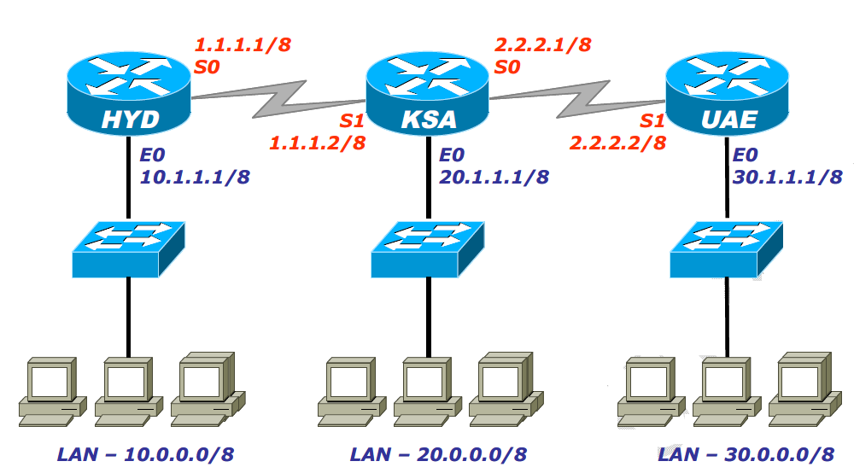
Lab Examples

Slide 15
Lab: STANDARD ACCESS-LIST
Lab-1 Requirement
1. Entire 20.0.0.0 network should be denied
2. Host 30.1.1.2 and 30.1.1.3 from UAE LAN should be denied

Slide 16
Lab: Standard ACL
Creation of ACL :
HYD (config) # access-list 5 deny 20.0.0.0 0.255.255.255
HYD (config) # access-list 5 deny host 30.1.1.2
HYD (config) # access-list 5 deny host 30.1.1.3
HYD (config) # access-list 5 permit any
Implementation
HYD (config) # interface fa0/0
HYD (config-if ) # ip access-group 5 out

Slide 17
Lab: Standard ACL
Lab 2 :
Restricting telnet access to the router to specified networks or hosts
Creation of ACL :
HYD (config) # access-list 10 deny host 10.1.1.2
HYD (config) # access-list 10 deny host 10.1.1.3
Implementation
CHE (config) # line vty 0 4
CHE (config-line) # access-class 10 in
CHE (config-line) # exit
CHE (config) # exit

Slide 18
Lab: Extended ACL
Lab Requirement
1. 10.1.1.1 should not ping 20.1.1.2
2. 10.1.1.2 should not access 30.0.0.4 web service

Slide 19
Lab: Extended ACL
On HYD:
HYD # config terminal
HYD (config) # access-list 100 deny icmp 10.1.1.1 host 20.1.1.2 echo
HYD (config) # access-list 100 deny tcp host 10.1.1.2 host 30.0.0.4 0.255.255.255 eq 80
HYD (config) # access-list 100 permit ip any any
Implementation
HYD (config) #interface fa0/0
HYD (config-if) # ip access- group 100 in
HYD (config-if) #exit
HYD (config) # exit
HYD # sh ip access-list

Slide 20
Lab: Extended Named ACL
Lab Requirement
1. 10.0.0.2 should access 30.0.0.4 web services
2. Other devices on 10.0.0.0 NETWORK should not access 10.0.0.4 web service

Slide 21
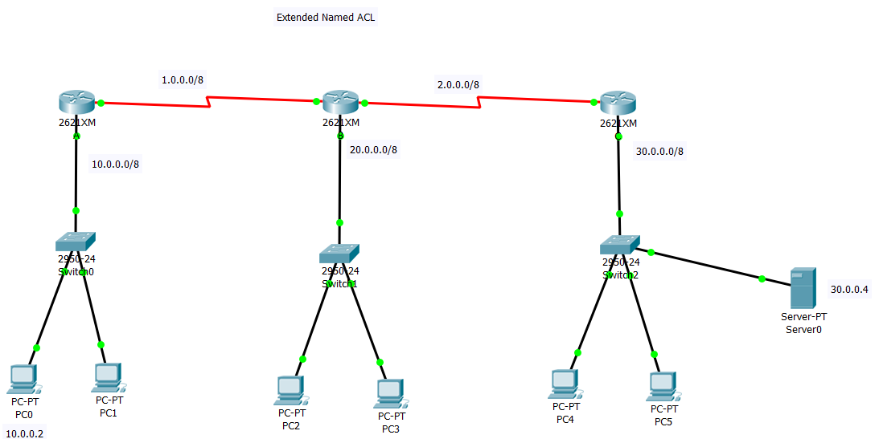
Lab: Extended Named ACL

Slide 22
Lab: Extended Named ACL
A(config)#ip access-list extended itp
A(config-ext-nacl)#permit tcp host 10.0.0.2 host 30.0.0.5 eq www
A(config-ext-nacl)#deny tcp 10.0.0.0 0.255.255.255 host 30.0.0.4 eq www
A(config-ext-nacl)#permit ip any any
Implementation
A (config) #interface fa0/0
A (config-if) # ip access- group itp in
A # sh ip access-list

