Slide 1
CCNA (200-125)
NAT (Network Address Translation)
Instructor:
Muhammad Naeem
(MSIT/RHCE/CCNP/CCNA/MCSE)
Cell: 0345-5238281
E-Mail: mna571@yahoo.com

Slide 2
Objectives:
NAT (Network Address Translation)
Types of Addresses
Types of NAT
Dynamic NAT
Static NAT
PAT

Slide 3
NAT (Network Address Translation)
Natting means "Translation of private IP address into public IP address ".
In order to communicate with internet we must have public IP address.
Address translation was originally developed to solve two problems:
1. to handle a shortage of IPv4 addresses
2. hide network addressing schemes.

Slide 4
NAT (Network Address Translation)
Small companies typically get their public IP addresses directly from their ISPs, which have a limited number.
Large companies can sometimes get their public IP addresses from a registration authority,
such as the Internet Assigned Numbers Authority (IANA).
Common devices that can perform address translation include firewalls, routers, and servers.
Typically address translation is done at the perimeter of the network by either a firewall (more commonly) or a router.

Slide 5
Types of Addresses
Inside Local Addresses – An IP address assigned to a host inside a network. This address is likely to be a RFC 1918 private address
Inside Global Address – A legitimate IP address assigned by the NIC or service provider that represents one or more inside local IP address to the outside world.
Outside Local Address - The IP address of an outside host as it known to the hosts in the inside network.
Outside Global Address - The IP address assigned to a host on the outside network. The owner of the host assigns this address.

Slide 6
Types of NAT
Static NAT
Dynamic NAT
NAT (Overload) /PAT

Slide 7
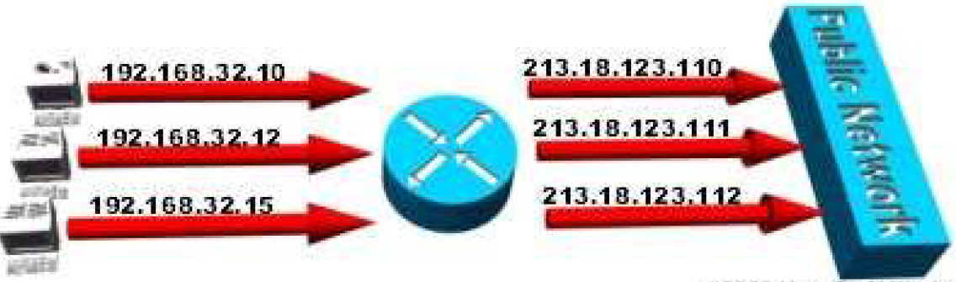
Static NAT
This type of NAT is designed to allow one-to-one mapping between local and global addresses.
Keep in mind that the static version requires you to have one real Internet IP address for every host on your network..

Slide 8
Static NAT
Syntax:
(Config)# IP nat inside source static <private IP> <public IP>
Implementation :
(Config) # interface s0
(Config-if)# ip nat outside
(Config)# interface e0
(Config-if)# ip nat inside

Slide 9
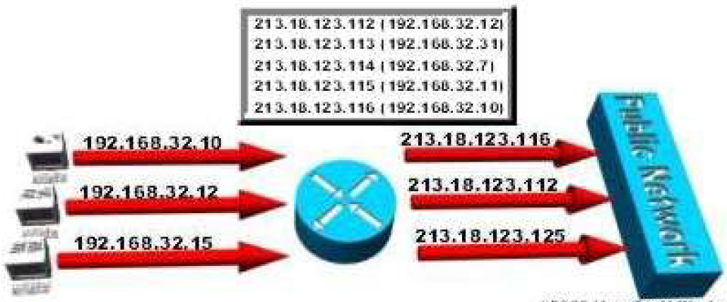
Dynamic NAT
This version gives you the ability to map an unregistered IP address to a registered IP address from out of a pool of registered IP addresses.
You don’t have to statically configure your router to map an inside to an outside address as you would using static NAT, but you do have to have enough real IP addresses for everyone who’s going to be sending packets to and receiving them from the Internet.

Slide 10
Dynamic NAT
Syntax :
(Config)# access-list < NO> permit <net.ID> <WCM>
(Config)#ip nat pool <name> <starting Pub IP><end Pub IP><netmask < mask>
(Config)# ip nat inside source list <Aclno> pool <name>
Implementation :
(Config) # interface s0
(Config-if)# ip nat outside
(Config)# interface e0
(Config-if)# ip nat inside

Slide 11
Dynamic NAT Overload
This is the most popular type of NAT configuration. Understand that overloading really is a form of dynamic NAT that maps multiple unregistered IP addresses to a single registered IP address—many-to-one—by using different ports.
It is also known as Port Address Translation (PAT), and by using PAT (NAT Overload), you get to have thousands of users connect to the Internet using only one real global IP address.
NAT Overload is the real reason we haven’t run out of valid IP address on the Internet

Slide 12

Dynamic NAT Overload

Slide 13
Dynamic NAT Overload
Syntax :
(Config)# access-list < NO> permit <net.ID> <WCM>
(Config)#ip nat pool <name> <starting Pub IP><end Pub IP> netmask< mask>
(Config)# ip nat inside source list <Aclno> pool <name> overload
Implementation :
(Config) # interface s0
(Config-if)# ip nat outside
(Config)# interface e0
(Config-if)# ip nat inside

Slide 14
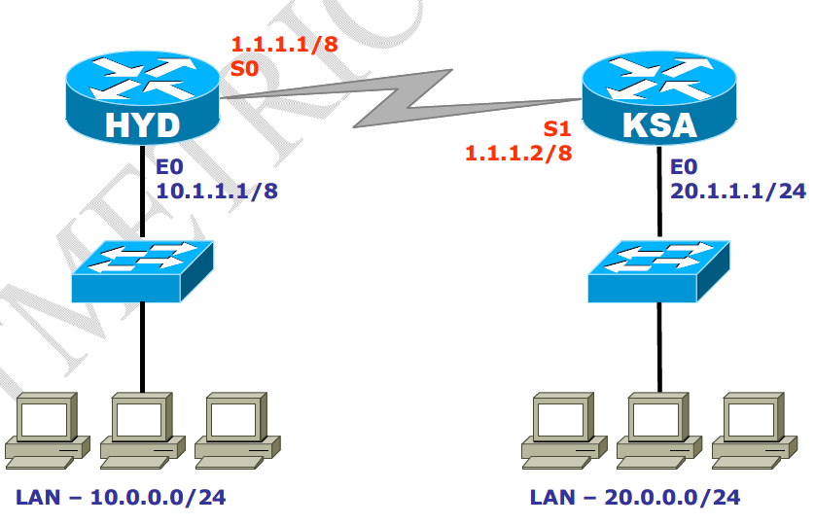
Lab Scenario

Slide 15
Lab: Static NAT
Lab requirment
Private IP range : 10.1.1.2 , 10.1.1.3
Public ip range : 200.1.1.1, 200.1.1.2
Lab pre-requirment:
Default route configured on both the routers .

Slide 16
Lab: Static NAT
HYD# configure terminal
HYD(Config)# IP nat inside source static 10.1.1.2 200.1.1.1
HYD(Config)# IP nat inside source static 10.1.1.3 200.1.1.2
Implementation :
(Config) # interface s0
(Config-if)# ip nat outside
(Config)# interface e0
(Config-if)# ip nat inside
To verify :
# sh ip nat translations
Assign tlnet password to KSA router and telnet from the PC in the HYD lan.
Issue sh users command after telnet you can see the ip translated in the output
# sh ip nat translations on HYD router

Slide 17
Lab: Dynamic NAT
Lab requirment
Private IP range : 10.0.0.0/8 Network
Public ip range : 200.1.1.0/28 range
Lab pre-requirment:
Default route configured on both the routers .

Slide 18
Lab: Dynamic NAT
HYD# configure terminal
HYD(Config)# access-list 20 permit 10.0.0.0 0.255.255.255
HYD (Config)#ip nat pool netmetric 200.1.1.1 200.1.1.14
netmask 255.255.255.240
HYD (Config)# ip nat inside source list 20 pool netmetric
Implementation :
(Config) # interface s0
(Config-if)# ip nat outside
(Config)# interface e0
(Config-if)# ip nat inside

Slide 19
Lab: Dynamic NAT
To verify :
# sh ip nat translations
Assign tlnet password to KSA router and telnet from the PC in the HYD lan.
Issue sh users command after telnet you can see the ip translated in the output
# sh ip nat translations on HYD router

Slide 20
Lab: DYNAMIC NAT OVERLOAD (PAT)
Lab requirment
Private IP range : 10.0.0.0/8 Network
Public ip range : only one ip to be used 200.1.1.1/28
Lab pre-requirment:
Default route configured on both the routers .

Slide 21
Lab: DYNAMIC NAT OVERLOAD (PAT)
HYD# configure terminal
HYD(Config)# access-list 20 permit 10.0.0.0 0.255.255.255
HYD (Config)#ip nat pool netmetric 200.1.1.1 200.1.1.1 netmask 255.255.255.240
HYD (Config)# ip nat inside source list 20 pool netmetric overlaod
Implementation :
(Config) # interface s0
(Config-if)# ip nat outside
(Config)# interface e0
(Config-if)# ip nat inside

Slide 22
Lab: DYNAMIC NAT OVERLOAD (PAT)
To verify :
# sh ip nat translations
Assign tlnet password to KSA router and telnet from the PC in the HYD lan.
Issue sh users command after telnet you can see the ip translated in the output
# sh ip nat translations on HYD router

Slide 23
How to remove Dynamic Nat
Router(config)# clear ip nat translations *
Note= (* means all ip nat translations)
Router(config)# no ip nat inside source list (listno) pool (poolname)
Router(config)# no ip nat access-list (listno)
Router(config)# no ip nat pool (poolname)

