Slide 1
Min Graph Coloring
Cullen Waller & Martin Nester

Slide 2
Min Graph Coloring
A coloring of a graph is an assignment of “colors” to each vertex, so that every edge has two different colors at its endpoints.
A min coloring of a graph is coloring of the graph, where no coloring with less colors exists.
Optimization Problem: What is the min coloring in graph G?
Decision Problem: Does a coloring of K colors exist in graph G?

Slide 3
Example
Input: Undirected Graph
Output: Min Coloring
A
B
C
A
B
C
D
E
F
D
E
F
# of colors = 3
Notes:
Input:
A B
A E A D
D E
B E
E C
B F
C F
Output:
A 0 B 1 C 1 D 1 E 2 F 0

Slide 4
Importance / Applications
Conflict Free Schedule
Mobile Radio Frequency Assignment
Register Allocation
Sudoku
GFG, ResearchGate

Slide 5
Reduction
3SAT
transform in O(n) time
kColor
Φ
3CNF
Formula
G
graph
Yes/No
G is
K Colorable
Yes/No
Φ is Satisfiable
K ≥ 3
Notes:
https://research.ijcaonline.org/ooc/number1/ooc1005.pdf

Slide 6
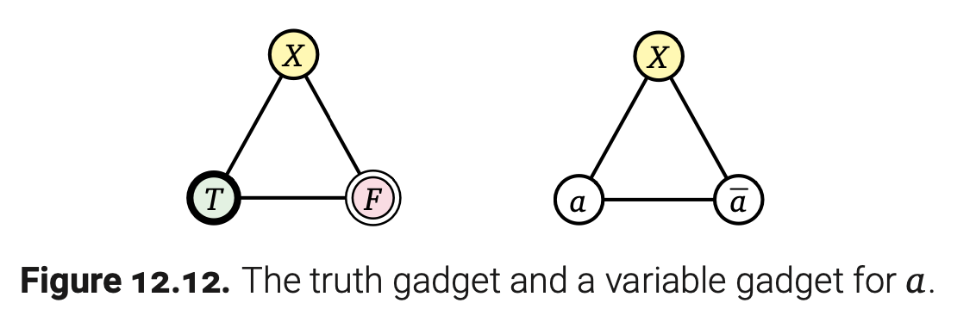
Reduction

Slide 7
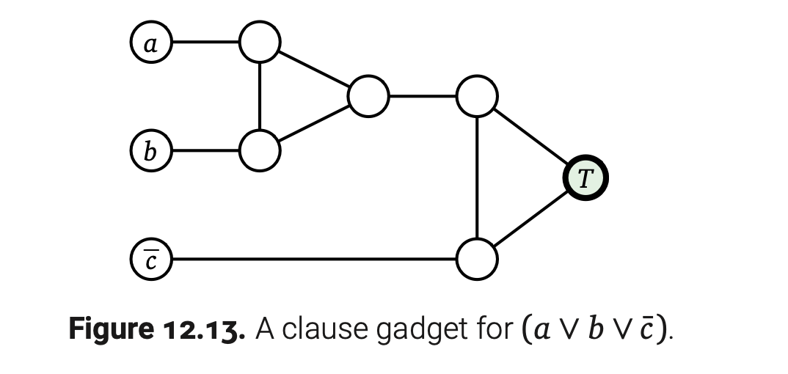
Reduction

Slide 8
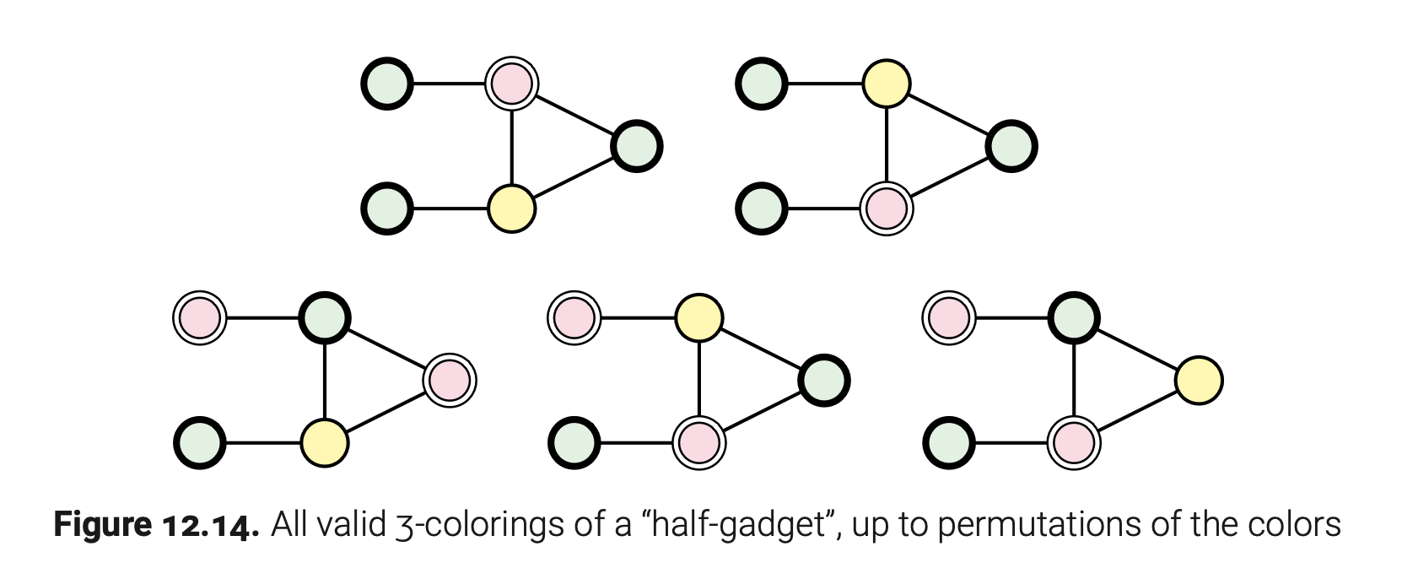
Reduction

Slide 9
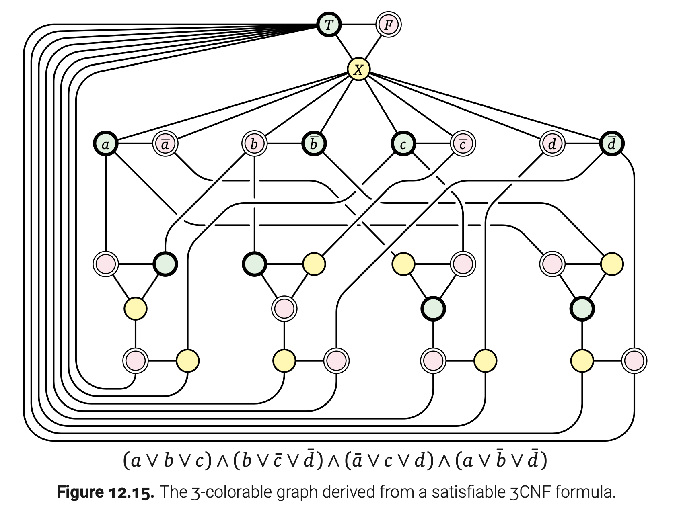
Reduction

Slide 10
Reduction
x+1 Colorable
x Colorable
1
2
…
|V|
Making a 3 colorable graph k-colorable

Slide 11
Certifier Process
def verify_k_coloring(k, coloring, edges):
"""
k: number of colors
coloring: dictionary, maps each vertex to a color
edges: iterator of edges each represented by a two-tuple of vertices
"""
if k != len(set(coloring.values())):
return False
for v1,v2 in edges:
if coloring[v1]==coloring[v2]:
return False
return True

Slide 12
Exact Solution
def colorings(graph):
for permutation in permutations(graph.keys()): # O(V!)
coloring = dict([(v, -1) for v in permutation])
for v in permutation: # O(V)
for color in range(len(coloring)): # O(V)
adjacent_colors = map(coloring.__getitem__, graph[v]) # O(V)
if color not in adjacent_colors: # O(1)
coloring[v] = color
break
yield coloring
def min_coloring(graph):
return min(colorings(graph), key=lambda c: max(c.values())) # O(V^2)

Slide 13
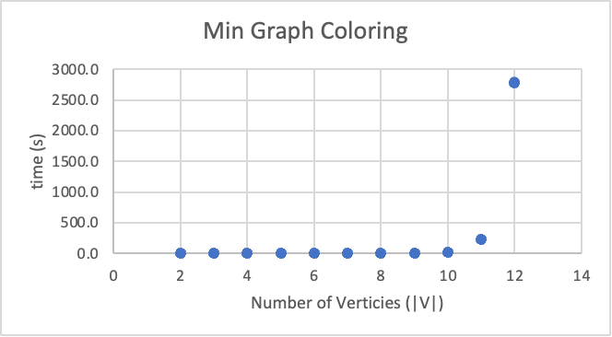
Runtime Analysis
|V| | Time
2-7 | <0.1s
8 | 0.2s
9 | 1.7s
10 | 18.5s
11 | 3.8min
12 | 46min

