Slide 1
Min Graph Coloring Approximation
DSatur Algorithm

Slide 2
DSatur Algorithm
Short for degree of saturation
Number of different colors of the neighbor vertices
Greedy
Picks the vertex with highest degree of saturation to color next
Ties broken by the highest degree
Exact for bipartite, cycle, and wheel graphs

Slide 3
DSatur Algorithm Pseudocode
DSatur (G)
while G has uncolored vertices
v => max_degree_of_saturation (G)
color v the lowest color not used by its neighbors
based on algorithm found at https://en.wikipedia.org/wiki/DSatur

Slide 4
Runtime Analysis
Since each iteration colors one uncolored vertex, G will be fully colored after V iterations
Finding the max degree of saturation requires checking each vertex in G, also V iterations
DSatur has a runtime complexity of O(V²)
DSatur (G)
while G has uncolored vertices
v => max_degree_of_saturation (G)
color v the lowest color not used by its neighbors

Slide 5
DSatur Example
Vertex | Degree of Saturation | Degree
v₁ | 0 | 2
v₂ | 0 | 3
v₃ | 0 | 2
v₄ | 0 | 2
v₅ | 0 | 3
v₆ | 0 | 2
v₁
v₄
1
2
v₂
v₅
3
v₃
v₆
4

Slide 6
DSatur Example
Vertex | Degree of Saturation | Degree
v₁ | 1 | 2
v₂ | 1 | 3
v₃ | 1 | 2
v₄ | 0 | 2
v₆ | 0 | 2
v₁
v₄
1
2
v₂
v₅
3
v₃
v₆
4

Slide 7
DSatur Example
Vertex | Degree of Saturation | Degree
v₁ | 1 | 2
v₃ | 1 | 2
v₄ | 1 | 2
v₆ | 1 | 2
v₁
v₄
1
2
v₂
v₅
3
v₃
v₆
4

Slide 8
DSatur Example
Vertex | Degree of Saturation | Degree
v₁ | 1 | 2
v₃ | 1 | 2
v₆ | 1 | 2
v₁
v₄
1
2
v₂
v₅
3
v₃
v₆
4

Slide 9
DSatur Example
Vertex | Degree of Saturation | Degree
v₁ | 1 | 2
v₃ | 1 | 2
v₁
v₄
1
2
v₂
v₅
3
v₃
v₆
4

Slide 10
DSatur Example
Vertex | Degree of Saturation | Degree
v₃ | 1 | 2
v₁
v₄
1
2
v₂
v₅
3
v₃
v₆
4

Slide 11
DSatur Example
Colors the graph in 2 colors
This is the optimal coloring
v₄
1
v₁
2
v₂
v₅
3
v₃
v₆
4

Slide 12
Suboptimal Graph Coloring
Vertex | Degree of Saturation | Degree
v₁ | 0 | 4
v₂ | 0 | 3
v₃ | 0 | 2
v₄ | 0 | 2
v₅ | 0 | 3
v₆ | 0 | 3
v₇ | 0 | 4
v₈ | 0 | 3
1
v₁
v₂
2
v₃
v₄
v₅
v₆
3
v₇
v₈
4

Slide 13
Suboptimal Graph Coloring
Vertex | Degree of Saturation | Degree
v₁ | 1 | 4
v₂ | 0 | 3
v₃ | 1 | 2
v₄ | 1 | 2
v₅ | 0 | 3
v₆ | 0 | 3
v₈ | 1 | 3
1
v₁
v₂
2
v₃
v₄
v₅
v₆
3
v₇
v₈
4

Slide 14
Suboptimal Graph Coloring
Vertex | Degree of Saturation | Degree
v₂ | 1 | 3
v₃ | 2 | 2
v₄ | 2 | 2
v₅ | 0 | 3
v₆ | 0 | 3
v₈ | 1 | 3
1
v₁
v₂
2
v₃
v₄
v₅
v₆
3
v₇
v₈
4

Slide 15
Suboptimal Graph Coloring
Vertex | Degree of Saturation | Degree
v₂ | 1 | 3
v₄ | 2 | 2
v₅ | 0 | 3
v₆ | 0 | 3
v₈ | 1 | 3
1
v₁
v₂
2
v₃
v₄
v₅
v₆
3
v₇
v₈
4

Slide 16
Suboptimal Graph Coloring
Vertex | Degree of Saturation | Degree
v₂ | 1 | 3
v₅ | 0 | 3
v₆ | 0 | 3
v₈ | 1 | 3
1
v₁
v₂
2
v₃
v₄
v₅
v₆
3
v₇
v₈
4

Slide 17
Suboptimal Graph Coloring
Vertex | Degree of Saturation | Degree
v₅ | 1 | 3
v₆ | 1 | 3
v₈ | 1 | 3
1
v₁
v₂
2
v₃
v₄
v₅
v₆
3
v₇
v₈
4

Slide 18
Suboptimal Graph Coloring
Vertex | Degree of Saturation | Degree
v₆ | 2 | 3
v₈ | 2 | 3
1
v₁
v₂
2
v₃
v₄
v₅
v₆
3
v₇
v₈
4

Slide 19
Suboptimal Graph Coloring
Vertex | Degree of Saturation | Degree
v₈ | 3 | 3
1
v₁
v₂
2
v₃
v₄
v₅
v₆
3
v₇
v₈
4

Slide 20
Suboptimal Graph Coloring
Colors the graph in 4 colors
1
v₁
v₂
2
v₃
v₄
v₅
v₆
3
v₇
v₈
4

Slide 21
Optimal Graph Coloring
Only requires 3 colors
1
v₁
v₂
2
v₃
v₄
v₅
v₆
3
v₇
v₈
4

Slide 22
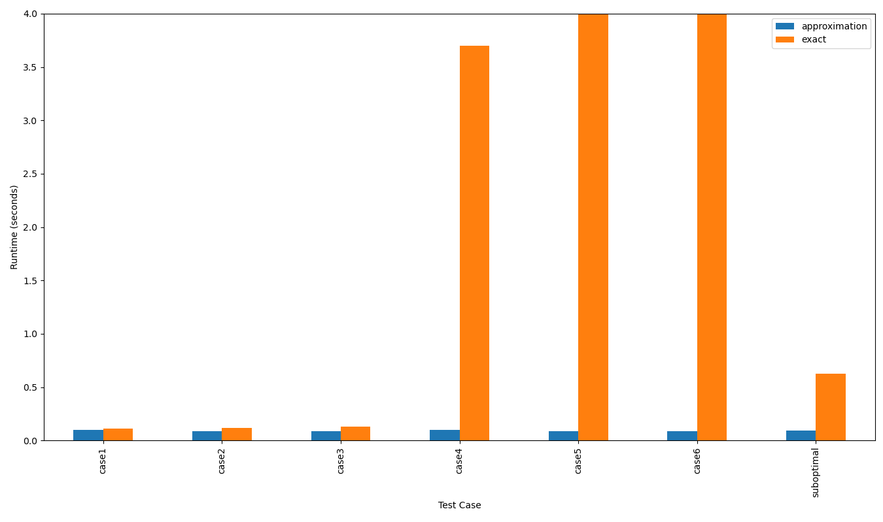
Runtime Results
note: the runtimes for the exact solution in case 5 and case 6 are much larger than the bounds of the plot

