Slide 1
Project Plan
Dashboard and Weather Incident Verification System
Team Auto-Owners
CSE 498, Collaborative Design
Evan Dontje
Edward Waller
Joseph Lockard
Department of Computer Science and Engineering
Michigan State University
Spring 2010
Notes:
CSE 498, Collaborative Design
Teams: Technical Specification / Schedule
Wayne Dyksen & Brian Loomis

Slide 2
Project Overview
Insurance Claims Web Application
  Used by Claims Associates
Determine accurate weather history for specific location on specific date
Compare weather history with claim
  Helps Associate determine if claim is valid

Slide 3
Functional Specifications
Login based customization
  Save user preferences
List Policy Holder’s Information
  Policy Information
  Begin Date
Query’s various weather services to obtain weather reports for a given location
Optimized for Mobile Devices
Notes:
CSE 498, Collaborative Design
Teams: Technical Specification / Schedule
Wayne Dyksen & Brian Loomis

Slide 4
Design Specifications
Customization
  Save user preferences
Search by policy holder or address
  Specify types of results
Return and display source of each result
  Some are more credible than others
Store results
  File
  Email

Slide 5
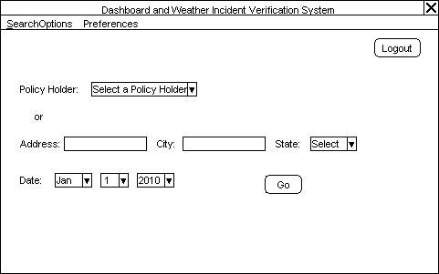
Screen Mockups

Slide 6
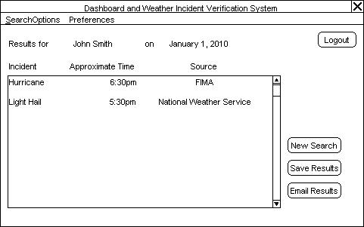
Screen Mockups Cont.

Slide 7
Technical Specifications
Language
  C#
Development Software
  Visual Studio 2008
  ASP.NET MVC
Version Control System
  Git

Slide 8
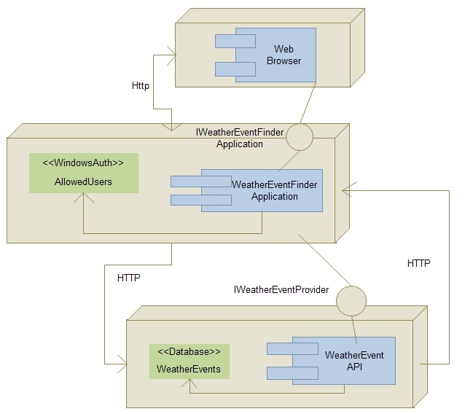
Architecture Illustrated
Notes:
CSE 498, Collaborative Design
Teams: Technical Specification / Schedule
Wayne Dyksen & Brian Loomis

Slide 9
System Components
Hardware Platforms
  PC
  Mobile Device
Software Platforms / Technologies
  Windows 7 with ASP.NET MVC
  Windows Server 2003 with ASP.NET MVC
Notes:
CSE 498, Collaborative Design
Teams: Technical Specification / Schedule
Wayne Dyksen & Brian Loomis

Slide 10
Testing
Login Screen
  Security Testing
User Preferences
  Saved Preferences
Information
  Accurate
Notes:
CSE 498, Collaborative Design
Teams: Technical Specification / Schedule
Wayne Dyksen & Brian Loomis

Slide 11
Risks
WSRP
  Glue together our portlet with Auto-Owner’s portal
  Can mock it out for now
Ranking Weather Services
  Determine accuracy of information from weather services
  Can ask for Auto-Owner’s experience
Extrapolation of Weather Data
  Determine weather between reported weather events
  Can guess with midpoint formula of coordinates
Weather API’s
  Each weather station has a different weather API
  Pick most important and try to query them now
Notes:
CSE 498, Collaborative Design
Teams: Technical Specification / Schedule
Wayne Dyksen & Brian Loomis

