Slide 1
Beta Demonstration
Weather Incident Verification System
Team Auto-Owners
CSE 498, Collaborative Design
Evan Dontje
Edward Waller
Joseph Lockard
Department of Computer Science and Engineering
Michigan State University
Spring 2010
Notes:
CSE 498, Collaborative Design
Teams: Technical Specification / Schedule
Wayne Dyksen & Brian Loomis

Slide 2
Project Overview
Insurance Claims Web Application
  Used by Claims Associates
Determine accurate weather history for specific location on specific date
Compare weather history with claim
  Helps Associate determine if claim is valid

Slide 3
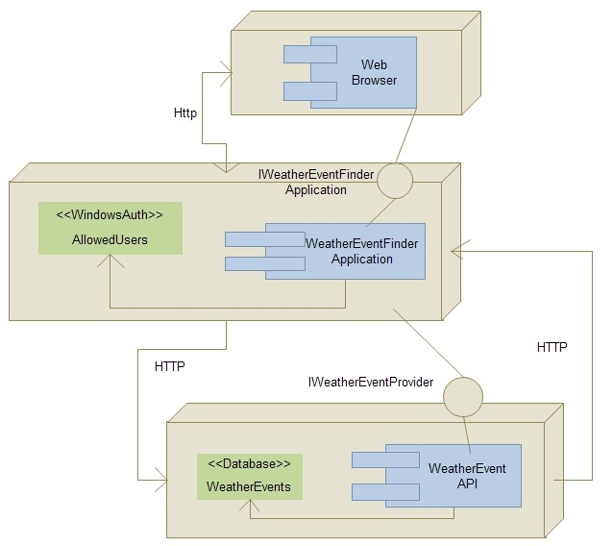
Architecture Illustrated
Notes:
CSE 498, Collaborative Design
Teams: Technical Specification / Schedule
Wayne Dyksen & Brian Loomis

Slide 4
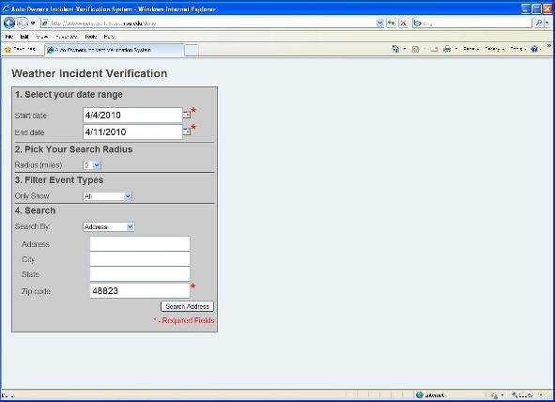
Screen Shot

Slide 5
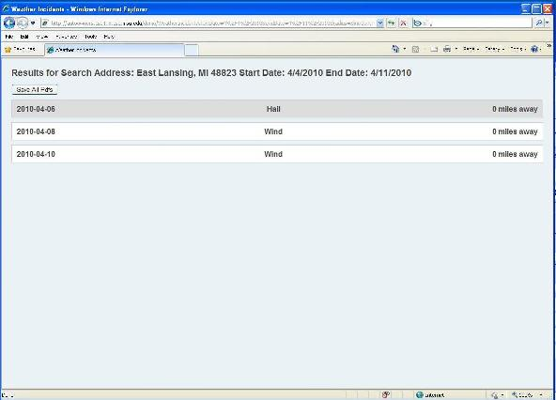
Screen Shot

Slide 6
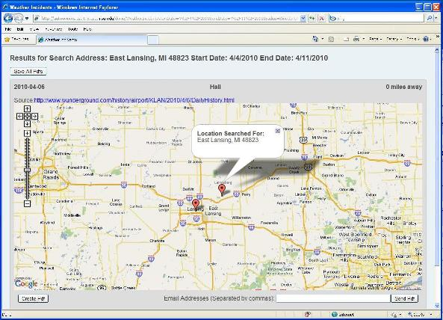
Screen Shot

Slide 7
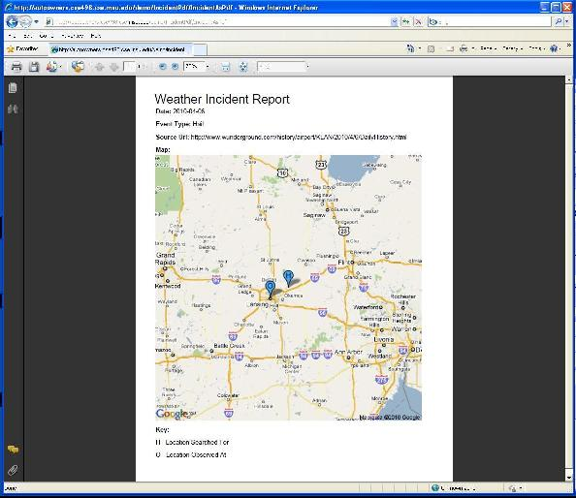
Screen Shot

