Slide 1





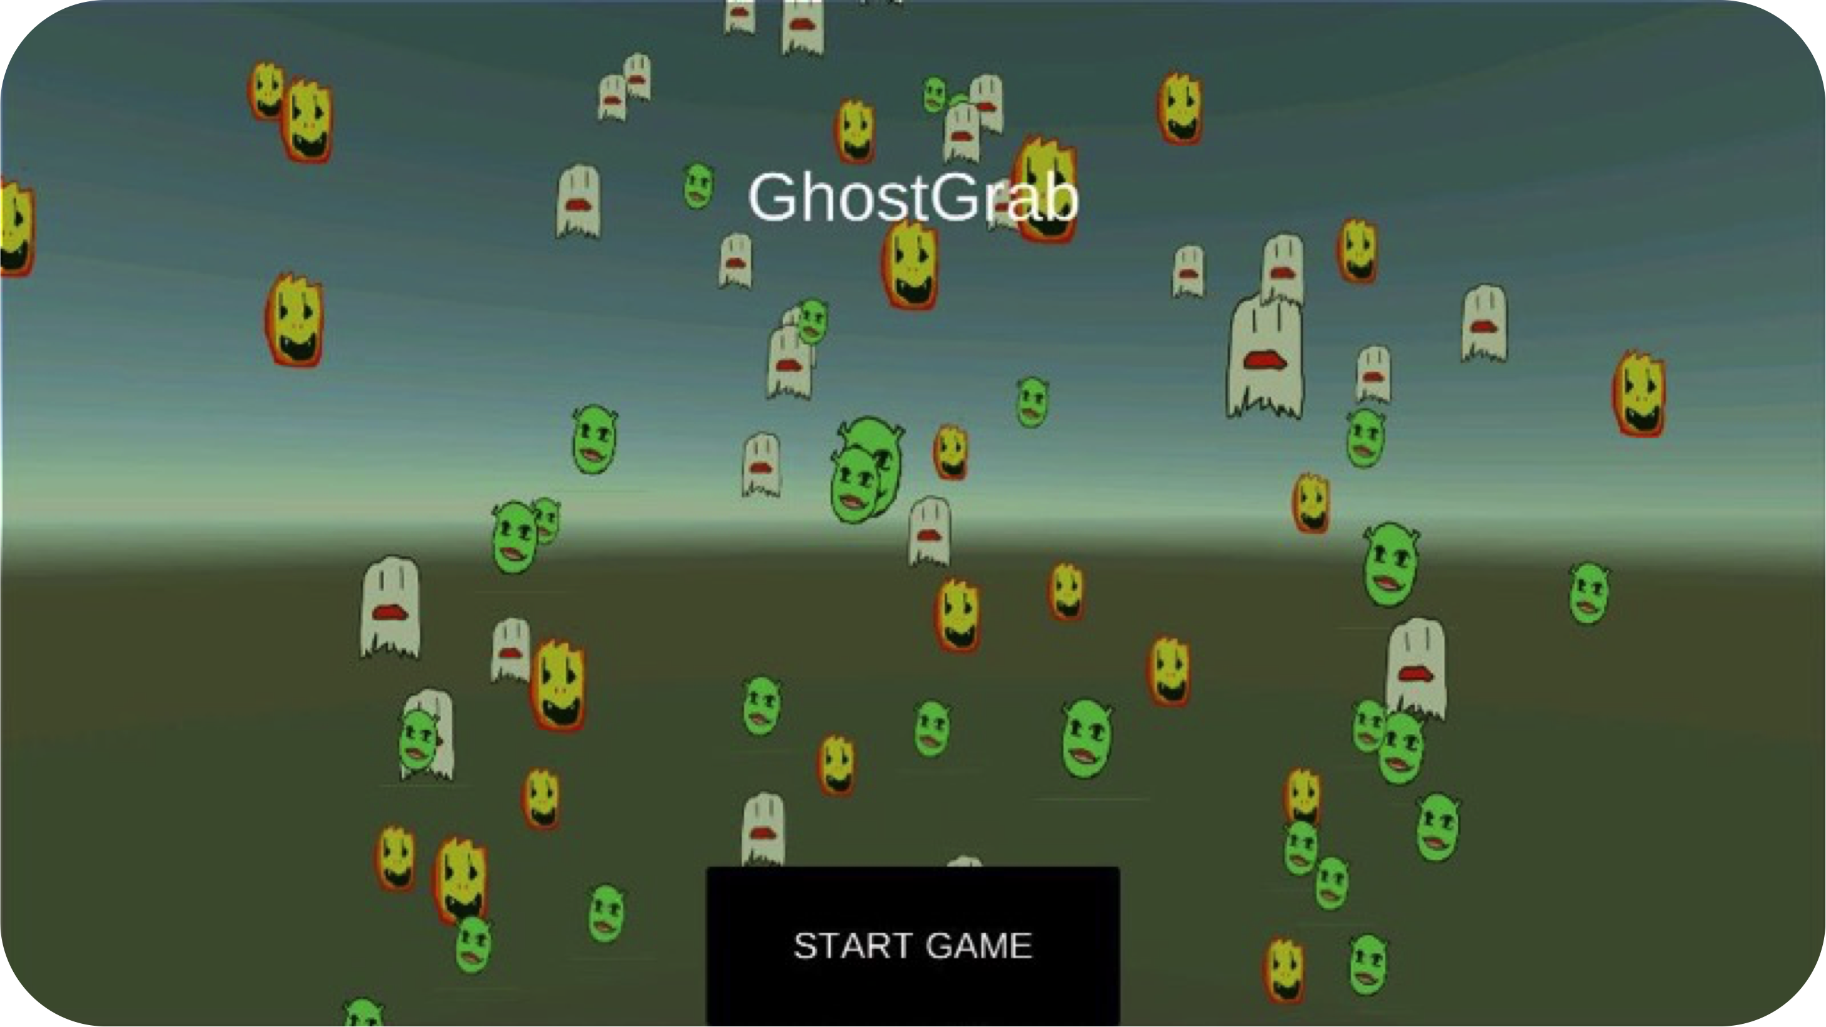
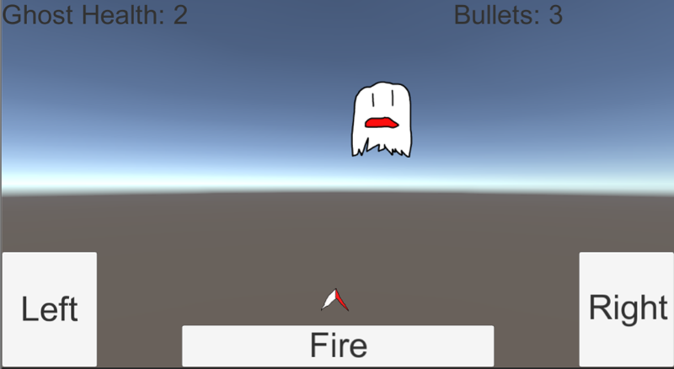
GhostGrab
Dylan Dover, Selina Chen, Jason Mayer, Lawrence Waller
Engineering Management 3700: Program and Project Management
School of Engineering, Vanderbilt University, Nashville, TN USA
Professor: Dr. Kenneth Pence
Background & Rationale
Project Description
Location-based, social gaming has experienced a wide growth in popularity during the last five years. We aim to capitalize on the popularity of GPS-integrated games and applications like Pokémon GO™ and other location-aware apps. The purpose of this project is to build a mobile game called GhostGrab that enables users to interact with their environment by catching and releasing ghosts.
The game utilizes the Unity™
embedded GPS systems to identify ghosts spawned at strategic locations. There are a number of different ghost types, each carrying their own point value and game. The user must win the game to capture the ghost and gain points.
Challenges
We experienced a number of development challenges during our work on GhostGrab.
Firstly, in order to connect our server-side code to our mobile application, we had to leverage a number of built-in Unity features, most notably the Unity HTTP library created by Andy Burke. This library proved quite difficult to use and we had to write additional interfacing code. Additionally, we had to learn to use Red Hat Linux™ and its unique command set in order to interface with AWS. Lastly, we had to confront scope creep and limit our expectations as we further explored all of the exciting Unity features and chose which to include in our final product.
Risk Management
We identified a number of potential delays, many of which we faced and resolved.
Production Delay | Likelihood | Impact | Expected Delay
Incompatibility between server and client-side code. | .65 | 2 days | 1.3 workdays
Creative differences and conflict resolution among the team might slow production. | .20 | 2 days | 0.4 workdays
The Google Play store might reject our app for copyright infringement. | .05 | 4 days | 0.2 workdays
Server downtime could delay testing of functionality. | .01 | 1 day | 0.01 workdays
Chromecast might not work with campus internet. | .50 | ½ a day | 0.25 workdays
OVERALL DELAY: |  |  | 2.16 workdays
DELAY, AS A PERCENTAGE OF TOTAL WORKDAYS |  |  | 10.29% Risk
Future Development
Due to the inherent bureaucratic difficulties in designing and testing applications for the Apple App Store, our application is currently available only on Android devices. In the future, we would like to port it to the iOS platform, a task made simple by the Unity engine.
Furthermore, we believe that our location-based tracking software could yield spin-off applications. Instead of tracking ghosts, for example, we could help the elderly geo-tag their possessions for convenient recovery. Lastly, we would like to add unique mini-games for each of the ghosts in our database.
Figure 4. Gantt Chart showing the length and completion of each task
Acknowledgements
Our team would like to thank Dr. Kenneth Pence for his advice.

